Slide 1
NC Medicaid Managed Care
Nick Galvez, NC Office of Rural Health
May 22, 2019

Slide 2
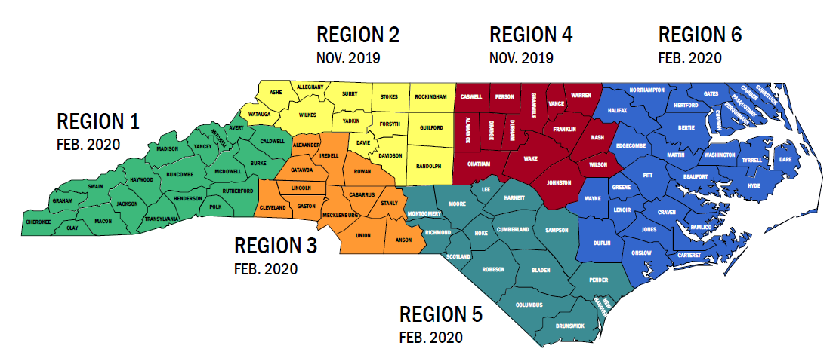
Standard Plan Regions and Rollout Dates Defined
Vision & Goals
Design
Procurement
Engagement
Implementation
Training
Rollout Phase 1: Nov. 2019 –Regions 2 and 4
Rollout Phase 2: Feb. 2020 –Regions 1, 3, 5 and 6
Learn more: https://www.ncdhhs.gov/news/press-releases/dhhs-announces-prepaid-health-plan-contracts-medicaid-managed-care

Slide 3
PHPs Selected for NC Medicaid Managed Care
Vision & Goals
Design
Procurement
Engagement
Implementation
Training
Statewide contracts
AmeriHealth Caritas North Carolina, Inc.
Blue Cross and Blue Shield of North Carolina, Inc.
UnitedHealthcare of North Carolina, Inc.
WellCare of North Carolina, Inc.
Regional contract – Regions 3 & 5
Carolina Complete Health, Inc.
Notes:
We are moving forward with implementation despite protests.
Have legal and procurement process to deal with protests. DHHS in slient period as it relates to add’l information

Slide 4
Vision & Goals
Design
Procurement
Engagement
Implementation
Training
General Engagement Approach
DHHS values input and feedback from stakeholders and will make sure stakeholders
have the opportunity to connect through a number of venues and activities
Regular webinars, conference calls, meetings, and conferences
Comments on periodic white papers, FAQs, and other publications
Questions, feedback: Medicaid.Transformation@dhhs.nc.gov
Groups DHHS Engages
Consumers, Families, Caregivers, SCFAC and Consumer Representatives
MCAC Subcommittee
Providers and Associations
Health Plans and LME-MCOs
Counties and Associations
General Public

Slide 5
Medicaid Payment model changes
DRG model | COST SETTLEMENT |  | NEW MCO model | NO COST SETTLEMENTS
BASE RATE $2704 | + supplements to = 100% of cost | DHHS determine new base rate | BASE RATE (unique, hospital specific) | Increase base rate to capture supplemental payment difference
 |  | Taking comments by providers/ CAHs | Effective in Nov or Feb (based on region) | DHHS cannot settle costs with MCOs
 |  | Training providers | DRAFT rate letter October 2019 to CAHs and MCOs

Slide 6
Roger Barnes, Medicaid CFO (retire June 2019)
Adam Levinson, Medicaid CFO
No DSH payments in the new payment model
Tier 1/Tier 2 counties rate floor of Medicaid FFS rate for 5 years
“MCOs will keep Medicaid patients away from EDs”
OP payment: Each hospital paid percent of charges that approximates 100% of cost; based on cost to charge ratio (update chargemaster)
Future State:
Under Medicaid Fee for Service and Medicaid Managed Care, most hospital reimbursements will be made through base payments, which are being increased from the current statewide base rate of $2,704 to new hospital-specific base rates that will incorporate supplemental payments.

Slide 7
Tailored Plan Design
Design
Procurement
Engagement
Implementation
Training
Upcoming Provider Training Events
Upcoming Managed Care Webinar Topics (20+ webinars)
Provider Payment and Contracting (recording available)
Overview of Quality and Value Initiatives Clinical Policies
Provider Policies (May 9th 12-1pm)
Beneficiary Policies
Behavioral Health Services: Standard Plans and Transition Period
* Recordings available
Other Upcoming Events
Virtual Office Hours: Weekly, began in Spring, 2019
Provider/PHP Meet and Greets: began in Spring, 2019
  First round ended 4/26/19
https://medicaid.ncdhhs.gov/providers
Notes:
A series of topic-based webinars will educate providers on key topics to effectively serve their patients in the transition to managed care; factsheets and FAQs will accompany each webinar.
The DHHS webpage will serve as a central hub for providers to access resources about the transition to managed care.

Slide 8
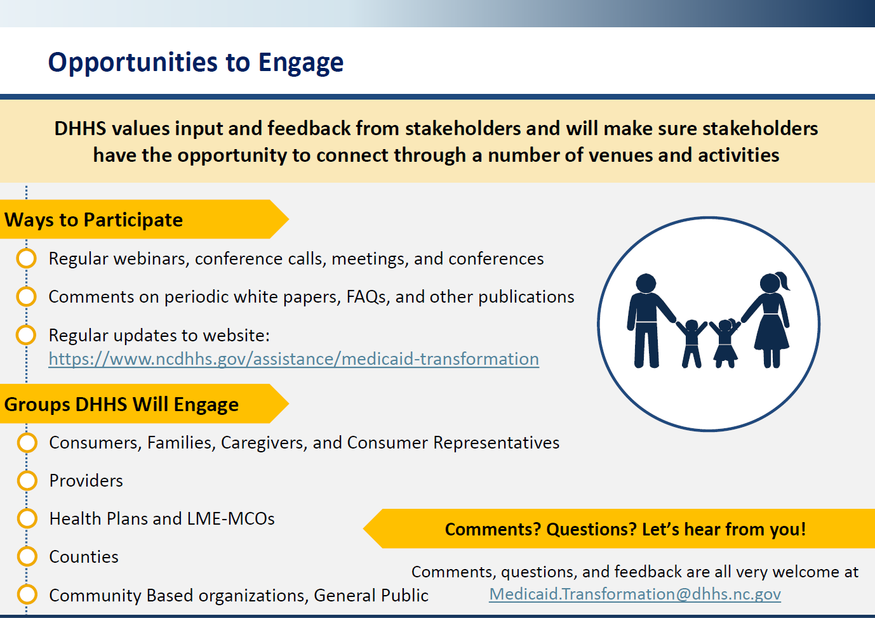

Slide 9
Healthy Opportunities Pilots Overview
North Carolina will implement an innovative five-year Pilot program that enables PHPs to pay for non-medical services directly related to health outcomes for high-need Medicaid enrollees living in selected communities
Over the next five years, the Pilots will provide up to $650 million in Medicaid funding to cover the cost of select Pilot services related to housing, food, transportation and interpersonal safety that directly impact the health outcomes and health care costs of enrollees in two to four geographic areas of the state.

Slide 10
Healthy Opportunities
Vision & Goals
Design
Procurement
Engagement
Implementation
Training
Embedding Healthy Opportunities in the Managed Care Program Only LME-MCOs
  All PHPs will have a role in addressing non-medical factors that drive health outcomes and costs, including:
    Screening for non-medical needs
    Connecting beneficiaries to community resources using North Carolina’s new platform for closed loop referrals, NCCARE360
    Providing additional support for high-need cases, such as assisting members who are homeless in securing housing
Healthy Opportunities Pilots:
  PHPs in two to four geographic areas of the state will work with their communities to implement the “Healthy Opportunities Pilots,” as approved through North Carolina’s 1115 waiver.*
  Pilots will test evidence-based interventions designed to reduce costs and improve health by more intensely addressing housing instability, transportation insecurity, food insecurity, interpersonal violence, and toxic stress for eligible Medicaid beneficiaries.
¹At the start of the first fiscal year that is one year after the implementation of the first contracts for Standard Benefit Plans.
² For four years beginning one year after launch of SP and who meet the criteria established by DHHS
Notes:
-Conversations began in 2013 at GA about transformation of Medicaid
-In 2015 GA passed enabling legislation that required the state to transform from FFS to managed care
Initial legislation was silent on definitive path for LME-MCOs
SL2018-48 clearly supported full integration of care which is crucial to delivering whole-person care for populations with significant behavioral health, I/DD, and TBI needs and defined LME-MCOs as PHPs,
BH I/DD TPs will not only serve populations that are among the most vulnerable covered by Medicaid; they will also manage federal block grant and state funds for populations that are uninsured and underinsured
Standard plan features will serve as foundation for TPs i.e. Quality Strategy
LME-MCOs only entity to have BH/IDD TP contract for 1st 4 yrs
With the June passage of legislation authorizing the creation of behavioral health and behavioral health tailored plans (BH I/DD TPs), DHHS is primed to kick-off a more intensive BH I/DD TP planning effort.

Slide 11
The Healthy Opportunities Pilots (the Pilots) present an unprecedented opportunity to test the impact of providing selected evidence-based interventions to Medicaid enrollees.
• To cover the cost of the federally-approved Pilot services, and
• To support, in the early years of the demonstration, capacity building for Lead Pilot Entities and to strengthen the ability of human services organizations to participate effectively in the Pilots.
All PHPs who have enrollees in the geographic regions of the Pilots will be required to participate.
Up to $100 million of the $650 million in Pilot funds may be used for these infrastructure investments.

Slide 12
Approved Services
1. Housing (tenancy support)
2. Food (food services)
3. Transportation (public transit/taxis)
4. Interpersonal Violence/Toxic stress (legal, BH support, parenting support, home visit)

Slide 13
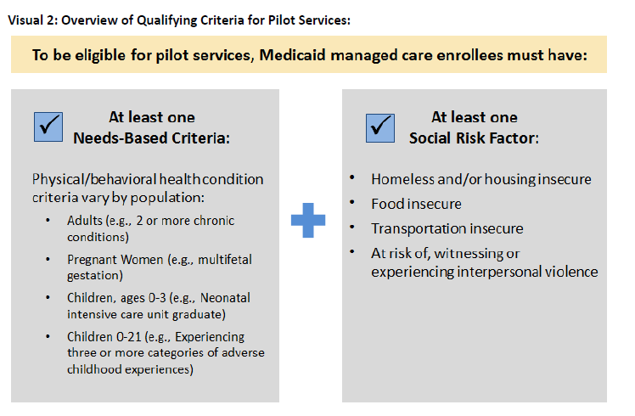

Slide 14
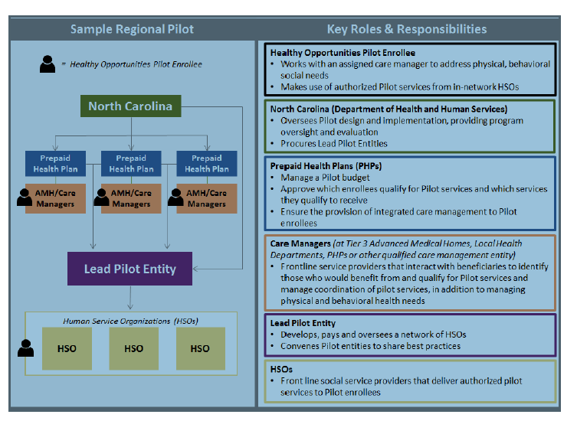
Visual 1: Key Pilot Players and Their Roles & Responsibilities

Slide 15
Through NCCARE360, community partners will have access to:
-A robust statewide resource directory that will include a call center with dedicated navigators, a data team verifying resources and text and chat capabilities.
-A data repository to integrate resource directories across the state to share resource data.
-A shared technology platform that enables health care and human service providers to send and receive secure electronic referrals, seamlessly communicate in real-time, securely share client information and track outcomes.
-A community engagement team working with community-based organizations, social service agencies, health systems, independent providers and more to create a statewide coordinated care network.
NCCARE360 implementation started in January 2019. NCCARE360 will be available in every county in North Carolina with full statewide implementation by end of 2020

Slide 16
NCCARE360 is the first statewide coordinated care network to electronically connect those with identified needs to community resources and allow for a feedback loop on the outcome of that connection.

Slide 17
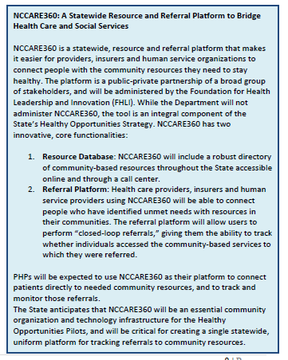

Slide 18
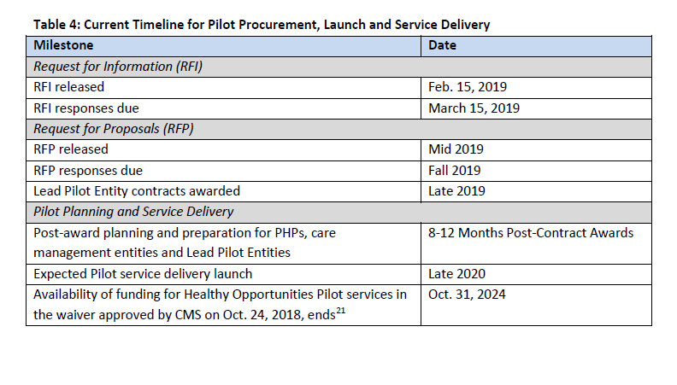
Timeline for Healthy Opportunities

Slide 19
DISCUSSION
NC MEDICAID TRANSFORMATION WEBSITE www.ncdhhs.gov/medicaid-transformation

