Slide 1
Opioid and Prescription
Drug Abuse Advisory Committee
Topic: Strategies to prevent overdose
among justice involved populations
March 27, 2026

Slide 2
WELCOME!
Thank you for joining us!
Restrooms are in the hallway just outside the doors at the back of the room
Snacks and coffee are out in the hall, please help yourself!
We will have time for questions from the audience. If you are joining us virtually, please use the Q&A chat
Today's meeting is being recorded and will be posted along with the agenda and slides on the OPDAAC website

Slide 3
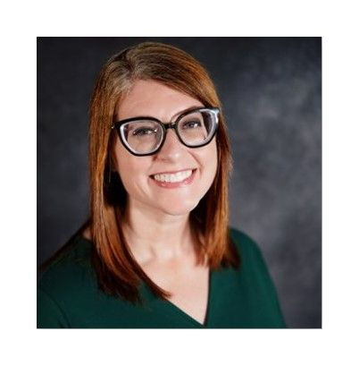
Kelly Crosbie, MSW, LCSW
Director and Assistant Secretary for Mental Health, Developmental Disabilities, and Substance Use Services
NCDHHS, Division of Mental Health, Developmental Disabilities, and Substance Use Services

Slide 4
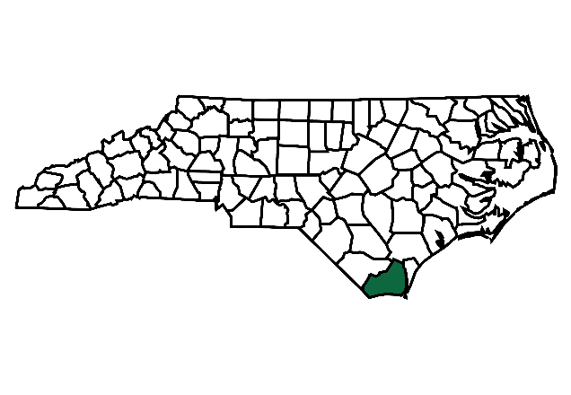

NC Opioid Settlements:
Justice-involved Strategies and
the Academy
Nidhi Sachdeva, MPH
Director of Strategic Health and Opioid Initiatives
NC Association of County Commissioners
March 27, 2026
Notes:
Talking Points:
Jeremy Seamon is filling in for team lead, Emma Long from the Brunswick County Sheriff’s Office, due to an inability to travel and be in person but is present virtually!

Slide 6

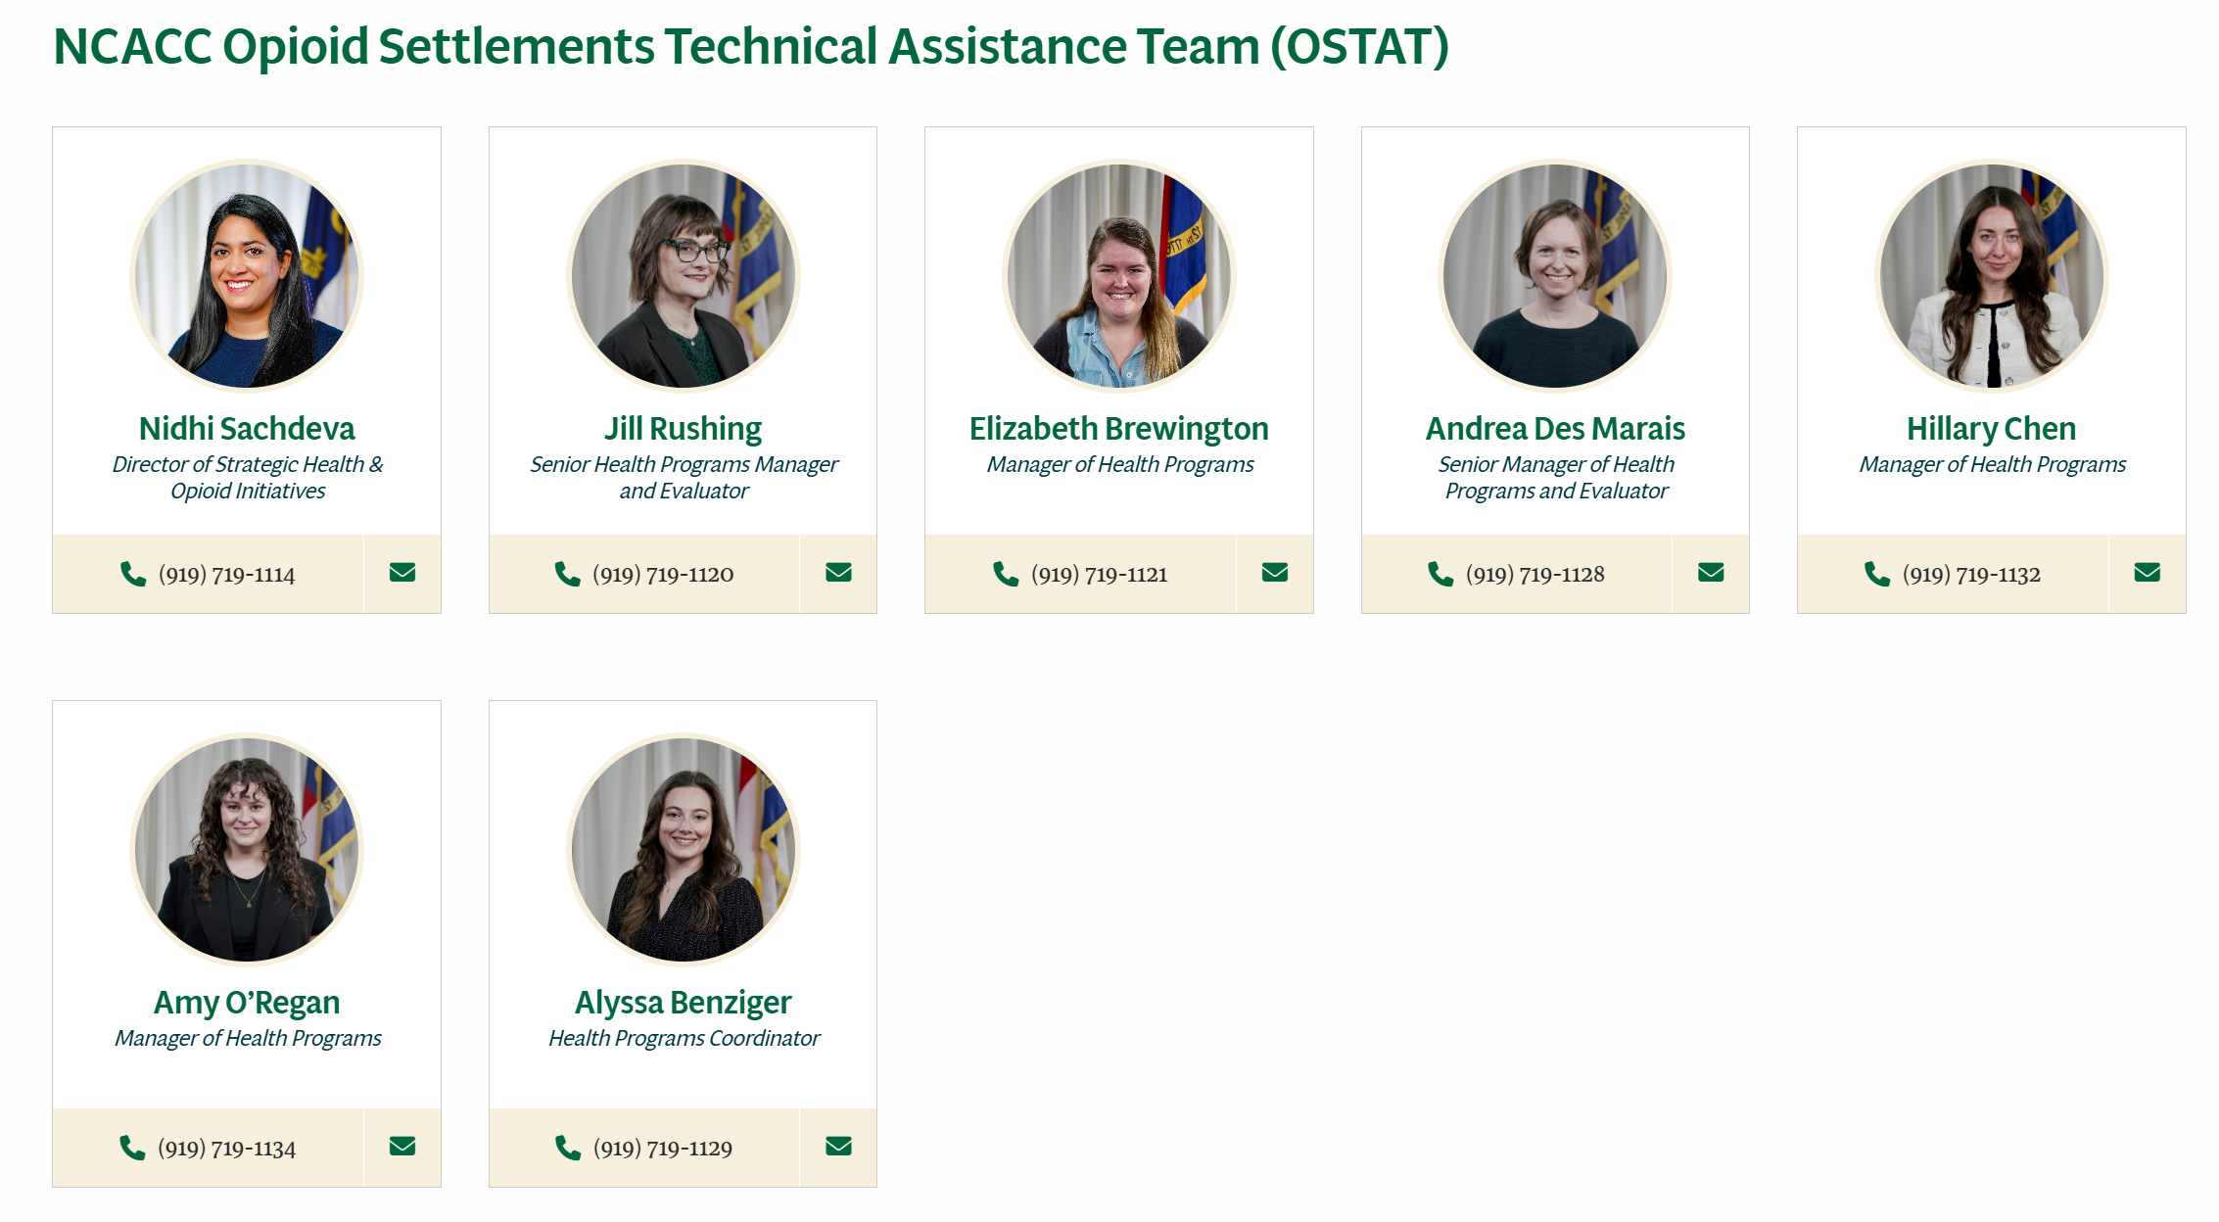
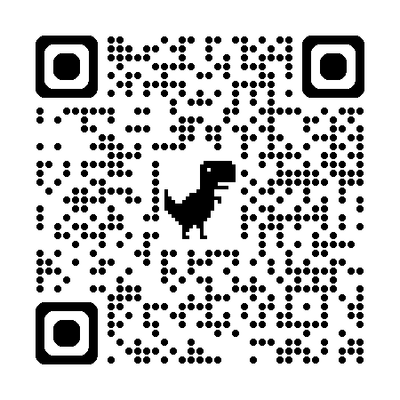
NCACC Opioid Settlement Technical Assistance Team (OSTAT)
Purpose
Improve the health of NC counties
OSTAT provides technical assistance, guidance, and training to help local governments strategically invest settlement funds in ways that reduce the harms of opioids and save lives from overdose

Slide 7
NCACC supports local governments at every stage of opioid settlement work — from planning to implementation to evaluation/reporting.
With OSTAT, counties:
Improve health-related services and nurture the county workforce
Align with the North Carolina Memorandum of Agreement (NC MOA) requirements and maintain compliance
Build staff capacity and confidence to lead and coordinate opioid abatement efforts
Prioritize and implement eligible, evidence-based strategies
Conduct collaborative strategic planning processes and engage effectively with community partners
Complete reporting and evaluate the effectiveness of programs and services

Slide 8
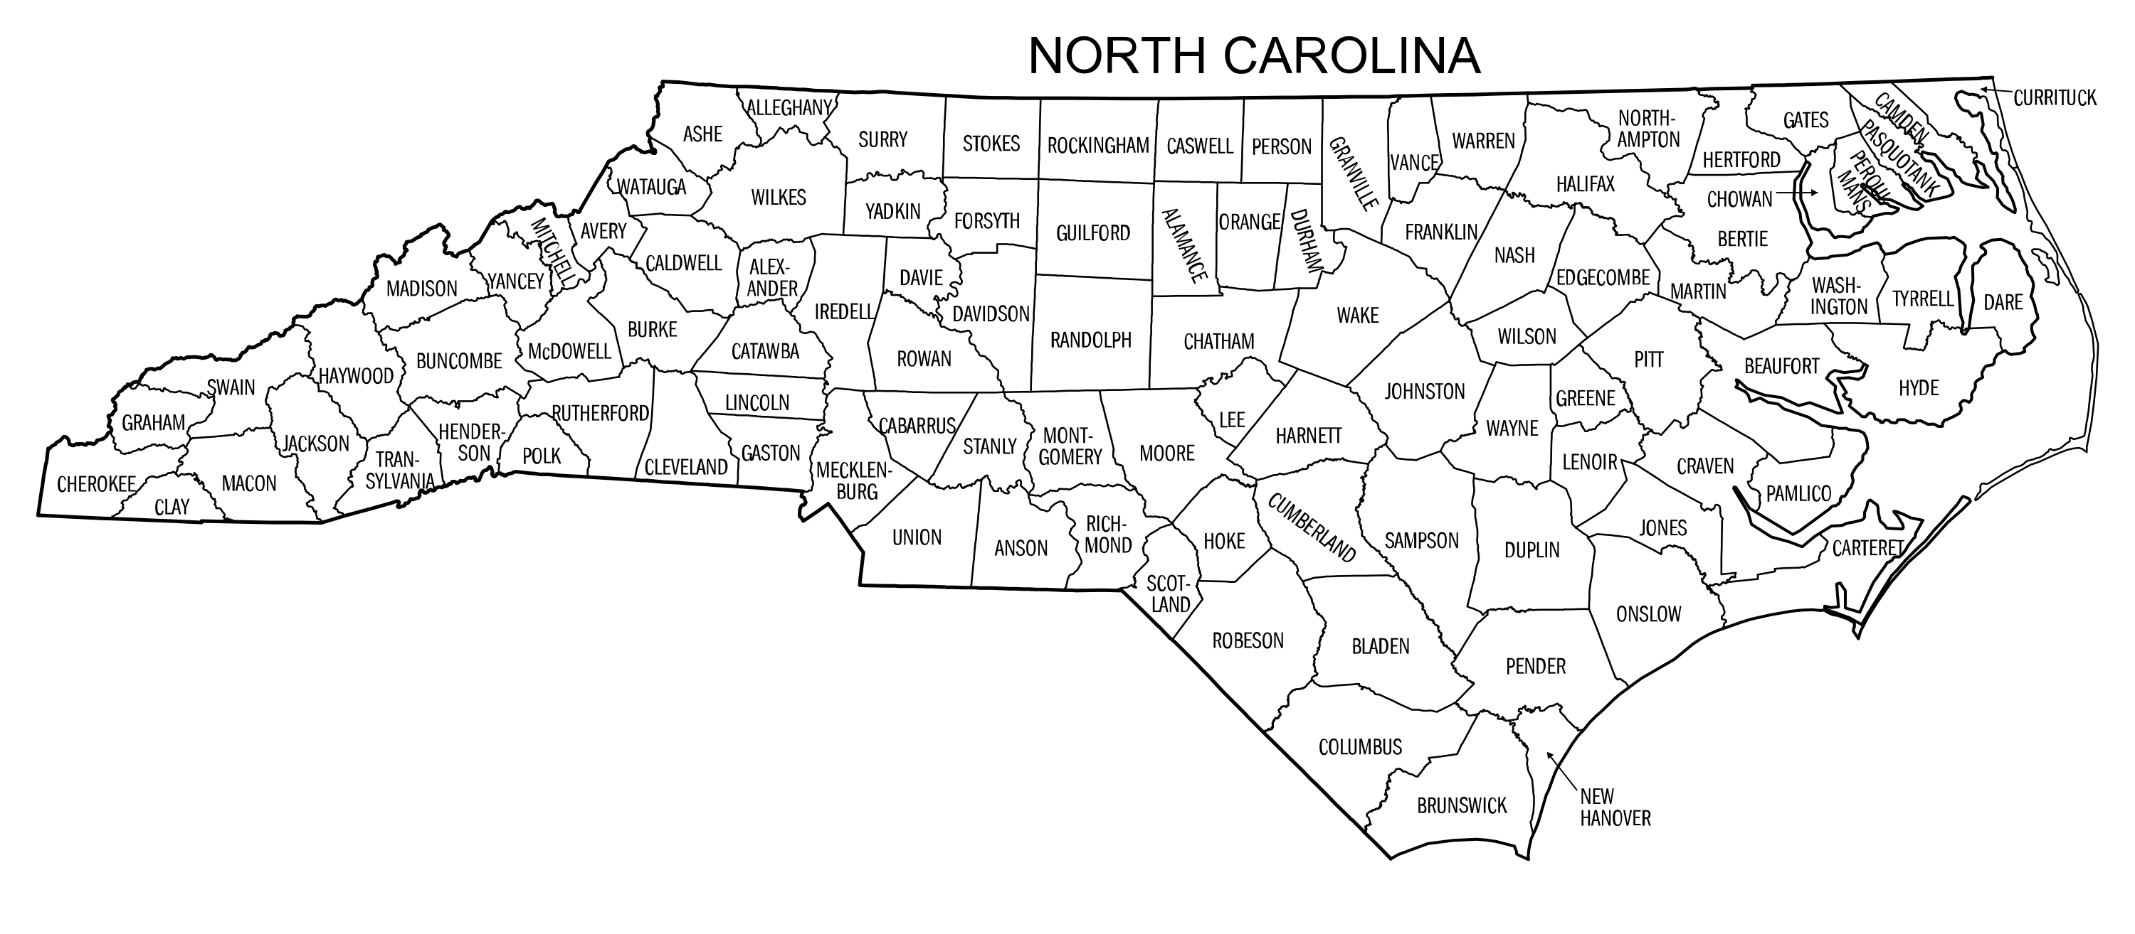
NC Counties Served
As of March 2026, OSTAT has provided over 2,600 instances of technical assistance to all 100 counties and settlement eligible cities!

Slide 9











Notes:
Nidhi

Slide 10

NC Opioid Settlements
North Carolina will receive over $1.6 billion over an 18-year period, which began in 2022
  85% goes directly to Local Governments listed in the NC MOA (all 100 counties; 17 eligible cities)
  15% goes to the State of NC

Slide 11
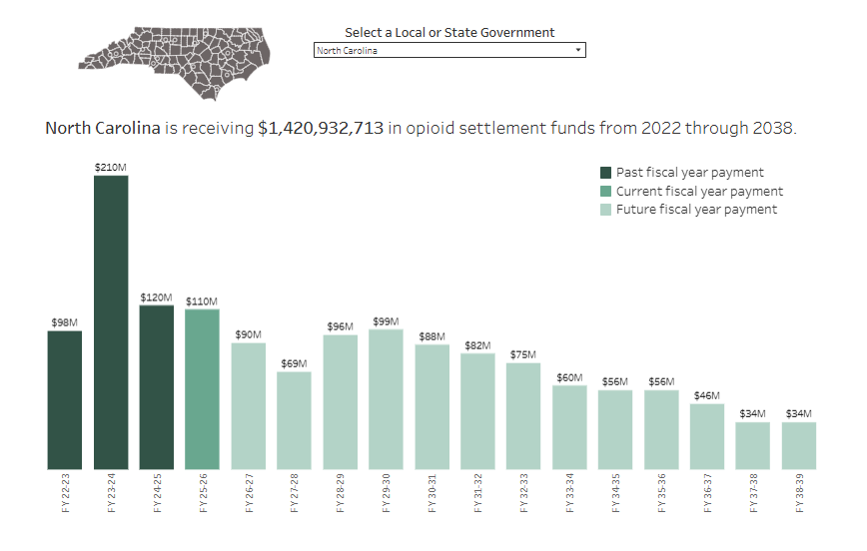
NCOpioidSettlement.org

Slide 12
Vision for NC Opioid Settlements
Culture/ Society
Community/ Organizations
Relationships
Individual
All people in NC are healthy and have connections to supports and services within a culture of care.
Notes:
Nidhi

Slide 13
Remediation Strategies
In line with the National Settlement Agreement, funds “may support programs or services…that serve people with Opioid Use Disorder (OUD) or any cooccurring Substance Use Disorder (SUD) or mental health condition.”
Notes:
Nidhi

Slide 14
NC MOA: High Impact Abatement Strategies (Exhibit A)
1. Collaborative strategic planning
2. Evidence-based addiction treatment
3. Recovery support
4. Recovery housing
5. Employment-related services
6. Early intervention
7. Community naloxone distribution
8. Post-overdose response
9. Syringe service programs (SSPs)
10. Legal system diversion
11. Addiction treatment for incarcerated persons
12. Reentry programs
Notes:
Nidhi

Slide 15
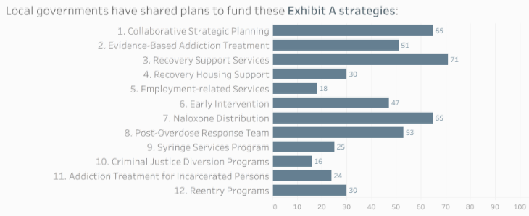
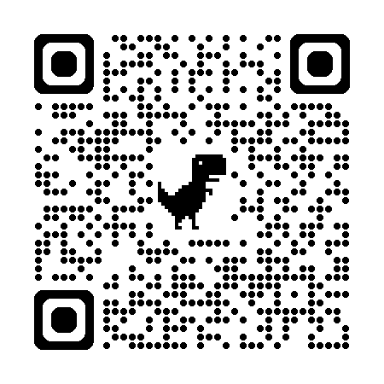
Local Spending Plans





Notes:
NIDHI

Slide 16



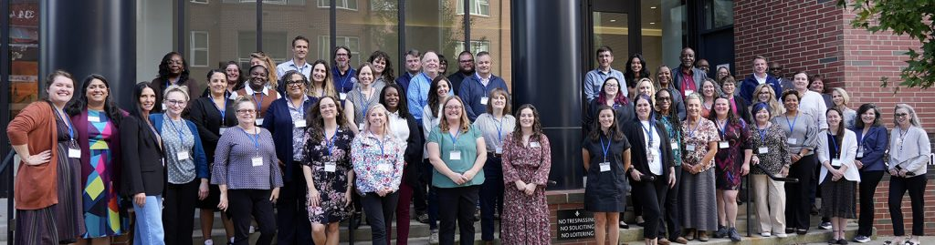
Opioid Settlement Academy
Prepare teams from North Carolina counties and municipalities to newly implement or expand one of the NC Memorandum of Agreement Exhibit A strategies using opioid settlement funds.
Notes:
Leah – OSA Academy overall and then note about this particular Academy on JIP strategies
Representatives from
North Carolina Association of County Commissioners – Opioid Settlements Technical Assistance Team (OSTAT)
NC DHHS, Division of Public Health – Injury and Violence Prevention Branch (IVPB)
NC DHHS, Division of Mental Health, Developmental Disabilities and Substance Use Services
UNC Chapel Hill Injury Prevention Research Center (IPRC)

Slide 17
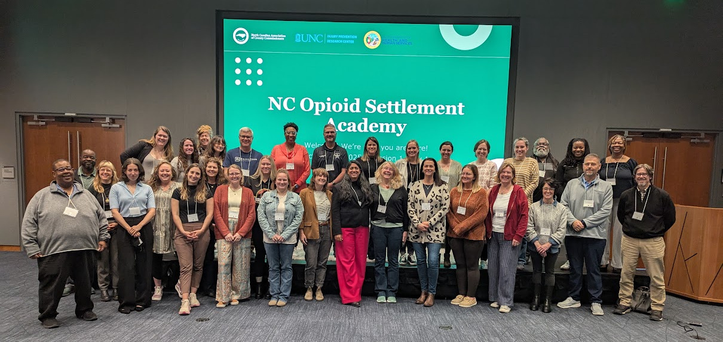
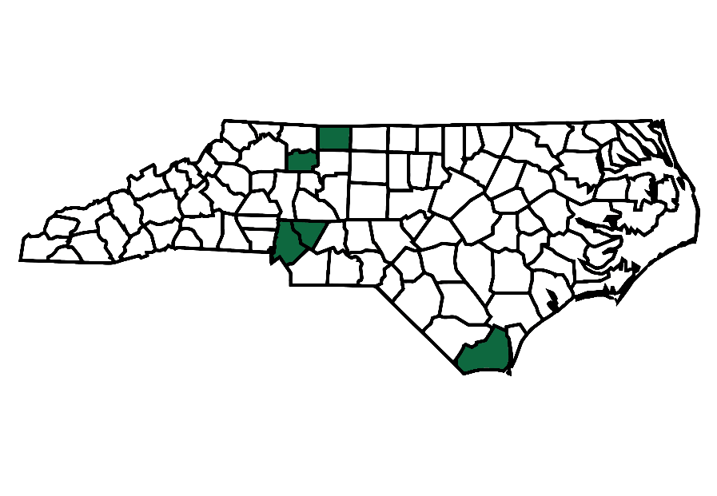

Opioid Settlement Academy: Justice-Involved Strategies
Thank you!
Notes:
Leah

Slide 18
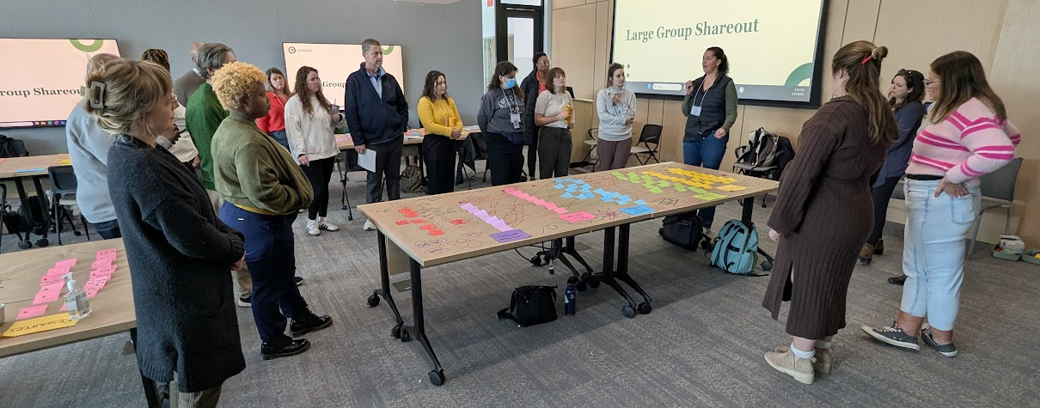
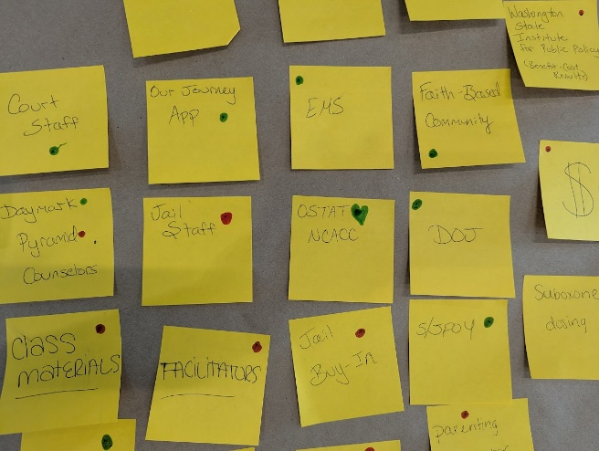
Strategy Map
Key Activities
Short-Term Outcomes
  What do we need to do the work?
  What will we deliver?
  What will success look like?
  What will we do?
  What will start to change?
Resources
Immediate Results & Products
Long-Term Outcomes

Slide 19
Trauma-Informed Counties (in Practice)
Safety
Trustworthiness & transparency
Peer support
Collaboration & mutuality
Empowerment, voice, & choice
Cultural, historical, & gender lenses
SAMHSA’s Concept of Trauma and Guidance for a Trauma-Informed Approach
Notes:
Ashley
All of these principles apply both to our work with participants and to making our organizations more trauma-informed for our staff. We’ll explore both of these aspects throughout the afternoon.
Handout: excerpt from SAMHSA guidance document pg 11 (pg 15 of pdf)

Slide 20
NC Opioid Settlement
Coordinators Network
Opioid Settlement Coordinators Network

Slide 21


Slide 22
Questions?
Opioid Settlement Technical Assistance Team (OSTAT)
Strategic Member Services
NC Association of County Commissioners
OpioidSettlement@ncacc.org
ncacc.org/opioidsettlement

Slide 23
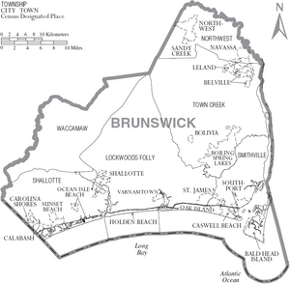
NC Opioid Settlement Academy
Brunswick County
Jeremy Seamon
March 27, 2026
Notes:
Talking Points:
Jeremy Seamon is filling in for team lead, Emma Long from the Brunswick County Sheriff’s Office, due to an inability to travel and be in person but is present virtually!

Slide 24

Brunswick County
Population
  Current population is estimated to be 181,626, making Brunswick one of the fastest growing counties in NC
  Brunswick County has 19 municipalities, more than any other county in the state
Brunswick County Detention Center
  Average Daily Population: 292 people
  Average Length of Jail Stay: 28 days
Brunswick County Overdose Statistics (2024):
  76 Reported Overdose Deaths
  98 Overdose Emergency Department Visits
“Bid on Brunswick”
Notes:
Talking Points:
Population growth in the news: WWAY Headline “Brunswick County is the Number One Place to Move” and US News and World Report stated “It’s the number one County people are thinking to move in. It’s because of low taxes, great attractions, and a temperate climate.”
19 Municipalities feeding into one detention center- the Sheriff’s Office’s Detention Center is the only law enforcement agency that provides detention for those pre-trial or with a state misdemeanor confinement sentence (SMCP) across all of Brunswick.
Overdose rates may be skewed due to individuals in the northern part of the county seeking medical care in New Hanover County and the under-reporting of overdoses due to increase in access to Narcan and not reporting successful reversals.

Slide 25
Meet our Academy team!
Kenneth Sullivan, 1st Sergeant
  Brunswick County Sheriff’s Office
  Classification and Programs Coordinator
Kinsey Weaver
  Brunswick County Health Services
  Public Health Educator
Emma Long, LCSWA, LCAS
  Brunswick County Sheriff’s Office
  ARROW Program Coordinator
Jeremy Seamon, LCMHC, LCAS, CCS
  Coastal Horizons Center
  Brunswick Program Director
Alice Anderson, RN
  WellPath
  Clinical Nurse Coordinator
Brunswick County Sheriff's Office Brunswick County Sheriff's Office ; Coastal Horizons Center – Promoting Choices for Healthier Lives and Safer Communities ; Home – Wellpath ; Health Services | Brunswick County, NC
Notes:
Talking Points:
Our team was chosen very deliberately based on our strategy of providing addiction treatment to incarcerated individuals- each member brought a unique perspective regarding why and how we could improve addiction treatment within the Brunswick County Detention Center.
The team lead, Emma Long, is a treatment provider and Addiction Response and Rediscovering One’s Worth Program coordinator within the detention center working directly with opioid settlement funds.
First Sergeant Sullivan has been with the Brunswick County Sheriff’s Office working within the detention center for 18 years and is currently the classifications and programs coordinator and provided officer perspective as well as insights into the daily operations of the facility.
Kinsey Weaver is a Public Health Educator with Brunswick County Health Services and has provided a context from which stakeholders can work together to achieve progress within addiction treatment.
Alice Anderson is a Registered Nurse and the Clinical Nurse Coordinator for Wellpath within Brunswick County Detention Center. She has provided insight into the logistics of providing medical and psychiatric care within the facility and guidelines with MOUD.
Jeremy Seamon is the program director for Coastal Horizons Center in Brunswick County and provided insight into the feasibility and process of working with community partners, local Opioid Treatment Programs, and guidelines with MOUD.

Slide 26
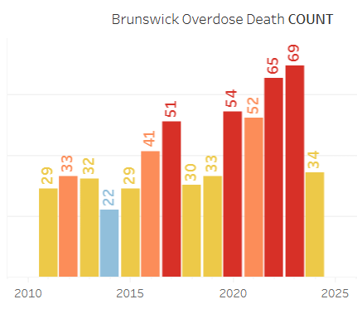
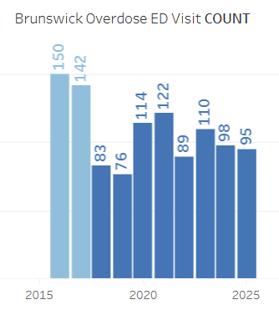
Exhibit A. Strategy 11
Addiction Treatment for Incarcerated Persons
Interactions with Established Strategies in Brunswick County:
  A.3 Recovery Support Services through the Brunswick County Sheriff’s Office
  A.7 Naloxone Distribution through the Brunswick County Health Services
  A.8 Post-Overdose Response Team through Brunswick County Emergency Management Services
Addressing a Vulnerable Population
  Highest risk of overdose and overdose death within 2 weeks post-incarceration
  Interruptions in MOUD increase the risk of death for incarcerated individuals
    Withdrawal accounts for as many as 1 in 15 deaths among incarcerated people
    Unmanaged withdrawal increases suicide risk
Local Progress - North Carolina Opioid Settlements ; North Carolina Overdose Epidemic Data | Division of Public Health ; Preventing Overdose in Criminal Justice Settings
Notes:
Talking Points:
Interactions with Established Strategies:
A3- The ARROW Program currently provides a behavioral health response to mental health and substance use with the incarcerated population and aids in successful re-entry through discharge planning with program participants.
A7- Individuals being released are notified of where and how to obtain naloxone through the distribution network.
A8- The PORT team is working with established providers to provide MOUD upon release and create “bridges” between release and induction with an outpatient OTP/MOUD provider when appropriate.
Addressing a Vulnerable Population:
Brunswick County had more overdoses reported than the surrounding counties of New Hanover, Columbus, and Pender
Brunswick is a large but extremely tight-nit County where people have witnessed the progression of addiction in those closest to them and are passionate about saving lives and encouraging recovery for friends, family and neighbors that find themselves incarcerated.
Our ongoing motivation is to continue to fully utilize the interconnected strategies and address the “gaps” in services with the A11 strategy.

Slide 27
Hopes for Brunswick County
The Brunswick County team is united in the belief that every person affected by addiction, especially those involved in the justice system, deserves hope, dignity, and a meaningful path to recovery.
We strive to transform our community’s response to addiction, strengthen public health, and help our community heal, one person, one family, and one future at a time.
To fulfill this purpose, we aim to:
  Increase access to MAT services
  Strengthen Continuity of Care
  Reduce Overdose and Recidivism
  Support Long-Term Recovery and Stability
  Enhance Community Understanding

Slide 28
Challenges and Solutions
Challenge: Community Understanding and Support of MOUD
  Potential Solutions
    Sequential Intercept Model Mapping
    Engage community in learning opportunities
    Provide training to staff
Challenge: Logistics of MOUD Continuation and Induction
  Potential Solutions
    Utilize interdisciplinary team
    Consult with Technical Assistance Providers
    Start with a “Pilot Program”
Notes:
Talking Points:
Community Understanding & Support-
The goal of completing the SIM Mapping would be to gather all County stakeholders and create a strong interdisciplinary team that addresses the needs of those involved with the criminal justice system, both participants and staff, leading to comfortability in providing feedback during both the planning and implementation process.
Community Engagement- “table” events like the Mental Health Summit, commission meetings, meetings within schools, churches, fundraisers etc. and provide education and personal experiences with addiction treatment
Staff Training- This would include training for detention center staff, medical providers, psychiatric providers, behavioral health providers- basically all staff that would be engaged with MOUD in the detention center. Training would include topics like addiction and recovery, MOUD science, stigma, trauma informed practices, diversion/monitoring, and best practices with MOUD in the detention setting.
Logistics-
Ensure each voice is heard and able to be an influential part in the planning process and create a feasible and effective program.
Technical Assistance Providers like VitalStrategies, RuloStrategies, and NCTAC. It has also been beneficial to discuss with other detention centers their MOUD programs. We have been connected to three other counties to date.
A pilot program allows us to “try things out” and figure out methods that could work within the Brunswick County Detention Center specifically

Slide 29
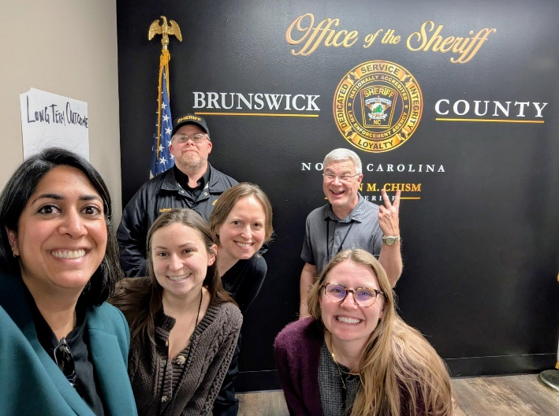
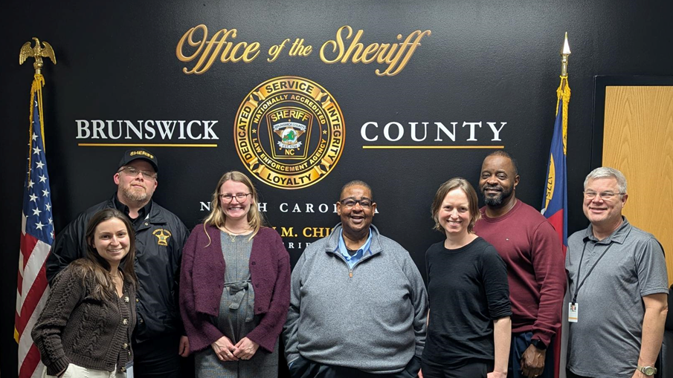
NC Opioid Settlement Academy Experience
Brunswick County Reflections:
Session 1:
Learning from Other Counties
  Successes, Challenges & Feedback
SIM Mapping and Re-Entry Resources
Session 2:
Working as an Interdisciplinary Team
Finding our Shared Purpose
Creating a Strategy Map & Action Plan
Clarifying next steps
Notes:
Talking Points:
Session 1-
Our team really enjoyed learning about what other counties have in place already when it comes to responding to addiction and fostering recovery. We were surprised by how many similar challenges we have all faced but also by the creative resources different people and places have utilized and connected to make progress.
Our team has been extremely interested in completing the SIM Mapping since learning about the model due to the emphasis on teamwork, addressing gaps in services and focusing on how people can successfully re-enter their communities after engagement with the criminal justice system (ex. NC FIT & LEAD). We have contacted our counties MCO and are working towards approval to complete the model.
Session 2-
Our second session was unique as we had a coaching team, SHOUTOUT Andrea and Nidhi, come to Brunswick County and meet us here. It was extremely helpful to have focused support and guidance for our strategy. We were able to work smoothly and with open minds to identify the purpose of our work (mentioned in earlier slide) and create a robust strategy map. We learned from each person’s experience and expertise and were able to make realistic adjustments to planning while maintaining our purpose. The experience of linking action items to short term and long-term outcomes has provided us with clear next steps in HOW we can begin to build support in expanding addiction treatment to the people incarcerated within the Brunswick County Detention Center. We were also able to work alongside VitalStrategies and envision a “jumping off point” for expanding MOUD within the facility and share those thoughts with leadership.

Slide 30
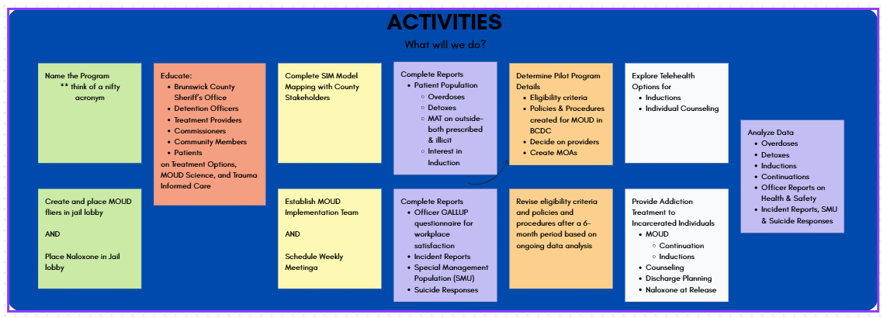
Celebrating Progress and Looking Ahead
Meeting with Leadership:
  Brunswick County Sheriff, Chiefs, & Lieutenants
  Community Partners
  Focus on Brunswick County specific challenges, goals, and plans of action
Next Steps:
  Implement the Strategy Map
  Expand the Team
  Engage and educate the community
Notes:
Talking Points:
Follow up from last slide- We also had the unique experience of being able to invite our Sheriff’s Office leadership into the sessions for feedback and guidance as well as share the vision we created and engage them in the conversation surrounding resources, goals and outcomes.
It was encouraging to see the interest, engagement, questions, and curiosity that was shared by our team into our leadership.
Creating the strategy map enabled our team to be able to have specific action items to put into place going forward- ex. Expanding our team in order to address all needs/thoughts when it comes to expanding treatment- adding higher leadership, legal, building strong community partnerships and networks with several treatment providers. As well as ways to engage and educate the community- through tabling, marketing, and creating spaces for “round table” discussions.”
Activities: One section of our Strategy Map that we were able to complete from our identified short and long-term outcomes of (a few examples):
Reduced Overdose & Suicide Deaths
Increased Access to Appropriate Treatment & Care
Increased Officer Safety, Mental Health, & Retention
Reduced Recidivism

Slide 31
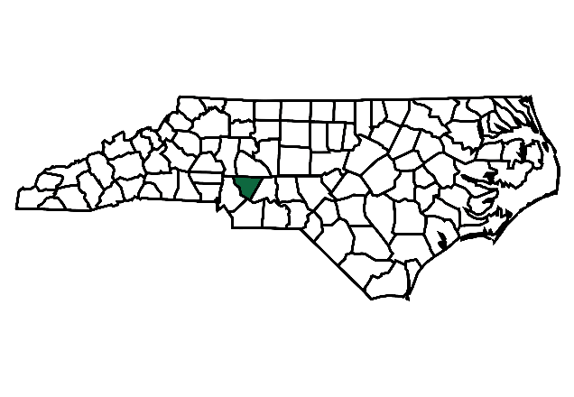
NC Opioid Settlement Academy
Cabarrus County
Virginia Fagg, M.Ed.
Opioid Settlement Project Manager
Cabarrus County
March 27, 2026

Slide 32

CabCo has the high-octane energy of the NASCAR scene with Charlotte Motor Speedway. Along with Reed Gold Mine, The Avett Brothers, Concord Mills, Earnhardt, Wallace, Schrader, and Haas Racing, Cannon Mills, the NC Research Campus, & Warren Clay Coleman, there are 5 distinct municipalities, each with their own character:
  Concord - County Seat - (~105,000 residents)
  Kannapolis (~60,000 residents)
  Harrisburg (~23,000 residents)
  Midland (~5,000 residents)
  Mount Pleasant (~1,800 residents)
Notes:
Warren C Coleman
(1849–1904): A Concord businessman born into slavery who became a prosperous merchant and founded the Coleman Manufacturing Company, believed to be the first Black-owned cotton mill in the U.S..
: Home to the Reed Gold Mine, where a 17-pound nugget found in 1799 sparked the first U.S. gold rush.

Slide 33
Cabarrus County has proactively addressed OUD through dedicated programs funded by Opioid Settlement Funds.
Medication-Assisted Treatment (MAT): The Cabarrus County Sheriff’s Office and Cabarrus Health Alliance collaborate on a joint MAT effort to treat inmates both during their stay and after release.
Program Impact: Since the launch of a linked Community Paramedicine MAT program in March 2024, there have been 194 patient contacts, with 70 individuals referred and 56 served with medication and resources immediately following release.
Statewide Context: A 2024 report found that only about 37% of North Carolina jails currently provide MAT for OUD, placing Cabarrus in the minority of counties offering these comprehensive services.

Slide 34
Meet our Academy team!
Kara Clarke – Deputy Chief, Cabarrus County EMS
Kamilah McKissick, Ph.D – Director of Behavioral Health, Cabarrus County
Kristin Klinglesmith, MPA – Assistant Director of Behavioral Health, Cabarrus Health Alliance
Lt. Matt Fisher - Cabarrus County Detention Center
Sonja Bohannan-Thacker, MSW – Director of Behavioral Health, Cabarrus Health Alliance
Virginia Fagg, M.Ed. – Opioid Settlement Project Manager, Cabarrus County
Cpt. Wesley Wallace – Cabarrus County Detention Center

Slide 35
The Impact of the Opioid Crisis on North Carolinians & Strategies to Address the Problem
The opioid crisis is a health and human services crisis.
According to the NC Department of Health and Human Services (NCDHHS) Dashboard:
From 2000 to 2022, more than 37,000 North Carolinians lost their lives to opioid overdose.¹
In 2022, 4,339 died from an overdose – the highest annual total over this timeframe.
In 2022, more than 11 North Carolinians died each day from a drug overdose.¹ Most (78%) of these overdose deaths were attributed to manufactured fentanyl.
From 2000 to 2022, Cabarrus County witnessed 770 opioid overdose deaths, with 74 in 2022, resulting in an annual rate of 34.2 per 100,000 residents
1 North Carolina Department of Health and Human Services. Opioid and Substance Use Action Plan Data Dashboard. Available at: https://www.ncdhhs.gov/opioid-and-substance-use-action-plan-data-dashboard. Accessed September 5, 2023.

Slide 36
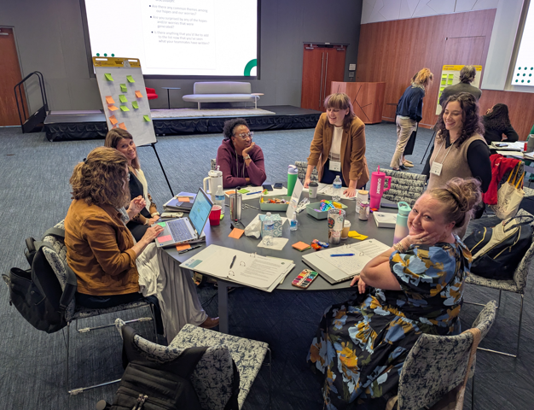
NC MOA – Exhibit A:
Strategy 12: Reentry Services
Strategy 11: Addiction Treatment in Jails
2024 Collaborative Strategic Plan Completed
  Identified Strategy 12 as a priority for Cabarrus County
SAMHSA Reentry Best Practices
  MAT Programs
  Peer Support Specialists
  Integrated Care for co-occurring disorders
  Targeting social determinants of health
  Trauma-informed Approach

Slide 37
Hopes for Cabarrus County
Our Purpose
“To restore hope, dignity, and opportunity by empowering individuals to rebuild their lives after incarceration — creating safer communities through second chances and shared accountability.”
Ensure every participant leaves with a personalized re-entry plan and the confidence to follow it.
Build strong community partnerships that create pathways to employment, housing, and mentorship.
Publish an Annual Impact Report highlighting outcomes and success stories.

Slide 38
Challenges and Solutions
RFP for Reentry Program (Strategy 12)
  “Reviving” a community wide Reentry Coalition to include multiple organizations and other funding sources
RFP for Collaborative Strategic Plan (Strategy 1)
  18-month process set to begin in FY27
Solutions
- Non-stigmatizing language and practice
- Harm Reduction approaches
- Trauma-Informed Care Principles
- Collaboration and transparency
- Hope and human dignity
Notes:
RFP for Reentry Program (Strategy 12)
“Reviving” a community wide Reentry Coalition to include multiple organizations and other funding sources
RFP for Collaborative Strategic Plan (Strategy 1)
18 month process set to begin in FY27
Solutions:
- Non-Stigmatizing Language and Practice – We see the person, not the addiction.
- Harm Reduction Approaches – We meet people where they are, offering safety and dignity at every step.
- Trauma-Informed Care Principles – We understand that healing cannot happen in fear; it happens in trust, stability, and empathy.
- Collaboration and Transparency – We build bridges between systems and voices to serve the whole person.
- Hope and Human Dignity – Because every person deserves a path to recovery and a chance to begin again.

Slide 39
NC Opioid Settlement Academy Experience
Reflections:
  Extremely helpful in the planning process of this initiative
  Team building and goal planning were highly effective
  Motivating and energizing to work with other counties
Notes:
Note: Audience will already know what the academy is, this is more about your county’s experience and reflections

Slide 40
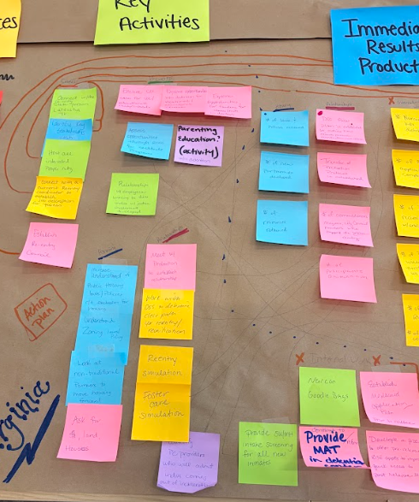
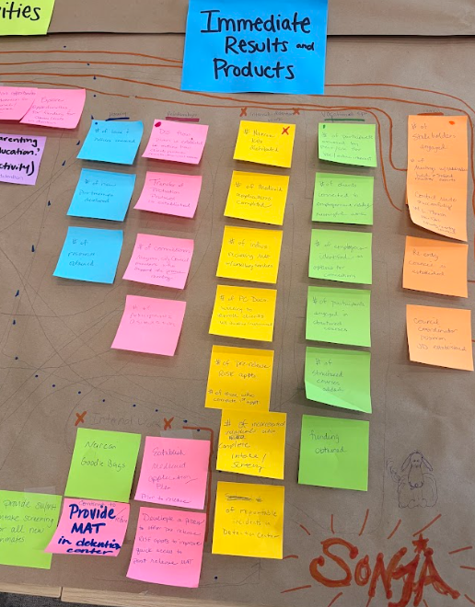

Slide 41
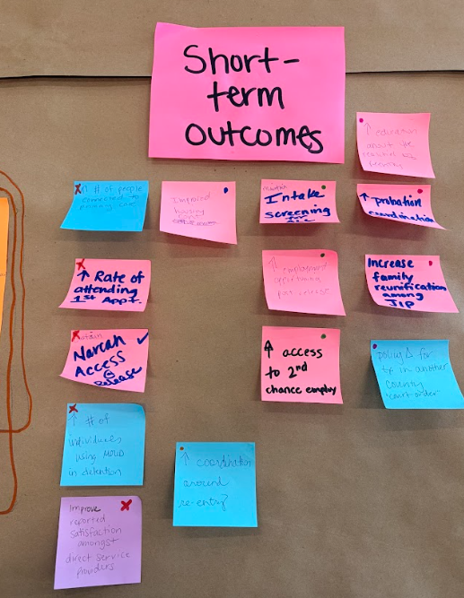
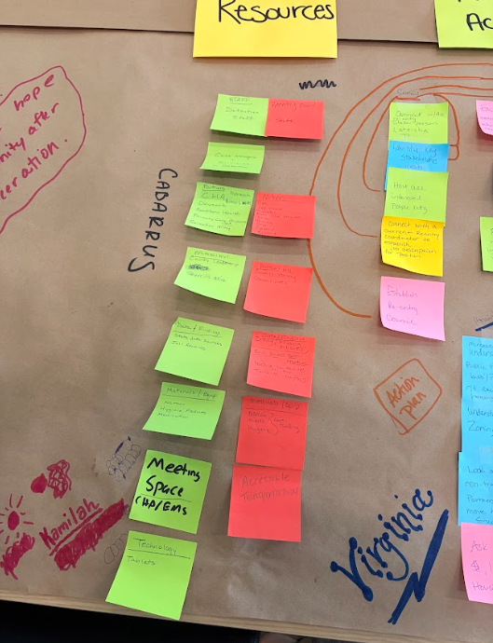
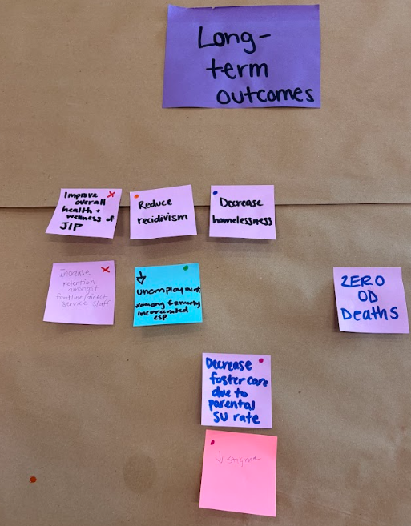

Slide 42
Celebrating Progress and Looking Ahead
SOP Development
  Finance
  Process & Procedures for funding applications & RFPs
Request for Proposal (RFP) for Re-Entry Funding slated to release in Spring 2026
Focus on Equity: Directing resources to historically marginalized communities that have been disproportionately affected by the overdose epidemic, including people of color and those experiencing homelessness.
Long-Term Planning: Using funds for infrastructure, data support, and sustainable programs rather than one-time, short-term solutions.
Collaborative Decision-Making: Engaging stakeholders with lived experience, family members, and community-based organizations to shape spending plans.

Slide 43
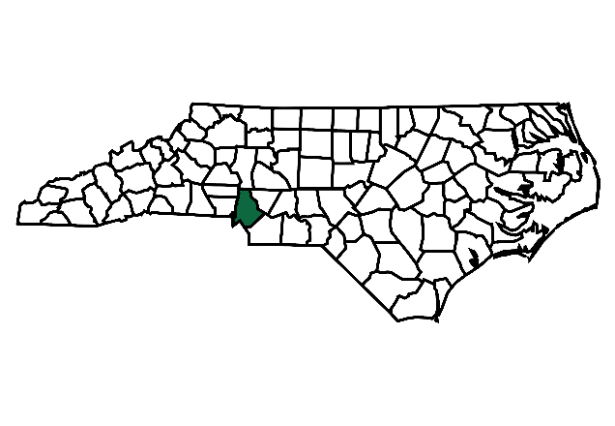
NC Opioid Settlement Academy
Mecklenburg County
Marcus Boyd, LCMHCS, LPCS, LCAS, CCS
March 27, 2026

Slide 44
Mecklenburg County
Mecklenburg County is one of the nation’s fastest‑growing communities, adding ~157 residents per day and reaching 1.2M people in 2024.
“One Meck” reflects our unified, resident‑centered approach to equitable services.
Meck Dec Day (May 20) honors the county’s early independence tradition and the “hornet’s nest” legacy.
The Mecklenburg County Detention Center (Central) houses over 1,900 inmates and is the largest pre‑trial facility in the Carolinas.
From 2020–2024, overdose deaths averaged ~24 per 100,000, peaking near 30 in 2023, with disproportionate impacts on African American and Hispanic residents.
Notes:
Mecklenburg County is one of the nation’s fastest‑growing counties, welcoming approximately 157 new residents each day. The latest official population estimate is 1,206,285 (July 1, 2024), spanning 546.08 square miles and including seven incorporated municipalities.
“One Meck” has become our County’s guiding philosophy, introduced by the County Manager to emphasize a unified, resident‑centered, cross‑departmental approach to delivering equitable outcomes for all Mecklenburg County residents.
Mecklenburg Declaration of Independence Day (“Meck Dec Day”), celebrated on May 20, honors the local tradition that Mecklenburg citizens issued the first declaration of independence from British rule on May 20, 1775—an act that prompted General Cornwallis to label the area a “hornet’s nest,” a symbol that continues to shape local identity. Sports fans will recognize the legacy: the Charlotte Hornets name has been used by both the original and current NBA franchises, and it was also the name of a minor league baseball team that operated in various forms from 1901 to 1973.
The Mecklenburg County Detention Center (Central) in Charlotte is designed to hold over 1,900 inmates, functioning as the largest pre-trial facility in North and South Carolina. At current time, time the ADP is hovering near 1900 as the result of a recent statutory shift.
Mecklenburg County % year overdose fatality rate from 2020 through 2024 was ~24 deaths per 100,000 people, reaching a peak in 2023 with nearly 30 deaths per 100,000 people.
The African American and Hispanic communities experienced higher fatality rates during this time period.

Slide 45
Meet our Academy team!
MCSO – Detention Programs
• Dorian Johnson — Detention Program Director
• Evelyn McGill — Assistant Director
Mecklenburg County Public Health – OD2A
• Tyler Green — Senior Program Manager
• Dr. Starr Peña Johnson — Program Coordinator
• Marcus Boyd — Opioid Settlement Program Manager
Community & Justice Partners
• James Searcy — Certified Front‑End Reentry SME, Listening First NC
• Dr. Stephen Strzelecki — Clinical Director, Forensic Evaluation Unit, CJS

Slide 46
Reentry Services
In 2025, Mecklenburg County launched its first full‑scale MAT program inside the detention center using opioid settlement funds.
Before this, individuals leaving custody had no structured way to continue treatment — creating a high‑risk gap at release.
Our reentry strategy directly addresses that gap by building a bridge from detention to community care.
The goal is simple: keep people connected, supported, and alive during the most vulnerable transition point.

Slide 47
Hopes for Our County
“By linking residents to treatment, housing, employment, healthcare and recovery support upon reentry, we create pathways to stability that benefit individuals, families, and neighborhoods.”
A measurable decrease in overdose incidents across the county.
Improved access to coordinated, evidence‑based services through our specialized vendor network.
Stronger engagement and support for individuals at highest risk, leading to earlier intervention and fewer crises.
To support that goal, we’re building a dedicated vendor network focused on evidence‑based strategies and coordinated activities that directly address the drivers of overdose.

Slide 48
Challenges and Solutions
Challenge: Multiple partners working across different parts of the system leads to slow, inconsistent coordination.
Solution: A structured vendor network with clear expectations, shared data practices, and regular communication.
Challenge: Reaching people at highest risk before an overdose occurs.
Solution: Expanded outreach capacity, evidence‑based engagement, and smoother referral pathways.

Slide 49
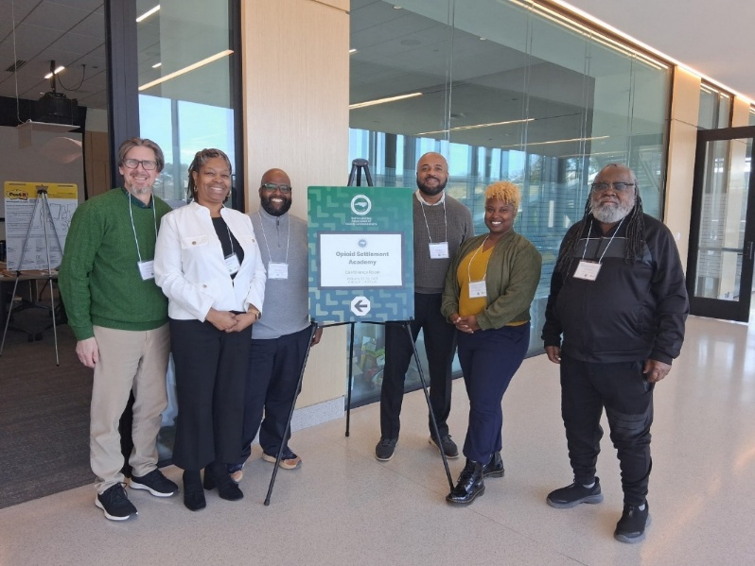
NC Opioid Settlement Academy Experience
The Academy gave our team space to focus, align, and clarify what we want to change.
Building the Strategy Map helped us see how our efforts connect across systems.
Learning from other communities strengthened our direction and motivation.
Notes:
Note: Audience will already know what the academy is, this is more about your county’s experience and reflections

Slide 50
Celebrating Progress and Looking Ahead
A key early win is defining our reentry model: pairing an internal detention‑center role with an external community‑based position to support MAT continuity.
A shared scope of work emphasizes motivational interviewing for both settings.
PORT has been bridging the gap while these roles are established, ensuring no one loses support.
We’re ready to move from planning to implementation and continue strengthening our vendor network.

