Slide 1
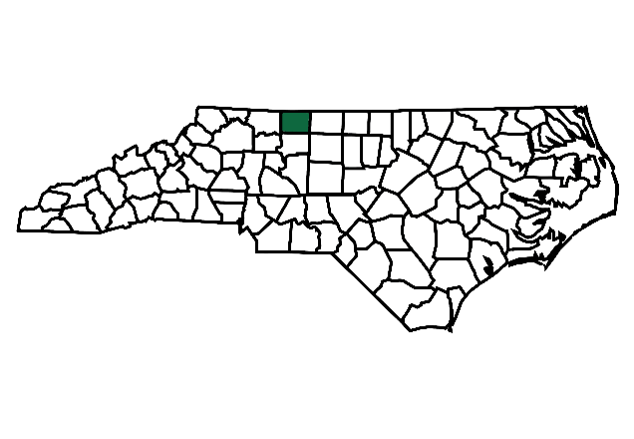
NC Opioid Settlement Academy
Stokes County
Crystal Bates, Savannah Hayes, Anna Jones, Crystal Wilfong
March 27, 2026
Notes:
Good morning, everyone. My name is Savannah Hayes, and I serve as the Opioid Prevention Coordinator for Stokes County. I hold a Bachelors in Nursing, and this work is deeply personal and professional for me. I am going to attempt to condense more than 28 hours of collaboration into 8-10 minutes so bear with me.
Today, I will be sharing our county's experience with the NC Opioid Settlement Academy, including what we set out to do, the challenges we've faced, and the progress we're proud of. One of our team members is attending a college event this weekend, but she may be watching online so everyone wave to Crystal!

Slide 2
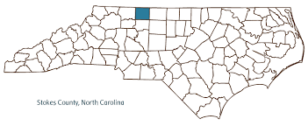
Stokes County
~44,900 residents (2023)
Median age 47.6
Largest municipality: King (~6,877)
The Overdose Death rate in Stokes:
  2024: 39.3 out of 100,000
  2023: 54.9 out of 100,000
  2022: 53.2 out of 100,000
STOKES COUNTY DETENTION CENTER
Located at 1013 N. Main St., Danbury - operated by Sheriff's Office
Rated capacity: 68 beds
Hanging Rock State Park & the Sauratown Mountains - an isolated remnant of the Blue Ridge
U.S. Census Bureau / DataUSA.io - population, income, demographics
Stokes County official site - geography, municipalities
NC DHHS Injury & Violence Prevention - overdose data (2023)
North Carolina Overdose Epidemic Data | Division of Public Health
NC Sheriffs' Association / DetentionCenters.net - jail capacity
Area Vibes - cost of living index
Notes:
Let me start by grounding everyone in who we are as a county, because context matters a lot when we talk about opioid response.
Stokes County is a small, rural county in north-central North Carolina with about 44,900 residents. Our median age is 47.6 — older than the state average — and our largest municipality is King, with under 7,000 people. We are a geographically spread out, rural community.
The overdose death rate in Stokes County has been significant. In 2022, we saw 53.2 deaths per 100,000 residents. That climbed to 54.9 in 2023. We did see a decrease in 2024 to 39.3 — which is meaningful progress — but we are far from done.
Our detention center is operated by the Sheriff's Office, rated for 68 beds. It's an important setting in our work, because the intersection of incarceration and opioid use disorder is exactly where our initiative is focused.

Slide 3
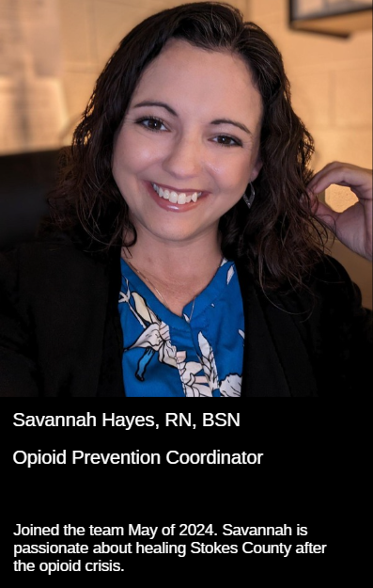
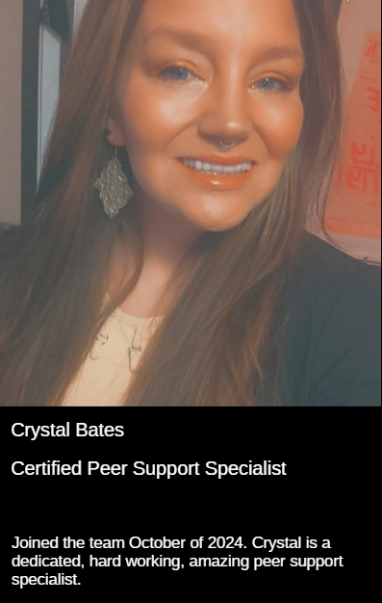
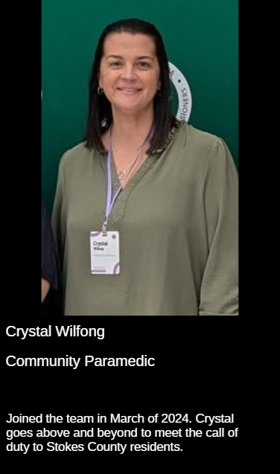
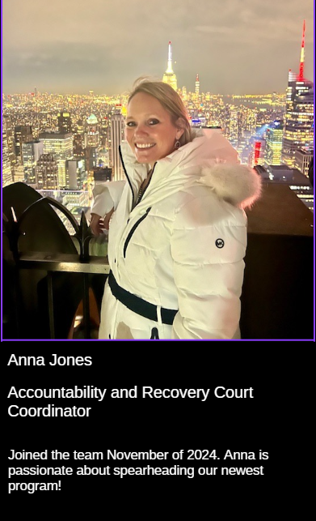
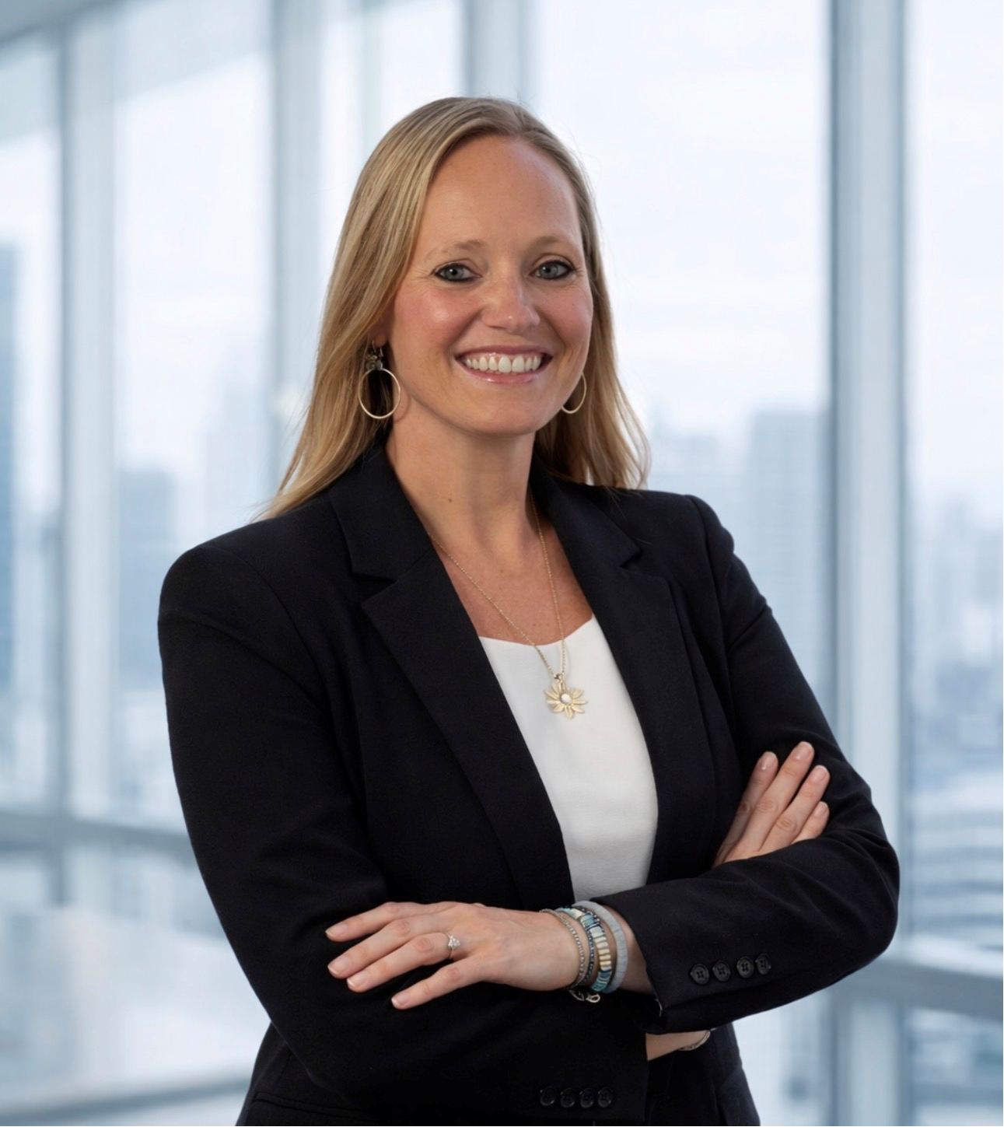

Meet our Academy team!
Notes:
Here is our Academy team. Each of us brings a different role and perspective to this work.
Crystal Bates, Anna Jones, Crystal Wilfong, and myself — Savannah Hayes — have been working together through this Academy process. We each come from different corners of our county's system, and that diversity has made us stronger.
I am a nurse and work in the health department; Crystal B is our peer support specialist that mainly works in the health department however is also involved with other county offices. Crystal W is our community paramedic, and Anna Jones is our accountability and recovery court coordinator. We all joined this team at various points in 2024.

Slide 4
Reentry Services
Currently collaboratively funding Accountability and Recovery Court Coordinator position under Recovery Support Services
High need, low resource county environment
Geographic and systemic isolation
Minimal in-jail programming and self-improvement opportunities
Extended sentences without rehabilitative support
Underserved incarcerated population
Cell service unreliable
In the absence of county-level data, Stokes County reflects statewide trends:
  Nearly 1 in 2 released prisoners is re-arrested within two years
NC Sentencing Commission, 2022
Notes:
Our initiative is centered on reentry services for justice-involved individuals with opioid use disorder.
Currently, we are collaboratively funding an Accountability and Recovery Court Coordinator position under Recovery Support Services. That's one of the tangible investments we've made.
But I want to be honest about the landscape we're working in. Stokes County is a high-need, low-resource environment. We experience geographic and systemic isolation — people don't have easy access to transportation, services, or specialists.
Inside the jail, there is minimal programming and limited self-improvement opportunities. Extended sentences without rehabilitative support create real barriers to recovery. Cell service is unreliable in many parts of the county, which limits even the most basic digital solutions.
And when we look at recidivism — in the absence of county-level data, we align with statewide trends showing nearly 1 in 2 released prisoners is rearrested within two years. That statistic drives everything we're doing.

Slide 5
Hopes for Our County
The Stokes County Reentry Initiative exists to help justice-involved individuals affected by opioid use return to the community with dignity, stability, and consistent recovery support to strengthen the overall health of Stokes County.
  We hope to increase connection to services by offering in person classes within the jail.
  We hope to lower recidivism by offering educational and recovery opportunities during incarceration.
  We hope to increase days of sobriety post release.
  We hope to complete the resource loop within our county.
Notes:
At the heart of our work is a mission statement: The Stokes County Reentry Initiative exists to help justice-involved individuals affected by opioid use return to the community with dignity, stability, and consistent recovery support — to strengthen the overall health of Stokes County.
We hope to increase connection to services by offering in-person classes within the jail — meeting people where they are, while they are incarcerated.
We hope to lower recidivism by providing educational and recovery opportunities during incarceration — so people leave with tools, not just a release date.
We hope to increase days of sobriety post-release — because that is the real measure of success.
And we hope to complete the resource loop within our county — so that when someone leaves jail, they aren't stepping off a cliff. They have a plan, a connection, and a community.

Slide 6
Challenges and Solutions
Securing and maintaining jail access within facility liability and staffing constraints
  Solutions:
    Include jail staff in planning of initiative
    Develop a memorandum of understanding around initiative offerings and regulations
    Fit classes into existing jail schedule
    Connect with other counties initiatives to be prepared
Recruiting and retaining qualified facilitators in a limited rural provider landscape
  Solutions:
    SCOPE team become trained as facilitators, find course offerings from other county programs
    Connect with local nonprofits and reentry programs for regional facilitators
    Use virtual and hybrid options when available
    Recruit peers to become facilitators
Notes:
Of course, none of this comes without challenges. I want to walk through two of the most significant ones and how we're approaching them.
First: securing and maintaining jail access. Working within a detention facility means navigating real liability and staffing constraints. Our solutions have been relational. We plan to include jail staff in the planning process, develop a memorandum of understanding around what we're offering, and structure classes to fit within the existing jail schedule. And we’re connecting with other counties to learn from their experience.
Second: recruiting and retaining qualified facilitators in a rural area with limited providers. For this, our SCOPE team is becoming trained as facilitators ourselves. We're connecting with local nonprofits and regional programs, exploring virtual and hybrid options, and — importantly — we're recruiting peers to become facilitators. People with lived experience are often the most powerful voices in the room.

Slide 7
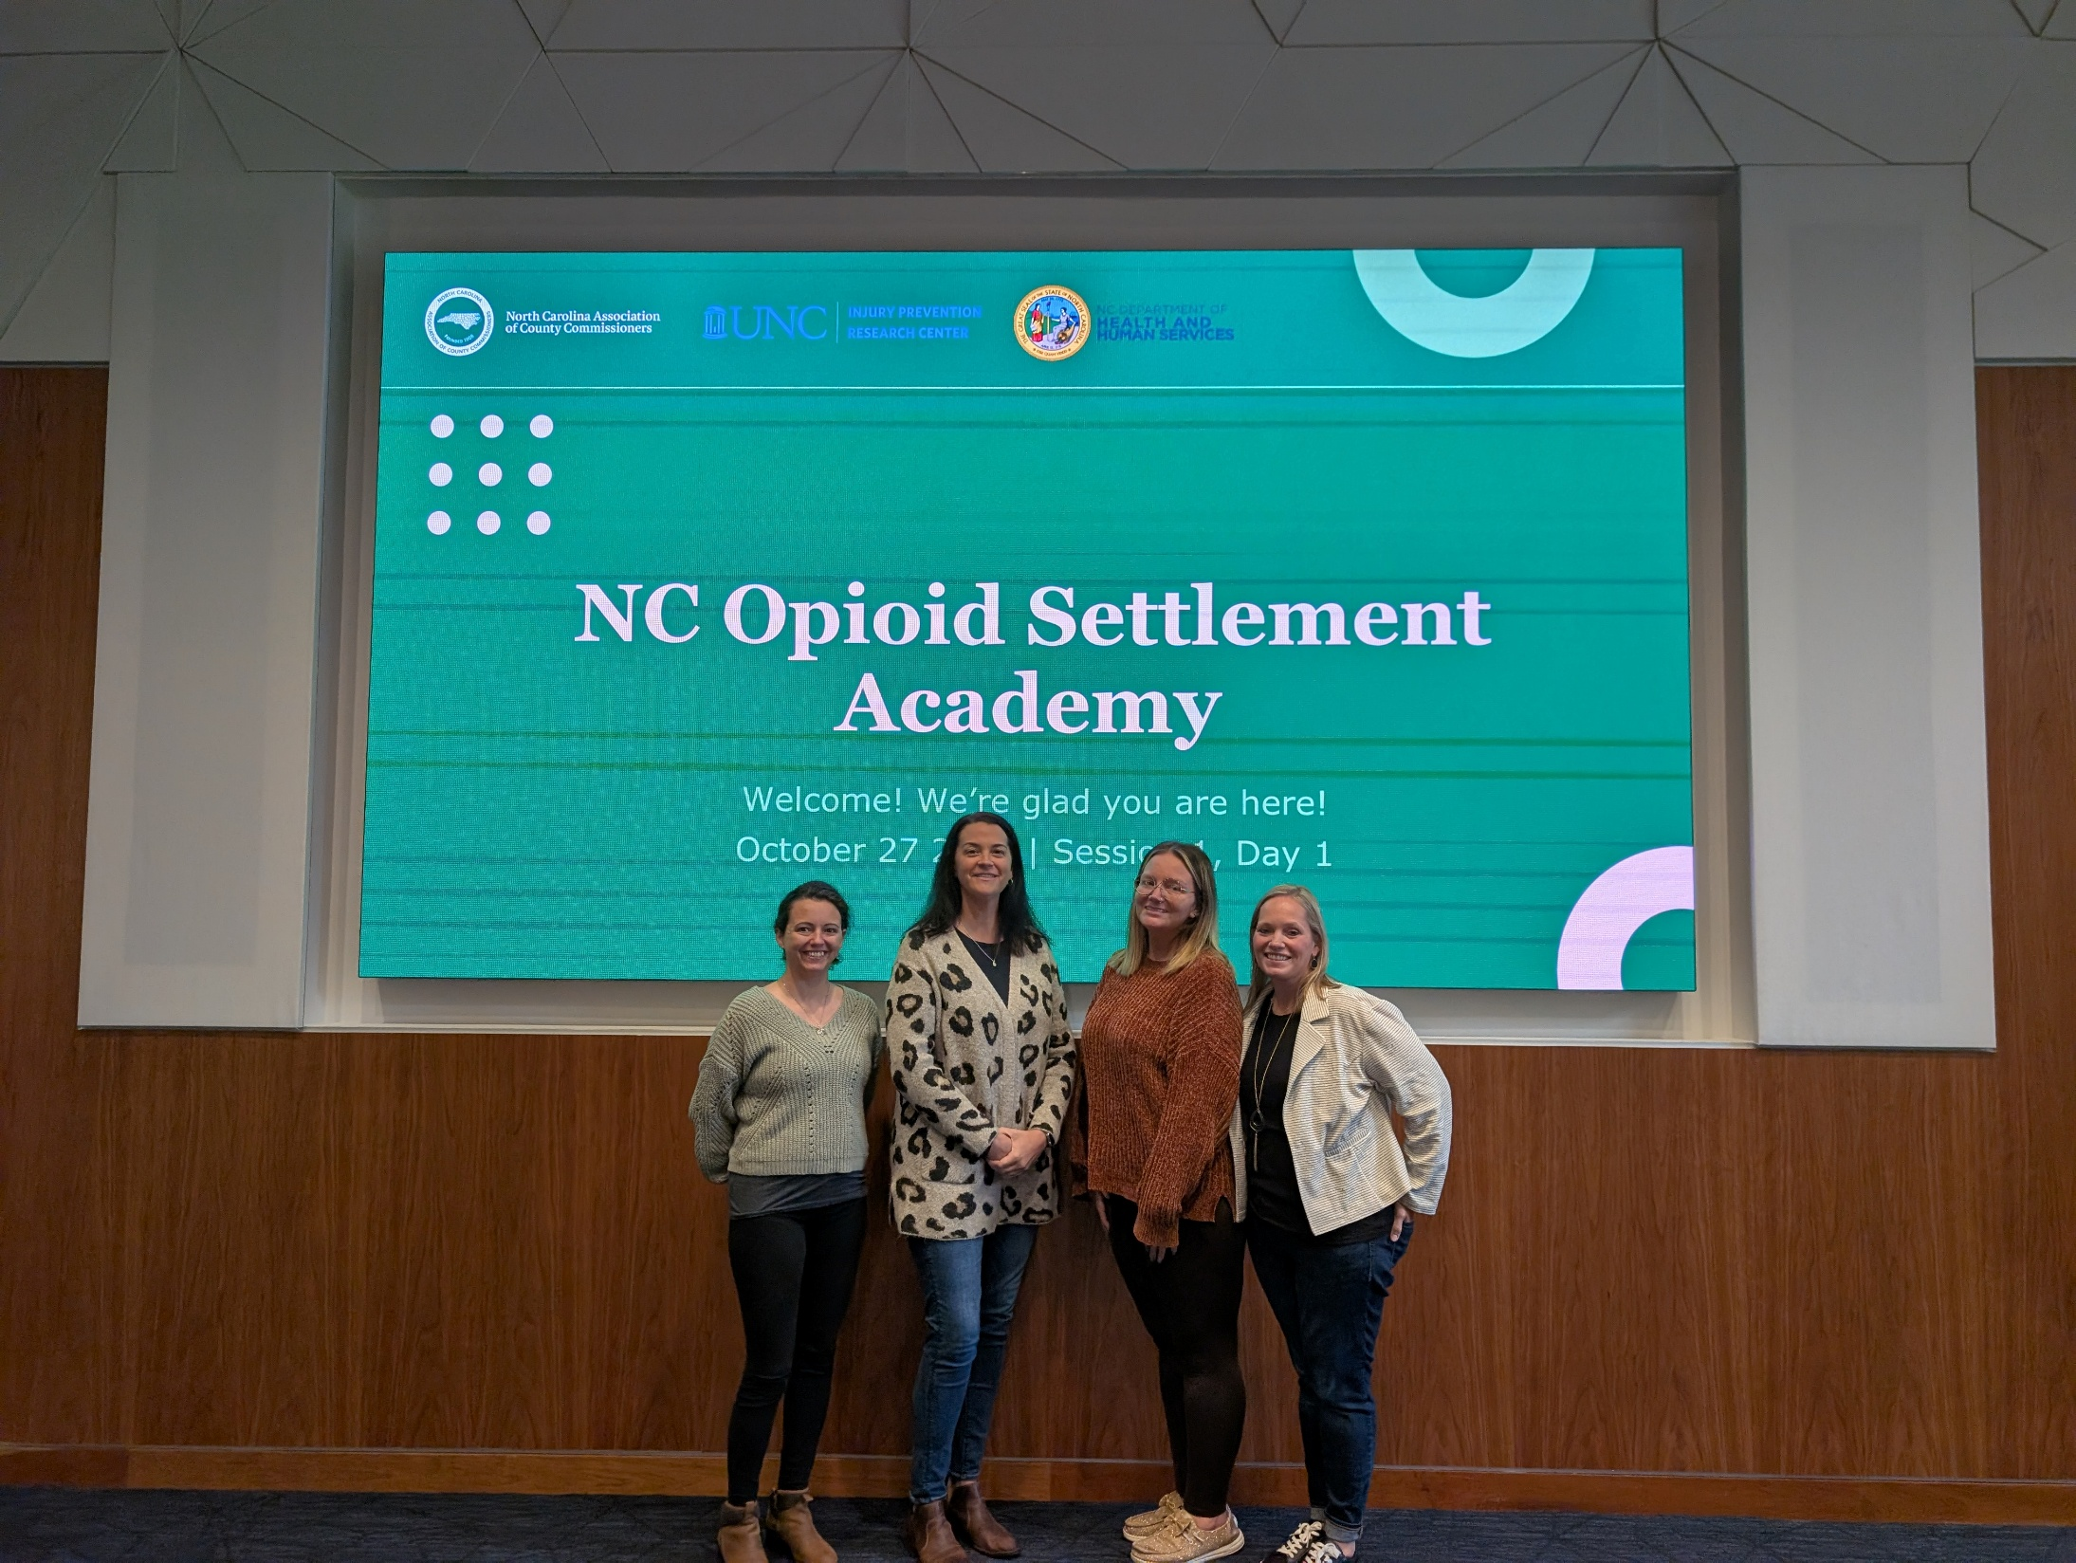
Notes:
Now I'd like to share a bit about our experience with the NC Opioid Settlement Academy itself — not just what the Academy is, but what it meant to us as a county team.
Going into the Academy, each of us came with different expectations and different questions. What we found was a process that challenged us to think bigger and more collaboratively than we had before.
We had so many great ideas during the first session and it was so rewarding to zero in on a shared goal and develop it.

Slide 8
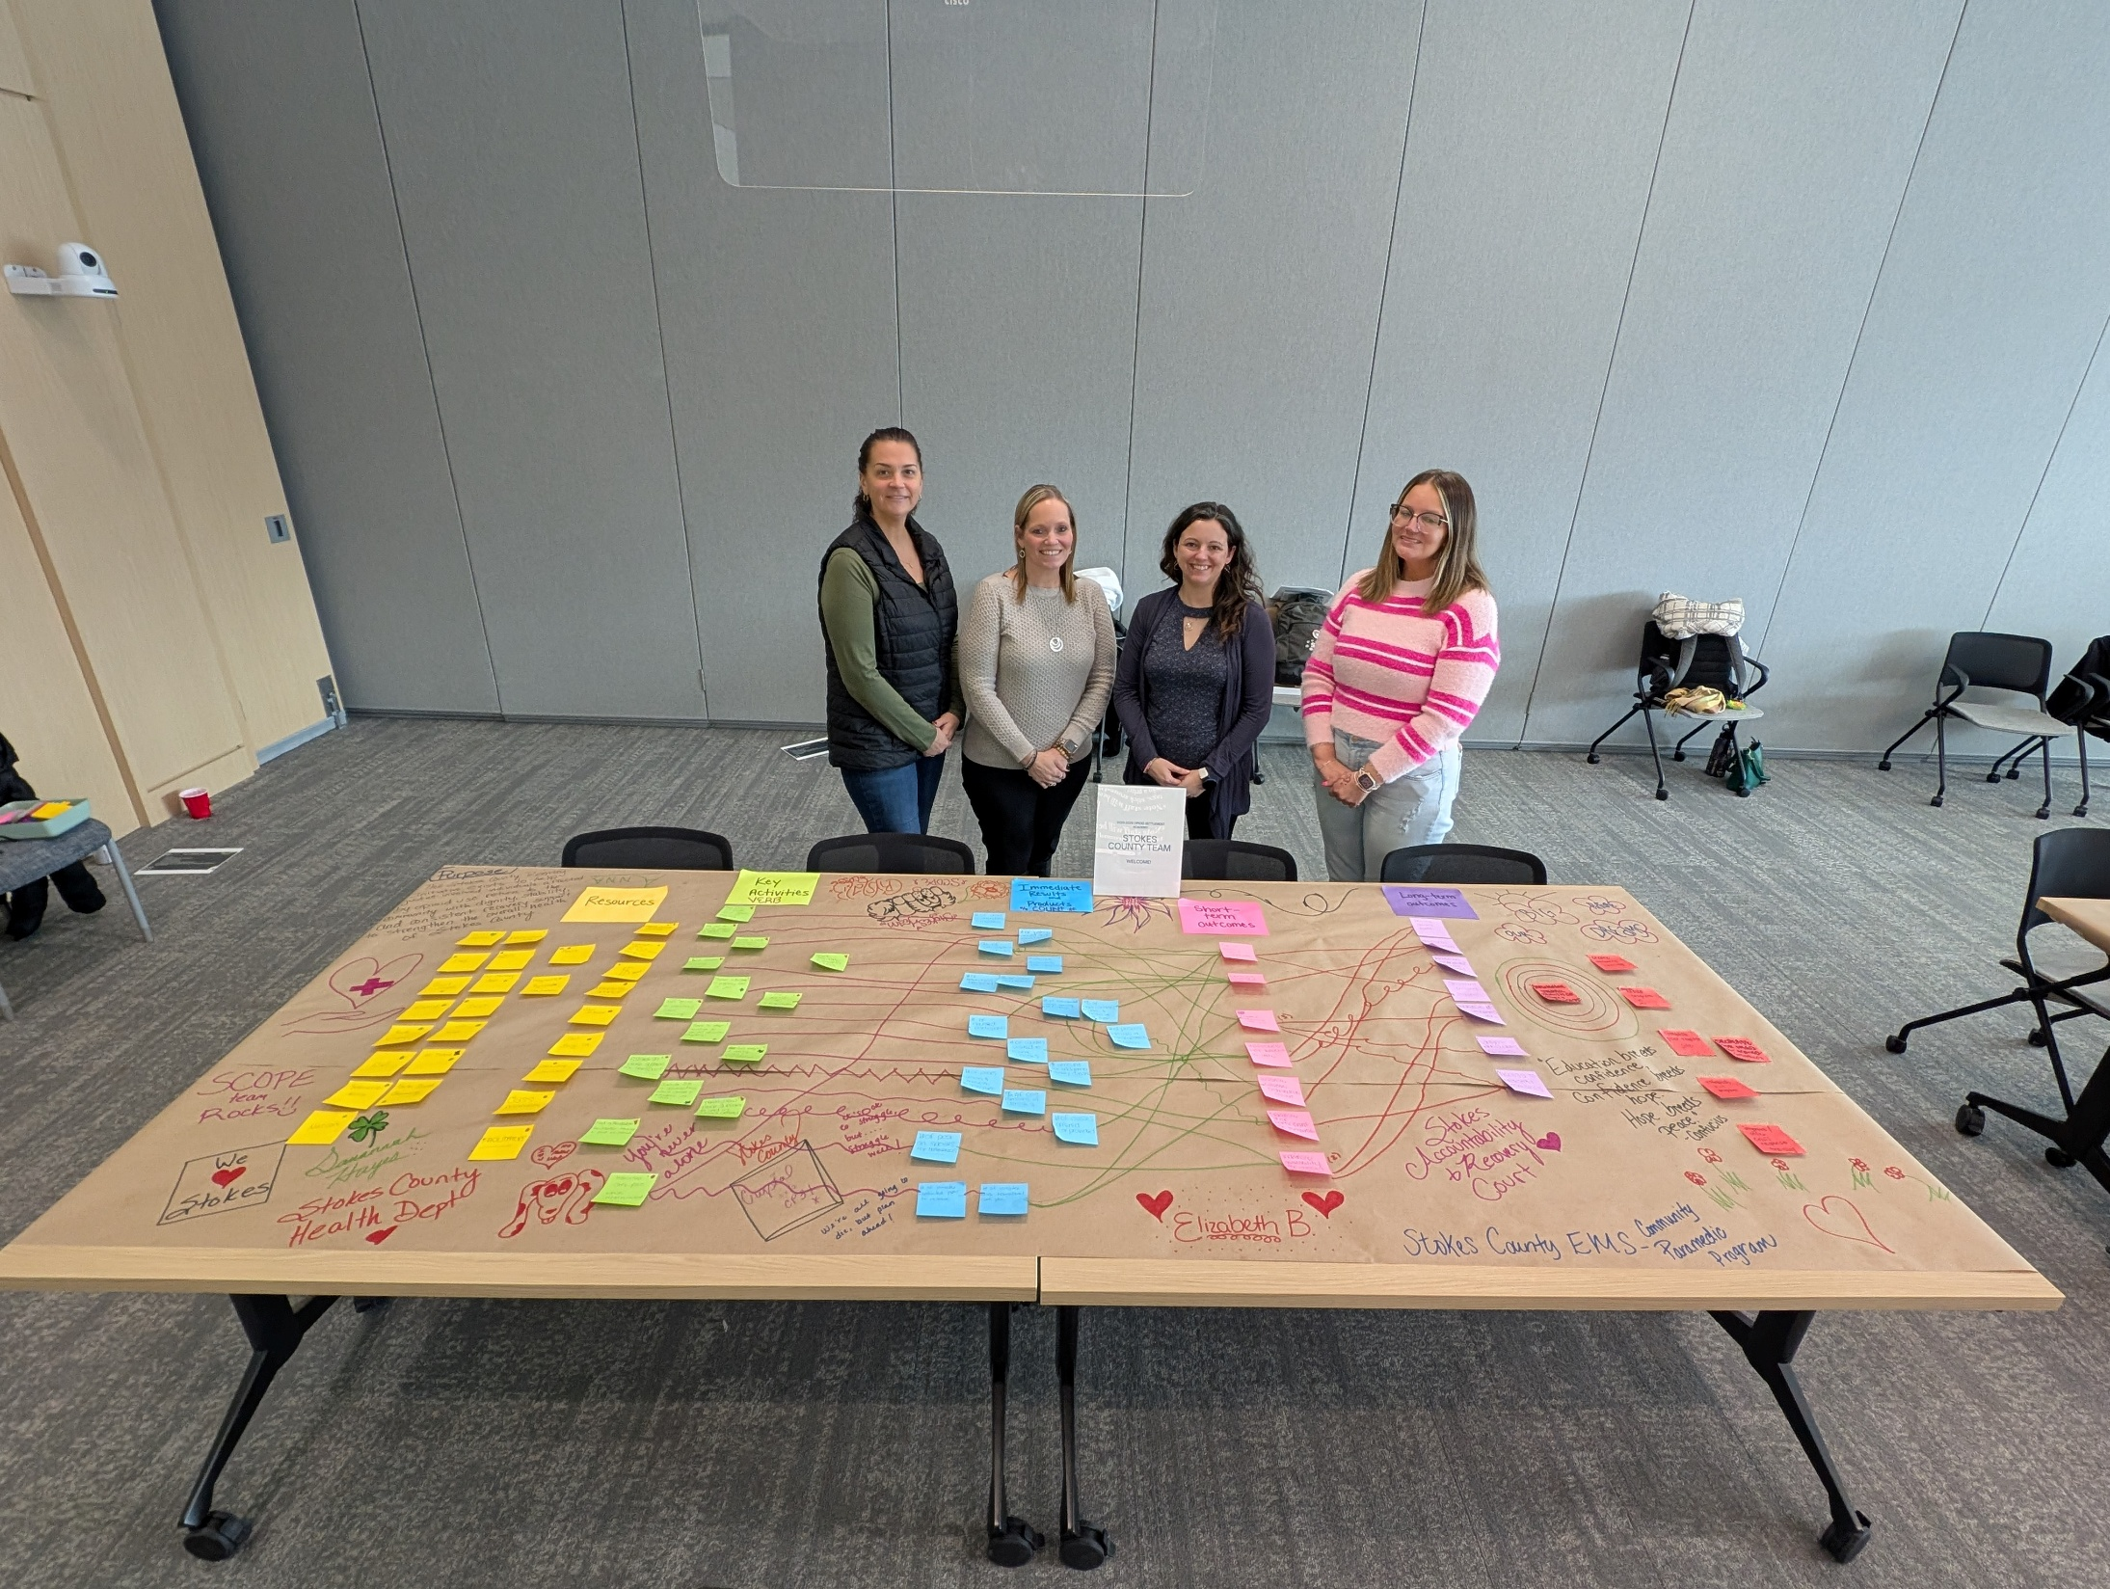
NC Opioid Settlement Academy Experience
Notes:
There were so many post its (laughs) and the interesting part about this process is that we could brain dump every resource, partner, intervention, and goal we could think of and literally
put our hands on them to organize them.

Slide 9
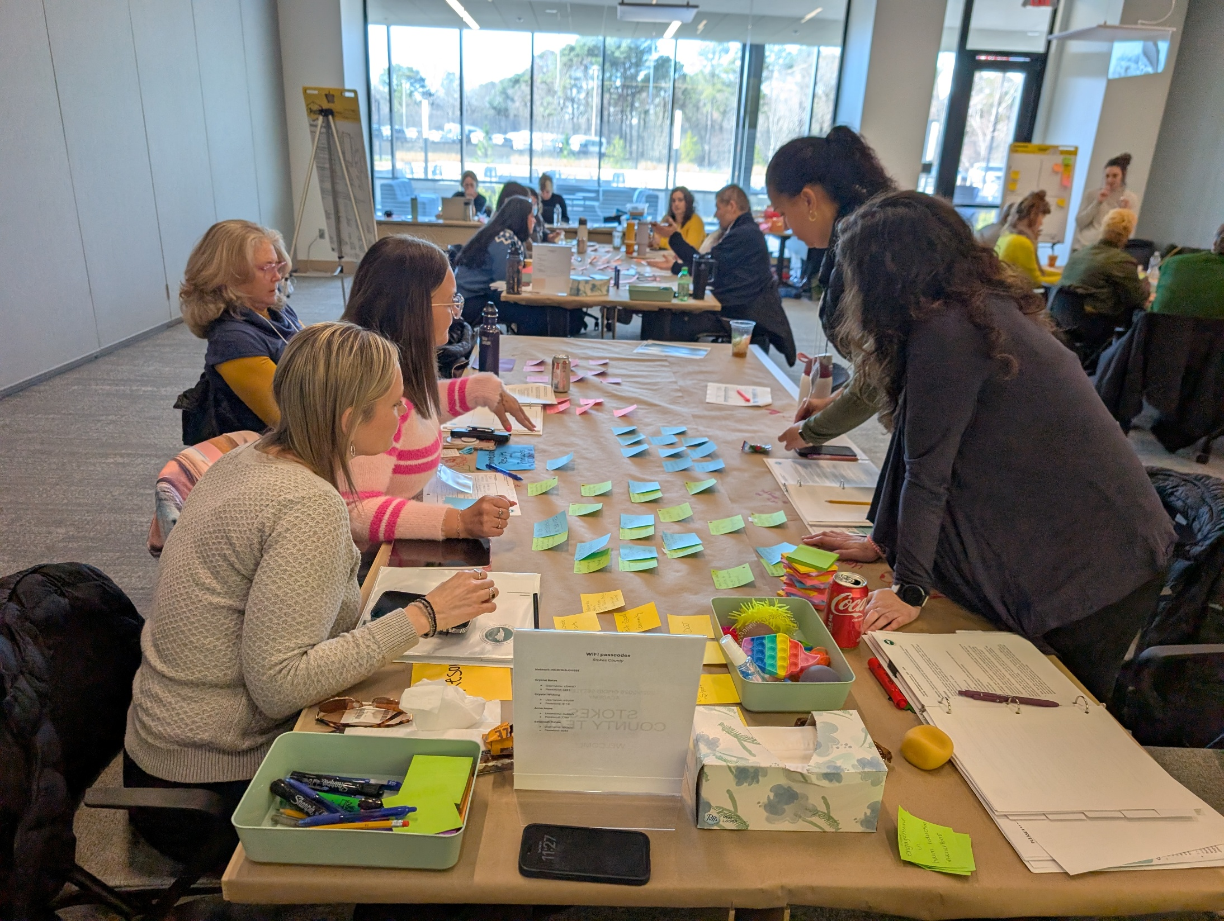
Notes:
This project was invaluable to our team when assessing not only the possibilities, but the feasibility of our initiative. This kind of collaboration doesn’t happen on phone calls or
teams meetings or after court or at lunch. This was a gift.

Slide 10

Short Term Outcomes
Long Term Outcomes
Resources
Key Activities
Immediate Results
OSTAT NCACC
Patagonia EMR
EMS & DSS
Train new peer support to aid in class offerings
Transition care plan while incarcerated
# of justice involved accessing health care services
# of inmates contacted prior to release w/ transition plan
Increase # of recovery court graduates
Decrease overdose deaths
Daymark Pyramid
Counselors
Court Staff
Our Journey App
Affordable facilitator trainings + post to socials
Include DSS in convos about classes and S/U data
# of posts on socials for trainings
$ amount for budgeting reentry classes
Decrease participants rearrested after program
Reduce recidivism
S/JFOY
DOJ
OD Maps
Cost analysis of reentry classes + scholarship
Travel to other counties to see jail education programs
# of classes offered or provided
% of CPD families in classes
Improve relationship with jail
Increase engagement w/ MAT participants
Youth Villages
KSA
NC Detect
Research more access to recovery/sober housing
Find access to
transportation
# of counties visited to observe classes
% of class completion
Introduce MAT induction in jail
Consistent recovery support
Suboxone Dosing
Faith Based Community
Peers
Ask jail to notify program of people close to release
Gather info on pregnancy MAT in jail
# of trainings identified
# of persons enrolled in transportation program
Increase Narcan distribution count
Increase # of programs inside the jail
Narcan
Federal/State Grants
Washington State Institute for Public Policy
Host SMART recovery group
Track alternate destination process
# of alternate destination sites identified
# of housed participants
Decrease # of participants w/o transportation
Increase warm handoffs
Meeting Spaces in Jail
Local Money
Facilitators
Meet with jail staff about classes/MAT in jail
Survey participants about class offerings/interest
% of satisfaction in services
# of incarcerated women receiving MAT/MOUD
Increase availability for classes in county
Increase access to necessary resources
Class Materials
Parenting Educator
Jail Buy-In & Jail Staff
Establish peer system for transport
# of staff in attendance at meetings
% of participants in jail inducted or receive MAT
The Stokes County Reentry Initiative exists to help justice-involved individuals affected by opioid use return to the community with dignity, stability, and consistent recovery support to strengthen the overall health of Stokes County.
# of peers willing & available to transport
Notes:
And that gift resulted in this beautiful monstrosity — it maps out the full picture of our initiative, from the resources we're starting with to the long-term outcomes we're working toward.
On the left side, you see our inputs and key activities: partners like EMS, DSS, Daymark, and the courts; tools like the Our Journey App and NC Detect; and community assets including peers, faith-based organizations, and Narcan.
Our key activities include things like offering classes inside the jail, tracking alternate destination sites, introducing MAT induction in the jail, hosting SMART recovery groups, and building a peer transport system.
Our immediate results include things like the number of classes offered, the number of inmates contacted prior to release with a transition plan, and training new peer support specialists.
Short-term outcomes include increasing access to healthcare services, improving relationships with jail staff, and increasing engagement with MAT participants.
And our long-term outcomes — what all of this is working toward — include decreasing overdose deaths, reducing recidivism, increasing the number of Recovery Court graduates, and building consistent recovery support across Stokes County.

Slide 11
Opioid Settlement Academy Experience
Each of us brought a unique perspective to the process
Our goal formed as we worked, what we wanted in the beginning was pared down to what was actionable
We were allowed the freedom to collaborate often (team time)
Having facilitators was invaluable to the process
Hearing from other counties what is possible was inspiring
Spending days together enhanced team connection
Notes:
Reflecting on our Academy experience, a few things stand out that I want to name for this group.
Each of us brought a unique perspective — nursing, peer support, emergency medicine, justice system — and that diversity made our work richer. Our goal evolved as we worked; what we set out to do at the start was refined into something more focused and actionable.
The team time built into the Academy was invaluable. We don't often get structured time to collaborate across departments and roles — having that built into the process made a real difference.
Having skilled facilitators guiding the process was vital. And hearing from other counties — seeing what is possible — was genuinely inspiring. Spending days together deepened our connection as a team. We left the Academy not just with a plan, but with momentum.

Slide 12
Celebrating Progress and Looking Ahead
Progress:
Recovery Court Coordinator and Peer Support Specialist are SMART Recovery facilitator trained and gaining class hours
Added second peer support specialist to support MAT program and improve department coverage
Building relationship with jail staff
Future Goals:
Class offerings for jail staff as well as justice-involved
Incorporation of new peers into reentry system
Interest in MAT induction in the jail
Notes:
So where are we now, and where are we headed?
On the progress side: our Recovery Court Coordinator and Peer Support Specialist are now SMART Recovery facilitator trained and actively gaining class hours. We've added a second peer support specialist to support our MAT program and improve department coverage. And we are actively building relationships with jail staff — which, as I mentioned, is foundational to everything else we're trying to do. There might have been cookies involved.
Looking ahead: we want to offer classes related to opioid use and recovery for jail staff, not just justice-involved individuals. We want to incorporate new peers into the reentry system. And we have a strong interest in MAT induction in the jail — which would be a significant step forward for Stokes County.
We know this work is long-term. But we also know that every connection made, every class offered, every person who leaves with a plan is a step toward building a brighter, healthier future in Stokes County. Thank you all so much.

Slide 13

NC Opioid Settlement Academy
Yadkin County
Junior Thompson
March 27, 2026

Slide 14
Yadkin County
“Come for a visit, stay for a lifetime” ~Yadkin County
  There are approximately 37,722 people living in Yadkin County as of 2025.
  Yadkin County’s overdose death rate, as of 2024, was 23.7 out of 100,000 residents.
  This represents 9 people who died of an overdose. This rate is a decrease of 57% from the prior year.
  The Yadkin County Detention Center capacity is currently 100 people with the average length of stay by individuals being 117 days.
Notes:
1-https://indd.adobe.com/view/235be228-d90d-44f8-8700-5e20ca68ca4c
2-https://www.dph.ncdhhs.gov/programs/chronic-disease-and-injury/injury-and-violence-prevention-branch/north-carolina-overdose-epidemic-data#TechnicalNotes-3327

Slide 15
Meet our Academy team!
Carolyn Pearson, Yadkin County Sheriff’s Office, Detention Center Corporal
Junior Thompson, Yadkin County Pre-Trial Release Coordinator
Laken Royall, Yadkin County Human Services Agency, Assistant Director
Marie Walters, Yadkin County Opioid Action Coordinator
Notes:
-Cpl Pearson brings valuable knowledge and expertise in her position within the Detention Center and provides a connection to individuals who are currently incarcerated. She also has established rapport with those individuals as well as with fellow Sheriff’s officers who can further identify individuals who may benefit from our services and ongoing support.
-Laken works within our consolidated Human Services Agency and brings a wealth of knowledge of our Public Health services along with other community agencies that work in conjunction with each other to provide community support. She is our liaison for the Human Services Agency and helps to provide clarity and support in areas regarding WIC/Medicaid, Public Health, and our local Health Department.

Slide 16
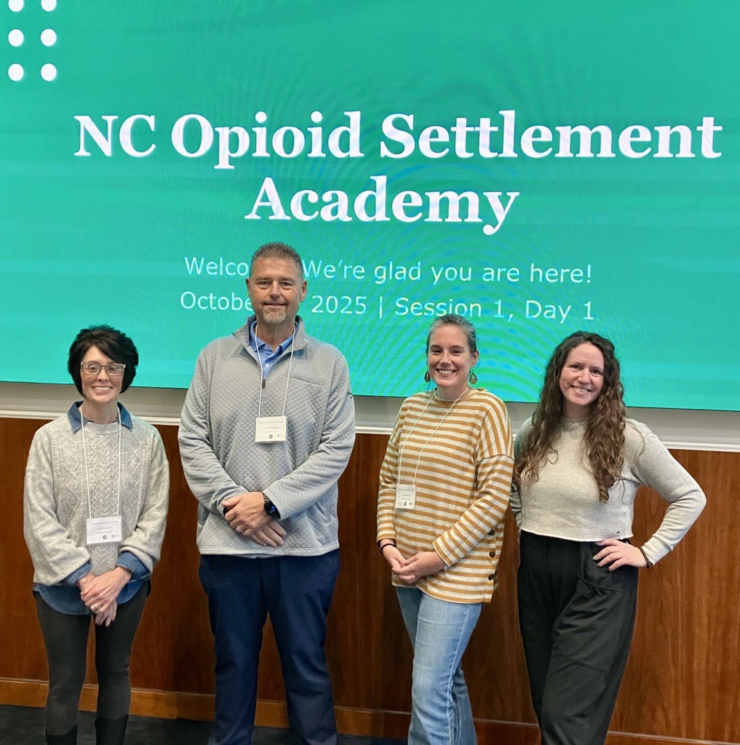
Notes:
Our team members

Slide 17
Why Reentry Programs and/or Services?
Yadkin County Detention Center has a 100 bed capacity.
50% of pre-trial detainees have drug related offenses.
13.5% are charged with violent offenses.
13% are charged with property related offenses.
6.7% are charged with sex offender related offenses.
On average 50% of individuals housed in the Yadkin County Detention Center have some form of OUD/SUD.
Notes:
Reentry Program strategy was selected as Yadkin County is already utilizing the Criminal justice diversion program to fund our Pre-Trial Release Coordinator position in order to support our justice involved individuals while they are eligible for Pre-Trial services. Having gone through the Opioid Settlement Academy and learned more about how to align the services which are already in place and how to bring additional services together through the Reentry program will allow our Board of County Commissioners to see our vision, and the benefit, in moving forward as a connected community by funding the Reentry Program strategy.

Slide 18
Hopes for Our County
Through collaboration with local agencies, faith-based organizations, and employers, Yadkin County is committed to fostering second chances, restoring dignity, and empowering every individual to build a productive, purpose-driven life.
We hope to use Reentry to meet the needs of those in the Detention Center so that upon release resources will be readily available.
We hope people leaving the Detention Center will be supported and connected to care in ways that celebrate the goodness and positive impact that they can make in the community.

Slide 19
Challenges and Solutions
There is an overall consensus that the lack of support and buy in from partners and participants would be our greatest challenges.
  The plan to overcome this is to approach our partners and participants with open communication, allowing them to engage in our vision at their discretion.

Slide 20
NC Opioid Settlement Academy Experience
The Yadkin County Team greatly enjoyed and benefited from our time participating in the Opioid Settlement Academy.
We were able to discuss some topics that were particularly challenging in order to come up with a concise plan in presenting our Reentry program strategy within the next budget year.
Notes:
Note: Audience will already know what the academy is, this is more about your county’s experience and reflections

Slide 21
Resources
Key Activities
Immediate Results
Short Term Outcomes
Long Term Outcomes
Host re-entry simulation
Increase % of re-entry council members who are engaged
Increase % of participants who have insurance coverage
ICGH-housing, MAT
Yadkin Christian Ministries
# of agency partners engaged w/ council
Reduce recidivism rate
# of presentations to human services
Distribute naloxone + engage community
Form re-entry council
Decrease in # of rearrests
Increase % of participants w/ OUD who have referred to employment services
YCSO
Solus Christus Treatment
Increase Community Education Awareness Acceptance
# of reentry council meetings
Distribute naloxone for post overdose training
Provide case management to assess needs
# of ref to OUD/SUD treatment
Increase % of OUD participants who schedule 1st appt w/ employment services
Daymark
Staff
Increase # of participants w/ OUD using primary care
Decrease unemployment rate w/ connection to opportunity
# of referrals to MAT services
Host re-entry content expert @ quarterly mtg
# of ref to mental health treatment
Increase % of transitions plans that address ALL needs
Health Dept. Healthcare Services
Strong & Clear Policy for serving clients
Expand menu of resources* available for referral
# ref. to health insurance/healthcare
Increase % of key re-entry partners who report back results of referrals
# of ref to housing resources
Increase physical + mental health conditions w/ connection to services
Make program marketable
Increase % of participants who received naloxone kit
PTRC Workforce Development HUD Project Reentry
Data on $ saved due to pre-trail services
Follow up to ensure connections have been made
# of naloxone kits distributed via zip code, purpose, amount
Stay engaged as needs change
# of resources in menu of resources
Increase % of participants w/ OUD who report stability @ 30/60/90 days
Reduce overdose death
Rise Up MAT
Create box w/ info for intake area/business cards
People in detention who don’t want to go back to jail
*menu of resources to include: OUD/SUD and mental health assessment and treatment, housing, health insurance
# of agreements w/ Sheriff's Office
# of intakes completed
NC Works Employment
Meeting w/ Sheriff's’ Office for agreements
# of participants who are f/u w/ after release after 30/60/90 days
# of unique people served
Through collaboration with local agencies, faith-based organizations, and employers, Yadkin County is committed to fostering second chances, restoring dignity, and empowering every individual to build a productive, purpose-driven life.
# of part. w/ OUD who report stability @ 30/60/90 days
Yadkin County Team

Slide 22
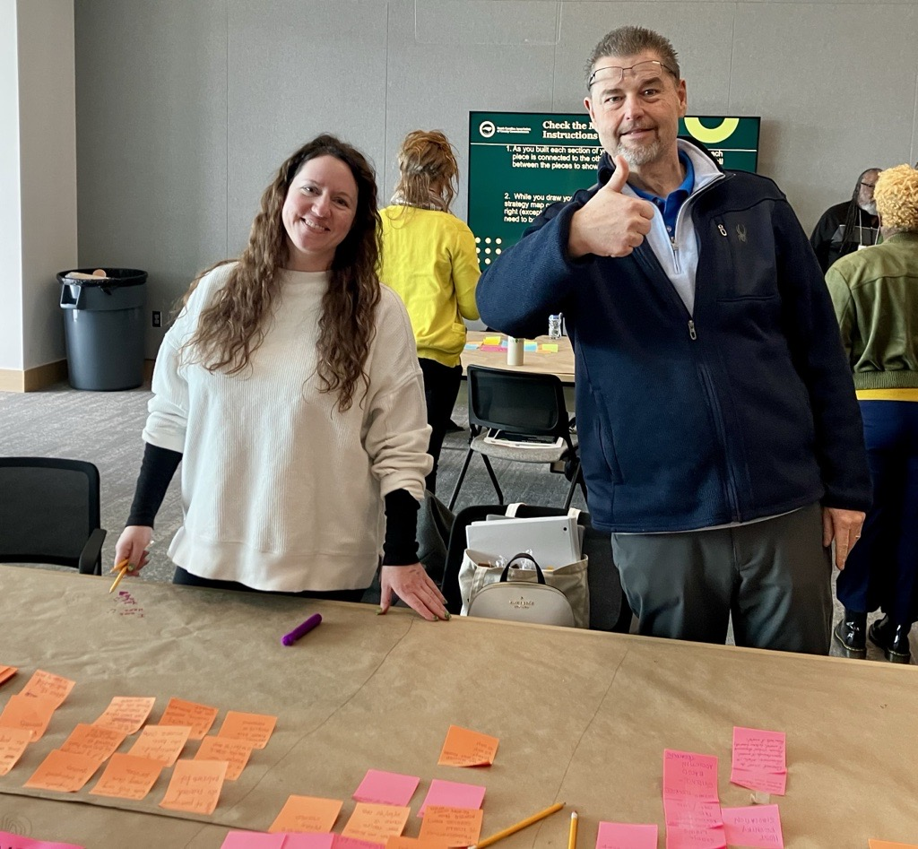

Slide 23
Celebrating Progress and Looking Ahead
Inclusion of pre-trial release coordinator position in our current local spending authorization resolution.
Positive discussion of connection to peer support services with Sheriff’s Office.
We are excited to see our vision begin coming to life through the intentional steps that we are making with our Sheriff’s Office to provide services to individuals who are justice-involved.

Slide 24

Diversion Programs in the State
Lars Paul
Law Enforcement Program Manager, NC Harm Reduction Coalition
Retired Captain, Fayetteville Police Department
Andrea Des Marais, MPH
Senior Health Programs Manager, NC Association of County Commissioners
Program Manager, NC Technical Assistance Center
March 27, 2026

Slide 25
Session Overview
The What and Why of Diversion
Opportunities for intervention
Reasons for implementing a program
How Programs Work
The basics
Adapting programs for your community
NC Program Successes
How to Get Started

Slide 26
The What and Why of Diversion

Slide 27

What is Diversion?
Alternative to repeated/increasing exposure to the legal system
Collaboration between justice system and community-based services
  Intensive case management and linkage to services to address underlying issues that may lead to law enforcement interaction
Can occur at different points of interaction with the legal system

Slide 28
Legal System Involvement & Opportunities to Break the Cycle
Pre-Arrest Diversion
Initial Detention & Court Hearings
Incarceration
Return to Community
Interaction with Law Enforcement
Arrest
Specialty Parole
Recovery Courts
Reentry Services
Notes:
This is a major oversimplification of the criminal justice system.
Each step up requires more time, more money, more personnel - not to mention trauma and future challenges for the person who is incarcerated
People can be diverted from continued escalation at any of these points

Slide 29
Why Do Pre-Arrest Diversion?
Achieve better outcomes for individuals
Improve public health and safety
Reduce strains on officer time and detention center resources
Notes:
You may want to find out how much your local detention center spends per person per day to hold someone – especially someone with complex medical issues.
A diversion program will definitely be cheaper

Slide 30
The “LEAD” Model (Law Enforcement Assisted Diversion)
The first pre-arrest diversion program
Uses officer discretion to divert individuals with low-level offenses related to drug use or sex work from the traditional criminal justice system and link them to supportive services
Linkage to services operates within a participant-centered framework to include intensive case management and peer support services
It is common to hear “LEAD” as shorthand for any pre-arrest diversion program
Programs must follow certain core criteria to be “LEAD” programs

Slide 31
Characteristics of Effective Pre-Arrest Diversion Programs
Pre-arrest
  Participants are diverted to case management before any charges are made
Non-coercive
  Participants are never compelled or forced to participate in the program
Participant-driven
  Participants set their own goals, pace, and priorities for positive change and recovery
Pre-Arrest Diversion in North Carolina: A Handbook for Law Enforcement Programs, NC Technical Assistance Center, January 2026.
Notes:
Not all programs are officially “LEAD.” Here are the key characteristics that we have found to be essential for diversion programs to work well.
These guidelines are based on our real-world experience and an NC-based program evaluation that Andrea will talk about later

Slide 32
Characteristics of Effective Pre-arrest Diversion Programs
Non-coercive
  Requirement for program participation is completing intake (usually within 14 days)
  After intake, original charges are not held over participant to enforce program “compliance”
  Participants might become “inactive,” but can always come back
Participant-driven
  Any positive change
  Goals might not include abstinence
  Return to use is normal and does not make someone ineligible for services
Pre-Arrest Diversion in North Carolina: A Handbook for Law Enforcement Programs, NC Technical Assistance Center, January 2026.

Slide 33
How Pre-Arrest Diversion Programs Work

Slide 34
Program Eligibility & Referrals
Eligibility Criteria
  Individuals suspected of low-level criminal offense
  Community-specific criteria determined by program partners
Referral Types
  Arrest diversion
  Social referrals
  Community referrals
Pre-Arrest Diversion in North Carolina: A Handbook for Law Enforcement Programs, NC Technical Assistance Center, January 2026.
Notes:
“Low-level offenses” tend to be things like shoplifting, trespassing, survival sex work, drug possession for personal use

Slide 35
Services & Supports
Case Management
  Clinical assessment followed by individualized support plan to address factors contributing to law enforcement interactions
Peer Support
  Overdose prevention
  Support with accessing services
  Motivational Interviewing and goal setting
Community-Based Services
  Health care, housing, food, transportation

Slide 36
Partnerships and Key Collaborators
Law Enforcement Agencies
District Attorney’s Office
Probation and Parole Offices
Case Management/Peer Support Agencies
Treatment Providers and Community Resource Organizations
Local Management Entity/Managed Care Organization (LME/MCO)
Pre-Arrest Diversion in North Carolina: A Handbook for Law Enforcement Programs, NC Technical Assistance Center, January 2026.
Notes:
Collaboration and buy in make programs more effective

Slide 37
Making Pre-Arrest Diversion Work for Your Community
Types of charges diverted
Level of charges diverted
Eligibility criteria

Slide 38
NC LEAD Program Successes

Slide 39
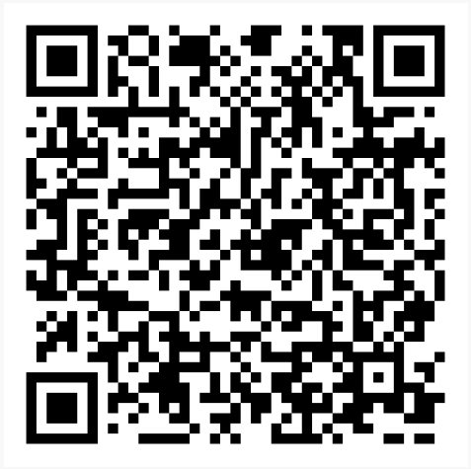
Evaluation of NC LEAD Programs
Conducted by Duke University School of Medicine in collaboration with
NC Harm Reduction Coalition
Four NC-based LEAD programs:
  City of Fayetteville
  City of Wilmington
  Catawba County
  Town of Waynesville
View summary and full report
Allison R. Gilbert, Reah Siegel, Michele M. Easter, Josie Caves Sivaraman, Meret Hofer, Deniz Ariturk, Marvin S. Swartz, & Jeffrey W. Swanson. Law Enforcement Assisted Diversion (LEAD): A multi-site evaluation of North Carolina LEAD programs. Duke University School of Medicine, January 2023
Notes:
Duke team conducted evaluation activities in 4 NCHRC LEAD sites in NC.
Sites from western NC to the coast
Conducted 2019 through 2021, report released in 2022

Slide 40
Evaluation Data Collection
Outcome
  Impact on participants
Process
  How much program activities were occurring
  Facilitators and barriers to implementation
Data Collection
  Surveys and interviews with 22 participants
  27 interviews with stakeholders
  4 focus groups with law enforcement officers
  Review of administrative, arrest, healthcare, and program data for 244 individuals
Allison R. Gilbert, Reah Siegel, Michele M. Easter, Josie Caves Sivaraman, Meret Hofer, Deniz Ariturk, Marvin S. Swartz, & Jeffrey W. Swanson. Law Enforcement Assisted Diversion (LEAD): A multi-site evaluation of North Carolina LEAD programs. Duke University School of Medicine, January 2023
Notes:
For both evaluations, the team took a mixed-methods approach
Focus groups and interviews with law enforcement officers, program participants, and stakeholders who work with the program, such as case managers, outreach workers, LEAD law enforcement coordinators, district attorney representatives, and clinical supervisors
Administrative data from various sources, such as the statewide criminal justice database used by local police departments and the managed care organization databases that have behavioral health data for people who have Medicaid or are uninsured.
Program data from each site, including intake assessments, case notes, and referral forms

Slide 41
Program Services Requested and Received
Allison R. Gilbert, Reah Siegel, Michele M. Easter, Josie Caves Sivaraman, Meret Hofer, Deniz Ariturk, Marvin S. Swartz, & Jeffrey W. Swanson. Law Enforcement Assisted Diversion (LEAD): A multi-site evaluation of North Carolina LEAD programs. Duke University School of Medicine, January 2023
Notes:
As a reminder, LEAD is based participant-defined goals and there is no requirement to get treatment, but most participants expressed interest in SUD and mental health treatment.
Overall successful at getting people connected to services. People wanted employment and housing as well, but it was harder to deliver on that.
Policies that exclude people with records of legal system involvement create barriers to housing and employment

Slide 42
Decrease in Citations and Arrests after Referral
Allison R. Gilbert, Reah Siegel, Michele M. Easter, Josie Caves Sivaraman, Meret Hofer, Deniz Ariturk, Marvin S. Swartz, & Jeffrey W. Swanson. Law Enforcement Assisted Diversion (LEAD): A multi-site evaluation of North Carolina LEAD programs. Duke University School of Medicine, January 2023
Notes:
One big takeaway is that citations and arrests decreased among people referred to the program. This graph shows the effect on everyone referred.

Slide 43
Decrease in Citations and Arrests after Referral
Allison R. Gilbert, Reah Siegel, Michele M. Easter, Josie Caves Sivaraman, Meret Hofer, Deniz Ariturk, Marvin S. Swartz, & Jeffrey W. Swanson. Law Enforcement Assisted Diversion (LEAD): A multi-site evaluation of North Carolina LEAD programs. Duke University School of Medicine, January 2023
Notes:
There was an even greater decrease among those with medium or high engagement with the program - greater effect on participants who were more “engaged”
Citations and arrests for these participants decreased by half after referral to the program
Think about what makes people want to engage with a program

Slide 44
Impact on LEAD Participants
“What I like about the LEAD program is the availability of someone being there for you and not judging you. Especially when you’re battling an addiction, a lot of people will look at you very differently without knowing the whole story...I was on drugs but I’m still a very good person and I’m still smart. But I made mistakes. Everybody makes mistakes, but they didn’t treat me any different and they were there for me... they didn’t give up on me.”
– NC LEAD Participant
“It was odd having an officer actually be like, ‘Hey, this could benefit you and we don’t want you to be arrested, we want to get you some help.’ […] I was so used to, ‘Hey, you’re going to jail’...I’d never heard of anything like that before.”
– NC LEAD Participant
Allison R. Gilbert, Reah Siegel, Michele M. Easter, Josie Caves Sivaraman, Meret Hofer, Deniz Ariturk, Marvin S. Swartz, & Jeffrey W. Swanson. Law Enforcement Assisted Diversion (LEAD): A multi-site evaluation of North Carolina LEAD programs. Duke University School of Medicine, January 2023.
Notes:
These are quotes from participants interviewed in the LEAD evaluation.
Emphasis on non-judgmental and unconditional support

Slide 45
Program Staff Perspectives
“I try to get them to be the best person they can be every day...and if that person’s mad, sad, upset, sitting in a corner using, then that’s okay. We’ll just sit there and talk, you know?...But try to get them to be able to survive long enough really to get help. That’s one thing I’ve seen: if they want it over time... it can happen. It’s just having someone there that they know they can call to say, ‘Hey, I’m ready to do something different.’ ”
– NC LEAD Program Staff
Allison R. Gilbert, Reah Siegel, Michele M. Easter, Josie Caves Sivaraman, Meret Hofer, Deniz Ariturk, Marvin S. Swartz, & Jeffrey W. Swanson. Law Enforcement Assisted Diversion (LEAD): A multi-site evaluation of North Carolina LEAD programs. Duke University School of Medicine, January 2023.

Slide 46
Law Enforcement Perspectives
“You get everybody around the room...everybody is there, and everybody has got their little piece of information. When you put them all together, you get a fuller picture about what is going on with this person, and maybe we start to understand why they haven’t returned text messages in the last two weeks […] Cops rarely talk to nurses, rarely talk to mental health providers, rarely talk to EMS folks. We’re not talking to each other. This system requires that you see the benefits of it.”
- NC Police Officer
Allison R. Gilbert, Reah Siegel, Michele M. Easter, Josie Caves Sivaraman, Meret Hofer, Deniz Ariturk, Marvin S. Swartz, & Jeffrey W. Swanson. Law Enforcement Assisted Diversion (LEAD): A multi-site evaluation of North Carolina LEAD programs. Duke University School of Medicine, January 2023.
Notes:
Person-centered and participant-led

Slide 47
How to Get Started

Slide 48
NC Technical Assistance Center (NC-TAC)
Statewide initiative to provide technical assistance to programs that support individuals at risk of incarceration and overdose
Collaboration between
NC Formerly Incarcerated Transition (FIT) Program
NC Association of County Commissioners (NCACC)
NC Harm Reduction Coalition (NCHRC)
Wilson Center for Science and Justice at Duke Law

Slide 49
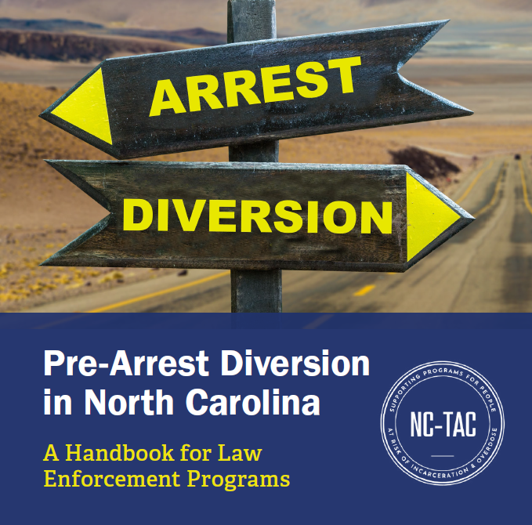
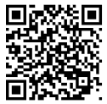
NEW Pre-Arrest Diversion Handbook
Guide to designing and implementing a pre-arrest diversion program
Developed by NC-TAC based on
Real world experience in NC
Findings from evaluation of NC programs

Slide 50
Key Sections
Pre-Arrest Diversion Handbook for NC
Background: Fundamentals of pre-arrest diversion
Aligning with Partners: Suggested collaborators, key talking points
Designing the Program: Eligibility, referrals & intakes, case coordination, connection to services
Preparing for Launch: Developing policies & procedures, staffing, training officers, community education
Overseeing and Implementing the Program: Conducting staff meetings, tracking participant progress, case management

Slide 51
Key Sections (cont.)
Pre-Arrest Diversion Handbook for NC
Learning from the Field: Examples of common scenarios
Improving Quality and Measuring Success: Documenting & reporting on program operations, outcomes, successes, and areas for improvement
Funding Programs: Possible funding sources for diversion programs
FAQs
Key Takeaways
Sample Policies and Forms

Slide 52

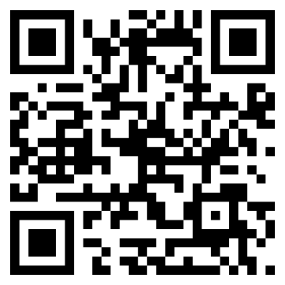
Check out the National LEAD Support Bureau
Leadbureau.org
Notes:
Great place for resources on developing a LEAD program
Also links to studies and evaluations looking at program outcomes, cost effectiveness, etc.

Slide 53
Reach out to NC-TAC
Request Technical Assistance &
Find Resources
Email:
nctac@unc.edu
Website: go.unc.edu/nctac

Slide 54
Contact Information
Lars Paul lars@nchrc.org
Andrea Des Marais opioidsettlement@ncacc.org
NC-TAC nctac@unc.edu
go.unc.edu/nctac

Slide 55
Questions?

Slide 56
Looking ahead…
Ashley Wurth, Lead, Services for Justice-Involved Individuals,
North Carolina Department of Health and Human Services, Division of Mental Health, Developmental Disabilities and Substance Use Services
Thank you to everyone who joined us today!

Slide 57
Next OPDAAC meeting will be held on June 12th, 2026 from 9:30AM-12:00PM.
  June, September and December meetings will be 100% virtual.
  More information will about the topic and how to register will announced in the future.
The agenda, slides, and meeting recording for todays meeting will be posted on the OPDAAC website in the coming weeks.
  You can also find information, materials and recordings for past meetings.
For more information regarding OPDAAC, questions or concerns, please send an email to OPDAAC@dhhs.nc.gov.

