Slide 1

NC Medicaid
H.R. 1 Overview

Slide 2
Medicaid strengthens North Carolina
Medicaid provides affordable health coverage and access to doctors and prescriptions for more than 3 million children, older adults, people with disabilities and working North Carolinians – that is 1 in 4 North Carolinians.
    Rural communities rely on Medicaid. In many rural counties, Medicaid provides health coverage to more than half of the population. And Medicaid is a major source of funding for rural hospitals.
    Medicaid supports North Carolina’s businesses and workforce and brings billions of dollars into the state's economy.
    Medicaid makes people healthier. North Carolinians newly covered by Medicaid under expansion have filled more than 5 million prescriptions for conditions like heart disease, diabetes, seizures and other illnesses.
    Since Medicaid expanded, there has been a 29% decrease in overdoses.

Slide 3
Federal law is changing who can get Medicaid health coverage
Despite Medicaid’s positive impact on people, communities and our State, changes are coming that will make it harder for some people to be covered.
  In 2025, Congress passed and the President signed a law that makes many changes to Medicaid.
  This law is referred to as the House Reconciliation Bill, H.R. 1, or the One Big Beautiful Bill.
  This presentation focuses on four big changes that will soon take place for people who have or are applying for health coverage through Medicaid.
    Many non-U.S. citizens will no longer be able to have Medicaid coverage.
    Most adults ages 19 through 64 will have to show they participated in an approved activity, like work, school or volunteering to be able to have health coverage through Medicaid.
    Most adults ages 19 through 64 will have to recertify (renew) their Medicaid every 6 months. That is a change from the current every 12 months.
    Changes to the length of retroactive coverage for all applying for Medicaid

Slide 4

Our commitment to you
The North Carolina Department of Health and Human Services and NC Medicaid are committed to getting you the information you need to know.
We are focused on helping people who are still eligible for Medicaid or applying for Medicaid understand the new federal rules
to keep or get health coverage through Medicaid.
We do not have all the answers from the federal government. We will tell you what we know, and what we don’t know. And we will update information when we have it.

Slide 5

New Federal Rules for Non-citizens

Slide 6
Non-citizens are the first impacted
Beginning October 1, 2026, federal law will only allow the following non-citizens to have health coverage through Medicaid:
Lawful permanent residents (people with a green card)
Children up to age 19 and women who are pregnant or within 12 months postpartum (after birth), who are lawfully residing in the United States but do not have permanent immigration status
People with Cuban or Haitian entrant status
Citizens of the Freely Associated States (Micronesia, Marshall Islands or Palau) living in the U.S.

Slide 7

What does it mean if you are no longer eligible for Medicaid?
Starting October 1, 2026, if you are a
non-citizen who is no longer eligible for Medicaid you:
Will lose Medicaid coverage, including the ability to go to the doctor, get prescriptions or receive mental health, dental and other services.
May qualify for Emergency Medicaid if the medical need is determined to meet the emergency criteria and the person meets all other factors of eligibility for Medicaid.

Slide 8

What can you do if you lose Medicaid?
Schedule and attend any needed doctor, dental or mental health appointments, and refill eligible prescriptions before October 1.
If your status has changed and you are now a lawful permanent resident (green card) holder, make sure your local Department of Social Services (DSS) has the correct information.
You can also get basic health care services at federally qualified health centers, rural health clinics and free and charitable clinics. Costs vary based on income. Learn more at ncdhhs.gov/divisions/office-rural-health/safety-net-resources​

Slide 9
New Federal Requirements for Most Adults Ages
19 through 64

Slide 10
Many adults will have new requirements
H.R. 1 OVERVIEW
Beginning January 1, 2027, most adults who have or apply for health
coverage through Medicaid will need to work or participate in approved activities.
These rules apply to adults who are ages 19 through 64 who:
Do not have a disability
Are not pregnant or eligible for postpartum coverage (12 months after a pregnancy ends)
Are not a parent, guardian, caretaker relative or family caregiver of a dependent child under age 14 or a person with a disability
Do not qualify for an exception or exclusion

Slide 11
Exceptions
H.R. 1 OVERVIEW
Exceptions include:
Children up to age 19
People who qualify for Medicare
People who get Supplemental Security Income (SSI) or Social Security Disability Insurance or (SSDI)
People who were incarcerated (in jail or prison) at some time during the last 3 months

Slide 12
Exclusions
H.R. 1 OVERVIEW
Excluded individuals are not subject to work requirements and are
evaluated in month of application. This includes:
“Medically frail” – A person with special medical needs that significantly impact their
ability to comply with the work and community engagement requirement, including:
  Blind and Disabled​
  Have a Substance Use Disorder​
  Have a Disabling Mental Disorder
  Have a Serious or Complex Medical Condition​​
Participants in a drug addiction or alcohol treatment and rehabilitation program
Parents, guardians, caretaker relatives or family caregivers of a dependent child under age 14 or a person with a disability
  Have a physical, intellectual or developmental disability that impairs their ability to perform 1 or more activities of daily living​

Slide 13
Exclusions Continued
H.R. 1 OVERVIEW
• Veterans with a total disability rating (100%)
• Members of a household receiving Supplemental Nutrition Assistance
Program (SNAP) and not exempt from SNAP work requirements
• People who already meet the work rules for Temporary Assistance for Needy Families (TANF)
American Indians, Alaska Natives or other members eligible for Indian Health Services (IHS)
Former foster care youth under age 26 and those currently in foster care
• Inmates of a public institution (prison or jail)
• Pregnant or eligible for postpartum coverage (12 months after a pregnancy ends)

Slide 14
Work and Community Engagement Requirements
H.R. 1 OVERVIEW
To have health coverage through Medicaid, adults ages 19 through 64
who do not meet an exception or an exclusion, must:
Work at a paid job, in-kind work or participate in a work training program
Volunteer in the community
Attend school at least half-time (usually 6 credit hours)
Have a monthly income that is at least $580 (can include money from other people in your household, such as your husband or wife)
Be a seasonal worker whose average monthly income for the last 6 months is at least $580 (equal to the federal minimum wage)
These activities can be combined. They must add up to 80 hours for the month. To find out if an activity meets the requirements, contact your local Department of Social Services.

Slide 15
What counts as work?
H.R. 1 OVERVIEW
Work and Community Engagement Requirements
In addition to a paid job, the law allows:
Job Search. A supervised job search, a structured employment program where people look for jobs with support from a counselor or job search training. Job search activities conducted to meet unemployment insurance requirements also count. These hours must be less than half of the required 80 hours each month.
In-kind work. This is work where you are paid with something other than money. For example, a property manager who receives free rent in exchange for building duties can meet the 80-hour requirement.
Unpaid work. This is different from community service as it can benefit a private company or an individual. This includes internships, a trial work period and unpaid caregiving hours of a family caregiver, who does not meet the exclusion of parents, guardians, caretaker relatives or family caregivers of a dependent child under age 14 or of a person with a disability.

Slide 16
What counts as volunteering?
H.R. 1 OVERVIEW
Work and Community Engagement Requirements
The activity must be completed through a structured program under a
non-profit or public organization for the direct benefit of the community. This can be voluntary or court ordered.
What counts as education?
This includes college, career and technical education (CTE), high school and GED programs.
Enrollment is determined by the institution and continues through academic breaks.
  For example, an individual who graduates from high school in May, enrolls in community college mid-August and applies for Medicaid in July will satisfy the requirements because their status before their break was full-time high school enrollment and within the normal rhythm of school schedules.

Slide 17
How many hours do I need to work or take part in an approved activity?
H.R. 1 OVERVIEW
Work and Community Engagement Requirements
When you apply for Medicaid:
Starting January 1, 2027, adults ages 19 through 64 that apply for Medicaid may have to show proof they worked, went to school or volunteered for 80 hours each month of the 3 months before they applied for Medicaid.
For example, if you apply for Medicaid coverage on April 1, 2027, and you do not have an exception or exclusion, you must show that you completed 80 hours of approved activities in the months of January, February and March. If you do not show activities for all 3 months, you may not get health coverage through Medicaid.

Slide 18
You will need to renew your Medicaid more often
H.R. 1 OVERVIEW
Work and Community Engagement Requirements
When you renew your Medicaid
Most adults ages 19 through 64 will need to recertify (renew) their Medicaid every 6 months instead of once a year – even if they meet an exception or exclusion.
When you renew your Medicaid, you may have to show proof you worked, went to school or volunteered for 80 hours for 3 of the 6 months of your certification period.
For example, if Mary’s certification period is from January to June, and she does not have an exception or exclusion, she must report her work, school or volunteer activities for 3 of those months to keep her Medicaid benefits for her next 6-month certification period. The months do not have to be in a row, she could report her 80 hours for the months of January, March and May
NOTE: This does not apply to American Indians, Alaska Natives or other members eligible for Indian Health Services (HIS)

Slide 19
What do you need to do?
H.R. 1 OVERVIEW
Work and Community Engagement Requirements
If you are an adult ages 19 through 64:
Look at the NC Medicaid website to see if you meet an exception or exclusion.
If you do, you do not need to work, go to school or volunteer.
If you do not qualify for an exception or exclusion, save your pay stubs, school records and volunteer logs. You may need to share them with your local Department of Social Services.
Make sure your contact information is correct with your local Department of Social Services. If they need information, they will mail you a letter to let you know, so it is important to have your correct address on file!

Slide 20
Keep your coverage
H.R. 1 OVERVIEW
Work and Community Engagement Requirements
If you do not meet an exception or exclusion from work and community engagement and you do not complete the 80 hours required for work, school or volunteer activities each month, you may lose full health coverage through Medicaid.

Slide 21
New Federal Rules for Retroactive Coverage

Slide 22
When does Medicaid coverage begin?
The date Medicaid coverage begins depends on when you apply. Medicaid may be able to pay medical bills for care provided before you applied for Medicaid. This is called “retroactive coverage.”
Beginning in 2027, Medicaid will cover eligible care you received up to 1 month before you applied.
Most adults ages 19 through 64 who do not have a disability: Starting January 1, 2027, Medicaid will cover up to 1 month of health care costs incurred before you submit your application.* This used to be 3 months.
  For example, if you apply in March 2027 and you are eligible, Medicaid can pay bills for covered services from February 2027.
Children, adults 65 and older, and people with a disability: Starting January 1, 2027, Medicaid will cover up to 2 months of health care costs incurred before you submit your application.* This used to be 3 months.
  For example, if you apply in April 2027 and you are eligible, Medicaid can pay bills for covered services from February and March.
  * If eligible for Medicaid that month.

Slide 23
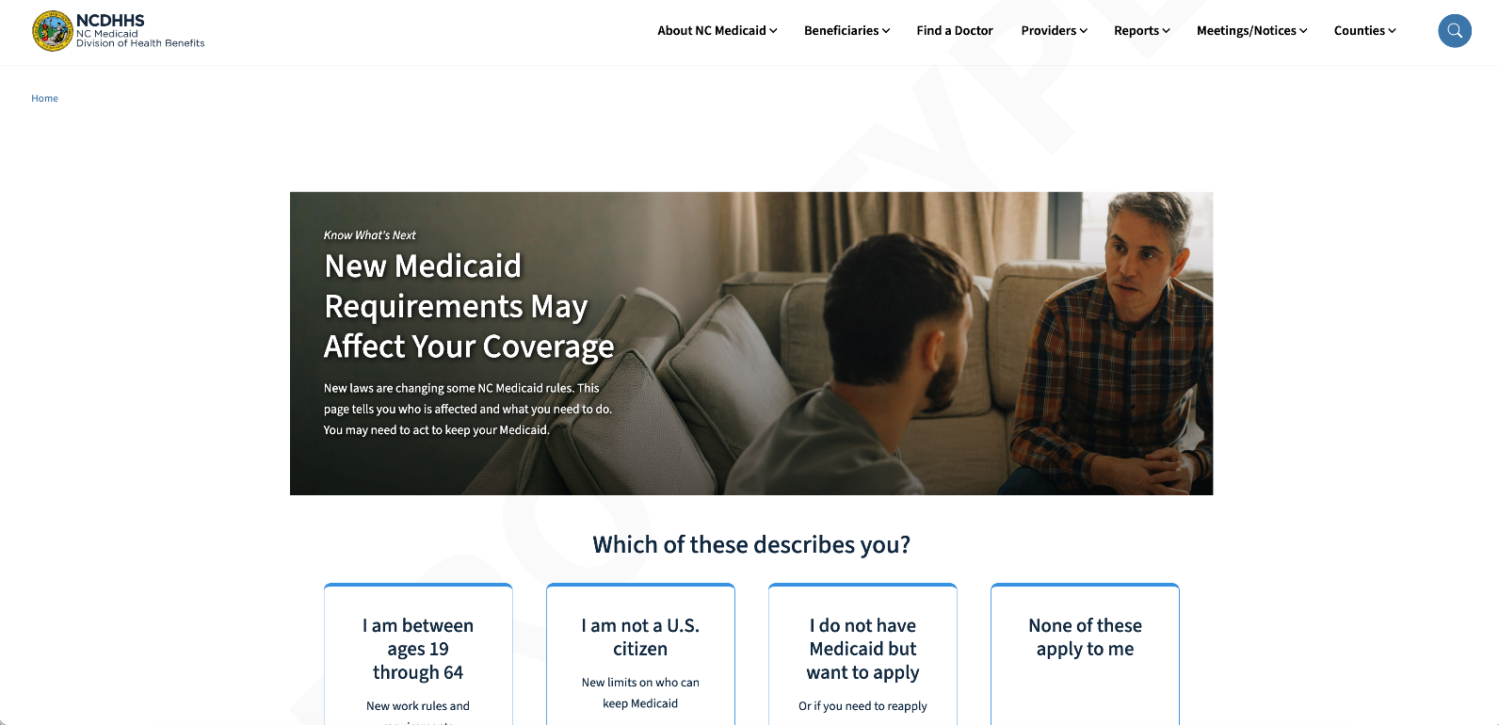
Additional Resources
Visit medicaid.nc.gov/changes.
Available in English and Spanish (medicaid.nc.gov/cambios)
Will be updated regularly with additional information
Note: Information may change with the Centers for Medicare & Medicaid final rule.

