Slide 1


MHBG Council Meeting
DMHDDSUS Updates
Kelly Crosbie, MSW, LCSW
Director
NC DHHS Division of Mental Health,
Developmental Disabilities, and Substance Use Services
August 2, 2024

Slide 2
DMHDDSUS Updates & Announcements
Notes:
URS - UNIFIED REPORTING SYSTEM

Slide 3
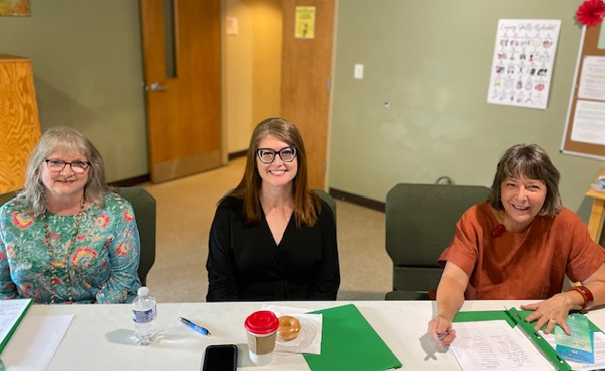

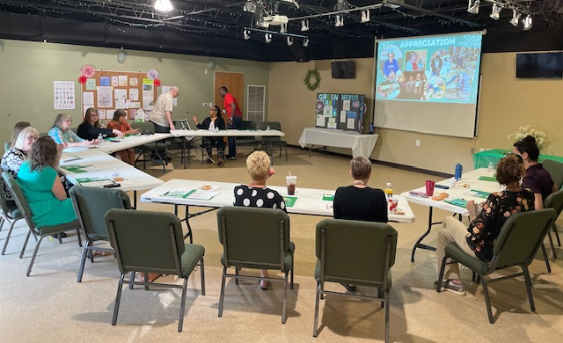
DMHDDSUS visited Green Tree Peer Center on July 31!
930 South Broad Street
Winston Salem, NC
https://www.greentreepeersupport.org/

Slide 4


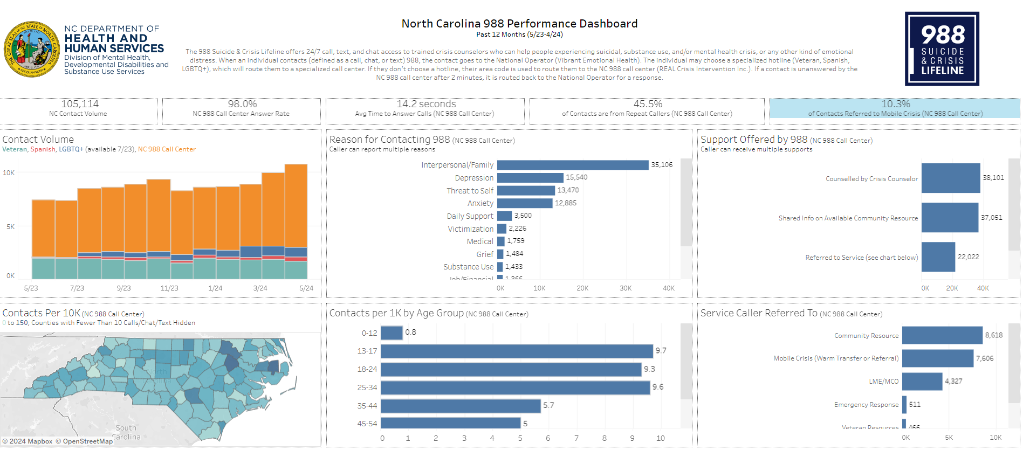
DMHDDSUS visited the 988 Center in honor of the 2-Year Anniversary!
Nearly 190,000 callers since July 2022!
Average time to answer calls is 14.2 seconds compared to national average of 33 seconds
98% NC 988 call center answer rate compared to 90% national average
You can access the 988 dashboard on the DMHDDSUS website and the press release on the DHHS website.

Slide 5
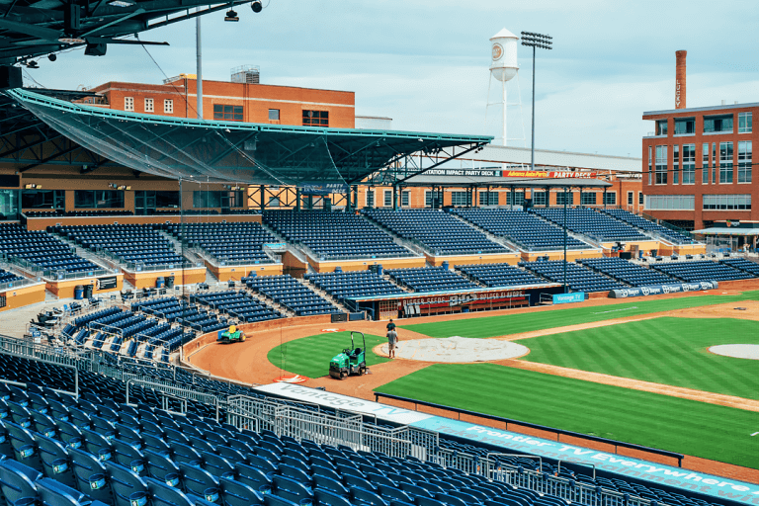

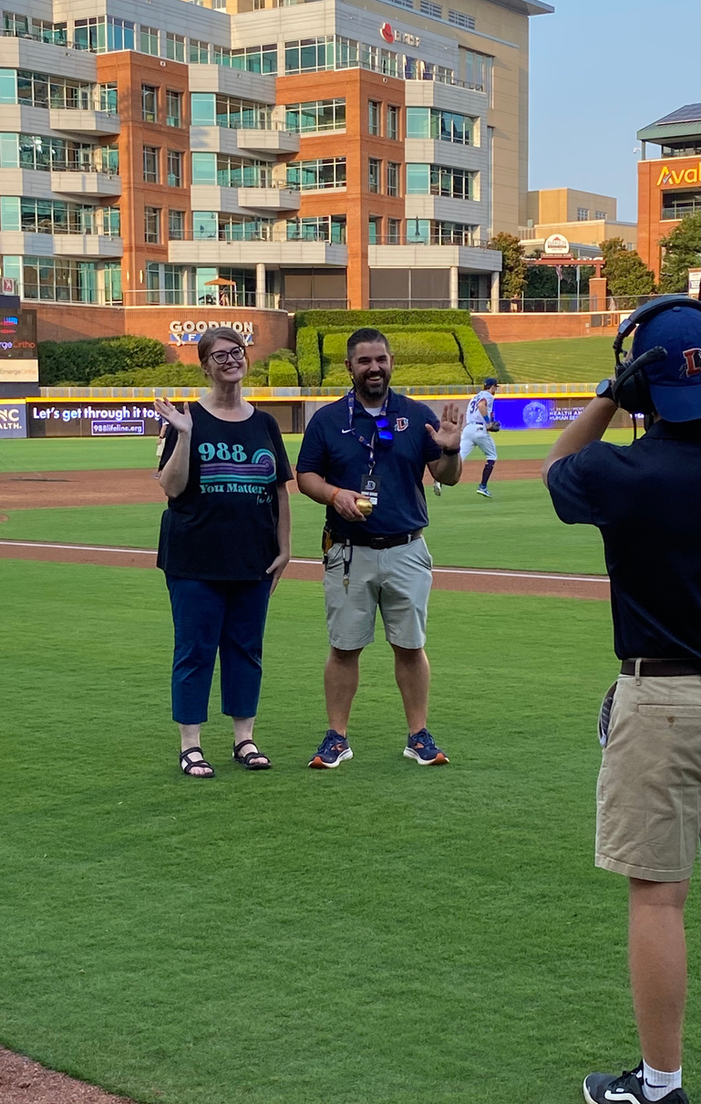

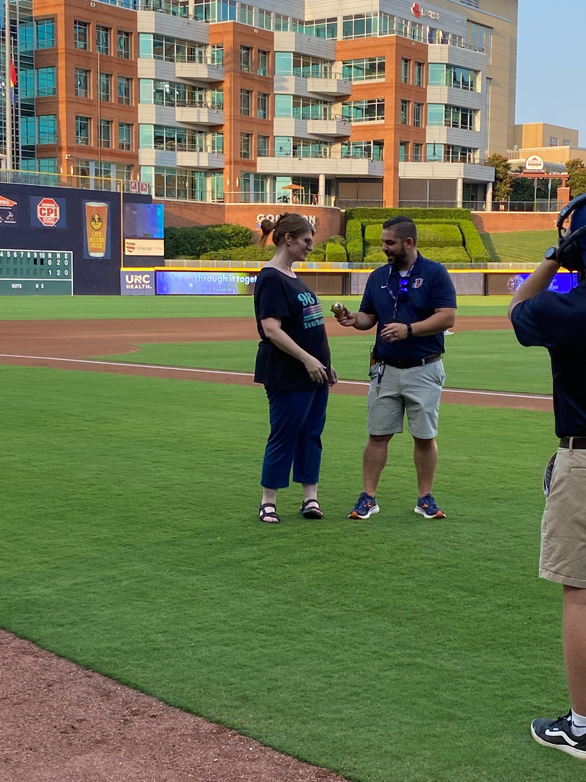
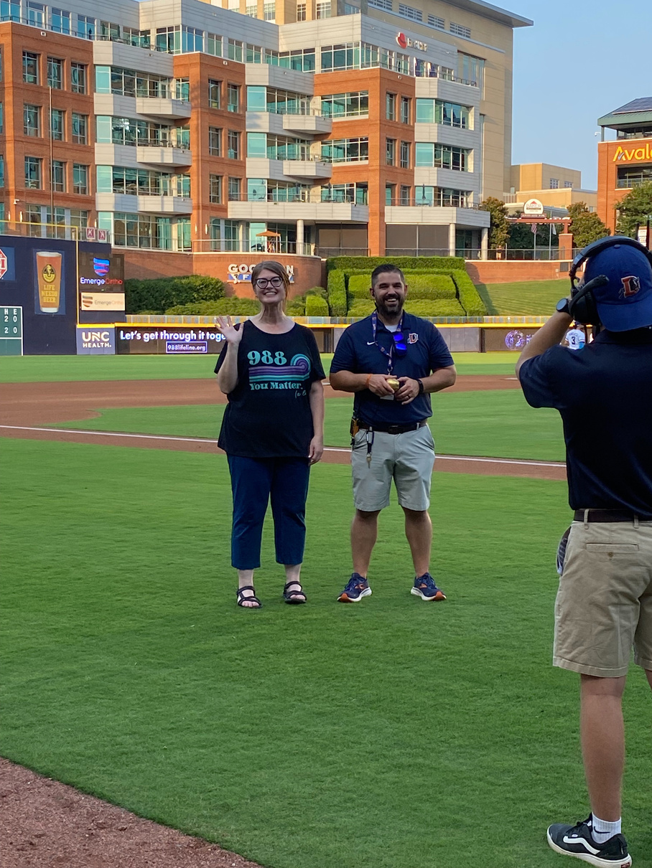
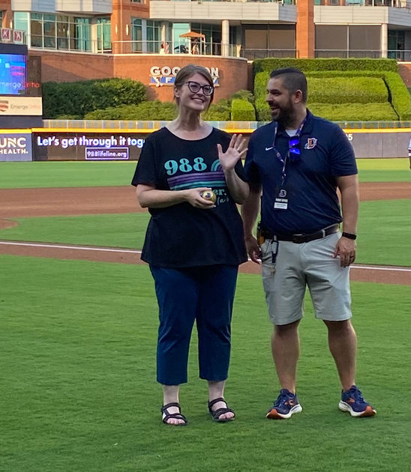

DMHDDSUS received an “honorary ball” at the Durham Bulls Game!

Slide 6



Order Free Mental and Behavioral Health Materials For The 2024-2025 School Year Now
NCDHHS has free bilingual educational print materials from 988 and Open to Care for non-profits, houses of worship, community organizations, NC schools and state and local governments to distribute in their communities.
Sign up today for these flyers, stickers, bookmarks and magnets for the 2024-2025 school year.
Order materials by August 30, 2024 – Materials will be shipped directly to you
To order your materials, please fill out this form: https://share.hsforms.com/1xssMZoOYRFmeWHeyqYJ7ZQ5bzii

Slide 7

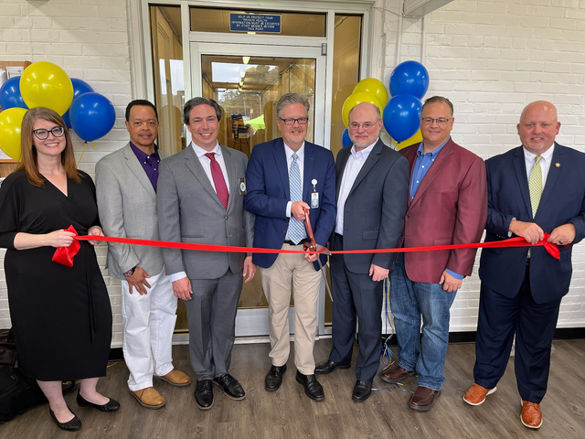

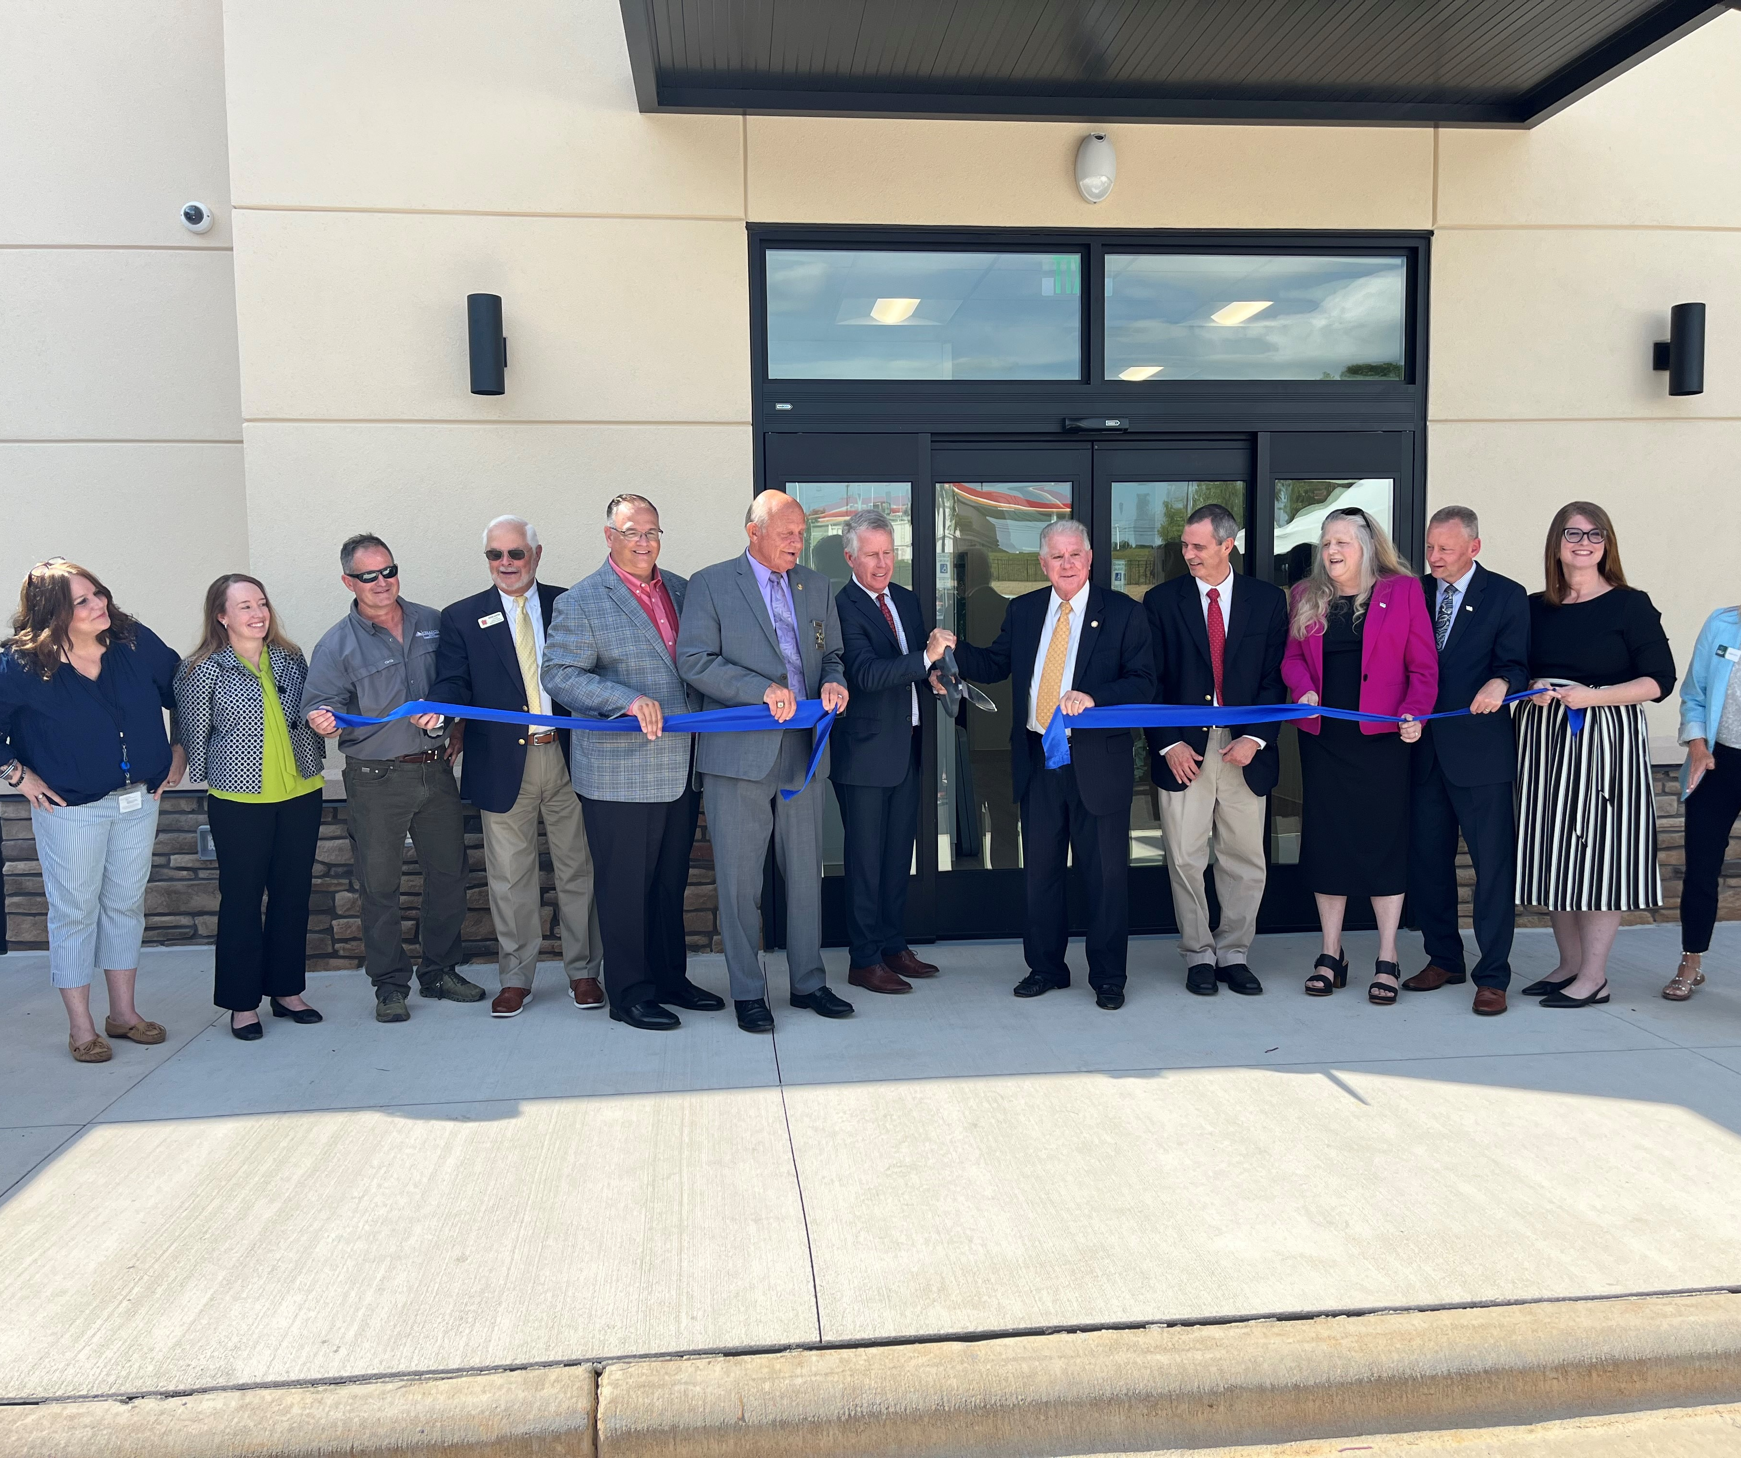


Crisis to Care​ Updates
NCDHHS is investing in behavioral health services that get people the right care, at the right time, in the right setting
$1.5M Investment to Pilot Mobile Crisis and Crisis Co-Responder Services ​
$15M Investment in 9 Behavioral Health Urgent Care Centers (BHUCs)
$22 Million Investment in Community Crisis Centers and Peer Respite in Wake County ​
Ribbon Cutting and Open House for Alamance Behavioral Health Center
Launch of The Statewide Peer Warmline

Slide 8

Request For Funding: Capacity Building for Diversion and Reentry Programs
Date/Time: Thursday, August 29, 2024
9:00-10:00 a.m.
Description: Join DMH/DD/SUS to learn more about an upcoming funding opportunity to support capacity building for diversion and re-entry programs.
This webinar will explore the rationale and vision for improving the lives of North Carolinians through this initiative and provide details on next steps.
Click here to register for the webinar!

Slide 9


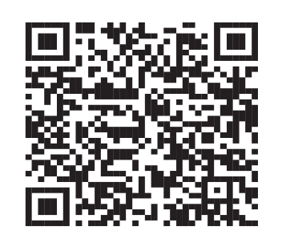

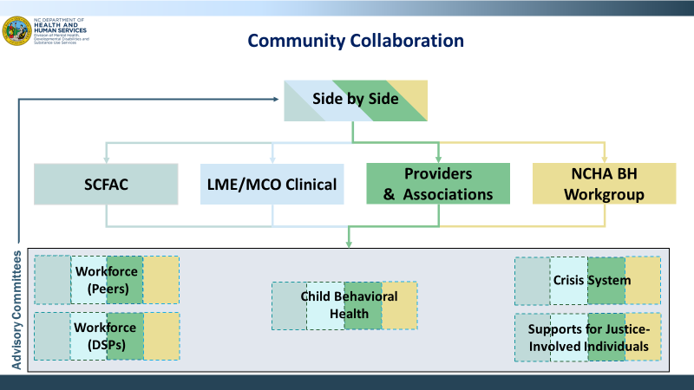
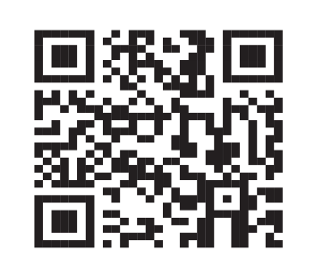

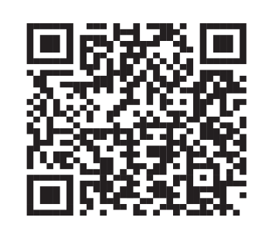

Stay Connected with DMHDDSUS
Join our Side by Side Webinars
Join our Advisory Committees
Join our Mailing List

Slide 10
DMHDDSUS Strategic Plan Updates
Notes:
URS - UNIFIED REPORTING SYSTEM

Slide 11

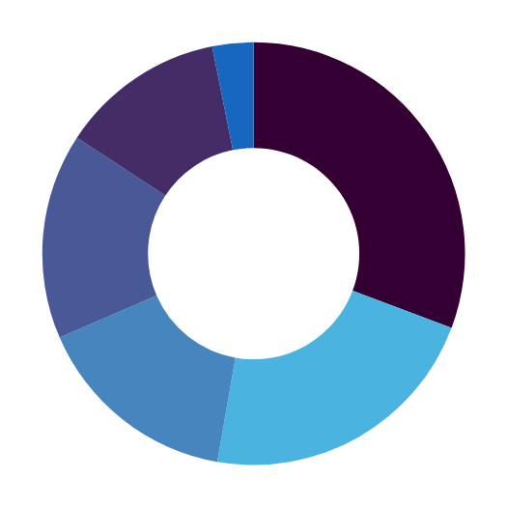




Strategic Plan Public Comment​
Thank you for the 128 comments submitted on the DMH/DD/SUS Strategic Plan for 2024-2029!​
Stakeholder Representation:
Most frequent themes of comments:
LME/MCO Employee
4
State Government Employee
16
Including consumer-directed care in workforce initiatives and grant programs​
Family member or legally responsible person​
39
Reducing ED wait times and improving crisis response times​
Other
20
Increasing wages and benefits for Direct Support Professionals​
Next Steps:
Person with Lived Experience
20
Service Providers
28
  Early August: Issue final Strategic Plan, which will include priorities, goals, measures, and initiatives.​
  Early Fall: Publish Strategic Plan dashboard

Slide 12
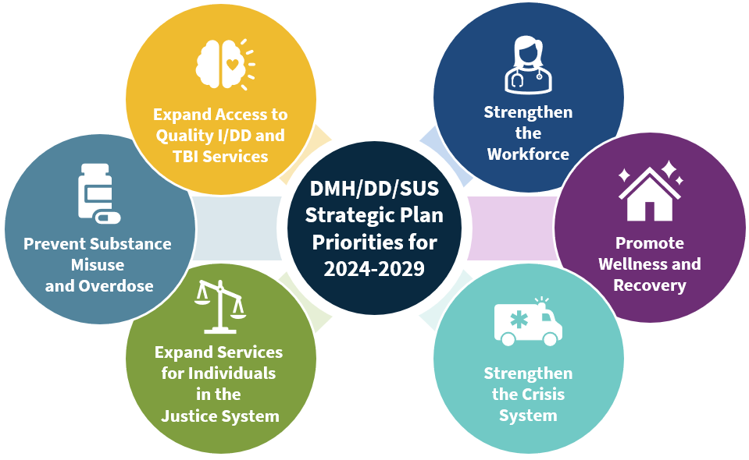
DMHDDSUS’ Populations of Focus & Priority Areas ​
​
Populations of Focus
Intellectual and Developmental Disabilities
Mental Health
Substance Use Disorder
Traumatic Brain
Injury
We will add another priority area for SMI/SED (complex needs)

Slide 13
Strategic Plan Next Steps
Each priority area has Goals, Projects, Measures
Priority Area | Goal | Example Initiative | Example Measure
Expand Access to Quality I/DD and TBI Services | 2.1: Increase I/DD Services. | Inclusion Connects, a cross-divisional initiative to connect individuals with I/DD and their families with community-based services to support their health and wellbeing | Number of individuals connected to community services for I/DD
Strengthen the Crisis System | 5.3: Increase Community Crisis Facility Use. | DMHDDSUS is making investments to stand up new Behavioral Health Urgent Care centers and Facility Based Crisis centers across the state | Number of North Carolina residents within 30min driving time to a 24/7 crisis facility
Expand Services for Individuals in the Justice System | 6.2: Increase Successful Community Re-engagement. | DMHDDSUS will invest in community reentry programs in counties that don’t already have reentry services, which improve reentry services for the justice-involved population by delivering psychiatric and physical health care services along with connections to community supports | Number of counties with at least one reentry program
This table includes a few illustrative examples. The final Strategic Plan will include goals, initiatives, and measures for six total priority areas.

Slide 14
Mental Wellness Projects
Accessible Comms Campaign
Network of Care Directory
Next Day Network
Access Grants (Immigrants/ESL, LQGQTIA+, Faith-Based, Deaf/Hard of Hearing, Aging, Veterans, Care Givers)
CCBHC (Certified Community Behavioral Health Clinic)
NAMI on Campus
Stretch: MH Stigma Campaign, Maternal Mental Health programming
DRAFT FOR DISCUSSION ONLY

Slide 15
SMI/SED Projects
Expansion of Peer Respite/Living Room (across all groups)
Expansion of First Episode Psychosis (FEP) programs
Child Residential Treatment Redesign
Stretch: Expansion of Clubhouse
DRAFT FOR DISCUSSION ONLY

Slide 16
IDD/TBI Projects
“Inclusion Connects”
  1915i Access
  Tailored Care Management Engagement
  Innovations Waitlist Monitoring & Outreach
  Community Integrated Employment (CIE)
Expansion of TBI waiver
Stretch: IDD Housing Plan, IDD-MH/Trauma/IPV, IDD Peers
DRAFT FOR DISCUSSION ONLY

Slide 17
SU Prevention, Treatment, Recovery Projects
UNSHAME NC
Marijuana Prevention Campaign
New Naloxone Saturation Plan
MOUD Saturation Plan
Mobile OTP
OBOT & NCPAL
Stretch: Collegiate Harm Reduction, PORT, Recovery Workplaces
DRAFT FOR DISCUSSION ONLY

Slide 18
Crisis Projects
“Crisis to Care”
  BHUC/FBC/MCM/MORES: Expansion, Quality, Financial Model
  988 Expansion
  Peer Line Expansion
  BH SCAN expansion
  START or I/DD expansion
  Co-Responder Models
Stretch: EMPATH Units, Suicide Interventions, IVC modernization
DRAFT FOR DISCUSSION ONLY

Slide 19
Justice Projects
Standard Diversion/Re-entry Care Management (ex. LEAD, TASC)
FACT (Forensic ACT)
Transitional Housing
DAC Education (TBI, IDD)
DAC Care Management Expansion (IDD)
CIT Centralized
JJCBH Team Standardization
MST/EBP Coaching
Court Education
DRAFT FOR DISCUSSION ONLY

Slide 20
Workforce Projects
Certified Peer Support Specialists/CPSS (certification, QP status)
DSP Workforce Plan (certification, rates, incentives)
QP certification /updating rules
Stretch: Licensed Professional Incentives/Engagement
DRAFT FOR DISCUSSION ONLY

