Slide 1
NC Department of Health and Human Services
NC DSS Important Updates on Civil Rights and NVRA Webinar Training for County Social Services
Carlotta Dixon, Title VI/ADA-Civil Rights Administrator
November 16, 2023
Notes:
This training conducted today will be accepted as the annual civil rights training required by USDA and US HHS.

Slide 2
Important Updates Agenda
NC DSS Assurance Statement of Non-Discrimination
Revised Non-Discrimination Statement
New Federal Plan to address Language Barriers
15 Languages meet the threshold statewide
Multilanguage Tagline
Questions

Slide 3
NC DSS Assurance Statement of
Non-Discrimination
DSS-1464
Statement of Assurance of Compliance with
Title VI of Civil Rights Act of 1964
dss-1464-ia.pdf
Notes:
The Assurance Statement and the Civil Rights Title VI/LEP Plan is due every year in August.

Slide 4
Non-Discrimination Statement
In addition to all information materials and sources, and websites, the non-discrimination statement must also be included on forms, public releases, announcements of scheduled services, and all other publications.
IT MAY NOT BE MODIFIED WITHOUT USDA or US HHS APPROVAL.
Notes:
Have version in Spanish as well.

Slide 5
Revised Joint Non-Discrimination Statement between USDA and US HHS
In accordance with federal civil rights laws and U.S. Department of Agriculture (USDA) civil rights regulations and policies, the USDA, its agencies, offices, and employees, and institutions participating in or administering USDA programs are prohibited from discriminating based on race, color, national origin, sex (including gender identity and sexual orientation), religious creed, disability, age, political beliefs, or reprisal or retaliation for prior civil rights activity in any program or activity conducted or funded by USDA. Programs that receive federal financial assistance from the U.S. Department of Health and Human Services (HHS), such as Temporary Assistance for Needy Families (TANF), and programs HHS directly operates are also prohibited from discrimination under federal civil rights laws and HHS regulations.
Persons with disabilities who require alternative means of communication for program information (e.g., Braille, large print, audiotape, American Sign Language), should contact the agency (state or local) where they applied for benefits. Individuals who are deaf, hard of hearing or who have speech disabilities may contact USDA through the Federal Relay Service at (800) 877-8339. Additionally, program information may be made available in languages other than English.

Slide 6
Revised Joint Non-Discrimination Statement between USDA and US HHS (cont.)
CIVIL RIGHTS COMPLAINTS INVOLVING USDA PROGRAMS
USDA provides federal financial assistance for many food security and hunger reduction programs such as the Supplemental Nutrition Assistance Program (SNAP), the Food Distribution Program on Indian Reservations (FDPIR) and others. To file a program complaint of discrimination, complete the Program Discrimination Complaint Form, (AD-3027) found online at: https://www.usda.gov/sites/default/files/documents/ad-3027.pdf, and at any USDA office or write a letter addressed to USDA and provide in the letter all of the information requested in the form. To request a copy of the complaint form, call (866) 632-9992. Submit your completed form or letter to USDA by:
mail: Food and Nutrition Service, USDA
1320 Braddock Place, Room 334, Alexandria, VA 22314; or
fax: (833) 256-1665 or (202) 690-7442; or
phone: (833) 620-1071; or
email: FNSCIVILRIGHTSCOMPLAINTS@usda.gov.
For any other information regarding SNAP issues, persons should either contact the USDA SNAP hotline number at (800) 221-5689, which is also in Spanish, or call the state information/hotline numbers (click the link for a listing of hotline numbers by state); found online at: SNAP hotline.

Slide 7
Revised Joint Non-Discrimination Statement between USDA and US HHS (cont.)
CIVIL RIGHTS COMPLAINTS INVOLVING HHS PROGRAMS
HHS provides federal financial assistance for many programs to enhance health and well-being, including TANF, Head Start, the Low-Income Home Energy Assistance Program (LIHEAP), and others. If you believe that you have been discriminated against because of your race, color, national origin, disability, age, sex (including pregnancy, sexual orientation, and gender identity), or religion in programs or activities that HHS directly operates or to which HHS provides federal financial assistance, you may file a complaint with the Office for Civil Rights (OCR) for yourself or for someone else.
To file a complaint of discrimination for yourself or someone else regarding a program receiving federal financial assistance through HHS, complete the form on line through OCR’s Complaint Portal at https://ocrportal.hhs.gov/ocr/. You may also contact OCR via mail at: Centralized Case Management Operations, U.S. Department of Health and Human Services, 200 Independence Avenue, S.W., Room 509F HHH Bldg., Washington, D.C. 20201; fax: (202) 619-3818; or email: OCRmail@hhs.gov. For faster processing, we encourage you to use the OCR online portal to file complaints rather than filing via mail. Persons who need assistance with filing a civil rights complaint can email OCR at OCRMail@hhs.gov or call OCR toll-free at 1-800-368-1019, TDD 1-800-537-7697. For persons who are deaf, hard of hearing, or have speech difficulties, please dial 7-1-1 to access telecommunications relay services. We also provide alternative formats (such as Braille and large print), auxiliary aids and language assistance services free of charge for filing a complaint.
This institution is an equal opportunity provider.

Slide 8
Non-discrimination Statement
USDA Nondiscrimination Statement
Short versions
This institution is an equal opportunity provider.
Esta institución es un proveedor que ofrece igualdad de oportunidades. (Spanish)
*Can be used in special circumstances only
Translations
Available on the USDA FNS Website and NC DHHS DSS FNS Website

Slide 9

New Federal Plan to address Language Barriers
U.S. Department of Health and Human Services
Office of Civil Rights
Breaking Language Barriers: Biden-Harris Administration Announces New Plan to Address Language Barriers and Strengthen Language Access
The HHS Language Access Plan is a critical step toward making health care and human services accessible to all; it represents a commitment to equal opportunities and improved health care for all Americans.
Today, the U.S. Department of Health and Human Services (HHS) took the next step in working to ensure greater access to the life-saving services that it provides for people with Limited English Proficiency (LEP) and people with disabilities. In releasing the HHS Language Access Plan, HHS joins agencies across the federal government in prioritizing communication in services to the public. Today’s action supports President Biden’s Executive Orders to advance racial equity and support for underserved communities, which aims to improve access to benefits and services across the Administration, including for people with LEP.
“It is 2023 and the fact that kids still have the same experience I had of translating complex medical information for my parents is unacceptable. Children, family members, and others should not be held responsible for translating complicated and emotional information in order for their loved one to access needed care,” said Secretary Xavier Becerra. “Language should never be a barrier to accessing health care and human services. With our updated Plan, we’re representing our unwavering commitment to equity and inclusivity across HHS.”
“The ability to communicate is critical to accessing health and human services and goes beyond the language you speak. Today’s new, strengthened Language Access Plan reaffirms our dedication to breaking down barriers across HHS, promoting inclusivity of communication and making services accessible to everyone, and upholding the principles of equity and justice,” said Office for Civil Rights Director Melanie Fontes Rainer. “We stand by our commitment to enforcing the civil rights of every individual in this country, regardless of their language or disability.”

Slide 10
HHS’s plan goes beyond solely addressing language access to individuals with limited English proficiency, by recognizing the effective communication and accessibility requirements of Sections 504 and 508 of the Rehabilitation Act of 1973 to increase inclusivity of communication for persons with disabilities. Section 504 prohibits discrimination against otherwise qualified individuals on the basis of disability in programs and activities receiving financial assistance from HHS, while Section 508 requires federal agencies to ensure that their information and communication technology, including websites, electronic documents, and software applications, are accessible to individuals with disabilities.
The updated Language Access Plan sets forth practical guidance, best practices, and action steps in order for HHS Operating and Staff Divisions to develop their own, agency-specific language access plans. The plan also calls for agencies to collect data regarding their language access services in order to increase access to their respective programs, activities, and services for persons with limited English proficiency.
The HHS Language Access Plan is the product of the Department-wide Language Access Steering Committee, which is run by the HHS Office for Civil Rights. Every part of HHS is invited to participate on the Steering Committee. HHS relaunched the Language Access Steering Committee last year to bolster language access across the Department.

Slide 11
This plan applies to all components across the Department:
Administration for Community Living (ACL)
Administration on Aging (AoA)
Administration on Intellectual and Developmental Disabilities (AIDD)
Agency for Healthcare Research and Quality (AHRQ)
Agency for Toxic Substances and Disease Registry (ATSDR)
Administration for Strategic Preparedness and Response (ASPR)
Centers for Disease Control and Prevention (CDC)
Centers for Medicare and Medicaid Services (CMS)
Food and Drug Administration (FDA)
Health Resources and Services Administration (HRSA)
Indian Health Service (IHS)
National Institutes of Health (NIH)
Substance Abuse and Mental Health Services Administration (SAMHSA)
Assistant Secretary for Administration (ASA)
Assistant Secretary for Financial Resources (ASFR)
Assistant Secretary for Legislation (ASL)
Assistant Secretary for Planning and Evaluation (ASPE)
Assistant Secretary for Public Affairs (ASPA)
Departmental Appeals Board (DAB)
HHS Chief Information Officer
Intergovernmental External Affairs (IEA)
Office for Civil Rights (OCR)
Office of the Assistant Secretary for Health (OASH)
Office of the General Counsel (OGC)
Office of Global Affairs (OGA)
Office of Inspector General (OIG)
Office of Medicare Hearings and Appeals (OMHA)
Office of the National Coordinator for Health Information Technology (ONC).
The updated Language Access Plan may be found here: https://www.hhs.gov/sites/default/files/language-access-plan-2023.pdf - PDF
The updated Language Access Plan will be available in various languages. These translations are forthcoming and once available they can be found here: hhs.gov/lep.
If you believe that you or another party has been discriminated against on the basis of race, color, national origin, sex, age, or disability, visit the OCR complaint portal to file a complaint online at: https://www.hhs.gov/civil-rights/filing-a-complaint/index.html.

Slide 12
EEOC Releases Updated Language Access Plan
The U.S. Equal Employment Opportunity Commission (EEOC) released an update to its federal agency language access plan today, in accordance with Executive Order 13166, “Improving Access to Services for Persons with Limited English Proficiency.”
The EEOC’s plan provides information on availability of interpretation services in field offices for the public, access to more than 200 languages for callers to our 1-800-669-4000 number, and translation of key agency documents into several languages. It also notes recent updates to the agency’s Spanish language website and availability of critical information about the laws enforced by the EEOC in seven other languages.
“The EEOC is committed to ensuring that individuals with limited English proficiency can access our services and avail themselves of the protections of the civil rights laws,” said EEOC Chair Charlotte A. Burrows. “The updated Language Access Plan in conjunction with the agency’s Strategic Enforcement Plan reaffirm the EEOC’s priority to ensure that vulnerable and underserved communities have meaningful access to our program and activities.”
In November 2022, Attorney General Merrick B. Garland directed federal agencies to revise their language access plans, share best practices and exchange information about language access initiatives and efforts in compliance with Executive Order 13166.
The Justice Department also announced the launch of the Federal Language Access Working Group, a new interagency group to exchange best practices and share language access resources to benefit recipients of federal financial assistance. The EEOC looks forward to joining this important effort as the new plan is implemented.
The EEOC prevents and remedies unlawful employment discrimination and advances equal opportunity for all. More information is available at www.eeoc.gov.

Slide 13
15 Languages meet the threshold statewide
Arabic Chinese
French German
Gujarati Hindi
Hmong Khmer
Korean Lao
Japanese Russian
Spanish Tagalog
Vietnamese
Notes:
Every year, State Programs funded by USDA are required to conduct a Language Analysis. I conducted an assessment on determinations of need for the Limited English Proficient (LEP) population based on a standard of 100 single-language-minority low-income households by county. This assessment was in accordance with the requirements in 7 CFR 272.4(b) and 7 CFR 271.2. I completed a comparative analysis using the following data sources:
Partnership with NC Governor’s Census Liaison, NC State Data Center, North Carolina Office of State Budget and Management, Bob Coats
U.S. Census Bureau B16002, 2017 American Community Survey 1-year Estimates
https://data.census.gov/cedsci/table?q=Language%20Spoken%20at%20Home&tid=ACSDT1Y2019.B16002&hidePreview=true
LEP.Gov Maps
https://www.lep.gov/maps/lma2015/Final
The result of the comparative analysis of data from the above sources concludes that the LEP populations in N.C. by county are:

Slide 14
LEP Population & Data Sources
Department of Justice site: LEP.GOV
http://www.lep.gov/maps/
US Census Data
2020 Census Results
American Community Survey
http://www.census.gov/acs/
Migration Policy Institute’s National Center on Immigrant
Integration Policy
http://www.migrationpolicy.org/

Slide 15
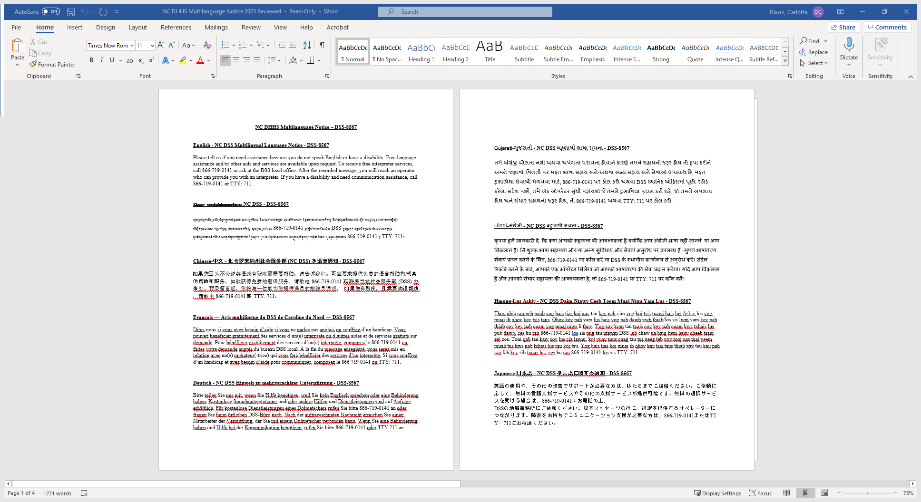
Multilanguage Tagline https://policies.ncdhhs.gov/divisional/social-services/forms/dss-8567-language-notice

Slide 16
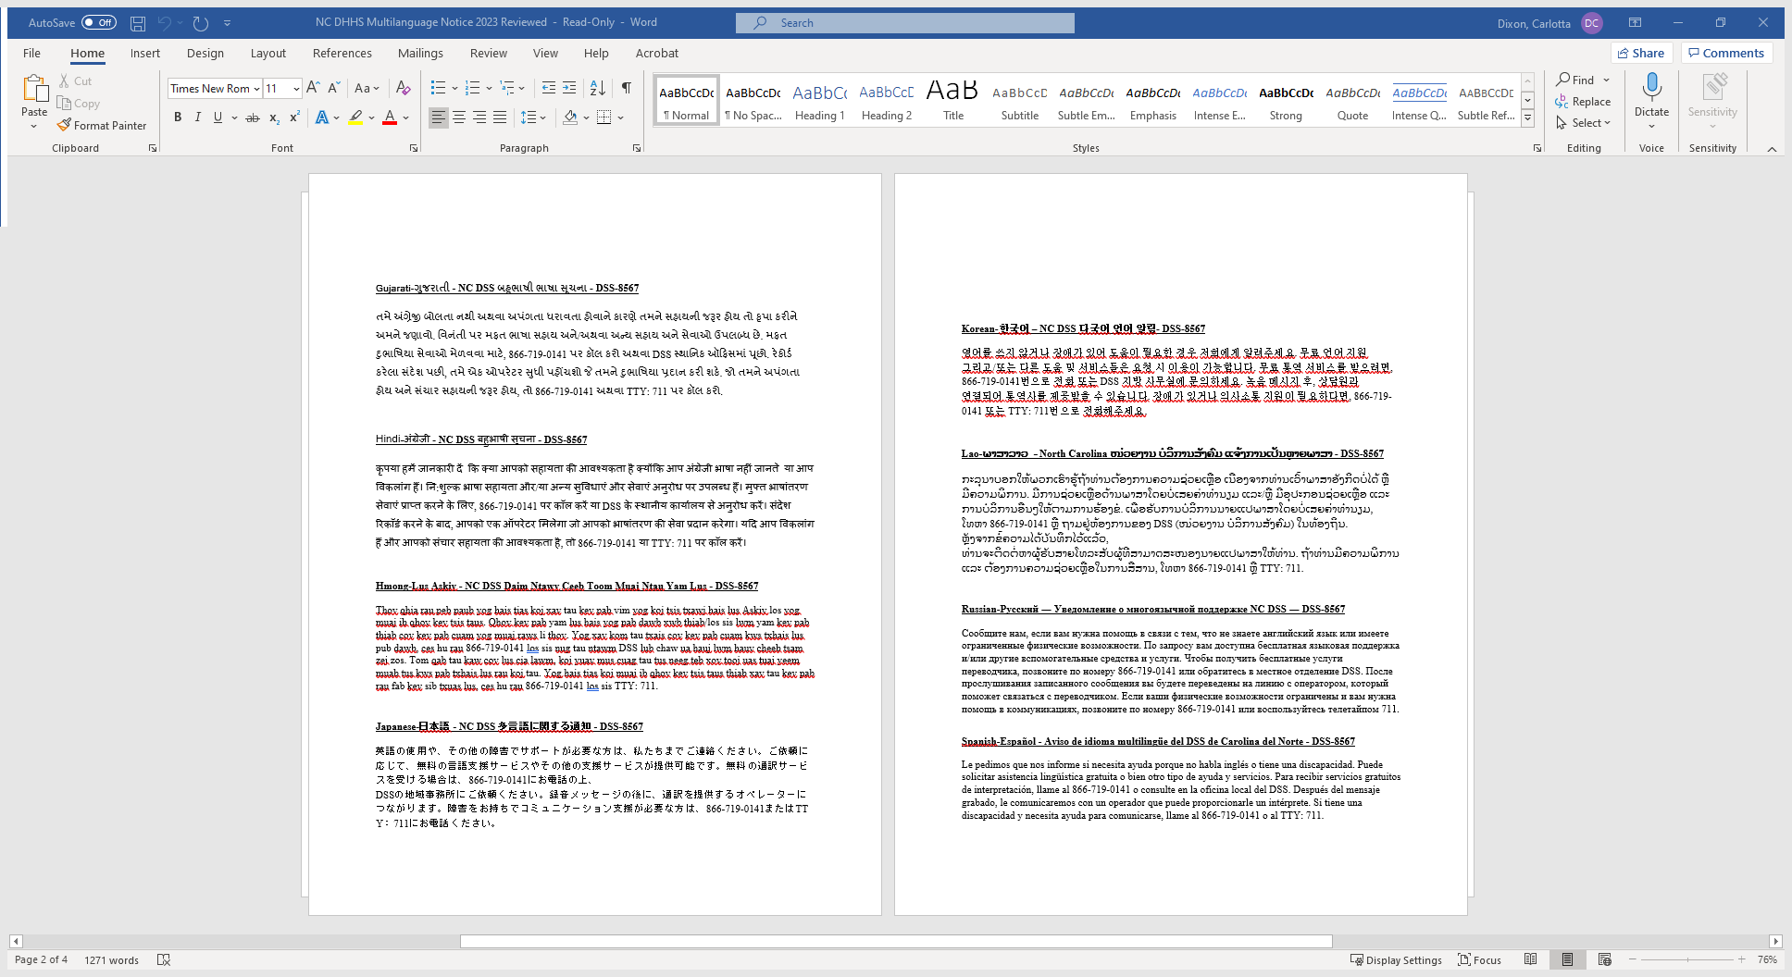
Multilanguage Tagline (cont. d)

Slide 17
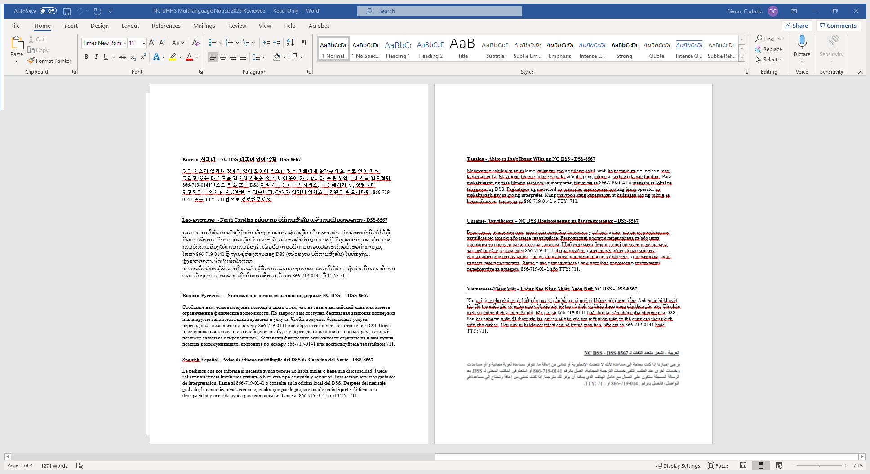
Multilanguage Tagline (cont.d)

Slide 18
NC DSS Civil Rights Webpage
https://www.ncdhhs.gov/divisions/social-services/civil-rights

Slide 19
Questions
Carlotta Dixon, MHS, CPM
Section Chief
State Emergency Response Team(SERT) ESF/RSF 6 Human Services Lead
Title VI/ADA-Civil Rights Administrator
NC Division of Social Services-Program Compliance
North Carolina Department of Health and Human Services
919-825-2478 State Emergency Operations Center (SEOC)
919-527-6421 Office
919-334-1198 Fax
Carlotta.dixon@dhhs.nc.gov
820 South Boylan Avenue, McBryde Building
Raleigh, North Carolina 27603

