Slide 1

NCEM HUMAN SERVICES
Dave Leonard
Human Services Branch Manager

Slide 2
State Sheltering Guides
Shelter Types
TOPICS
Access and Funcitional Needs in Shelters
Partnerships

Slide 3
SHELTER GUIDE
  Provide options and guides for Local, Tribal and State sheltering and mass care
  Consists of Guide and 5 Annexes (listed below)
    Local Sheltering Annex
      Great local info
    State Coordinated-County Hosted Shelter Annex
    State Operated Shelter Annex
    NC-VA Evac Annex
    NC Mass Evacuation and Transportation Annex
  Additional Annexes forthcoming

Slide 4
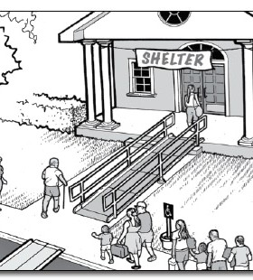
SHELTER GUIDE
Staffing Matrix
Division / Agency Responsibilities
Staff job descriptions
Shelter set-up recommendations (size, ADA concerns,

Slide 5
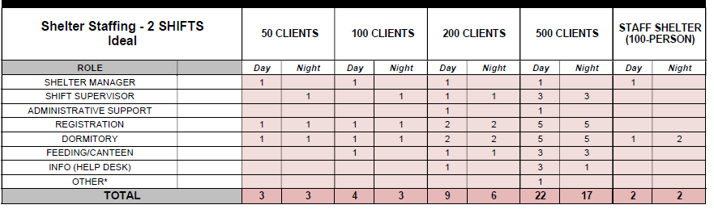
American Red Cross Staffing Matrix

Slide 6

Local Sheltering Annex
Information that can be integrated into Local Shelter Plan
Concepts of Operations
  Feeding, Medical, Health, Mental Health, Child Support, Pet Sheltering, Safety & Security

Slide 7
SHELTER TYPES
Emergency Evacuation Shelter: Immediate refuge during rapid evacuations; typically for no more than 72hrs; 20 sq. ft per person
Short Term Shelter: Sustainable for populations displaced for typically no more than 2 weeks; 40 sq ft per person
Long Term Shelter: Typically, more than 2 weeks; 60-80 sq. ft per person

Slide 8
Shelter needs / resource requests are typically handled at the local level
  Where are your shelter resources stored?
    Cots, blankets, ADA devices, etc.
    GO-KIT
      Registration forms
      Pens, paper, etc.
    Feeding Plan
      Make plan with Local EM prior to opening shelters
Shelter Resources via WebEOC
Resource Requests
  Notify Local EM at County EOC regarding resource request
  Local EM, if unable to fill the request, will send the request via WebEOC to the State Emergency Operation Center (SEOC) to be filled

Slide 9
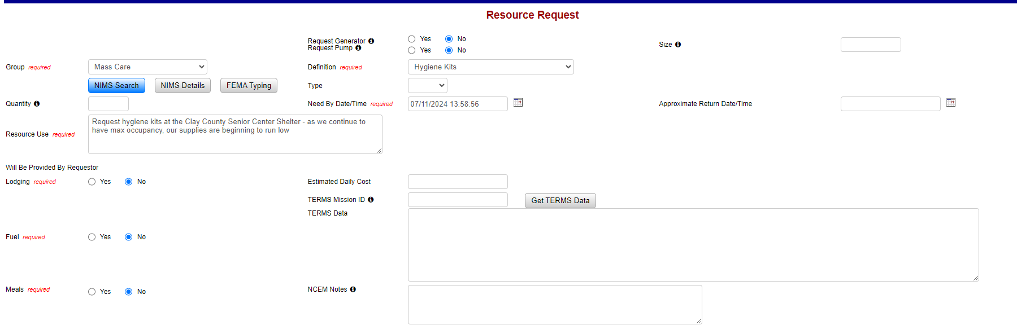
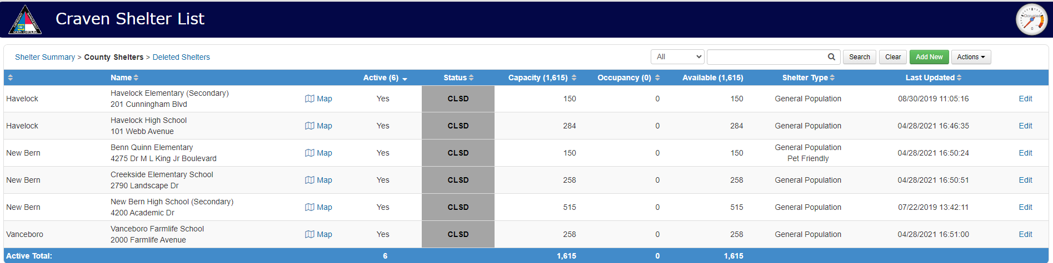
WEBEOC RESOURCE REQUEST

Slide 10
Shelter Status: Report all Shelter status, including numbers in WebEOC on the Shelter Board. Typically done via communications from Shelter to County Emergency Operation Center (EOC)
  How do you communicate with your Local EOC?
    Cell, landline, email, or perhaps Amateur Radio
  Make sure Communications is worked out prior to opening a Shelter
Shelter Status Reports
Official capacity numbers taken at night (typically after 9PM)—American Red Cross FROST Report
Recommended that numbers are reported regularly to Local EOC for their entry into WebEOC as well as for their County Situation Reports that they provide to the SEOC

Slide 11
WEBEOC SHELTER BOARD

Slide 12
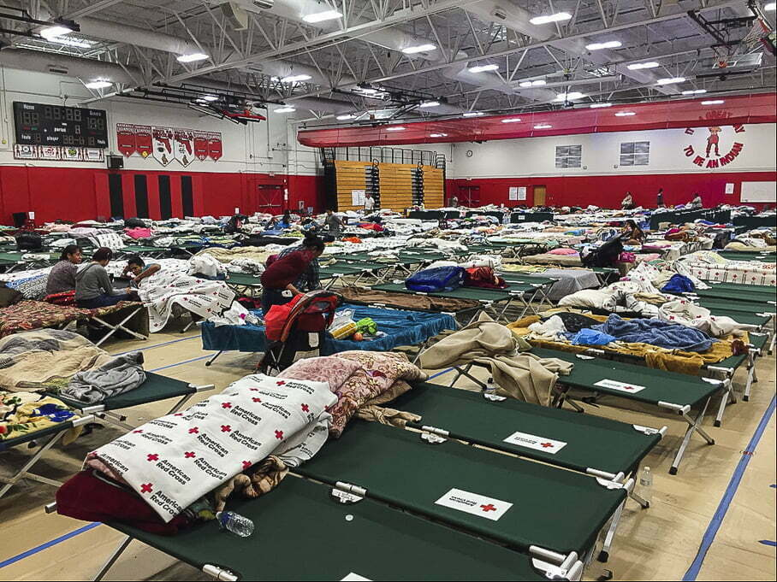
SHELTERING
Shelter Location / Accessibility
Physical Accessibility Considerations
Shelter Services
Communication
  County level and with Clients

Slide 13

Access and Functional Needs-Communications
Ensure that messaging is delivered through a variety of platforms and in languages appropriate to the shelter population.
  Written communication should be simple and available in multiple languages
    Registration forms, shelter signage, posted messages, etc.
Have interpreters available for verbal communication
  Request interpreters through local processes first
https://www.etsy.com/nz/listing/937857530/american-sign- language-asl-digital

Slide 14

Functional Assessment Support Team
------------
FAST
Trained, deployable teams that work in Disaster Service Centers during disasters. They assist with assessments and addressing the needs of people with access and functional needs.
They help shelter managers identify solutions to assist residents in maintaining their independence in the shelter.

Slide 15
STATE SHELTERING OPERATIONS
State Coordinated-County Hosted Shelter
  Local (Host County) shelter operations supporting another county (Risk County)
    Host County operating one of their county shelter for citizens from another County (County to County Mutual Aid / Statewide Mutual Aid
    Risk County—provide assistance (staffing, resources, etc)
  State Support
    Same support by State as if it was a Local Shelter Operation
    Reimbursable expenses

Slide 16
STATE SHELTERING OPERATIONS
State Operated Shelter
  Large Scale Shelter
    Often referred to as a Mega Shelter
    Typically, 500-plus sheltered
  State supported services
    Feeding, Staffing, Wrap-around Services, Security, Medical, etc.

Slide 17
Training and Exercises
Training:
  American Red Cross Classes
    Online, in person
    Reach out to Local EM for upcoming class offerings
Exercises
  Tabletop Exercises
  Full-scale Exercises

Slide 18
Partnerships
Partnership
  Local Emergency Management
  Local DSS
  Local Governmental Support
    County / Municipal Management
    County / Municipal Agencies and Departments
      Parks and Rec, Tax Department, Administration, etc.
  State DSS
  Volunteer Agencies
    American Red Cross, Faith-based Organizations, Salvation Army, etc.
  NC Emergency Management Human Services Branch

Slide 19
QUESTIONS?
David.leonard@ncdps.gov

