Slide 1


Multi-Agency Shelter Transition Team (MASTT)
Multi-Agency Briefing: October 24, 2024
Notes:
(Title Slide Option 1)

Slide 2
Welcome
Introductions
Opening Remarks

Slide 3
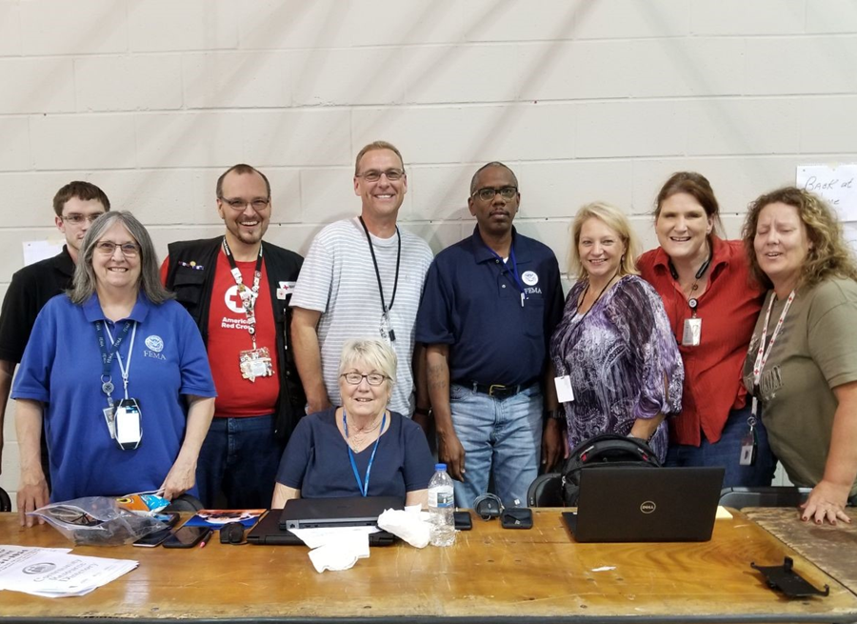
MASST Overview—A Holistic Approach
The Multi-Agency Shelter Transition Team (MASTT) is a collaborative approach to assisting survivors in accessing necessary resources to transition into more sustainable housing/sheltering solutions after a disaster with support from FEMA, HUD, Red Cross, and local organizations that work in the housing/sheltering space.
Representatives from a variety of agencies/organizations can work collaboratively to build a recovery plan that will best address a survivors needs
Helping disaster survivors transition into the next solution…not just emptying shelter facilities.
Hurricane Florence, North Carolina, 2018

Slide 4
Phases of Disaster Housing Operations
Housing operations can be divided into three phases: Sheltering, Interim Housing, and Permanent Housing
Sheltering: serves an immediate need for those persons that are displaced and need some place to stay for the short-term.
  Transitional Housing – Transitional Sheltering Assistance (TSA)/Non-Congregate Sheltering (NCS)
Interim Housing: Interim housing is the intermediate period of housing assistance that covers the gap between sheltering and the return of survivors to permanent housing (Temporary Rentals or Housing Units).
Permanent Housing: Permanent housing refers to the return of disaster survivors to permanent housing as part of their recovery from a disaster.

Slide 5
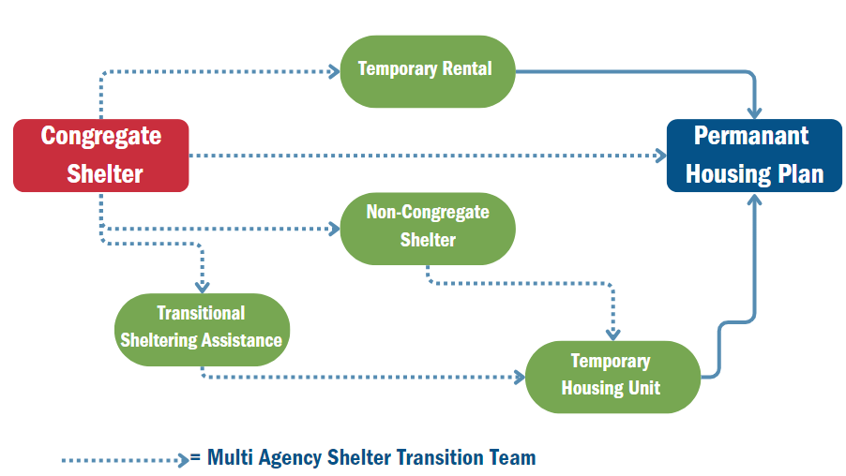
Housing Continuum

Slide 6

What is Shelter Transition?
Transition of survivors from congregate sheltering to interim or other appropriate housing is challenging.
Resolving the complex issues facing survivors requires the active engagement of multiple Local, State, Federal, and Non-Governmental Organizations (NGOs).
Survivors often tell their story multiple times.
The best results come from States/Tribes with a transition plan
Hurricane Harvey, Texas, 2017

Slide 7
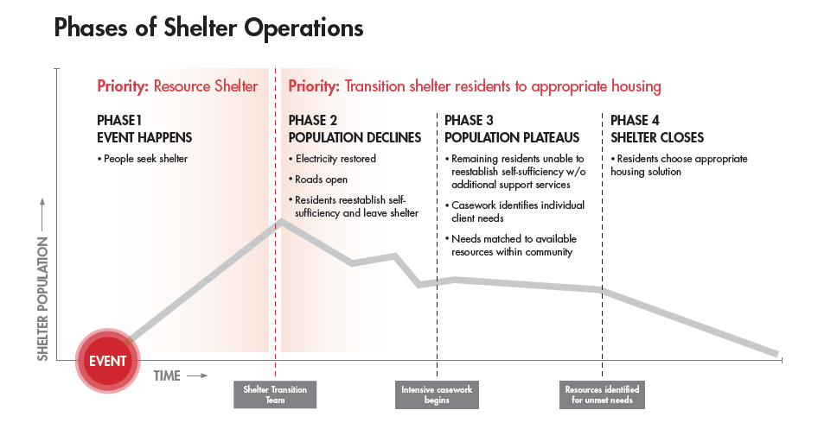
Shelter Transition Model

Slide 8
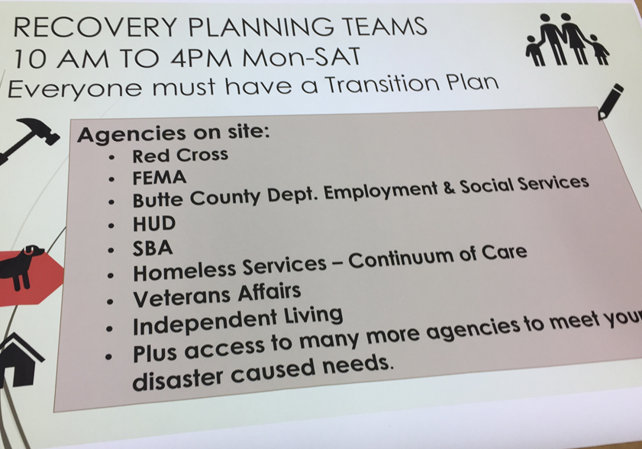
Successful Shelter Transition—Local Jurisdiction
Coordinates the effort
Appoints a POC for shelter transition
Designates, in coordination with partners, a location, date, and time for all stakeholders to convene.
Establishes a strong MASTT
Will also be beneficial if you are transitioning a shelter during a non-declared disaster
Camp Fire, California, 2018

Slide 9



Successful Shelter Transition
Collaborate and coordinate with shelter residents
Identify barriers to the recovery process for the shelter resident
  Transportation; lack of housing availability; financial instability; physical, mental and/or behavioral health disabilities; no family/friends; previously unhoused, etc.
Identify resources and programs that can be provided and coordinated

Slide 10
Barriers to Shelter Transition
Barriers | Symptoms
Economic | Lack of insurance/underinsured Disaster caused economic instability Source of income temporarily/permanently affected
Housing | Shortage of local area housing inventory Housing unit uninhabitable or the repairs not completed Lack of accessible housing
Medical | Community infrastructure will not support individual with AFN, social needs, quality of life, and ongoing medical care Repairs to home require accessibility improvements AFN TSA options limited or not available
Emotional | No family, friends or support system in area Psychological distress, overwhelmed by the disaster event Benefits from social interaction at the shelter
Social | Better quality of life in the shelter Separated from caretaker Home environment does not support household member with functional needs

Slide 11
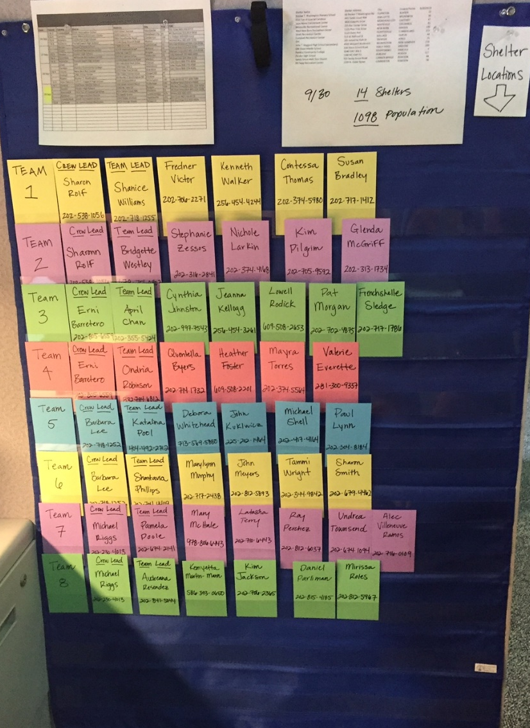
MASTT Implementation and Organization
Managing multi-agency team members
Training
Coordination meetings
Cross County challenges with agency representatives
Team leads
Consistency
Travel time for teams
Reporting

Slide 12
Any Questions?

Slide 13

American Red Cross

Slide 14
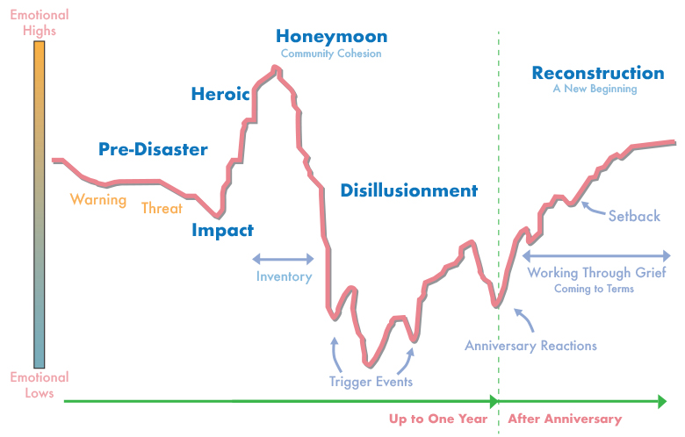
How People React to Disasters
14

Slide 15
American Red Cross’ Role in Sheltering and MASTT
Sheltering Support to NC State-Managed Shelters:
  Dormitory management
  Support for shelter resident feeding
  In collaboration with local and state providers - Provision of Disaster Health, Mental Health and Spiritual Care Services
  Shelter Resident Triage and Casework services

Slide 16
Shelter Resident Transition (SRT) Triage
A point in time assessment of shelter residents
Includes focused questions to understand:
  Disaster-related impacts
  Pre-disaster housing status
  Shelter residents’ existing resources and complicating factors
Results in identification of shelter resident transition needs which supports identification of partners to fulfil those needs

Slide 17
SRT Casework
A service provided to shelter residents to identify their individual resources and understand their transition barriers to help them develop an individualized action plan to more quickly transition from the shelter to a more sustainable living solution.
To accomplish this, three driving concepts are core to SRT:
Shelter residents are not the sum of their barriers
More is done for shelter residents when the community is engaged
An accelerated recovery sets families up for success for what is to come next

Slide 18
SRT Casework Services
Empowerment
Coaching
Advocacy
Information
Resources and referrals
Transition planning
Case conferencing
Needs-based financial assistance

Slide 19
Red Cross Participation on MASTT
Red Cross SRT Caseworkers will serve on the MASTT
There are designated SRT Caseworkers that will serve on the MASTT.
SRT Caseworkers have been supporting shelter residents since shelters opened. They are in a unique position to share additional insights about shelter residents’ needs.

Slide 20
Red Cross Logistics
MASTT Shelter Resident Transition (SRT) Caseworkers will escort shelter residents to the designated MASTT area
Shelter residents with the most complicated barriers will be the first to meet with the MASTT
Caseworkers can provide supplemental information about shelter residents that may not be captured
They will participate on end of day debriefs
Most of the population at Gold’s Gym leaves for the day and returns in the evening. Consideration: schedule MASTT appointments for those shelter residents

Slide 21
Any Questions?

Slide 22

Transition Considerations for Individuals with Disabilities and Access and Functional Needs

Slide 23
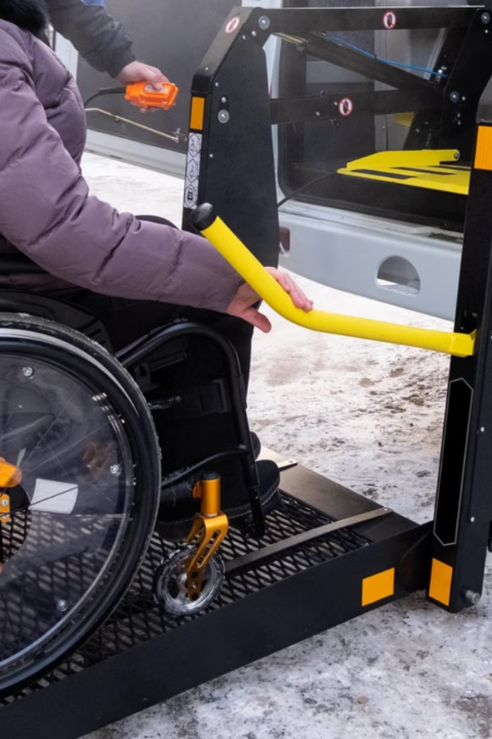
Understanding Disabilities
1
Types of Disabilities
Can include physical, sensory, cognitive, developmental, or mental health disabilities and many are invisible.
2
Diversity
Recognize diversity within disability populations and avoid stereotypes.
3
Intersectionality
Remember that people with disabilities can be part of more than one marginalized population.

Slide 24
Specific Needs in Shelter Settings
Communication Access
Health Maintenance
Accessibility
19% speak Spanish, some Russian speakers. 16 households need communication equipment.
55 households need medication access. 27 require durable medical equipment.
Physical accessibility for mobility impairments. 5 households need bariatric accommodations.

Slide 25

Mental Health and Personal Care
Mental Health Follow-up
91 households require mental health support due to displacement stress.
Personal Care Assistance
8 households need help with daily personal care tasks.
Service Animals
11 households have service animals.

Slide 26

Households with Children
Infants and Toddlers:
School Age Children:
At least 11 households have children under 4 years old.
It is important to determine if any children in the household receive any services or supports for learning, mental health, or developmental disabilities. Do they have an IEP?

Slide 27

Housing Navigation
1
Assess Accessibility Features:
Understand if pre-disaster housing had accessibility features.
2
Determine Current Needs:
Ensure temporary or short-term housing situation meets accessibility needs.
3
Identify Accessible Housing:
Connect with affordable options and improve access when possible.

Slide 28




Supporting Independent Living
Skill Assessment:
Assistive Technology:
Transportation:
Have awareness of an individuals' abilities related to daily living activities, and what services they will need to live nearby.
Connect clients with necessary assistive devices and technology.
Address transportation needs for (55) households requiring medical care access.

Slide 29
Self-Determination in Disaster
Preserving Dignity and Autonomy
Tailored Assistance
Resilience and Recovery
Control
  Individuals retain control over their lives during a crisis.
Decision – Making
  People make choices about their needs and priorities.
People are experts of their own lives and needs.
Empowerment leads to more appropriate, personalized aid.
Involvement
  People participate in decisions affecting their well-being.
Recovery
  Develops sense of control in difficult situations.
Self-determination gives everyone a voice in the process

Slide 30




Effective Communication Strategies
Person-First Language:
Use respectful, empowering language focusing on the person, not the disability.
Diverse Communication Methods:
Employ clear language, visual aids, sign language, and assistive devices.
Active Listening:
Practice empathy and understand the emotional impact of displacement.

Slide 31
Disability Resources
Centers for Independent Living
Non-residential, community-based organizations
to support people with disabilities.
Advocacy and Protection
Ensure that individuals have contact information for Disability Rights NC
Family Support and Information
There are many non-profit organizations that provide disability specific information and family support. Ensure families are reconnected or connected as appropriate.

Slide 32
Any Questions?

Slide 33

North Carolina Centers for Independent Living
Notes:
Advocacy efforts may include the following: • Developing and presenting state-wide reports regarding the needs of people with disabilities to public policy makers (legislators and state agencies) and the governor. • Developing and presenting reports on the successes of the IL Network in the state, to public and private boards, commissions, or other entities interested in Independent Living and/or people with disabilities. • Presenting the SPIL to policymakers and sharing the funding needs to fully implement it. • Representing the needs of people with disabilities on boards and councils. • Providing comment on revisions to or new policies and/or programs that affect services for people with disabilities. • Providing comment at public hearings. • Holding public forums to gather input/feedback from people with disabilities and stakeholders on issues, programs, needs, etc., and sharing a report with the governor and policymakers

Slide 34

What are Centers for Independent Living?
Designed and operated by individuals with disabilities, Centers for Independent Living (CILs) provide independent living services for people with disabilities. At least 51% of their staff are people with disabilities.
CILs are at the core of ACL's independent living programs, which work to support community living and independence for people with disabilities across the nation based on the belief that all people can live with dignity, make their own choices, and participate fully in society.
Centers provide tools, resources, and supports for integrating people with disabilities fully into their communities to promote equal opportunities, self-determination, and respect.

Slide 35
Services every Center provides:
Every CIL facilitates independent living by providing:
Assistance moving from institutions to the community
Support to avoid entering institutional settings
Help for young people transitioning to community living as an adult
Information & referrals to services & practical resources
Training on IL skills, such as personal care, budgeting, household management, & more
Peer counseling, support, & mentoring
Individual & systems advocacy

Slide 36


Centers for Independent Living in Western North Carolina
Asheville Location:
108 Leicester Highway
Asheville, NC 28806
Phone: (828) 298-1977
Counties Served: Buncombe, Henderson, Madison, McDowell, Polk, Rutherford & Transylvania
Sylva Location:
525 Mineral Springs Drive
Sylva, NC 28779
Phone: (828) 631-1167
Counties Served: Cherokee, Clay, Graham, Haywood, Jackson, Macon & Swain
Winston-Salem:
7744 North Point Blvd.
Winston-Salem, NC 27106
Phone: (336) 767-7060
Counties Served: Davidson, Davie, Forsyth, Stokes, Surry & Yadkin
* Durable Medical Equipment available in partnership with NCATP

Slide 37
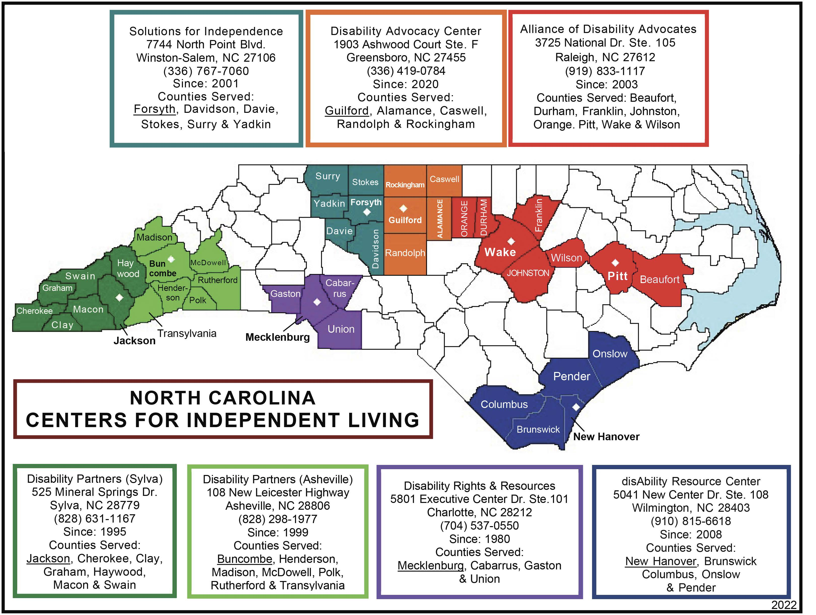
Map of NC Centers for Independent Living
If a person with a disability needs services outside of Western North Carolina, please contact the Center for Independent Living closest to the area they are residing or contact the following:
NC Statewide Independent Living Council Office at 984-480-632

Slide 38
Any Questions?

Slide 39
North Carolina Office of Recovery and Resiliency
October 24, 2024

Slide 40

Overview of NCORR
NCORR
Administers emergency, recovery and resiliency grant programs for local jurisdictions and low- to moderate-income households in North Carolina.

Slide 41
Overview of NCORR
Example NCORR Programs
Regions Innovating for Strong Economies and Environment (RISE)
Resilient Coastal Communities Program (RCCP)
Grants and Loans to Local Government
Rent and Utility Assistance
Housing Stability
Downpayment Assistance
Affordable Housing and Infrastructure
Homeowner Recovery (replace, repair, reimburse, relocate)

Slide 42
NCORR & MASTT Support
NCORR and NCEM are partnering to oversee the North Carolina Disaster Case Management (NC-DCM) Program for Helene, working to:
Develop individualized recovery plans, focusing on housing stability
Connect survivors to necessary services
Ensure case managers are equipped with the tools and training to support long-term recovery
We will work to facilitate connections with agencies and partners to streamline survivor support, ensure accurate tracking of recovery progress and identify unmet needs for continued assistance.

Slide 43
Any Questions?

Slide 44
Housing and Homelessness
Division of Aging
North Carolina Department Health and Human Services (NCDHHS)

Slide 45

Housing Programs in NC DHHS Division of Aging
Targeting and Key Housing Program – State funded housing program for adults with disabilities that are the head of household, with low-income at or below 50% of the Area Median Income for the county of residence who want to live independently in integrated communities of choice.
Emergency Solutions Grant (ESG) – HUD funded housing program for households experiencing homelessness or at risk of becoming homeless.
State Fiscal Recovery Funding (SFRF) – A portion of this funding is administered through the ESG program to provide Rapid Rehousing and Financial Assistance to households experiencing homelessness or at risk of homelessness. The other portion is awarded and implemented through the Area Agencies on Aging (AAAs) for Housing and Home Improvements and Financial Assistance for eligible older adults.

Slide 46
Targeting and Key Rental Assistance Program
Summary: The Targeting Program and Key Rental Assistance expands affordable housing opportunities for low-income individuals with disabilities. The program aims to connect eligible persons to housing that is affordable, decent, permanent, integrated, accessible, and independent.
Eligibility: 18+ years and older with a disability, head of household, low income at or below 50% of the Area Median Income, receiving support services.
Services Available: Permanent Supportive Housing in integrated neighborhoods, key rental assistance, application fee, security deposit and hold fees.
How do participants “get in” to the program? Many kinds of service agencies make referrals, including but not limited to, behavioral health care agencies, county social service departments and regional offices of divisions within NC DHHS. These agencies sign the Targeting Program Agreement to Participate and are committed to providing ongoing support services refer eligible individuals to the Targeting and Key Rental Assistance Program. DHHS will accept direct referrals for people in the shelters in disaster declared counties.

Slide 47
Targeting and Key Rental Assistance Program part 2
WNC Partners | Location (Counties)served | Contact information
Vaya Health | Alamance, Alexander, Alleghany, Ashe, Avery, Buncombe, Caldwell, Caswell, Chatham, Cherokee, Clay, Franklin, Graham, Granville, Haywood, Henderson, Jackson, Macon, Madison, McDowell, Mitchell, Person, Polk, Rockingham, Rowan, Stokes, Swain, Transylvania, Vance, Watauga, Wilkes, Yancey
Partners Health Management | Burke, Cabarrus, Catawba, Cleveland, Davie, Davidson, Forsyth, Gaston, Iredell, Lincoln, Rutherford, Stanly, Surry, Union, Yadkin
Direct Referral to DHHS | Disaster Counties

Slide 48
Emergency Solutions Grant (ESG)
Summary: ESG is a U.S. Housing and Urban Development (HUD) funded program that awards qualified local governments, and non-profit organizations address homelessness and households at risk of becoming homeless. These eligible applicants use ESG funding to improve the number and quality of emergency shelters, provide essential services the shelter residents, rehouse homeless individuals and families, and prevent individuals and families from becoming homeless.
Eligibility: Individuals and families experiencing homelessness or at risk of becoming homeless and has an annual income below 30% of the Median Family Income for the area as determined by HUD.
Services Available: Street Outreach, Emergency Shelter, Rapid Rehousing, Homelessness Prevention, and NC HMIS Data Collection system.
How do participants “get in” to the program? Coordinated Entry is the central access point in each county for those experiencing homelessness or at risk for becoming homeless. Currently, ESG is not accepting new clients.

Slide 49
Coordinated Entry (CE)
WNC Partners | Location (Counties) served | Contact information
Western Piedmont Hospitality House City of Asheville HERE in Jackson County Thrive Inc Gaston-Lincoln-Cleveland Continuum of Care | Alexander, Burke, Caldwell, Catawba, McDowell Alleghany, Ashe, Avery, Mitchell, Watauga, Wilkes, Yancey Buncombe Cherokee, Clay, Graham, Haywood, Jackson, Macon, Madison, Swain Henderson, Polk, Rutherford Transylvania Cleveland, Gaston (Gastonia), Lincoln | 828-485-4297 818-264-1237 828-747-8510 828-278-7433 828-697-1581 211

Slide 50
Area Agencies on Aging – Housing and Home Improvement Programs
Summary: This funding is for home improvement and financial assistance for older adults (60+) to prevent them from moving to congregate or institutionalized settings prematurely. This is being administered by the 13 Area Agencies on Aging.
Eligibility: Vulnerable older adults aged 60 and over.
Services Available: SFRF: Housing and Home Improvement, Housing and Home Improvement Financial Assistance, Housing and Home Improvement Non-client Expenses, and Administrative Costs.
How do participants “get in” to the program? Eligible older adults access services through the Area Agency on Aging (AAAs) covering the county of residents where they live.

Slide 51
SFRF: Area Agencies on Aging
WNC Partners: Area Agencies on Aging: | Location (Counties) served | Contact information
Region A Region B Region C Region D | Southwestern Commission (Cherokee, Clay, Graham, Macon, Haywood, Jackson, Swain) Land of Sky (Buncombe, Madison, Henderson, Transylvania) Foothills Regional Commission (McDowell, Rutherford, Cleveland, Polk) High Country Council of Governments (Ashe, Alleghany, Avery, Mitchell, Watauga, Wilkes, Yancey) | Sarajane Melton, 828-586-1962, Ext. 220 LeeAnne Tucker, 828-251-7436 Laura Lynch, 828-351-2336 Zack Green, 828-265-5434, Ext. 122
Region E Region F Region G | Western Piedmont Council of Governments (Alexander, Burke, Caldwell, Catawba) Centralina Regional Council (Iredell, Lincoln, Gaston, Rowan, Cabarrus, Mecklenburg, Union, Anson, Stanly) Piedmont Triad Regional Council (Surry, Yadkin, Davie, Davidson, Forsyth, Stokes, Rockingham, Caswell, Randolph, Alamance, Guilford, Montgomery) | Tina Miller, 828-485-4212 Linda Miller, 704-348-2712 Adrienne Calhoun, 336-904-0300

Slide 52
North Carolina Housing Opportunities for Persons with AIDS (HOPWA)
Summary: The Housing Opportunities for Persons with AIDS (HOPWA) Program was established by the US Department of Housing and Urban Development (HUD) to address the specific housing needs of persons living with HIV/AIDS and their families. Funding from HUD supports the HOPWA Program in these regions for the purpose of planning, developing, and assuring the delivery of quality housing support services. The primary goal of the HOPWA Program is to increase access to and ensure the provision of safe, decent and affordable housing and housing-related services to persons living with HIV infection and their families in North Carolina and to ensure that all HOPWA recipients living with HIV infection are receiving medical care.
Eligibility: HIV diagnosis, resident of NC, household at or below 80% of the area median income for the county of residence.
Services Available: Tenant Based Rental Assistance (TBRA), Short-Term Rent, Mortgage, and Utility Assistance (STRMU), Supportive Services (SS), Permanent Housing Placement (PHP), and Short-term Facility Based Care (STFBC.)
How do participants “get in” to the program? In North Carolina, the HOPWA Program emphasizes the delivery of a comprehensive continuum of housing support services for persons living with HIV throughout Regional Networks of Care and Prevention. North Carolina has been divided into 10 Regions, each with its own Network of Care and Prevention.

Slide 53
North Carolina HOPWA Providers and Metropolitan Statistical Areas (MSAs')
WNC Partners | Location (Counties) served | Contact information
Western North Carolina AIDS Project (WNCAP) | Avery, Buncombe, Cherokee, Clay, Cleveland, Graham, Haywood, Henderson, Jackson, Macon, Madison, McDowell, Mitchell, Polk, Rutherford, Swain, Transylvania, Yancey | Antonio Del Toro, Executive Director 828 252-7489, Ext. 314 Email: adeltoro@wncap.org
AIDS Leadership-Foothills Area Alliance, Inc. Carolinas Care Partnership-Charlotte MSA | Alexander, Alleghany, Ashe, Burke, Caldwell, Catawba, Watauga, Wilkes Lincoln, Gaston | Jess Jones 828-322-1447, Ext. 223 Email: jjones@alfainfo.org Leorian Grant, Housing Information Specialist, 704-323-0151 Email: leoriang@regionalhousingpartnership.org

Slide 54
Oxford Housing
Summary: OHI is the 501 (c) (3) umbrella organization of a national network of democratically run Level 1 recovery homes for individuals in recovery from substance use and/or opioid use disorder. OHI partners with the NCDPS Correctional Facilities & Detention Centers, LME/MCOs, recovery centers and other partners.
Eligibility: Completion of inpatient treatment, Completion of medical detoxification (if needed), enrolled in a MAT/MAR Program, or Re-entry from the Department of Public Safety. To also include a willingness to work on a personal recovery program such as a mutual aid org, such as twelve-step recovery program or other recognized programs.
Services Available: Recovery Housing for no less than six members per house (non-coed) houses for Men, Women and Women with their Children). For FY25, Equal Expenses Shared (EES) assistance for up to (95) individuals transitioning into an Oxford House from incarceration.
How do participants “get in” to the program? Interested individuals in recovery can self-refer of be referred by an organization, then fill out an online application (oxfordvacancies.com). The applicant would need to call the house where they would like to set-up an interview, show up timely for their interview, be open an honest during the interview process. The house members vote to accept new members, with (80%) yes votes to needed for approval, and if accepted, the new member may then move in immediately.

Slide 55
Oxford Housing
WNC Partners | Location (Counties) served | Contact information
 | Yes, Buncombe and Burke counties have 31 Oxford Houses with 224 available beds. Currently, there are 30 of those houses up running and available. Current vacancies as of 10/07/24 is 11 Women’s Beds, 2 women’s and children’s beds and 8 men’s beds.

Slide 56
Transitions to Community Living (TCL)
Summary: NC entered the Olmstead Settlement in 2012 to demonstrate substantial compliance with the settlement agreement by the end of fiscal year 2025. As a result, TCL ensures that individuals in congregate living arrangements (adult care homes, family care homes, State Psychiatric Hospitals) who can live independently in integrated communities of choice receive appropriate diversion from congregate living settings.
Eligibility: Medicaid or Medicaid Eligible, a US citizen, have a documented Severe and Persistent Mental Illness, and either be: 1) living in a congregate living situation and want to move to the community 2) residing at a state psychiatric hospital and have no or unstable housing 3) be in the community and deemed ‘at risk’ for entry into an Adult Care home or a family care home.
Services Available: Tenancy support services, Assertive Community Treatment Team, Community Support Team, IPS-SE, Peer Support, Tenancy Management Services, Community Inclusion
How do participants “get in” to the program? Local Management Entity/Managed Care Organization (LME/MCO) staff which cover the county where the member’s Medicaid is would be responsible for screening individual and determining eligibility. Members would need to have a Referral, Screening and Verification Process (RSVP) completed and can be done by the member, family member, provider, LME/MCO, basically anyone. Click here to complete a referral for screening.

Slide 57
Transitions to Community Living
WNC Partners | Location (Counties) served | Contact information
Vaya Health | Alamance, Alexander, Alleghany, Ashe, Avery, Buncombe, Caldwell, Caswell, Chatham, Cherokee, Clay, Franklin, Graham, Granville, Haywood, Henderson, Jackson, Macon, Madison, McDowell, Mitchell, Person, Polk, Rockingham, Rowan, Stokes, Swain, Transylvania, Vance, Watauga, Wilkes, Yancey | (800) 962-9003
Partners Health Management | Burke, Cabarrus, Catawba, Cleveland, Davie, Davidson, Forsyth, Gaston, Iredell, Lincoln, Rutherford, Stanly, Surry, Union, Yadkin | (888) 235-4673

Slide 58
VAYA Health Mental Health Supports
Summary: Vaya provides counseling for those that need additional assistance during the transition period.
Eligibility: People in need of mental health support during the transition taking place resulting from the impact of Helene in impacted counties.
Services Available: Counseling, assistance with navigating the transition process, including obtaining documentation, requesting resources, identifying appropriate providers, providing brochures and information on available Mental Health services, and referrals to services and providers for which individuals are eligible.
How do participants “get in” to the program? Vaya staff will enroll eligible individuals at the shelters and provide handouts for those that do not want to enroll immediately.

Slide 59
Vaya Health Mental Health Supports
WNC Partners | Location (Counties) served | Contact information
Vaya Health | Alamance, Alexander, Alleghany, Ashe, Avery, Buncombe, Caldwell, Caswell, Chatham, Cherokee, Clay, Franklin, Graham, Granville, Haywood, Henderson, Jackson, Macon, Madison, McDowell, Mitchell, Person, Polk, Rockingham, Rowan, Stokes, Swain, Transylvania, Vance, Watauga, Wilkes, Yancey | Phone: 828-225-2785 Crisis Line: 800-849-612

Slide 60
Any Questions?

Slide 61
U.S. Department of Housing and Urban Development (HUD) and
HUD SNAPS Disaster Technical Assistance
10/23/2024
Notes:
Brian

Slide 62
HUD & Disaster Technical Assistance Team
Overview
  Provide HUD Special Needs Assistance Programs (SNAPS) Disaster Technical Assistance for people who may not have the resources to move towards housing stability due to a natural or public health disasters.
  Facilitate housing solutions for HUD clients through referrals
  Identify HUD vacancies across Public Housing and Multifamily portfolios
  Coordinate Housing Counseling Agencies and resources
Notes:
Brian

Slide 63
HUD SNAPS Disaster Technical Assistance Team
Who We Are
  A specialized, small, and nimble team within the Special Needs Assistance Programs at HUD, which conducts efforts aimed at people who are vulnerable and/or homeless.
What We Do
  We respond to natural and public health disasters when we know there is a substantial group of people who may not have resources to move toward housing stability.
When We Activate
  When a disaster occurs, and at the request of a Continuum of Care,
  HUD SNAPs, Government, FEMA, and/or Red Cross.
Notes:
Brian

Slide 64
Continums of Care (CoCs)
A Continuum of Care (CoC) is a program that coordinates local agencies and service providers to address homelessness.
CoCs know the local landscape of service providers, and what is available to people experiencing homelessness.
CoCs will not be able to immediately provide permanent housing to all people but can assist with housing solutions for people experiencing homelessness.

Slide 65
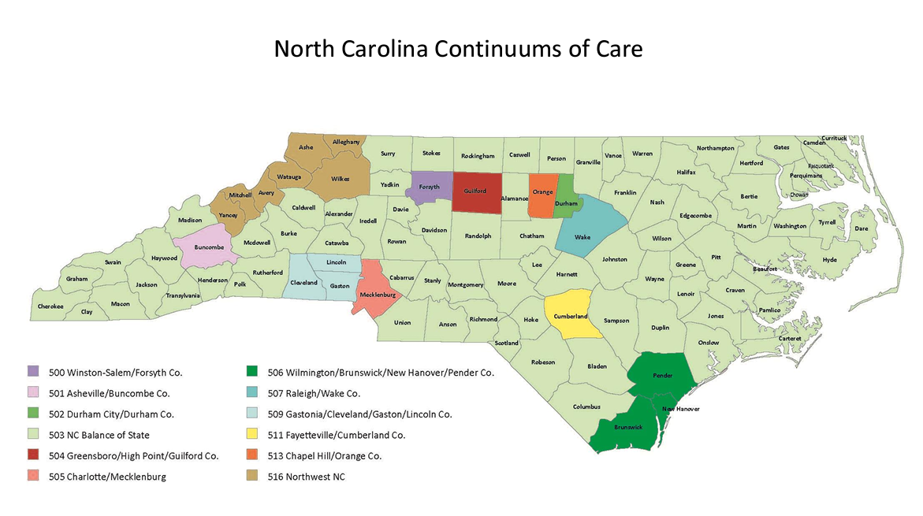

Slide 66
Continums of Care (CoCs)
Disaster Shelters are located within 3 CoCs.
CoC Name | Coverage Area | Website
Northwest North Carolina | Alleghany, Ashe, Avery, Mitchell, Watauga, Wilkes, Yancey | www.hosphouse.org/nwcoc
Asheville/Buncombe | Buncombe | www.ashevillenc.gov/projects/asheville-buncombe-continuum-of-care/
North Carolina Balance of State | Seventy-Nine counties including: Alexander, Burke, Caldwell, Catawba, Clay, Haywood, Henderson, Jackson, Macon, Madison, McDowell, Polk, Rutherford, Swain, Transylvania | www.ncceh.org/bos/

Slide 67
Any Questions?

Slide 69
Back@Home North Carolina Initiative
The Back@Home North Carolina Initiative provides an infrastructure utilized by multiple programs.
Because Back@Home is designed for common activities that stabilize people in housing, the infrastructure can be utilized for programs with distinct purposes and related funding sources.
Each program under the initiative has a defined target population and geographic area. As of 2024, three projects are under the initiative:
  Back@Home-Disaster (Operated Sep 2018 – June 2022, reopening Oct 2024 for Helene)
  Back@Home-CV (Operated August 2020 – September 2022)
  Back@Home-BoS (October 2023 -- present)

Slide 70
Back@Home Recipe for Success
Housing Stabilization Services
Unit Access
and Move-In Financial Assistance
Rent and Utility Financial Assistance
+
+
Infrastructure and Backbone Support

Slide 71
HSS Providers, Service Areas, and Shelters
Housing Stabilization Services (HSS) Provider | Counties | Shelters
HERE in Jackson | Clay, Haywood, Jackson, Madison, Macon | Haywood County Armory
Partners Health Management | Burke, Catawba, Gaston, Cleveland, Lincoln
Thrive | Henderson, Polk, Rutherford, Transylvania | Henderson County Athletics and Activity Center Transylvania Parks & Rec Rutherfordton Presbyterian Church
Vaya Health | Alexander, Alleghany, Ashe, Avery, Buncombe, Caldwell, McDowell, Mitchell, Watauga, Wilkes, Yancey | WNC Ag Center Expo Building AB Technical Community College McDowell County Senior Center Blue Ridge Elementary Golds Gym Kellina Lane Shelter Mitchell County Recovery Center

Slide 72
Back@Home-Helene will support MASTT with households who have no other options.
Households referred to other programs for housing needs
MASTT will assess households
MASTT problem-solving with households for referrals
Households with no referral options
Back@Home
will assess for enrollment and support housing stability plan

Slide 73
Any Questions?

Slide 74

Healthy Opportunities Pilot
Overview

Slide 75

Healthy Opportunities Pilot
Overview

Slide 76

The Healthy Opportunities Pilot
HOP supports a select set of NC Medicaid Managed Care recipients who have needs related to healthy food, safe housing, reliable transportation, and/or personal safety, and healthy relationships. Pilot services are reimbursable through NC Medicaid.

Slide 77
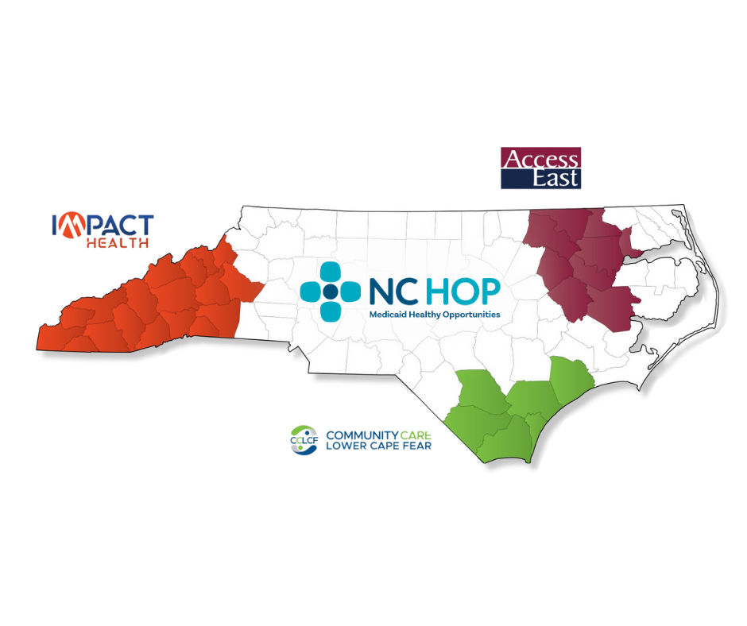
NC Healthy Opportunities Pilot Regions

Slide 78
HOP
Services

Slide 79





HOP Services: provided by 61 human service organizations across 18 counties in WNC
Housing
Food
Transportation
Assistance with finding a home
Financial assistance for moving
Home safety repairs
Accessibility modifications
Healthy meals and food boxes
Fruit/vegetable prescriptions
Classes related to nutrition and diabetes
Vouchers to ride public transportation
Door-to-door rides
Car repairs
Mileage reimbursement
Interpersonal Violence & Toxic Stress
Cross Domain
Services that include multiple facets of the domains such as respite care and linkages to legal assistance for IPV or housing items
Interpersonal violence counseling
Parenting classes
Home visiting services

Slide 80

Connecting People to Care
Enrollment
Referral
Prescreening
Resolution
Jenny has asthma and receives services from a local nonprofit. Jenny shares she recently discovered mold in her home.
Her local nonprofit refers Jenny to Impact Health’s website to complete a pre-screening.
An Impact Health care navigator reviews Jenny’s eligibility criteria and shares her information with her NC Medicaid health plan via NCCARE360.
Jenny’s asthma symptoms improve, and she doesn’t need to see her doctor as frequently.
Jenny’s care manager determines she qualifies for HOP and makes referrals for home repairs and a HEPA home filter.

Slide 81
Eligibility for HOP Services
Individuals with Standard or Tailored Managed Care Plans and:
  Adults who have two or more chronic conditions or multiple visits to the ER each month.
  Women who are pregnant that have conditions that lead to a high-risk pregnancy.
  Children that have one chronic condition or an ACE score of 3 or more.
  Babies that were a NICU graduate or had a low birth weight.

Slide 82


How to Get Pre-Screened
visit wnc-hop.org
call 828-278-9900
visit wnc-hop.org*
call 828-278-9900
*select “Other” and note MASTT when identifying who is completing the form.

Slide 83
Additional Resources
HOP eligibility criteria
impacthealth.org/who-we-serve
HOP organizations and services provided in WNC impacthealth.org/network
HOP services, definitions, eligibility, and impact data ncdhhs.gov/healthy-opportunities-pilots
NC Medicaid eligibility, expansion, and how to apply medicaid.ncdhhs.gov
Ordering HOP promotional material
https://impacthealth.org/hop-outreach-material-request-form/

Slide 84
Any Questions?

Slide 85
EIPD 101: Services for Jobseekers with Disabilities

Slide 87
Learning Objectives
EIPD’s Mission
How Does EIPD Help Jobseekers with Disabilities? ​
Who is Eligible?​
Process and Timeline Overview
Jobseeker Services for Adults​
Jobseeker Services for Youth and Students
How to Refer Someone to EIPD

Slide 88
EIPD’s Mission
Promote competitive integrated employment and independence for people with disabilities through client partnership and community leadership.

Slide 89
How EIPD Helps Jobseekers with Disabilities

Slide 90
How Does EIPD Help Clients?
EIPD helps individuals with disabilities
Prepare for work​
Find a job​
Return to work​
Maintain a job​
Advance in employment​
We focus on abilities and new possibilities​
Exploring interests, abilities and aptitudes​
Establishing an employment goal​
Planning and delivering the services and supports that client needs to achieve goal​
Notes:
EIPD helps people with disabilities achieve their employment goals. If you have a disability and want to find a job, keep working or advance professionally, EIPD can help you chart your path to a career with a future in North Carolina.
EIPD can provide counseling, education, training, job placement assistance, assistive technology and many other services, depending on what you need to meet your goals for competitive integrated employment.

Slide 91



How EIPD Can Help - Examples
No work experience?
Returning to work?
At risk of losing job?
Help you go back to same job or find a similar job
Help you overcome barriers and keep working
Help identify a career goal and get your first job
Notes:
FACILITATOR NOTES Estimated Time: X minutes
[…]

Slide 92
Process and Timeline

Slide 93






Process: Steps to Employment Success
Referral
Plan Development
Application
Services
Eligibility
Employment

Slide 94
Timeline: Application to Employment
Up to 60 days
Up to 90 days
Varies by Client
Application
Eligibility
Individualized Plan
Case Closure
  Intake with EIPD staff
  Review existing medical and psychological records
  Referral for medical and/or psychological evaluations as needed
  Work assessment or trial work period
  Vocational assessments and interest testing
  Evaluate barriers
  Look at interests and capacities
  Comprehensive assessment
  Research jobs
  Job shadow and informational interviews
  Choose job goal
  Select services needed to achieve goal
  Write and sign Individualized Plan for Employment (IPE)
  Implement plan of services to achieve employment goal
  Get hired in position that reflects employment goal
  Maintain employment for 90 days
  Case closed as successful employment outcome
Notes:
After applying for services, EIPD must determine eligibility.
If individual is an SSI/SSDI recipient, they are deemed automatically eligible.
EIPD must obtain documentation of disability and the barriers to successful employment resulting from the disability.
By law, this determination should be made within 60 days. If documentation requires additional time, an extension of eligibility process can be authorized.
Federal law requires that the disability must be documented by a specialist; for example, an orthopedist will provide documentation of a diagnosis of arthritis.
If documentation of a disability doesn’t exist, EIPD can arrange for medical and/or psychological evaluations by the relevant specialists.
If a client is determined eligible for EIPD services, a counselor will conduct a comprehensive assessment of client needs, abilities and skills to identify barriers to employment and rehabilitation needs.
This comprehensive assessment is in partnership with the client
Depending on client, this may require vocational evaluations, community-based assessments, etc.
This process may take up to 90 days
Using the information from the comprehensive assessment, the EIPD counselor and the client will jointly develop an Individualized Plan for Employment (IPE)
IPE specifies the rehabilitative services and supports that a client needs to achieve their employment goal
IPE must be in place to begin delivering EIPD services
IPE is revisited annually to ensure client success and steady progress towards employment goal
EIPD services continue after a client has been hired in a job that reflects their goal for employment
EIPD will work with client and employer to ensure a good fit
When client has maintained employment for 90 days, their case is closed with “successful employment outcome”

Slide 95
EIPD Partnerships
We collaborate with disability service providers, local and national employers, workforce system and other community partners to support jobseekers with disabilities and connect them with careers.
Notes:
EIPD collaborates with workforce system partners, like NCWorks career centers, public schools, and community colleges, to prepare job seekers for good-paying jobs in NC’s competitive economy.
EIPD Business Relations Reps partner with employers in communities statewide to assess hiring/retention needs, recruit candidates from the VR talent pool, provide technical and subject matter expertise in workplace accommodations and modifications, financial incentives and tax benefits of hiring VR candidates, workplace inclusion and more.
VR works in partnership with other service providers, including Community Rehabilitation Programs (CRPs), to develop jobs and identify job placement opportunities for clients with higher support needs.

Slide 96
Eligibility

Slide 97

Who is Eligible for EIPD Services?
Individual is a legal resident and at least 14 years old
Individual wants to pursue employment
Individual faces disability-related barriers to employment
EIPD services can reduce or eliminate these barriers

Slide 98




Eligibility for Social Security Beneficiaries
If an individual receives Social Security Disability Insurance (SSDI) or Supplemental Security Income (SSI), they are presumed eligible for services
Working with an EIPD counselor, the individual will pick an employment goal and develop an Individualized Plan for Employment (IPE)
SSI/SSDI beneficiaries will be referred to a benefits counselor to discuss how earned income can impact their benefits
EIPD will include documentation of individual’s disability and barriers to employment for their casefile

Slide 99
Overview of EIPD’s Jobseeker Services

Slide 100
Core Jobseeker Services
Counseling and Guidance
Job-Related Services
Training
Diagnosis and Treatment of Impairments
Rehabilitation Technology
Notes:
One of these core services MUST be provided in order for EIPD to work with a client. Services that would be considered a support service cannot be provided alone in order to assist someone. I.E- Housing….we cannot provide housing assistance to someone who ONLY needs housing assistance as that is not a core service. Everything we do must relate back to the employment goal and assisting our clients in being successful in employment.

Slide 101
A Closer Look: Job-Related Services
Assessments and Evaluations
Job Search Assistance
Work Experiences
Disability Management

Slide 102

Assessments and Evaluations
Individualized Plan for Employment
3
2
Career Exploration and Options
1
Determine Strengths and Abilities

Slide 103

Job Search Assistance
1
2
3
Resume and Application Assistance
Employment
Marketing Skills Training
Job Club Meetings

Slide 104

Work Experience
1
On-the-Job Training (OJT)
2
Internships
3
Other Work-Learning Experiences

Slide 105

Disability Management
2
Benefits Counseling
1
Identifying and requesting accommodations
3
Self-Advocacy

Slide 106
EIPD Youth and Student Services

Slide 107

Student Services: Pre-ETS Overview
Pre-Employment Transition Services
Pre-ETS gives students with disabilities early access to career planning, work experience, and job readiness training to support a successful transition from high school to college, careers and adulthood.
To participate in Pre-ETS, you must:
Be a student with a disability (IEP, 504 plan or other documentation)
Be enrolled in a post-secondary program
Have a signed consent form

Slide 108





Student Services: Pre-ETS Activities

Slide 109
Youth Services: Transition Services Overview
EIPD Transition Services
Young people with more significant disability-related barriers can apply to become an EIPD client. Eligible clients will partner with a counselor to explore career interests, identify an employment goal, develop a customized plan to achieve that goal, and overcome challenges they face along the way.
To participate in Pre-ETS, you must:
Be a youth with a disability, age 14+
Apply for EIPD services and be determined eligible

Slide 110
How do Referrals Work?
Potential clients may be referred by a teacher, counselor, doctor, or parent; however, a referral is not required.
You can self-refer by calling the nearest EIPD office to schedule an intake appointment.
Find a local office: ncdhhs.gov/divisions/eipd/local-office-listing
Call your closest regional office:
Western Region 828-608-5690
Central Region: 919-579-5100
Eastern Region: 252-355-9010

Slide 112
Next Steps and Closing Remarks

