Slide 1
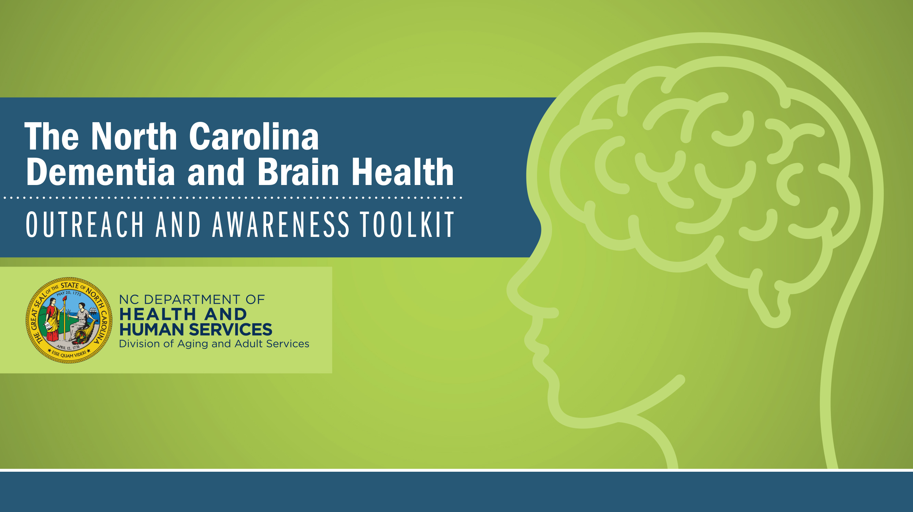

NORTH CAROLINA NATIVE AMERICANS
North Carolina Building Our Largest
Dementia (NC BOLD) Infrastructure Project

Slide 2

NORTH CAROLINA
NATIVE AMERICANS
High Risk | High Need
North Carolina Building Our Largest Dementia (NC BOLD) Infrastructure Project

Slide 3
POPULATION GROWTH
Native American Population is growing and is diverse
  American Indian and Alaska Native alone population
  2020 Census 3.7 million (1.1%)
  2010 Census 2.9 (.9%)
North Carolina Building Our Largest
Dementia (NC BOLD) Infrastructure Project

Slide 4
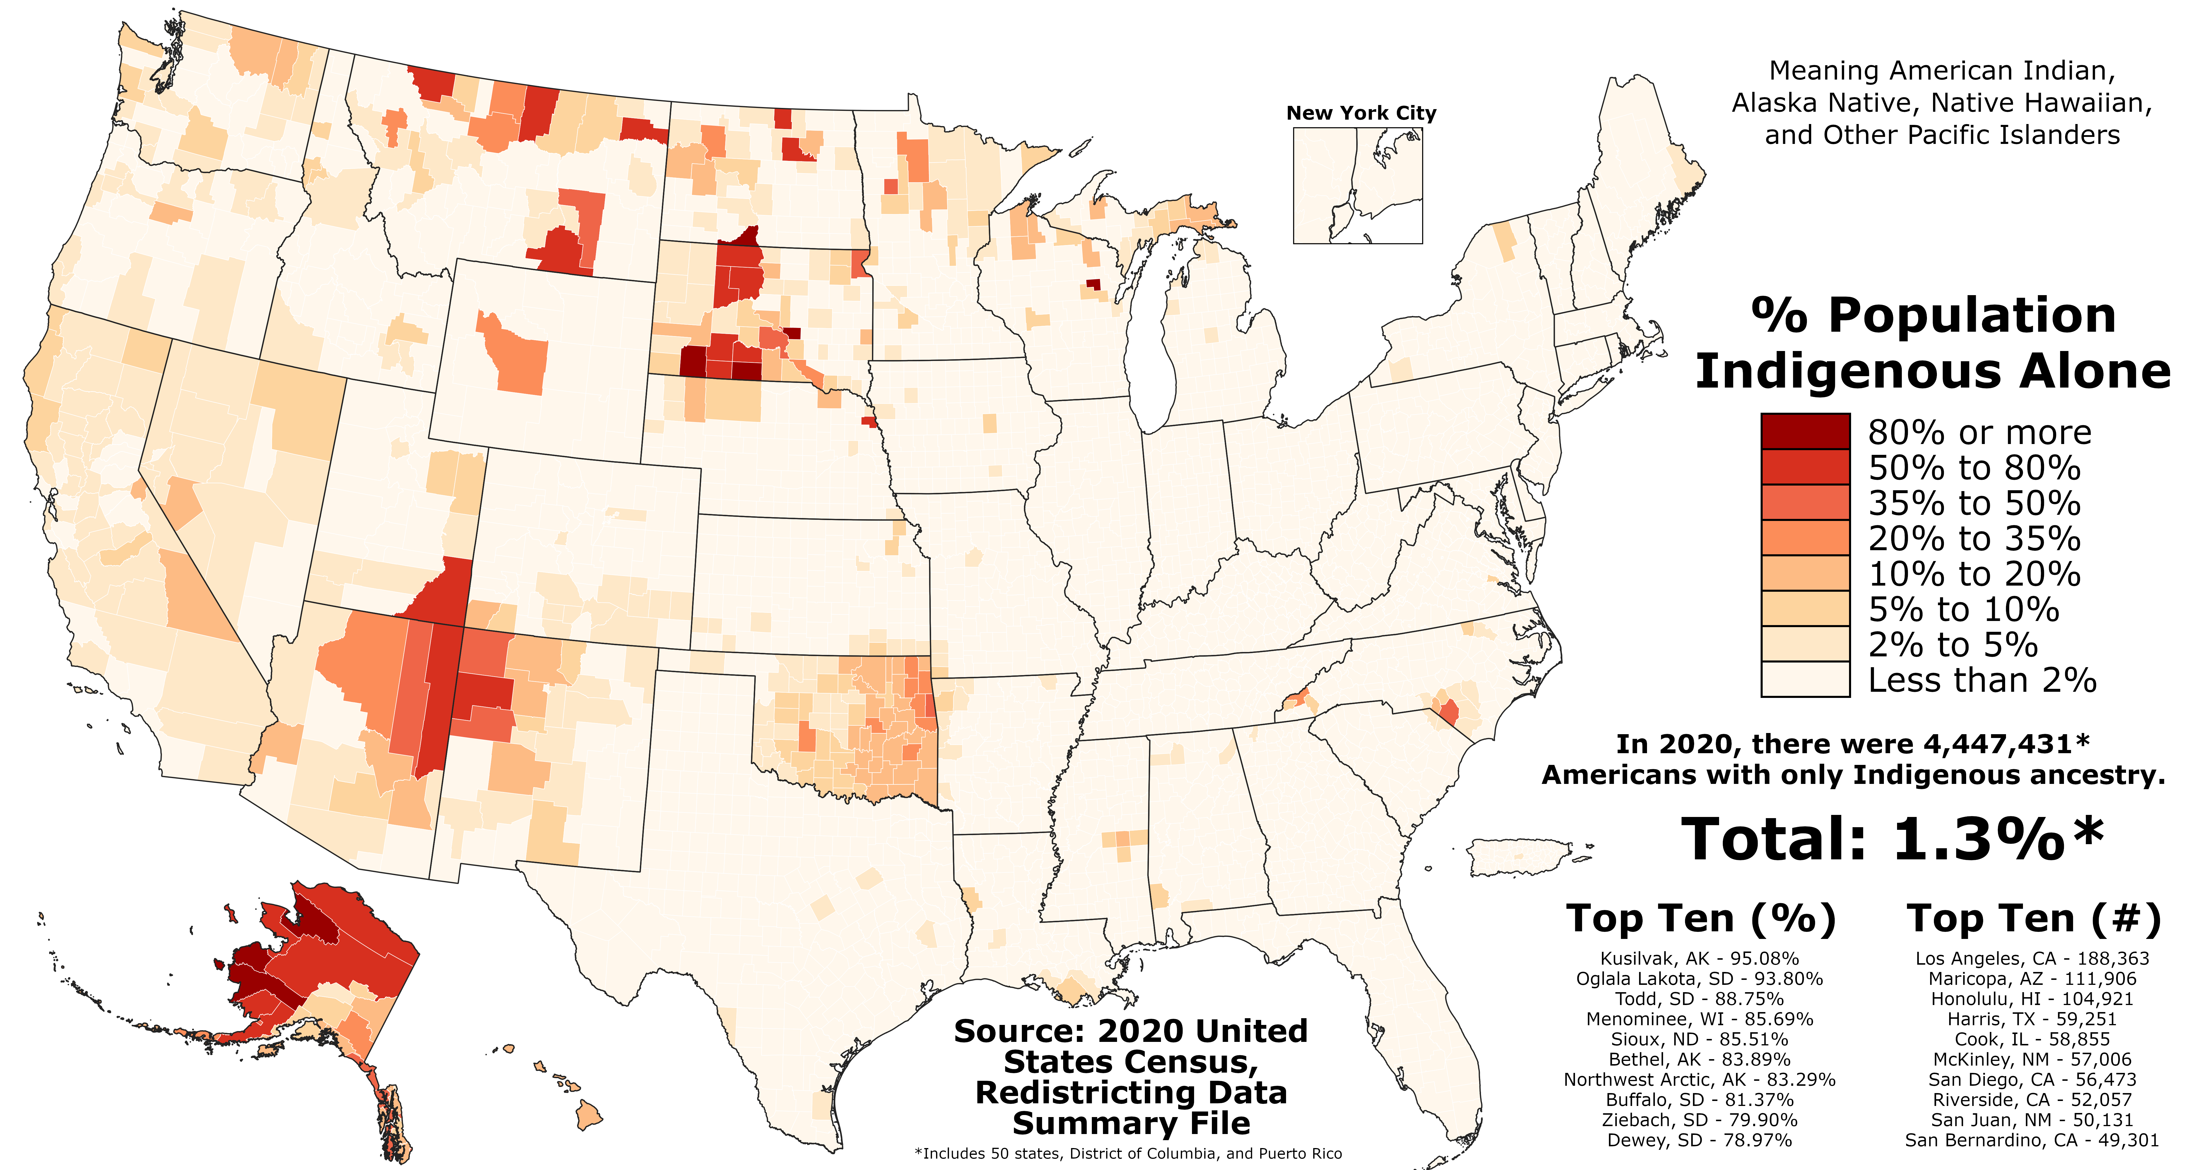
North Carolina Building Our Largest
Dementia (NC BOLD) Infrastructure Project

Slide 5
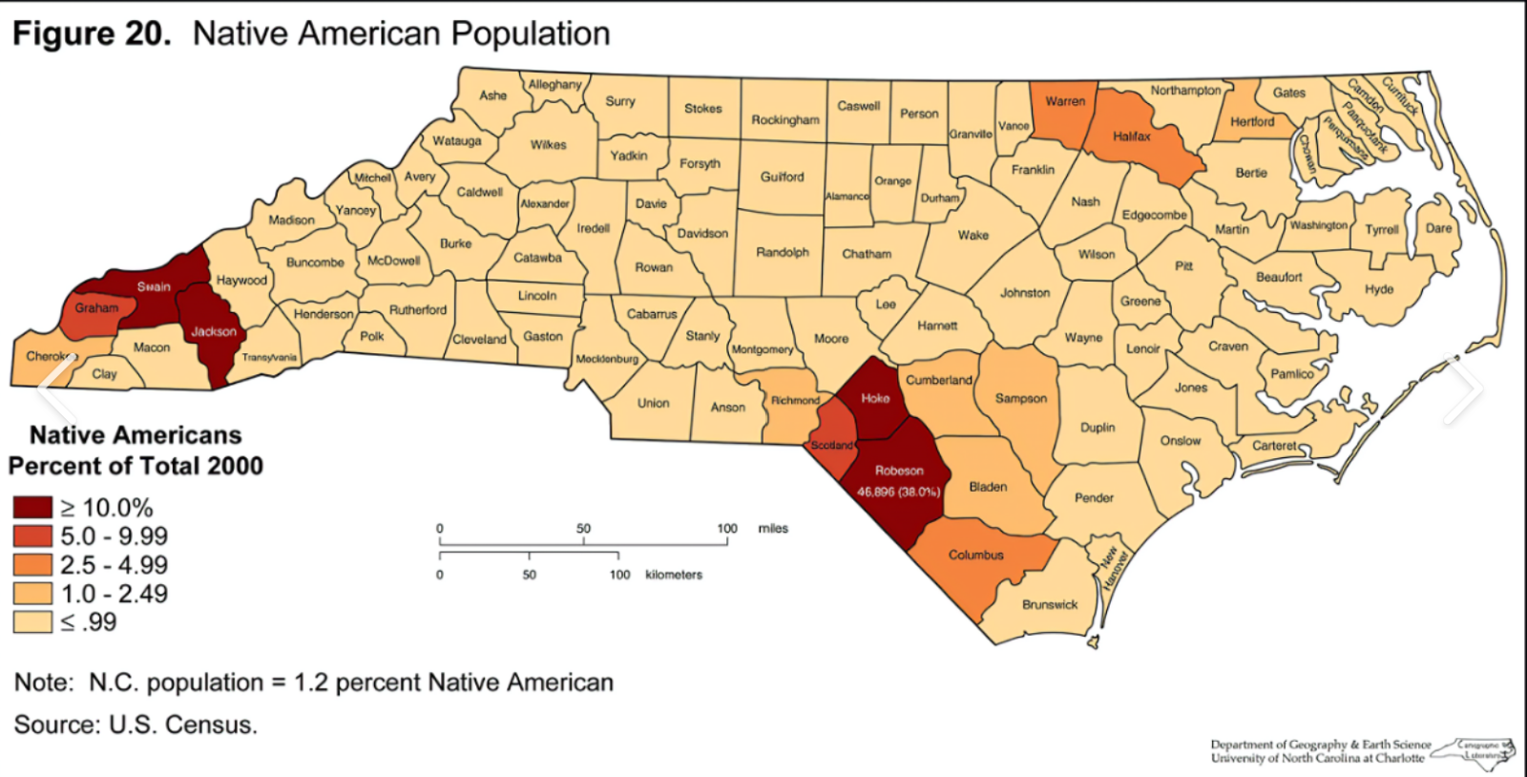
North Carolina Building Our Largest
Dementia (NC BOLD) Infrastructure Project

Slide 6
QUICK FACTS
One in 5 Native American adults aged 45 and older reports experiencing memory or thinking problems t...
1 in 3 Native elders will develop Alzheimer's or some other form of dementia.
49% of Native Americans say that they have access to culturally competent providers.
Alzheimer's Association https://www.alz.org/help-support/resources/native-americans
North Carolina Building Our Largest
Dementia (NC BOLD) Infrastructure Project

Slide 7
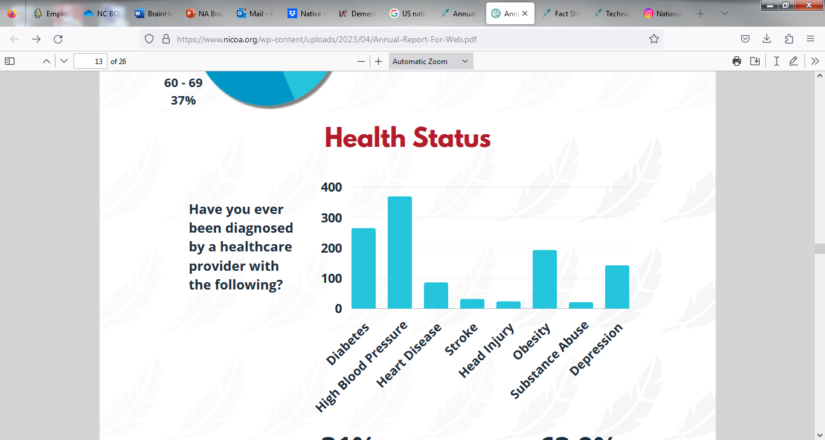
NATIVE AMERICAN'S HAVE HIGH PREVALENCE RATES OF CHRONIC DISEASE ASSOCIATED WITH AD/ BRAIN HEALTH
www.nicoa.org
North Carolina Building Our Largest
Dementia (NC BOLD) Infrastructure Project
Notes:
There are knowledge gaps, especially about caregiving and disease risk, among Native Americans.

Slide 8
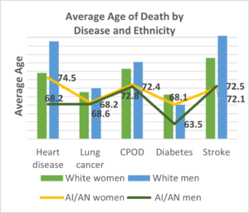
MORTALITY
https://www.nicoa.org/
North Carolina Building Our Largest
Dementia (NC BOLD) Infrastructure Project

Slide 9
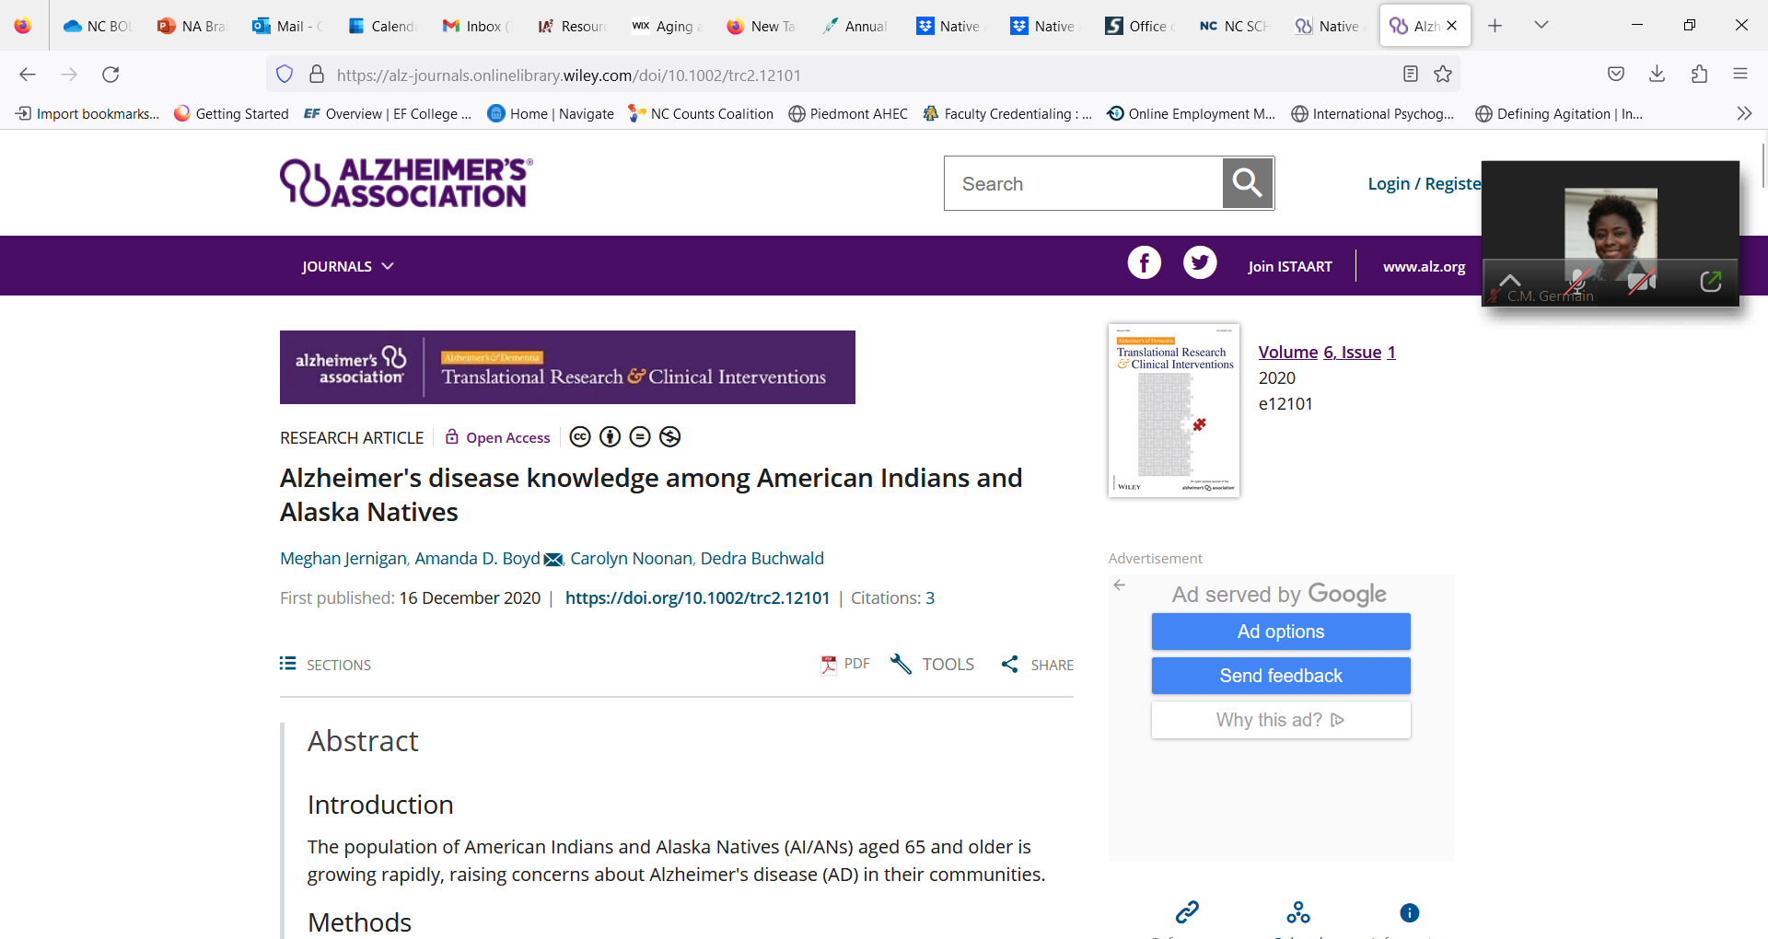
There significant knowledge gaps among Native Americans. (Jernigan et al, 2020)
  disease risk
  caregiving
North Carolina Building Our Largest
Dementia (NC BOLD) Infrastructure Project

Slide 10

NATIVE AMERICAN AGENCIES ON AGING
International Association for Indigenous Aging (IA2)
National Indian Council on Aging (NICOA)
  Minimal representation in NC
Office of Indian Affairs
www.samhsa.gov/tribal-affairs/oiasa
NC DPS BRFSS
North Carolina Building Our Largest
Dementia (NC BOLD) Infrastructure Project

Slide 11
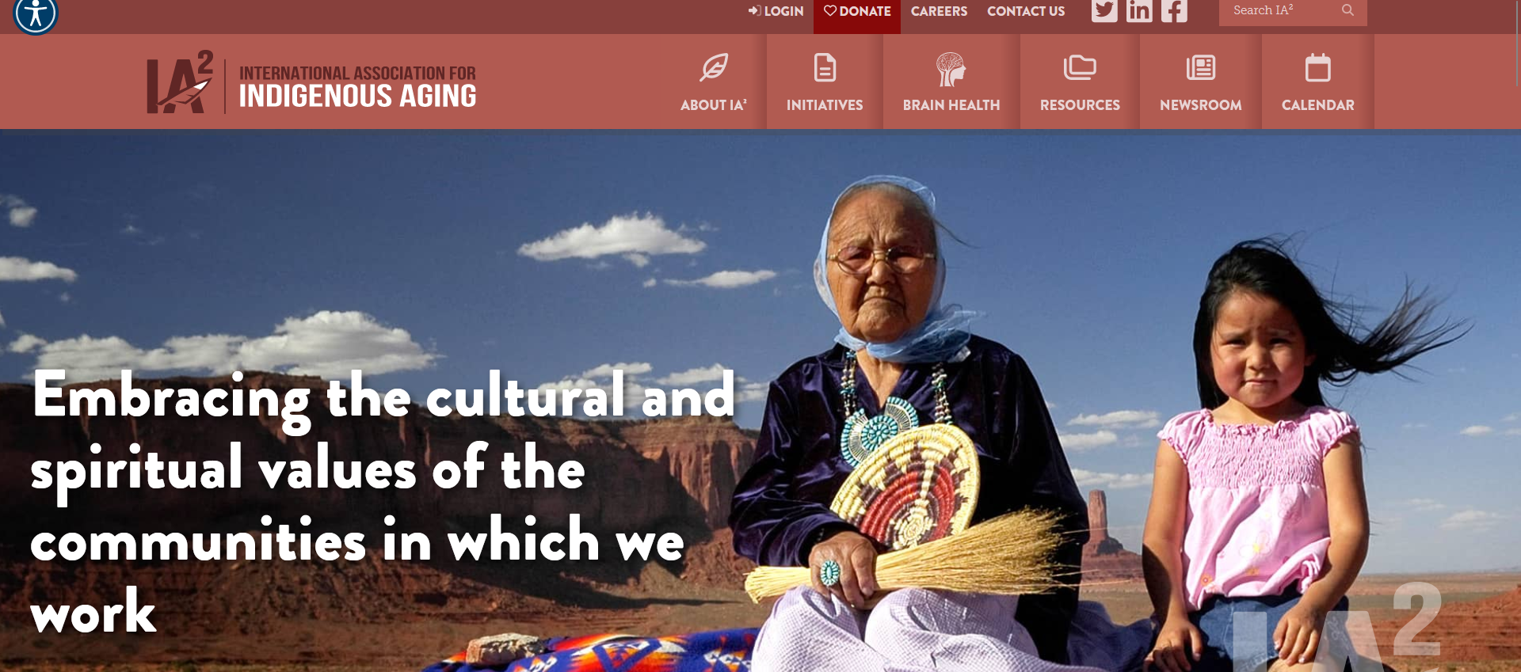
https://iasquared.org/
North Carolina Building Our Largest
Dementia (NC BOLD) Infrastructure Project
Notes:
IA2 also received CDC grant to develop Healthy Brain Road Map

Slide 12
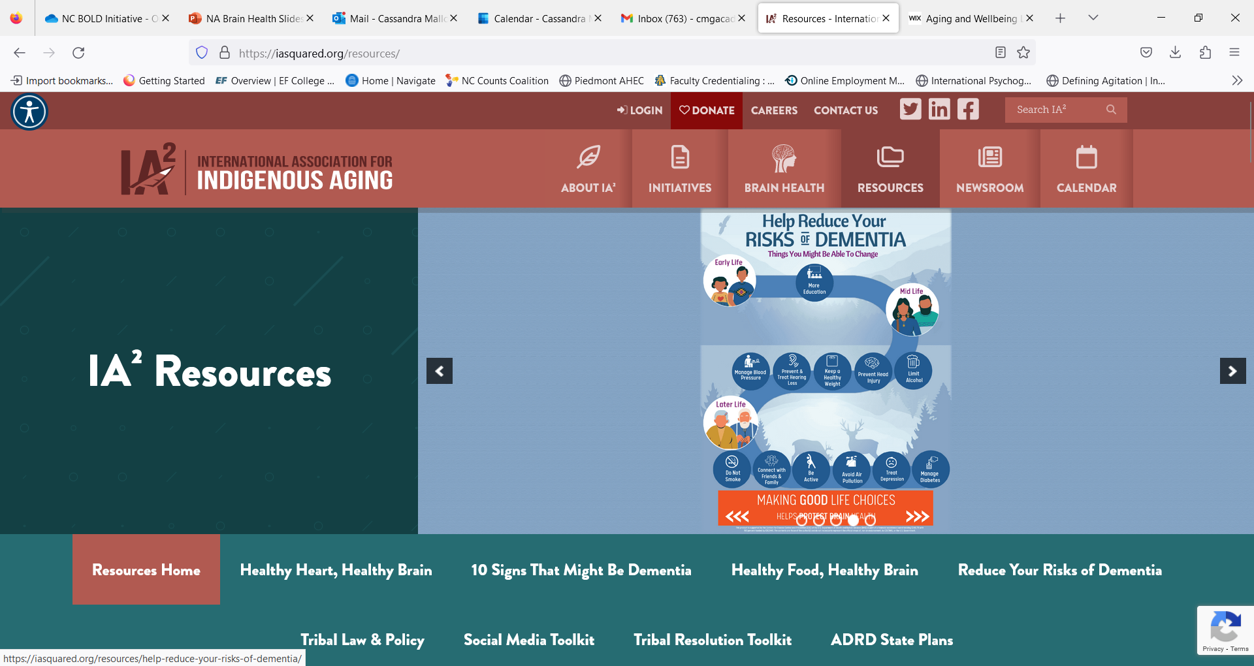
North Carolina Building Our Largest
Dementia (NC BOLD) Infrastructure Project
Notes:
A variety of information and resources on brain health that can be downloaded for use in the community.

Slide 13

https://www.nicoa.org/
North Carolina Building Our Largest
Dementia (NC BOLD) Infrastructure Project

Slide 14
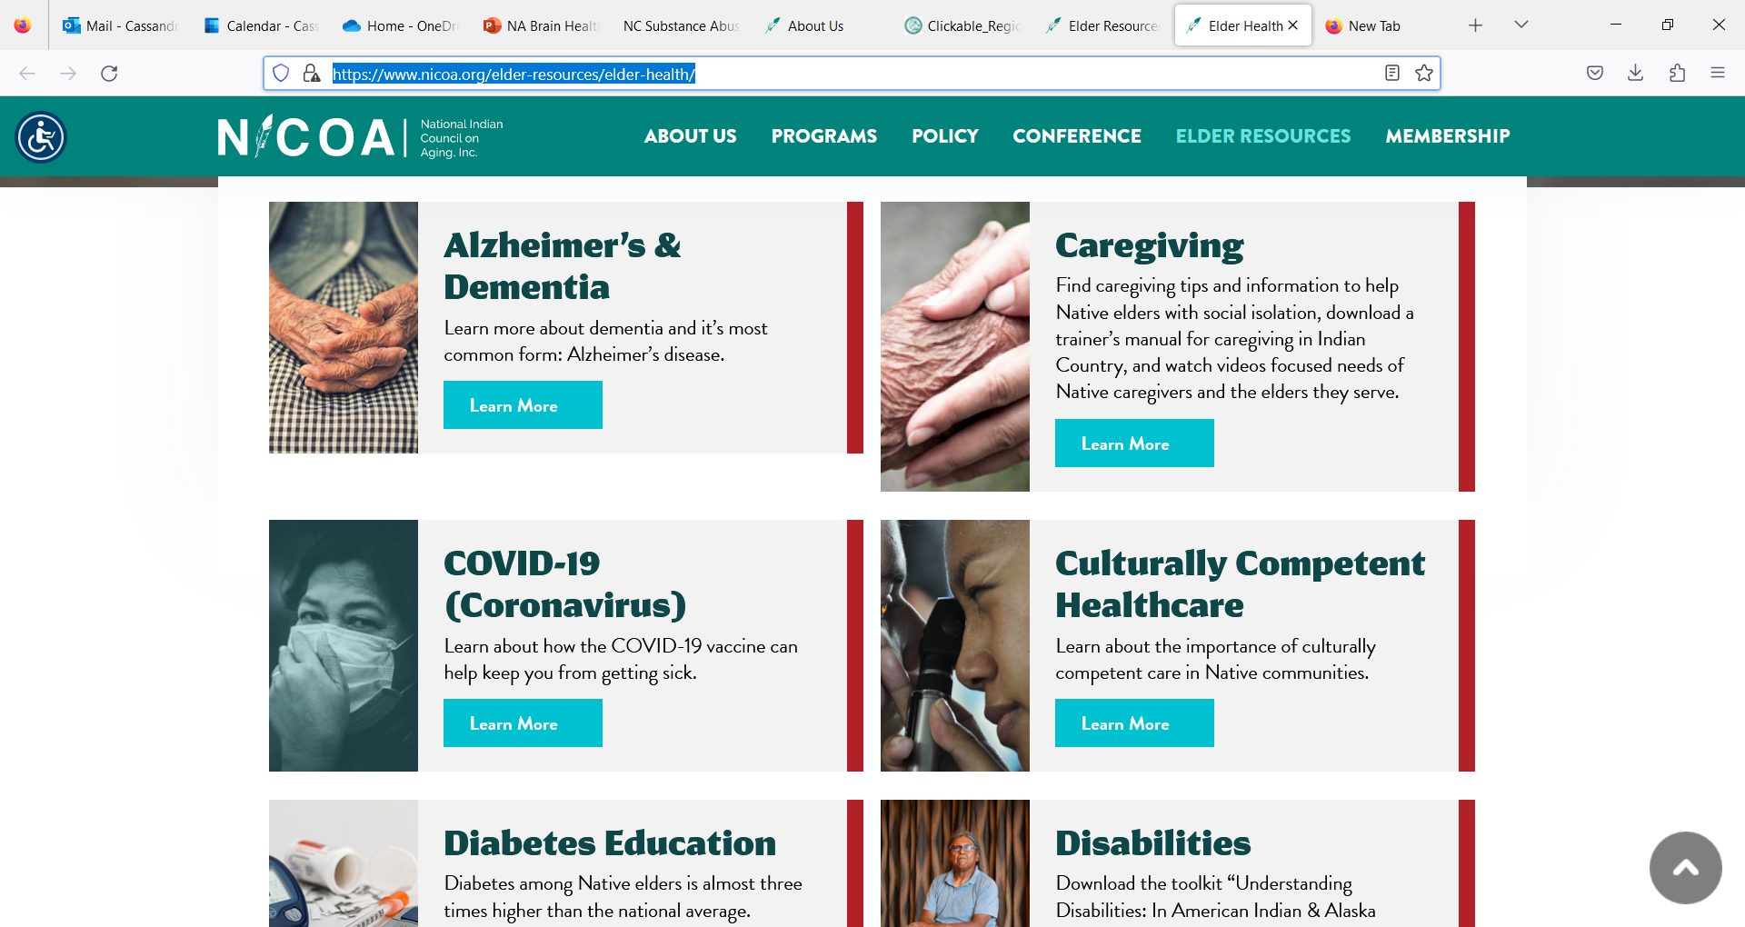
ELDER HEALTH https://www.nicoa.org/elder-resources/elder-health/
North Carolina Building Our Largest
Dementia (NC BOLD) Infrastructure Project

Slide 15
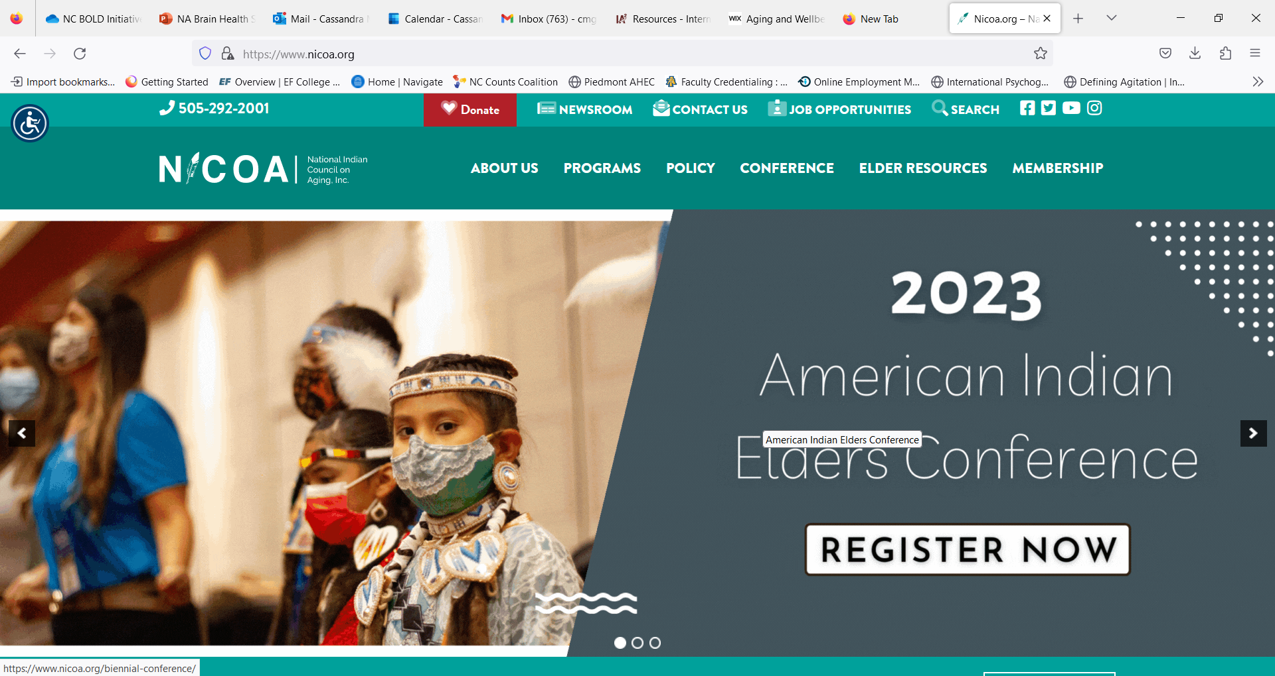
North Carolina Building Our Largest
Dementia (NC BOLD) Infrastructure Project
Notes:
Engaged in advocacy, providing elder resources and services in the NA community. Conduct annual needs assessment

Slide 16
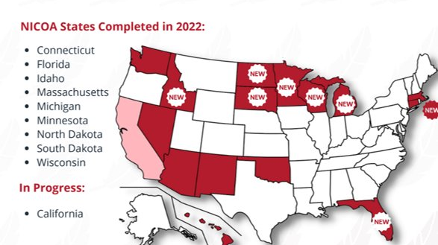
North Carolina Building Our Largest
Dementia (NC BOLD) Infrastructure Project

Slide 17
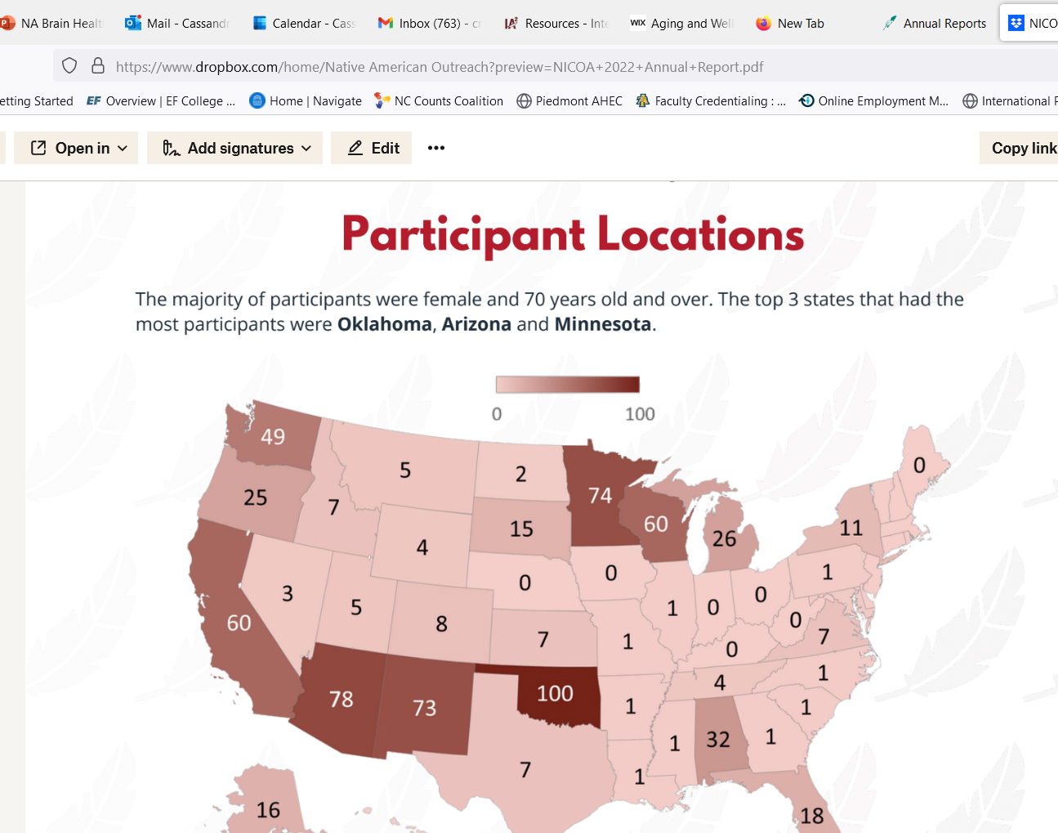
NICOA NEEDS ASSESSMENT PARTICIPATION
North Carolina Building Our Largest
Dementia (NC BOLD) Infrastructure Project

Slide 18


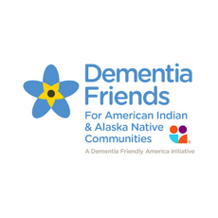
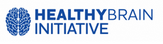
ADDITIONAL RESOURCES
Alcohol
www.samhsa.gov/tribal-affairs/oiasa
Smoking
https://tobaccopreventionandcontrol.dph.ncdhhs.gov/about/resources.htm
www.samhsa.gov/tribal-affairs/oiasa
Diabetes
www.ihs.gov/newsroom/factsheets/
Lifestyle/Heart Health
https://iasquared.org/resources/
Initiatives Existing Partnerships
https://iasquared.org/new-initiatives/
North Carolina Building Our Largest
Dementia (NC BOLD) Infrastructure Project

Slide 19

Thoughts and Questions?
North Carolina Building Our Largest
Dementia (NC BOLD) Infrastructure Project

