Slide 1
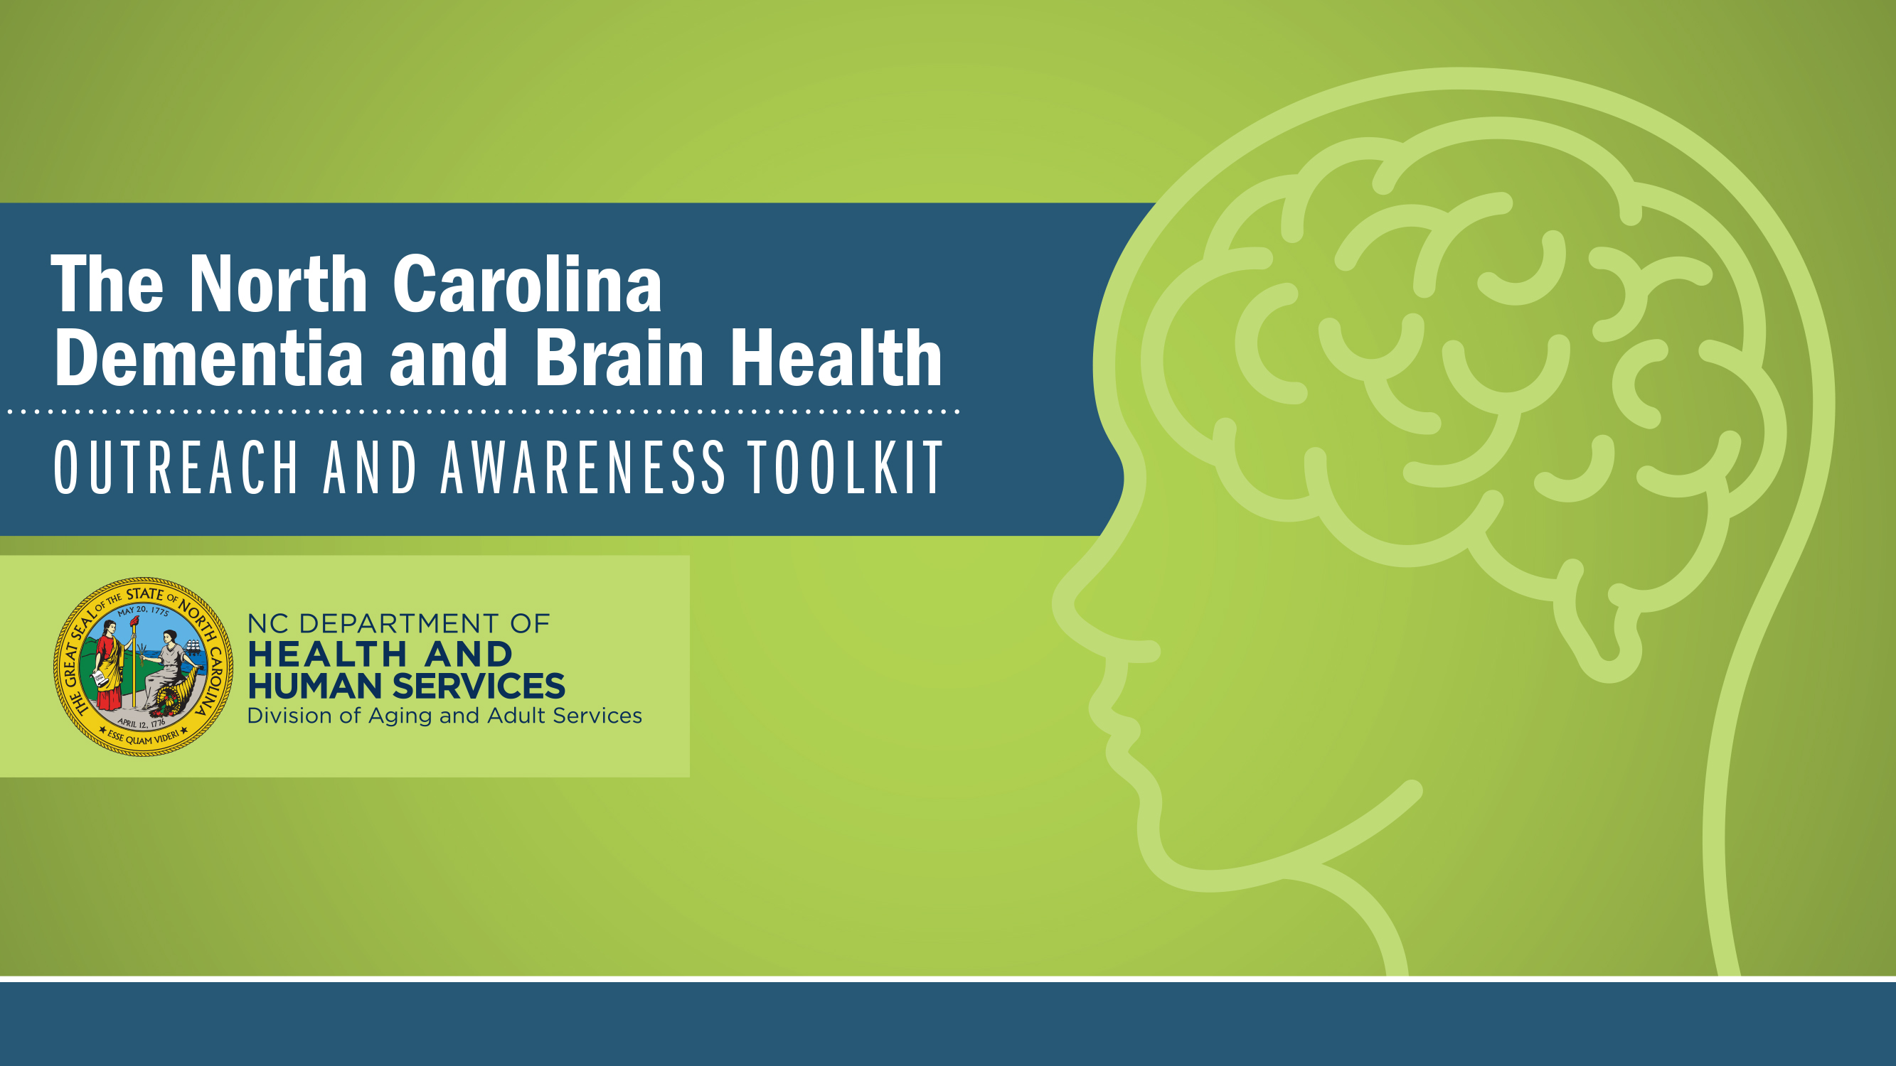

NC REGISTRY FOR BRAIN HEALTH
North Carolina Building Our Largest
Dementia (NC BOLD) Infrastructure Project

Slide 2

NC REGISTRY FOR BRAIN HEALTH
North Carolina Building Our Largest
Dementia (NC BOLD) Infrastructure Project

Slide 3

WHERE WE ARE TODAY ….
Alzheimer’s disease treatment tipping point
Good news, new treatments outweighing years of clinical trial “failures”

Slide 4
2023 DRUG DEVELOPMENT
ALZHEIMER’S DISEASE
141 unique agents
187 clinical trials
36 in 55 Phase 3 studies
Non amyloid targets: tau, inflammation, synapse and neuronal protection, vascular factors, and new neuron formation “neurogenesis.”
Published: May 25, 2023
Cummings J, Zhou Y, Lee G, Zhong K, Fonseca J, Cheng F. Alzheimer's disease drug development pipeline: 2023. Alzheimers Dement (N Y). 2023 May 25;9(2):e12385. doi: 10.1002/trc2.12385. Erratum in: Alzheimers Dement (N Y). 2023 Jun 28;9(2):e12407. PMID: 37251912; PMCID: PMC10210334.

Slide 5

DIVERSITY IN CLINICAL TRIALS –
WE HAVE GOT TO DO BETTER!
As new therapies are developed, it is important experimental therapeutics are available to all
And, that it is clear that these drugs will be safe and effective in all populations.
  African Americans are two times more likely to develop Alzheimer's compared
  to whites.
  Less than 10% of participants in most clinical trials are African American (Flores et al 2021)¹
1 Flores LE et al. (2021) Assessment of the Inclusion of Racial/Ethnic Minority, Female, and Older Individuals in Vaccine Clinical Trials. JAMA Network Open;4(2):e2037640

Slide 6
DIVERSITY IN CLINICAL TRIALS
Reasons for the imbalance and lack of population diversity within clinical trials are complex (Franzen et al 2022)²
Health inequities, lack of access to care, structural inequalities limiting access to research, reluctance, historical trial injustices leading to mistrust, and rigid study designs that create obstacles to participation.
FDA (April 2022) now requires all companies doing clinical trials to have a plan for increasing diversity before they start the work.
2 Franzen S et al. (2022). Diversity in Alzheimer's disease drug trials: The importance of eligibility criteria. Alzheimers & Dementia 18(4):810-823.

Slide 7
DIVERSITY IN CLINICAL TRIALS
Most recent promising results in an
Alzheimer’s treatment trial called
“Trailblazer study”
1795 trial participants
91.5% White
19 African-American/ Black (~1%)
35 Hispanic (~2%)
Reasons for the imbalance and lack of population diversity within clinical trials are complex (Franzen et al 2022)²
Health inequities, lack of access to care, structural inequalities limiting access to research, reluctance, historical trial injustices leading to mistrust, and rigid study designs that create obstacles to participation.
FDA (April 2022) now requires all companies doing clinical trials to have a plan for increasing diversity before they start the work.
2 Franzen S et al. (2022). Diversity in Alzheimer's disease drug trials: The importance of eligibility criteria. Alzheimers & Dementia 18(4):810-823.

Slide 8
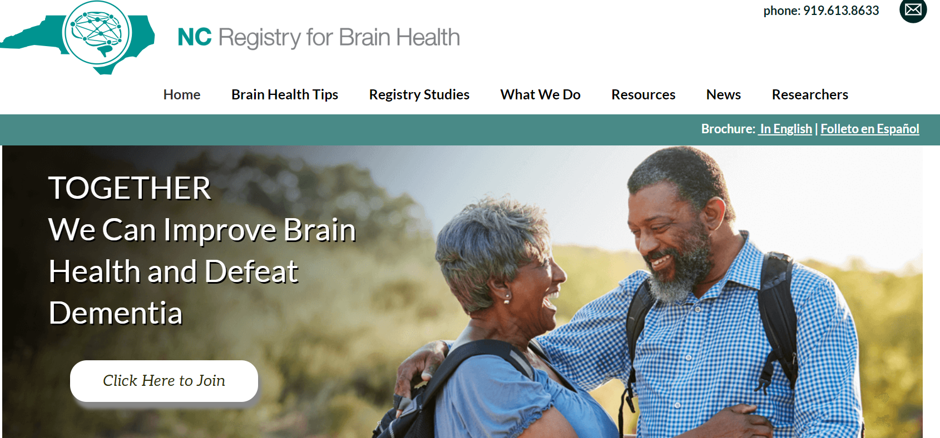
NC REGISTRY FOR BRAIN HEALTH (www.ncbrainhealth.org)

Slide 9
WHAT IS THE NC REGISTRY FOR BRAIN HEALTH?
The “Registry” is a group of people across North Carolina interested in receiving the latest news to improve brain health and to prevent Alzheimer’s disease and other dementias. It is also a way for people to get involved in studies by receiving regular notices of enrolling studies that might meet their interests.
Notes:
READ SLIDE
Benefits to you include receiving reliable and timely information in form of
-monthly e-blasts
-quarterly newsletters that provide you with reliable, current information useful in your life

Slide 10
WHAT IS THE NC REGISTRY FOR BRAIN HEALTH?
The “Registry” is a group of people across North Carolina interested in receiving the latest news to improve brain health and to prevent Alzheimer’s disease and other dementias. It is also a way for people to get involved in studies by receiving regular notices of enrolling studies that might meet their interests.
Funded by the State to increase
access to information and to research studies to improve brain health
FREE!!
Notes:
READ SLIDE
Benefits to you include receiving reliable and timely information in form of
-monthly e-blasts
-quarterly newsletters that provide you with reliable, current information useful in your life

Slide 11
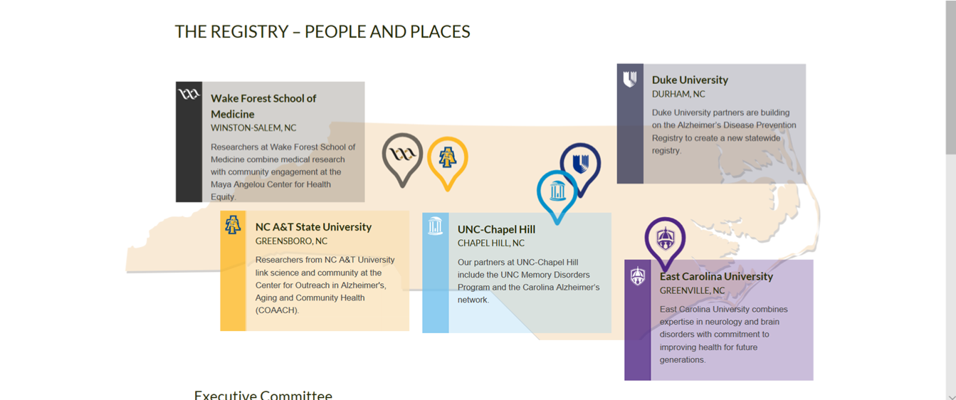
WHO WE ARE: IMPACT ACROSS THE STATE OF NC
Notes:
Five research partners across the state and this will grow
Duke
Wake Forest
UNC Chapel Hill
ECU
NC A&T

Slide 12
WHO’S JOINED SO FAR? (July 24, 2023)
Total enrollees: 11,059
Racial Demographics
Race (check all that apply)
7107 (64.3%) White
3124 (28.2%) African-American/Black
201 (1.8%) Multi-racial
192 (1.7%) Unknown
142 (1.3%) Asian
178 (1.6%) Other
112 (1.0%) American Indian/Alaska Native
4 (0.0%) Native Hawaiian/Other Pacific Islander
Do you have any Hispanic or Latino Ethnicity?
9850 (89.1%) No 387 (3.5%) Yes 609 (5.5%) No response 213 (1.9%) Don't know
What is the highest level of school
you have completed?
1998 (18.1%) Unknown
3045 (27.5%) Graduate degree
2660 (24.1%) 4-year college degree
2276 (20.6%) Some college or Associate's 920 (8.3%) High School graduate
160 (1.4%) Less than HS diploma
Notes:
Roughly 33% from groups underrepresented in research
Very educated
It is very important that *everyone* be represented in research. Those who have not - like African Americans, Hispanics, and Native Americans - are more likely than Caucasians to be diagnosed with ADRD and so it's even more important that they be included in studies for effectiveness in treatments and approaches.

Slide 13
WHO’S JOINED SO FAR? (July 24, 2023)
Total enrollees: 11,059
Gender
8134 (73.6%) Female
2885 (26.1%) Male
15 (0.1%) Nonbinary
15 (0.1%) No response
1 (0.0%) Transgender
2 (0.0%) Transgender male
2 (0.0%) Transgender female
Age (approximate)
20 (0.2%) 100s
312 (2.9%) 90s
1526 (13.8%) 80s
3197 (28.9%) 70s
3016 (27.3%) 60s
1225 (10.7%) 50s
664 (6.0%) 40s
389 (3.5%) 30s
258 (2.3%) 18-29s
452 (4.1%) Unknowns
Notes:
Here is an overview of who is currently enrolled in the Registry. You'll notice
More women than men
Majority in 60s and 70s

Slide 14
SOME TYPES OF STUDIES
  Studies of how lifestyle change may reduce risk and slow down disease
  Clinical trials examining medications that might work to improve memory functioning or slow decline
  Studies of new technologies to help better identify early signs of disease

Slide 15
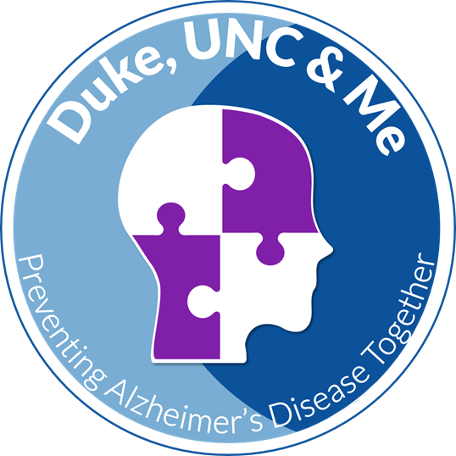







MEMORY AND AGING STUDY
What is normal memory loss as we get older?
The Memory & Aging Study will identify the biological factors involved in normal brain aging and disease. We need a group of people of different backgrounds to participate in this important research which we hope will have a positive impact in your community.
You may participate if you are:
Between ages 25 and 80
Willing to attend study visits and participate in any or all study procedures:
  Brain imaging (MRI)
  Memory evaluations
  Blood tests
  Spinal fluid sample
For more details, please contact us:
Phone: (919) 613-8633 | Email: NCBrainHealth@dm.duke.edu
You will be paid for your participation.
In collaboration with:
PRO00103958

Slide 16
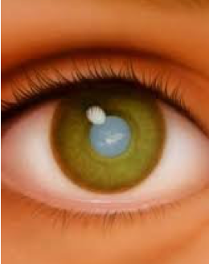
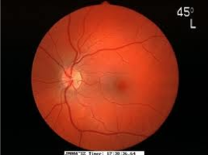
DUKE STUDIES: RETINAL IMAGING TO DETECT AD
Study conducted by Duke Department of Ophthalmology and Bryan ADRC
  Based on the idea that inflammation of retina
  (the light-sensitive layer at the back of the eye) is similar to brain inflammation in AD, and may identify individuals at risk of AD before memory impairment is evident
  Retinal images may become an important tool in early diagnosis of AD
Study involves a two-hour visit with complete retinal exam at the Duke Eye Center, at no
charge to participant.
  Current need for participants with mild cognitive impairment with memory loss

Slide 17
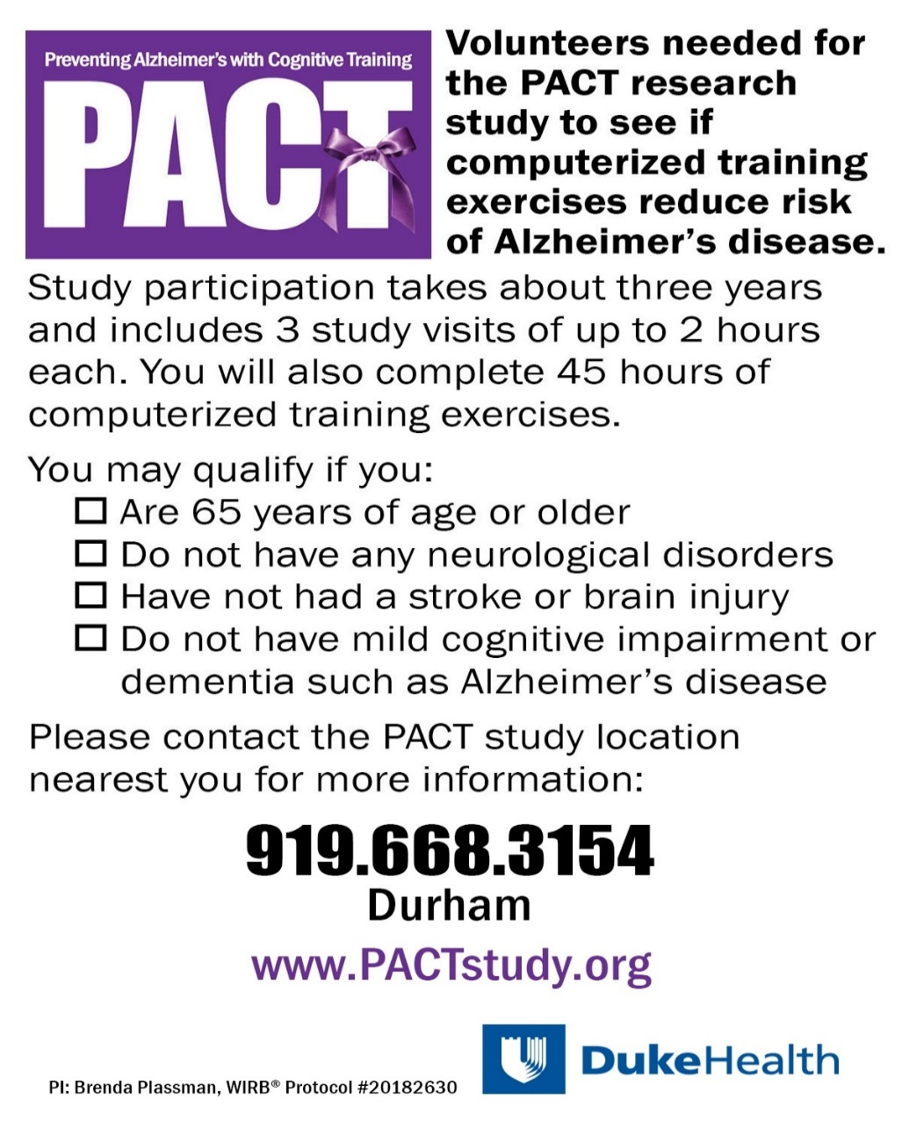

Duke Study — “ PACT”
Preventing Alzheimer’s with Cognitive Training

Slide 18
NC REGISTRY FOR BRAIN HEALTH - CHALLENGES
Mostly Women
Mostly Educated
Need more ethnically diverse populations
Need to assure we are reaching rural, communities with disadvantage
Those who successfully enroll in research are White - 89%
Sex and Gender Minorities
Indicate need for science of enrolling and recruiting into studies

Slide 19

BE INFORMED
GET INVOLVED
JOIN THE NC REGISTRY FOR BRAIN HEALTH

Slide 20
Thoughts and Questions?
North Carolina Building Our Largest
Dementia (NC BOLD) Infrastructure Project

