Slide 1

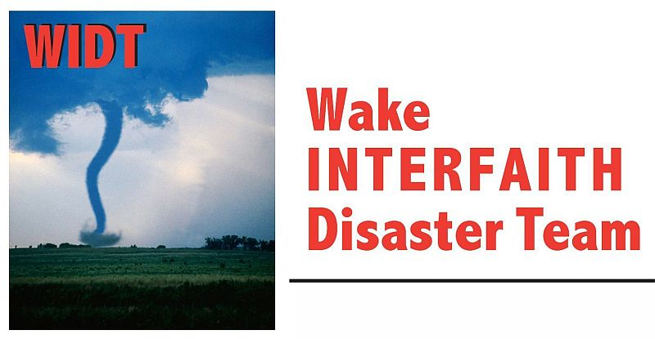




NC VOAD & LTRGs
Disaster and Case Management
NC Voluntary Organizations Active in Disaster
Long Term Recovery Groups

Slide 2
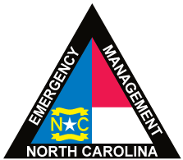

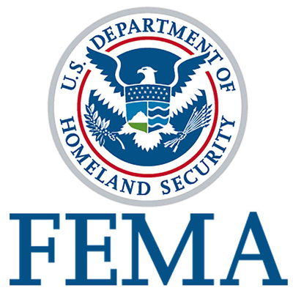


Cooperation, Communication, Coordination, Collaboration

Slide 3
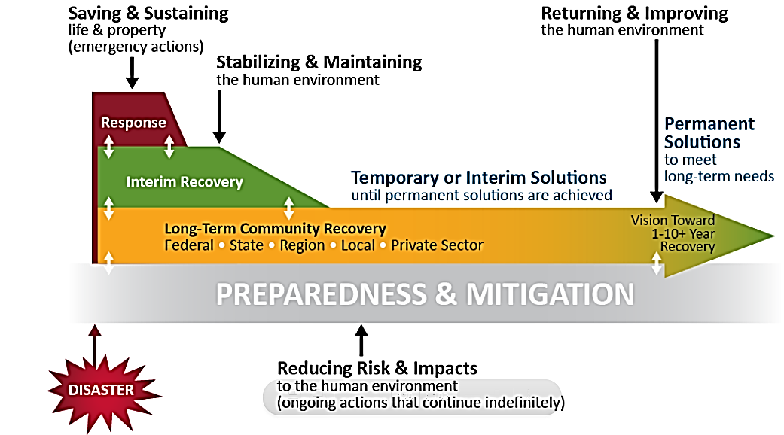

Notes:
SUBJECT SLIDE: One Look at the Disaster Cycle
SAY: There are lots of ways to look at the disaster cycle. In this view, developed by FEMA, the phases are in layers. You will see a cyclical version in the next slide. Though the disaster (at the bottom) precipitates the community’s reaction toward recovery, preparedness and mitigation (grey line) should be happening before, while responding and after a disastrous event strikes.
We’re here today to discuss how you in this room want to embrace recovery because your community has been struck by disaster. This slide notes several important take-aways: the early emergency and relief (maroon and green) portions of your response were aimed at saving lives and stabilizing structures to prevent further damage. You can see how much longer the orange line is, reflecting how much more time may be needed for the entire community to recover.
So, let’s take a look at another view of the disaster cycle.

Slide 4
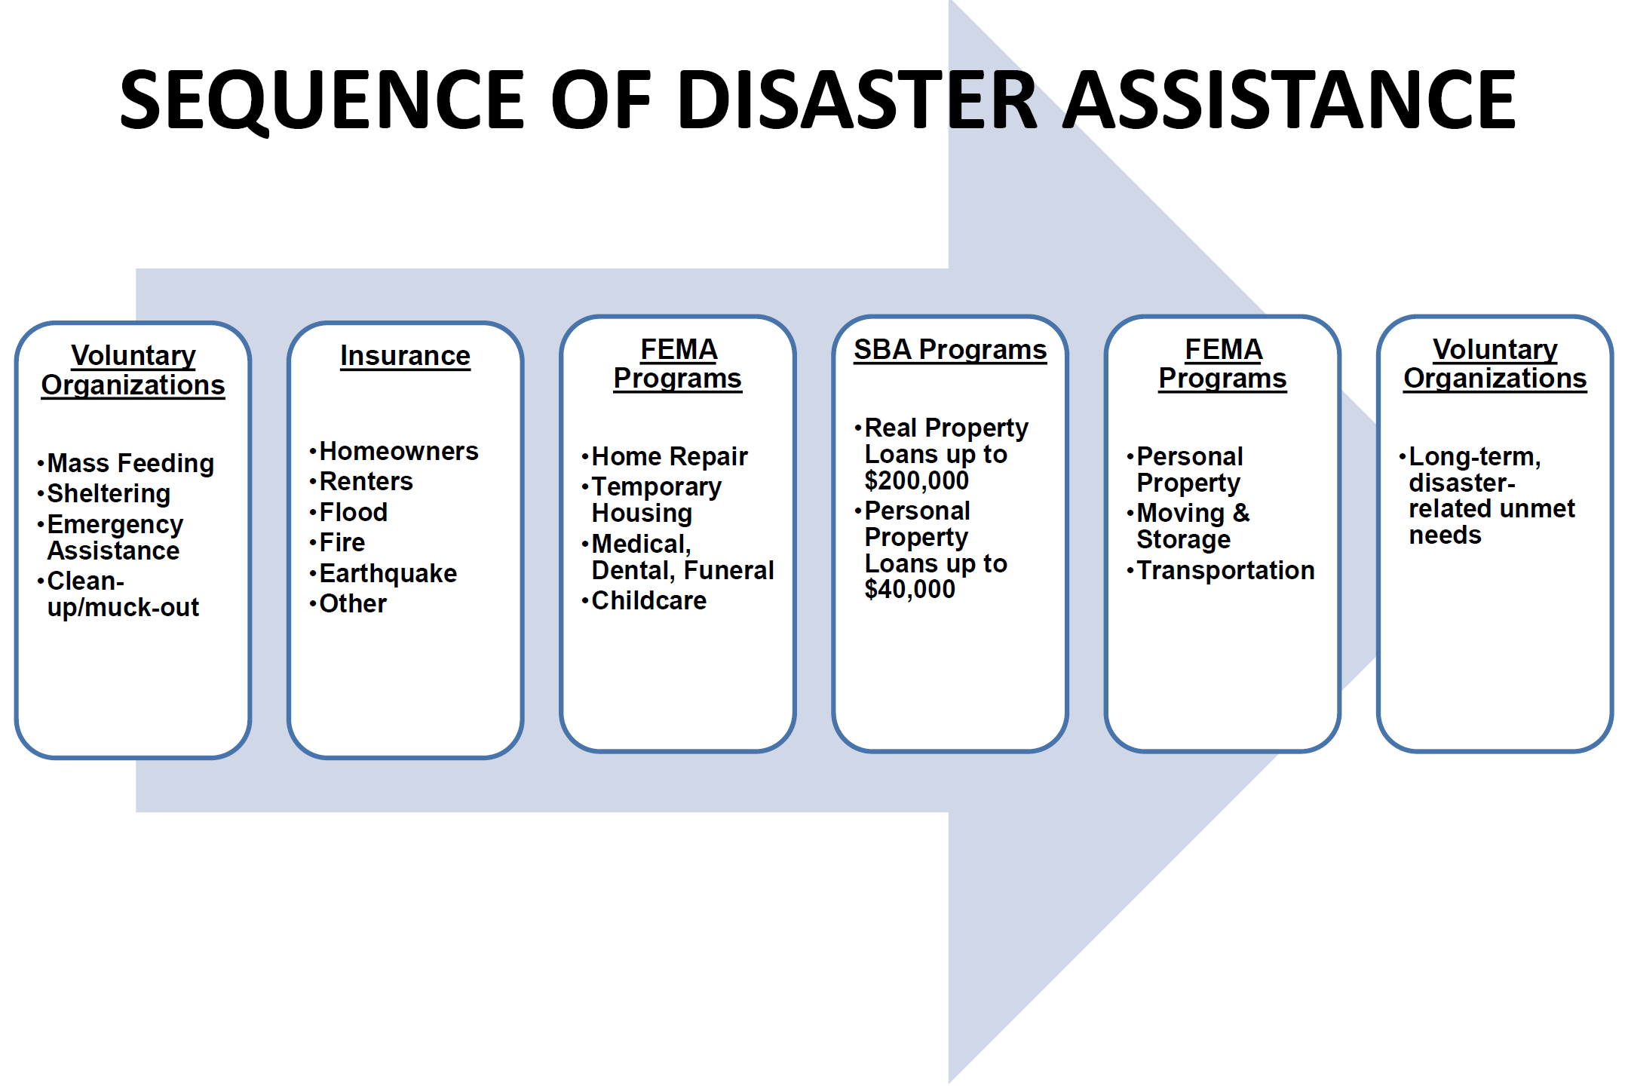
Sequence of Delivery
Notes:
Same information, different view

Slide 5
LONG-TERM RECOVERY GROUP (LTRG)
A long term recovery group (LTRG) is a cooperative body that is made up of representatives from faith-based, non-profit, government, business and other organizations working within a community to assist individuals and families as they recover from disaster.
Notes:
TITLE SLIDE: Long-term Recovery Group
SAY: Please look at the definition of a long term recovery group.
A long term recovery group is needed when personal resources, insurance, government grants/loans are insufficient to meet the need of disaster survivors. Long term recovery groups assure that disaster survivors receive assistance from local neighbors, coalesce community members around the response and include as many participants as possible in order to maximize resources and minimize duplication of effort. There are many ways to develop LTRGs; each community is encouraged to put its own special “stamp” on the recovery because each community is unique and each disaster is different. There are many things that a long term recovery group is NOT. It is not the government; it is not the “boss”; it is not a resource for on-going human need. It IS a response to a particular disaster at a particular time in a particular place.
ASK:
What is the experience of people in the room? Have there been LTRGs here in the past? Have those in the room had experience with previous LTRGs?

Slide 6
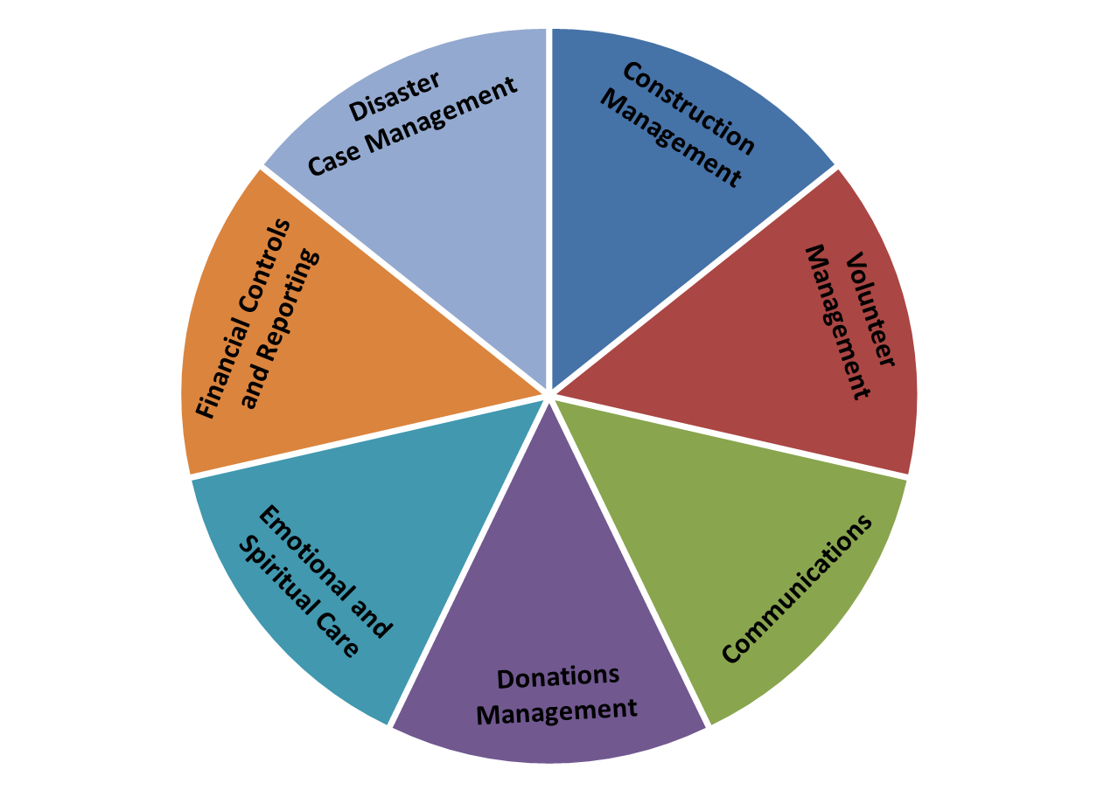
Every good long term recovery includes …..
Notes:
TITLE SLIDE: Every good long term recovery includes….what?
SAY: Each community long term recovery group has the opportunity to be exactly what it wants to be. There will be lots of opinions and suggestions about how your organization should form, but be assured that you are in complete control of your mission and process…as long as you assure that you will work ethically, honestly and with respect for your community.
Nevertheless, National VOAD organizations have been involved in long-term recovery group formation for decades and have the following suggestions:
Some or all of the following functions can expedite recovery: communications, spiritual and emotional care, resources, volunteer management, donations, construction and disaster case management.
Development of each of these functions is more fully explained in the National VOAD Long Term Recovery Guide at nvoad.org. Member organizations have experience in these functions and will support you as you develop. Please refer to the matrix of member organizations and contact provided to you during today’s workshop.
This circle rightly implies that the functions are interconnected; what it does not demonstrate is how the a client is guided throught the various functions with the strong support of a disaster case manager, who continues to be the client’s single point of contact, even after construction and volunteers are assigned.
In order to support the functions on this slide, long-term recovery groups will need to consider where fiscal management will reside (an existing 501(c)3 perhaps?), as well as whether adminstrative support and data management will be needed.
ASK: Are there other programs your long term recovery group is considering? If your group is small, are there ways to combine some of these functions?
The following slides give us an opportunity to spend a moment discussing these functions.

Slide 7
Disaster Casework and
Disaster Case management
…are functions in support of empowering and of addressing the basic needs and recovery needs of individuals and families.
Disaster Casework
Case Management
Notes:
TITLE SLIDE: Disaster Casework and Disaster Case management
Faciltator note: Make every attempt to have copies of the National Voluntary Organizations Active in Disaster Long Term Recovery Guide available to give to each participant. Refer to Chapter 4, Page 16.
SAY: Every program of a long term recovery depends on the successful development of every other program. Though disaster case management is one of the pivotal components, long term recoveries too often believe it is the “solution” to every problem, rather than one of the spokes in a strong wheel…or slices of a delicious pie as this graphic suggests! Without careful thought to the development of the disaster case management process, frustration is a guarantee…and the critical help survivors need will be delayed.
As long term recovery groups form...often while relief activities (such as stabilizing structures, making them secure and preventing further damage) are underway...many groups are already thinking about ways to support a hurting community with a quick and caring touch. The American Red Cross, the Salvation Army and other early participants are making surveys and screening for services. Others will be visiting door-to-door to provide information about resources and referrals to those who are feeding or distributing supplies.
Those early visits may also include gathering basic information about what survivors might need immediately or ultimately in order to sustain the current situation and plan for a future one. Local communities, with the support of existing VOAD members, church groups, community service clubs or social service agencies, are perfect to make those visits in coordination with city, county, emergency management, national guard or other coordinating entities...once the area is safe and steps have been take to protect survivors from identity theft, cultural offense or inappropriate exposure.
These early efforts are what the National VOAD Disaster Case Management Committee defines as “disaster casework.” Disaster Casework is early intervention provided by skilled helpers who aid survivors in taking next steps in their recovery. Interventions include providing accurate and timely information and referral, identifying resources to meet urgent needs, and screening for disaster program eligibility, including long term disaster case management.
This early intervention:
▪ helps to minimize the risk of duplication of benefits which may pose barriers for recovery;
▪ assists in the restoration of pre-disaster social service benefits for qualified individuals; and ▪ provides clients with information on the importance of record keeping for future assistance.
Disaster Casework
▪ is often initiated in the relief phase of disaster response; and
▪ may complement disaster case management in the recovery phase.
Too often those many entities do not gather to share information and prevent redundancies, but long term recovery groups can and should have them all “at the table” as they are forming so all that gathered “disaster casework” can precipitate a seamless transition into disaster case management.
DISASTER CASE MANAGEMENT
Disaster Case Management is a time-limited process by which a skilled helper (Disaster Case Manager) partners with a disaster-affected individual or family (Client) in order to plan for and achieve realistic goals for recovery following a disaster.
There are numerous options for coordinating disaster case management within a long term recovery group. Please see the matrix of National VOAD partners with training capabilities in disaster case management to offer assistance as you consider how to develop a disaster case management strategy.
The National VOAD resource, “Disaster Case Management Guidelines,” is an excellent resource for a better understanding of the principles and practice of disaster case management.

Slide 8
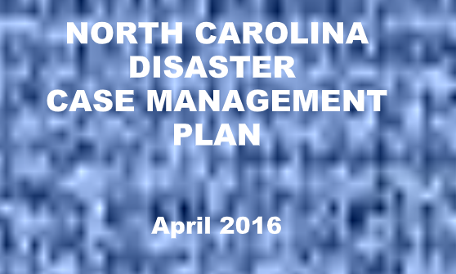
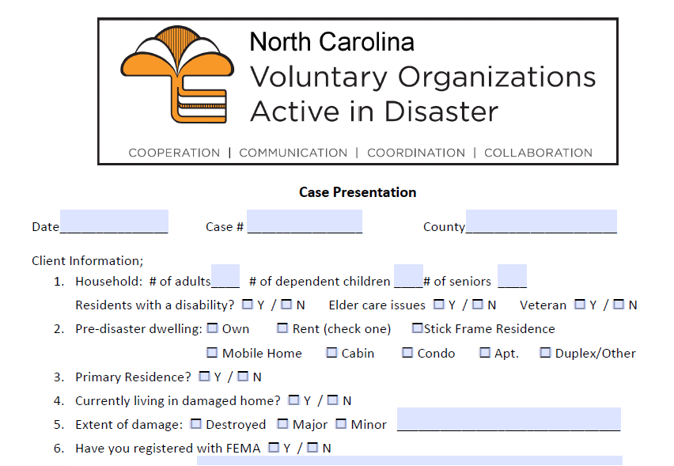
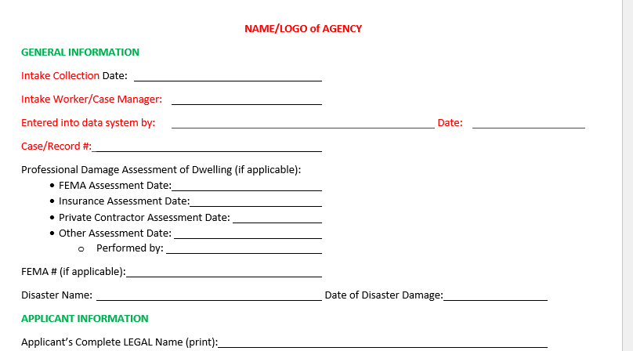
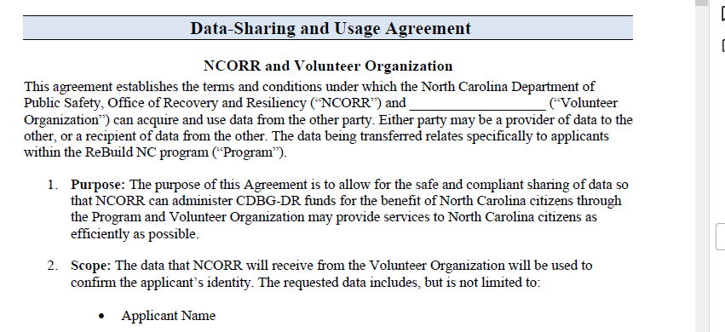
Case Presentation
Data Sharing
Generic Client Intake

Slide 9
Financial Controls and Reporting
It is the responsibility of the LTRG,
along with its fiscal agent, to
ensure that good financial
controls are in place.
Financial Controls
and Reporting
Notes:
TITLE SLIDE: Financial Controls and Reporting
Facilitator note: LTR Guide, Chapter 10, Page 38
SAY: The last piece in the circle is the piece that requires the most stringent ethical standards. Donors expect a financial management system that includes checks and balances, as well as careful recordkeeping. Experienced charities and community agencies often “gift” their accounting services to a LTRG, providing their 501(c)3 status for tax deductible contributions.

Slide 10
Case Management
Begins early in the aftermath of the disaster
Works with the client to jointly create and execute a plan to effect recovery
Avoids duplication of benefits
Maintains a single committee to assure fair and equitable treatment and construction prioritization
Continues throughout the aftermath of the disaster until needs of the client are met

Slide 11


Cooperation
LTRG
Communication
Coordination
Collaboration
Notes:
TITLE SLIDE: Your LTR
SAY: When all you can see are the edges, it’s difficult to see the completed picture. It’s true in every disaster in every community that recovery seems daunting. The good news is that so many of the puzzle pieces have been in development for decades. Your community has within or near it excellent resources to help you determine the way forward. You are here because you agree that the hurt is too big to bear alone and that we are all needed to restore hope and healing after a disaster.
It is the fervent hope of National VOAD, its members and partner agencies that your community will travel the emotional roller coaster with confidence and support, move through the Sequence of Disaster Assistance without stumbling and reach out for help with the assurance that you are surrounded with those who will offer mentoring, guidance, presence and resources.

Slide 12
Ann Huffman
NC VOAD Disaster Case Management Committee
NC Conference UMC
919-610-8018
ahuffman@nccumc.org
www.ncvoad.org

