Slide 1
Local Agency Outreach Presentation for Partners
INSTRUCTION SLIDE
  See NOTES
TIPS FOR DEVELOPING PRESENTATIONS
**OMIT SLIDE BEFORE PRESENTING
Notes:
OMIT SLIDE PRIOR TO PRESENTING
PPT Updated August, 2026
The purpose of this power point presentation is to provide local agency staff a framework that they can use to develop a presentation about their Local Agency’s WIC Program. Local agencies should save this presentation and modify and enhance as needed based on the purpose and target audience of their outreach efforts.
To change the master template: View>Slide Master>Edit individual slides
Each slide contains notes with tips about what to talk about or how to enhance the slide, you can update the notes as needed based on your target audience, presentation style etc.
General Tips on Developing a Power Point Presentation:
Use [graphics + narration] instead of [text + narration] whenever possible.
Graphics can be images, illustrations, charts, graphs, videos, screen captures.
Show, don’t tell.
Use a statement of assertion as the heading (i.e., state the main point in full sentence format) and use the bullets for supporting evidence.
Use graphics only when they support learning, rather than simply as “decoration” (clip art often falls into this category)
If a photo adds to understanding, consider using photo as background with key statement overlaid on white space.
Use motion only when necessary (e.g., in an animation). Motion is distracting more often than not.
<20 words printed on a slide
~30-60 seconds narration per slide
Text on screen and narration shouldn’t be redundant or just read of the slide (especially for those new to the subject being presented)
Less is more, especially if the script is available as a handout.
Avoid using red and green font
Avoid using font size smaller than 32 for titles and 24 for text

Slide 2

The North Carolina WIC Program
Subtitle of presentation
Presenter Name, Credentials
Position Title
Date
Notes:
Introduction slide
Add your agency’s logo where the WIC North Carolina logo is presently
Template and Icon developed using artwork from NWA

Slide 3




What is WIC?
The Special Supplemental Nutrition
Program for Women, Infants and Children
Public Health Nutrition Program
Funded by the United States Department of Agriculture (USDA)
Notes:
Describe the WIC Program:
the nation’s most successful public health nutrition program.
federally funded by the USDA
works to assure healthy pregnancies, healthy birth outcomes and healthy growth and development for women, infants and children up to age 5
Photo Credit:
Fotolia: Fotolia_159613984_Subscription_XXL
Fotolia: Encourage 18w USDA Loving Care
Fotolia: Asian Girl Eating Watermelon2_Fotolia_4448433
AsianGirl Fotolia_28645333_Subscription_XL

Slide 4
WIC’s Mission
“To assure healthy pregnancies, healthy birth outcomes, and healthy growth and development for women, infants and children up to age 5 who are at nutritional risk, by providing nutritious supplemental foods, breastfeeding promotion and support, education on healthy eating, and referrals to health care and critical social services.” ~National WIC Association
Notes:
Does your agency have a mission statement? Include it here.

Slide 5
WIC Fun Facts
Across America, there are 90 state WIC Agencies, 1,900 local WIC Agencies, and 10,000 clinics!
WIC Agencies across North Carolina provide support to over 258,000 women, infants and children in all 100 counties every year!
WIC supports 56% of ALL infants born in the USA!
Add your agency’s statistics here!
https://www.ncdhhs.gov/localWIC
Notes:
Add your local agency statistics here or delete text box/.
Links to more information:
In NC find your local agency here: https://www.ncdhhs.gov/localWIC
US Facts about WIC: https://www.ncdhhs.gov/us-wic-fact-sheet2026pdf/download?attachment
NC Facts about WIC: https://www.ncdhhs.gov/nc-wic-fact-sheet2026pdf/download?attachment

Slide 6
WIC Overview
Insert video here: https://youtu.be/ghPyQAwNHi0
Or DELETE
Notes:
Click on box to play WIC: Overview from NWA
Or go here: https://youtu.be/ghPyQAwNHi0
Internet connection required
Video Credit: WIC: Overview by NWA
Published on Mar 7, 2014
Motherhood is one big job. Choosing healthy foods while pregnant, learning how to breastfeed, finding the right doctors for yourself and your children, and getting those kids ready to learn in school really does take a village. For the last 40 years, WIC has provided all that support and more to mothers and families.

Slide 7
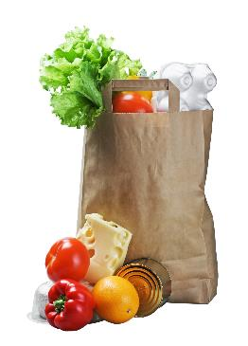







What does WIC provide?
Healthy Food
Breastfeeding Support
Nutrition Education
Community Referrals
Notes:
Describe WIC services in detail
Healthy foods
Nutrition Education
Breastfeeding Education and Support
Community Referrals
May want to state that the rest of the presentation will provide more in-depth information about each of these services…
Image Credits:
Fotolia_51062246_Subscription_XL.jpg
Fotolia_48160578_Subscription_XL.jpg
A group of people sitting at a table_WIC Works
WIC Breastfeeding Peer Counseling Image_WIC WORKS
NWA Artwork: Carrot, droplet, apple, megaphone icons: www.nwica.org
Centeral Network Connection_Fotolia_111399324_Subscription_XL.jpg

Slide 8
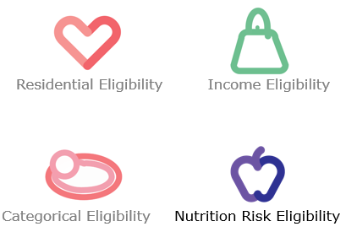
Who does WIC serve?
Notes:
Who does WIC serve? To be eligible for WIC there are 4 eligibility criteria: residential, income, categorical, and nutritional risks.

Slide 9




Who does WIC serve?
Pregnant/Postpartum women
Breastfeeding women
Infants
Children up to age 5
Live in North Carolina
Receive Medicaid, TANF (Work First), Food and Nutrition Services (food stamps) OR have a household income less than or equal to income guidelines
Have a nutrition risk
Notes:
Categorical requirements: WIC participants must be pregnant/postpartum/breastfeeding woman, an infant, or a child under 5 years old
Residential requirements: Live in North Carolina.
Income requirement: participants must a family income less than 185% of the U.S. Poverty Income Guidelines (which I will show on the next slide). Or be adjunctively eligible via participation in another program such as Medicaid, Work First Families Assistance (TANF), or the NC Food and Nutrition Services (food stamps). So if you are eligible for one of those programs, you automatically meet the income eligibility requirement. This is what we call adjunctive eligibility.
And then the 4th eligibility requirement is Nutritional risk: a nutritionist or what we refer to in WIC as CPA-a competent professional authority- determines the nutritional risk of a participant. There are wide range of applicable risk criteria based on the nutrition assessment that the nutritionist completes. Risk crirteria include risks related to anthropometric like overweight/underweight, biochemical like low hgb or high lead, medical/clinical such as a medical diagnosis, dietary risks such as inappropriate nutrition practices and eco-social such as food insecurity
Image credits:
Confidence-18w USDA Loving Care.tif
WInfantEatingfromHighChair_Fotolia_42705435_Subscription_XXL.jpg
Pregnant woman eating sandwhich_Fotolia_66538632_Subscription_XXL.jpg
BusyMom18w USDA Loving Care.tiif
HispanicMom&YoungSon_Fotolia_19118823_Subscription_L.jpg

Slide 10
NC WIC Program Income Guidelines
Effective June 8, 2026
Number of People In Household | Gross Household Income
 | Annual | Monthly | Weekly
1 | $29,526 | $2,461 | $568
2 | $40,034 | $3,337 | $770
3 | $50,542 | $4,212 | $972
4 | $61,050 | $5,088 | $1,175
5 | $71,558 | $5,964 | $1,377
https://www.ncdhhs.gov/ncwic/mywic#AmIeligibletoreceiveWIC-3521
Notes:
If applicants are not adjunctively income eligible, Income eligibility is determined by looking at potential participants household income and the number of people living in the household.
A household (or economic unit) is defined as a person or group of persons, related or nonrelated, who usually (although not necessarily) live together, and whose production of income and consumption of goods or services are related. The income of everyone in the economic unit is counted to determine eligibility.
Gross Income is the total of all cash income before deductions for income taxes, employees’ social security taxes, insurance premiums, bonds, etc. For self-employed applicants, gross income means the net income after the deduction of legitimate business expenses.
WIC Income Guidelines
The 2026-2027 WIC Income Guidelines are listed in the table (as of June 8, 2026). This just gives you an idea of the income guidelines for WIC participants. A more detailed table can be found on the Community Nutrition Services website. https://www.ncdhhs.gov/ncwic/mywic#AmIeligibletoreceiveWIC-3521

Slide 11
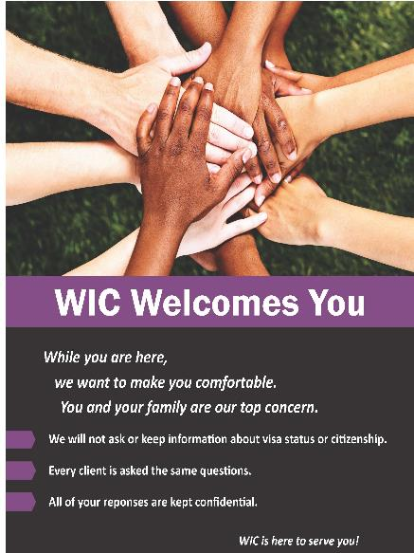
Citizenship Status
Citizenship is not required to receive WIC services.
WIC participation will not impact a participant’s ability to receive other services or to attain citizenship.
Notes:
Explain there is no effect of citizenship on WIC participation
Image Credit: WIC Welcomes You Poster_NSB Graphic Artist

Slide 12

What happens at a WIC appointment?
Identification
Proof of Residence
Proof of Income
Height/Weight/Hemoglobin check
Nutrition Assessment
Nutrition Care Plan:
  Goals
  Nutrition education
  Tailored food prescription
  Referrals
Notes:
Describe a typical WIC appointment for applicants:
Verify identification; address; and income (describe the allowed proofs if relevant)
Collect height weight and hgb, lead as needed
Nutritionist assess measurements and iron levels
Complete a nutrition assessment and determine nutrition risk
Develop a care plan includes working with participant to set nutrition goals, providing patient centered nutrition education, prescribe a food package and refer clients to resources in the community or within the agency.
Image Credit: WIC works

Slide 13
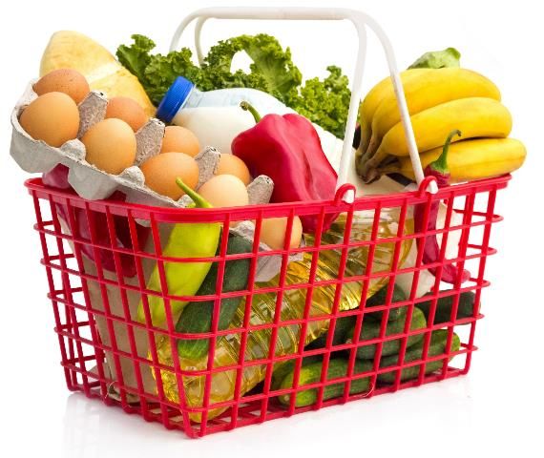
Healthy Foods – Food Prescriptions
  Monthly food benefits are issued to an electronic benefit account. An eWIC card is issued to participants to purchase healthy foods at the grocery store
  Each participant is prescribed a tailored food package by a nutritionist or Competent Professional Authority (CPA) that helps meet the specific nutrition needs of WIC population
  Key nutrients in food package:
          Fiber
          Low in fat and sugar,
          Good sources of iron, vitamins A, C, D, folate, calcium and more!
Notes:
One of the main pillars of WIC is the provision of healthy foods. WIC supports low-income families in providing nutrient rich foods to promote healthy growth and development
Receive monthly food benefits to purchase healthy foods at the grocery store. This is loaded to an electronic benefit account, and then an eWIC card is issued to purchase the food. This is accepted at many local and chain grocery stores through the state.
Each participant is prescribed a tailored food package by a nutritionist
WIC program is a supplemental food program (so it is not intended to provide all the needed food for the month)
The food package contains key nutrients such as fiber, iron, vitamins A, C, D, folate , calcium while being lower in fat and sugar
WIC does diffes from Food and Nutrition Services (Food stamps) in that participants receive only approved types of foods, brands, sizes, etc
Image Credit: grocery basket Fotolia_56339361_Subscription_XXL.jpg

Slide 14
Healthy Foods:
Food Prescriptions for Women and Children
Milk (Whole, 1% or Skim)
Breakfast Cereal
100% Juice
Choice of Whole Grains
Eggs
Canned Tuna or Salmon
Beans, Peas, or Lentils
and/or
Peanut Butter
Fruits and Vegetables
(Cash Value Benefit or CVB)
Notes:
Listed on the screen are the basic foods in a Child’s or a Woman’s Food Package. Depending on the category of the WIC Participant and the age of the child, the quantities vary and types of some foods may vary, for example milk. As you can see, the standard food package provides milk, cereal, juice, whole grains, eggs, beans/peas or lentils, peanut butter and fruits and vegetables.
1%/Skim milk is the standard for issuance to children ≥24 months of age.
Whole milk can be provided with a prescription from the medical provider
Whole milk is the standard for issuance to children ages 12 to 24 months of age.
2% milk can be issued per nutritionist assessment
Fruits and vegetables are provided in form of the Cash Value Benefit (CVB) which is a dollar amount that participants receive each month for fresh, frozen or canned fruits and vegetables.
Image Credit: grocery basket Fotolia_56339361_Subscription_XXL.jpg

Slide 15
Food Prescription for Fully
Breastfeeding Women
Healthy Foods:
Skim or 1% Milk
Cheese
Juice
Cereal
Eggs
Beans, Peas or Lentils AND Peanut Butter
Choice of Canned Tuna or Salmon
Whole Grains
Fruits and Vegetables
Notes:
On the screen is an example of a food Package for fully breastfeeding women, which is one of our largest food packages in terms of volume of food.
Includes cheese, additional peanut butter, and also the only food package with canned tuna/salmon
Women Fully breastfeeding multiples get more food.

Slide 16
Children (1-5 years old)
Whole or 1%/Skim Milk
Breakfast Cereal
100% Juice
Choice of Whole Grains
Eggs
Beans, Peas, or Lentils OR Peanut Butter
Canned Tuna or Salmon
Fruits and Vegetables
Notes:
Describe the Child’s food Package
Include when a child would get Whole, 2% and 1%/skim
1%/Skim milk is the standard for issuance to children ≥24 months of age.
Whole milk provided with Rx
Whole milk is the standard for issuance to children ages 12 to 24 months of age.
2% milk can be issued per CPA’s assessment

Slide 17
Pregnant Woman or Partially Breastfeeding
Skim or 1% Milk
Juice
Cereal
Eggs
Beans, Peas or Lentils AND Peanut Butter
Canned Tuna or Salmon
Choice of Whole Grains
Fruits and Vegetables
Notes:
Describe the food Package for pregnant and partially breastfeeding women
1%/Skim milk is the standard for issuance; Whole milk provided with Rx; 2% milk can be issued per CPA’s assessment
Women who are pregnant with multiples and women who are pregnant and breastfeeding may get more food.

Slide 18
Fully Breastfeeding Women
Skim or 1% Milk
Cheese
Juice
Cereal
Eggs
Beans, Peas or Lentils AND Peanut Butter
Canned Tuna or Salmon
Choice of Whole Grains
Fruits and Vegetables
Notes:
Describe the food Package for fully breastfeeding women
1%/Skim milk is the standard for issuance; 2% milk can be issued per CPA’s assessment; Whole milk provided with Rx
Includes cheese, additional peanut butter, canned tuna/salmon
Women Fully breastfeeding multiples get more food.

Slide 19
Postpartum Women
Skim or 1% Milk
Juice
Cereal
Eggs
Canned Tuna or Salmon
Beans, Peas or Lentils OR Peanut Butter
Fruits and Vegetables
Notes:
Describe the food package for postpartum women that are not breastfeeding:
food package includes: milk, juice, cereal, eggs, , beans OR peanut butter, and a cash-value voucher for fruits and vegetables
does not include whole grains;
1%/skim standard milk issuance; 2% available per CPA; whole milk available with Rx
woman receives food package up to six months postpartum who’s infant is receiving formula from WIC and who is not breastfeeding.

Slide 20
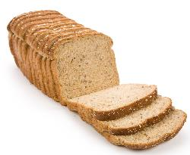
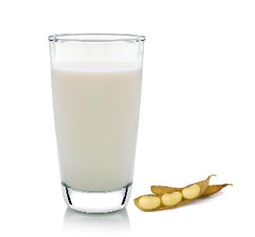
Tailoring and Substitutions
Whole Grain Options
Whole Wheat Bread
Brown Rice
Whole Wheat Pasta
Whole Wheat or Corn Tortillas
Milk Substitutions
Cheese
Tofu
Yogurt
Types of Milk
Lactose-free/reduced milk
Soy-based beverage
Canned evaporated milk
UHT milk
2% Milk
Whole Milk for Children over 2 years and women
Notes:
Tailoring and substitutions of the WIC food package is permitted
.
So, WIC participants have an option of Whole grains such as whole wheat bread, brown rice, whole wheat pasta and whole wheat or corn tortillas.
The Nutritionist is able to tailor participant’s milk products when indicated by the nutrition assessment. Types of milk available include:
Lactose-free/reduced milk
Soy-based beverage
Canned evaporated milk
UHT (ultra high temperature) milk
Reduced fat (2%) milk may be issued to children and women and when a Nutritionist determines there is a medical need based on an individual nutrition assessment.
Children over the age of 2 and women can receive whole milk if they provide medical documentation that indicates the need for whole milk in the treatment or management of a medical condition.
There are also Milk substitutions available to participants:
Participants are able to substitute some of their milk for Cheese, yogurt or tofu.
Get more than one milk substitution so they can choose cheese and yogurt for example.
Describe the choices of wholegrains in the food package
Choice of whole wheat bread, brown rice, whole wheat pasta, or whole wheat or corn tortillas
Participants choose at the grocery store as long as whole grains are included in their food package.

Slide 21

Fully Breastfed Infant
Breastmilk
Infant Cereal
Infant Fruits and Vegetables Or CVB
Infant Meats
Notes:
Describe mother –baby dyad:
mother and infant are viewed as a pair (or dyad) for the first year after birth.
Feeding option of the infant determines the infant’s food package AND the mother’s food package.
Feeding option of the infant changes, the infant’s food package AND that the mother ‘s food package changes.
Describe the Fully breastfed infant food package
No formula, infant cereal, stage 2 infant fruits and vegetables, and infant meats at 6 months
Receive twice as much fruits and vegetables than infants not fully breastfeeding
each infant who is fully breastfed gets this food package
Image credit: W Mom and Child Breastfeeding3_Fotolia_16678824.jpg

Slide 22
Infants Receiving Formula
Partially Breastfeeding
Fully Formula Feeding
Formula (standard)
Infant Cereal
Infant Fruits and Vegetables or CVB
Notes:
Describe differences in partially breastfeeding infant and fully formula fed infant food package.
Food Packages for infants are tailored based on the needs of the mother and infant.
Nutritionists have conversation with the nursing mother to determine the appropriate amount of formula to prescribe.
Breastfeeding is encouraged and supported
Infants will receive infant cereal and stage 2 infant fruits and vegetables at 6 months. No meats. Less than a fully breastfed infant.
Infants who are fully formula fed and receiving contract standard milk-or soy-based formula will also receive different amounts of formula depending on the age of the infant.
Birth-3 months: 9 cans powder
4-5 months: 10 cans powder
6-11 months: 7 cans powder

Slide 23
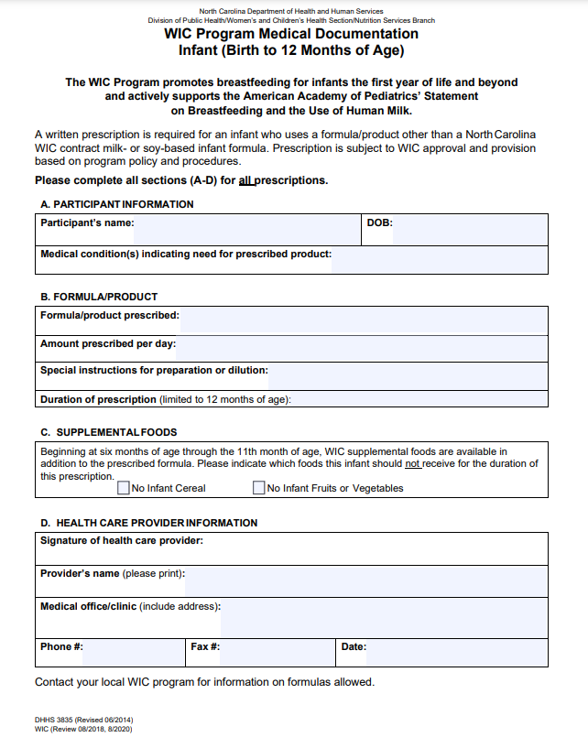
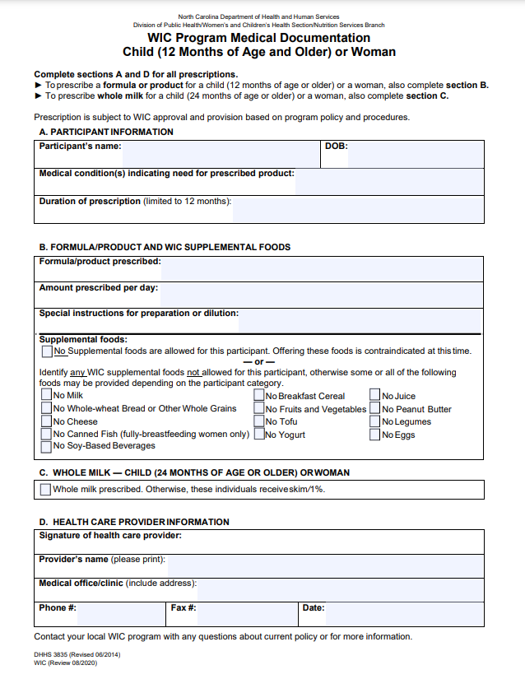
Exempt Infant Formulas & WIC-Eligible Nutritionals
Medical conditions can qualify for special formulas and or nutritional supplements
WIC Program Medical Documentation is required
Health Care Provider Resources
Notes:
WIC provides a standard formula; there are medical conditions that require a formula other than a standard milk- or soy- based formula and or what we refer to as WIC Eligible Nutritionals (an example of a WIC eligible nutritional is like pedisure for a child or boost for a woman).
In order to be issued an exempt infant formula or nutritional, a prescription from a medical provider is required. Usually, it’s the WIC Program Medical Documentation Form with required information such as participant name, DOB, medical condition required the special product and amount prescribed. Many local agencies provide these forms to local pediatricians, etc and the provider can also access it on our website.

Slide 24
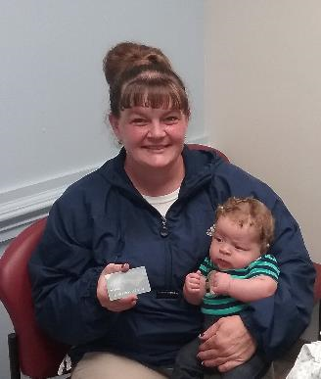
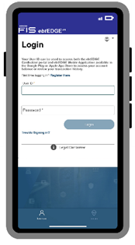
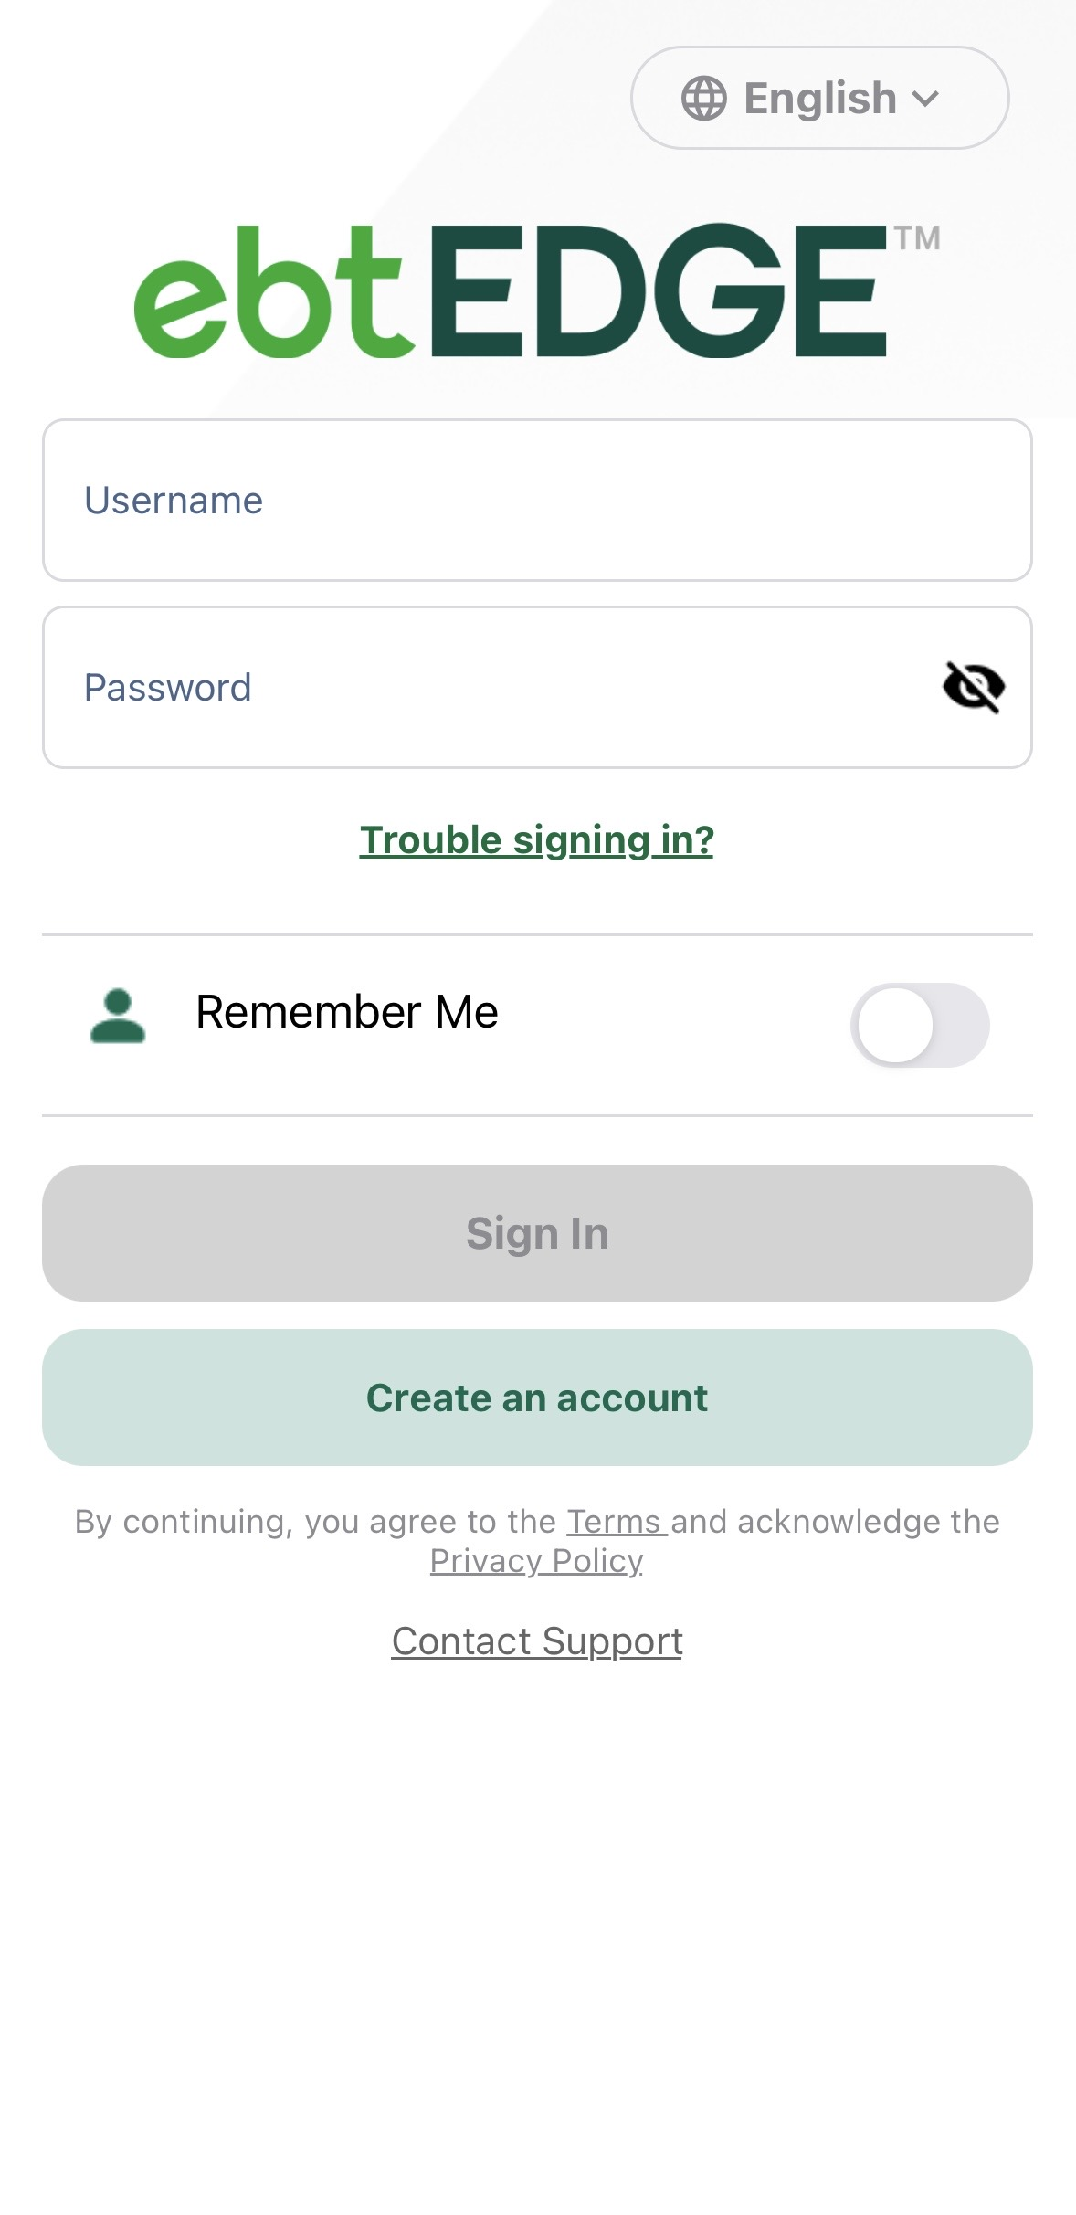
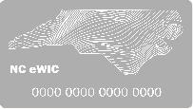
Shopping for Healthy Foods
About 1600 stores accept eWIC benefits in NC
eWIC Card works like a debit card
Purchase only what is needed
The ebtEDGE app simplifies
shopping!
Notes:
Now we have completed our WIC certification appointment, received our food package and had our foods issued to our eWIC card. Let’s go shopping!
NC has around 1600 vendors that accept WIC! From large chain stores to smaller, local grocery stores!
Shopping for WIC foods is easy with the eWIC card; works like a debit card
Participants purchase only what they need that trip and generally have about a month to purchase their food.
ebtEDGE app: participants can check their food balance for the month, scan items while shopping and see when their monthly benefits expire.
Image credit:
Phone_Fotolia_115065257
eWIC Card_NSB Graphic artist
Mom and baby with eWIC Card_scotland county ewic pic.jpg (photo consent on file)

Slide 25
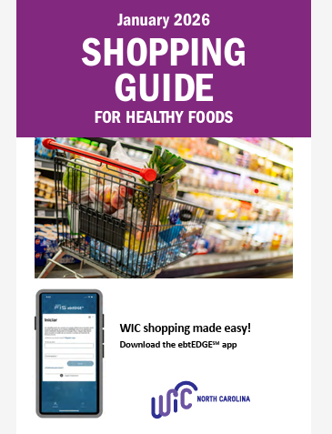
Shopping for Healthy Foods
NC WIC Program Shopping Guide
Notes:
We also provide a traditional printed shopping guide to all new participants and when requested.
Approved foods can be stricter than what is allowed by USDA, but we can’t approve foods that are not allowed by the federal regulations.

Slide 26

Farmers’ Market Nutrition Program
May – September
Active Women and Children (2-4 years)WIC participants
Up to $30 of cash value benefits
Any fresh, locally-grown fruits and vegetables
NC WIC FMNP
Notes:
From May to September, participants receive up to 30 dollars worth of cash value benefits to purchase any fresh, locally grown fruits or vegetables.
Children aged 2 to 4 and Women who are actively participating in the WIC Program are eligible to receive these benefits. Each eligible participate will receive six coupons worth $5 each.
There’s a limited number of agencies operate the FMNP Program; this year, around 26 county WIC’s operate the FMNP.

Slide 27

Breastfeeding Promotion and Support
Notes:
The next benefit is Breastfeeding Promotion and Support.
Discuss current recommendations for breastfeeding
Describe WIC’s role in breastfeeding promotion and support
Increase the initiation, duration and exclusivity of breastfeeding
All WIC agencies have trained personnel ready to help moms make informed decisions about their infant feeding choice.
Instructs mothers in the basics of breastfeeding.
Describe in detail education provided to moms
Highlight classes your agency offers
Give examples of topics covered: the benefits of breastfeeding, ways to make breastfeeding comfortable, how to tell if the infant is getting enough, and fitting breastfeeding into mom’s lifestyle etc.
Image Credit: NWA Social Media Posts

Slide 28


Breastfeeding Promotion and Support
Trained Staff
Breastfeeding-friendly Environment
Breastfeeding Peer Counseling Program
Breastfeeding Supplies
Notes:
Highlight ways your agency promotes breastfeeding and supports breastfeeding mothers and infants:
Trained BF staff (highlight IBCLCs on staff)
Provide breastfeeding friendly environment (consider adding pics of your agencies breastfeeding room)
Highlight support groups available through your agency
Offer supplies such as breast pumps, breast pads, and supplemental feeding devices.
Discuss each breast pump and supplies available
Describe requirements if applicable
Image credit: WIC Works Photo - AA PC - AA mom bf

Slide 29
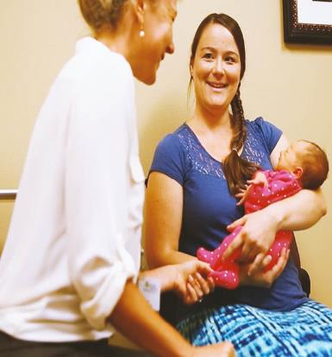
Breastfeeding Peer Counseling Program
Peer-to-peer support
Provides basic breastfeeding information
Refers to lactation experts and health care providers as needed
“Breastfeeding peer counselors kept me breastfeeding for a whole year thanks to their help.” -NC WIC Participant
Notes:
OMIT SLIDE IF YOUR AGENCY DOES NOT PARTICIPATE IN BFPC PROGRAM
Highlight benefits of Breastfeeding Peer Counselor Program
North Carolina currently has 82 agencies funded for the Breastfeeding Peer Counselor Program..
Peer Counselors are mothers who are currently breastfeeding or who have done so in the past.
Trained to provide information, encouragement, and support to new mothers
Peer-to-peer support is an essential component to a successful breastfeeding program.
When are BFPC’s available in your agency?
Image Credit: NWA_peercounselors.jpg

Slide 30


Nutrition Education
Participant-centered Nutrition Counseling
Group Classes
Mini-lessons
Online Nutrition Education
Notes:
The next major benefit of WIC is nutrition education. Nutritionists in WIC clinics provide participant-centered nutrition counseling. Some agencies also provide group nutrition classes and low risk nutrition education that we refer to as mini lessons are general nutrition education topics. Generally, a WIC participant will receive nutrition education every 3 months (4 x/y). Required nutrition education contacts on the local agency end,
There are variety of ways in which local agencies provide nutrition education:
One-on-one counseling, group classes are offered in some NC WIC agencies.
On-line Nutrition Education through wichealth.org
allows participants to complete the required second nutrition education contact at their convenience.
Mini lessons are developed by nutritionists and presented one-on-one by trained management support staff
Nutrition classes on a variety of topics: Healthy beverage choices, food label reading, portion distortion, and increasing physical activity are just a few topics that may be addressed.
Taught by WIC Staff
Cooperative Extension staff (EFNEP) Expanded Food and Nutrition Education Program Outside Staff
Outside staff may be brought in to provide nutrition education if the need arises.
The purpose of Nutrition education:
To teach about the relationship between nutrition, physical activity and good health.
To improve the eating and physical activity habits as they relate to the participant’s nutritional risk.
To promote optimal use of the WIC Program’s supplemental foods, and other nutritious foods.
To provide nutrition education that is appropriate to an individual’s age, educational background, household situation, language, cultural and ethnic preferences, and nutritional needs.
Image Credit:
NWA apple graphic
WIChealth.org logo

Slide 31

Community and Health Care Referrals
Immunization Services
Prenatal Care
Well Child Health Care
Social Services
Substance Abuse Counseling and Treatment
Food Assistance Resources
Dental Care
Notes:
The fourth major benefit of the WIC program is community and healthcare referrals, as needed
Local agencies often have reciprocal relationships with the health care community, receiving referrals from private and public health care providers and providing referrals as needed for healthcare providers
Encourages persons already receiving medical services to continue and encourages individuals not receiving medical care to seek and maintain appropriate health
Coordinate services for participant convenience
Referrals other than general healthcare include:
immunizations (often to the health department in which the WIC clinic may be located)
substance abuse counseling and treatment..
Lead Screening
Medicaid/Health Choice
Food Stamps – now called Food and Nutrition Services
Lactation support
Dentist
Food banks/pantries
Pregnancy centers
Image Credit: NWA Megaphone graphic

Slide 32

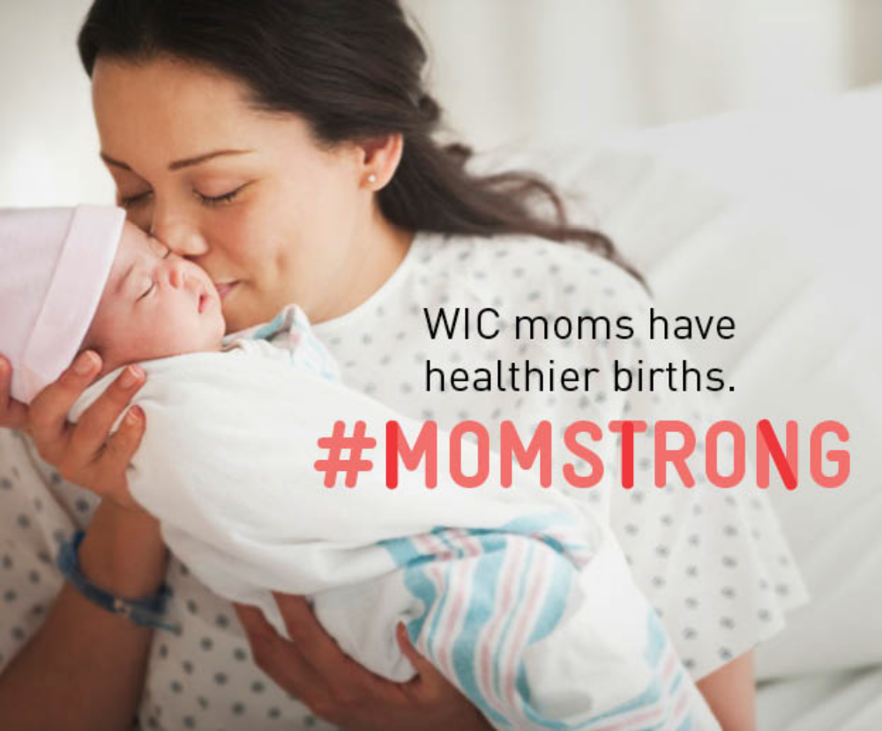
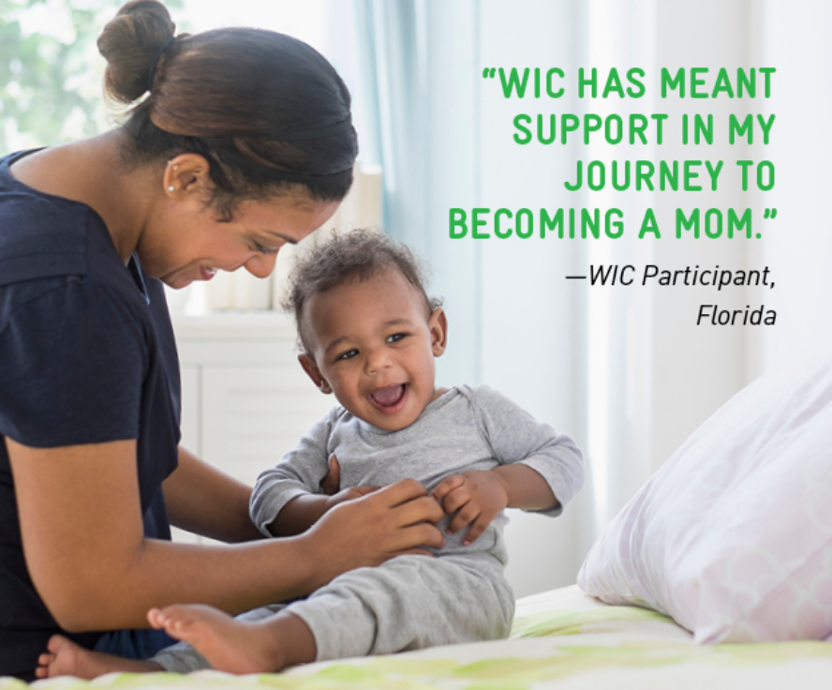
Why should you refer clients to WIC?
Notes:
What are your participants saying about the program?
Highlight Current research:
WIC Works…. WIC is effective in reducing the probability of high-risk births, very premature and low-birth weight babies (Effects of federal nutrition program on birth outcomes, G.Y.Feng, 2012)
WIC children have increased intakes of iron, potassium, and fiber (The effects of SNAP and WIC Programs on nutrient intakes of Children's, Yen, S; Food Policy 2010)
WIC children at ages 1 to 2 have less dental related Medicaid costs compared to children who do not participate in WIC (The effects of Women, Infants, and Children Supplemental Food Program on dentally related Medicaid expenditures Lee, J.Y, Rozier, R.G, Journal of Public Health Dent, 2004)
WIC interventions can help improve healthful behaviors that are linked to reducing early childhood overweight (WIC-based intervention to prevent early childhood overweight, Whaley, S.E. et al., Journal of Nutrition Education and Behavior; 2010)
Image Credits: NWA 2018 Social Media Posts

Slide 33

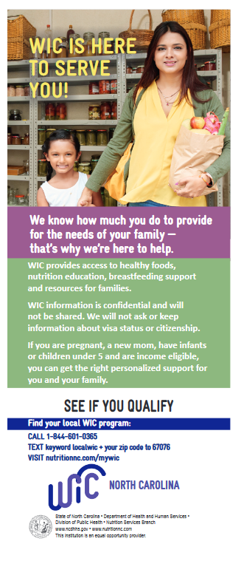
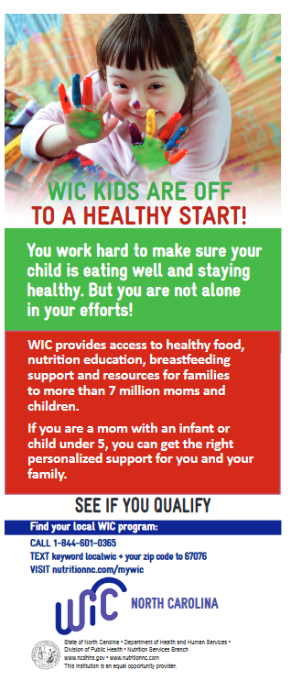
Referrals to WIC:
Outreach Materials
Notes:
Interested in outreach WIC materials to provide to potential WIC participants?! We have resources for you! NC WIC has a variety of outreach bookmarks, pamphlets and brochures!
See our website for samples of outreach materials
Provide copies of the WIC Program Exchange of Information form.
If you would like outreach materials, please contact us and we will get you what you need. I will provide my email in the chat and you can email me for information on ordering outreach materials!
Refer clients to the MY WIC page: https://www.ncdhhs.gov/ncwic/mywic
More information including a prescreening tool (FNS) and the NC WIC Online Referral Form. The online referral form can be filled out by a potential participant and will connect them with the WIC agency in their area.
Describe how clients can be referred to WIC based on your audience
Is there a Formal process your agency would like to use to receive referrals
Consider discussing the Use of referral forms
Call
Describe any resources available that can be used to refer clients
See our website for samples of outreach materials
Provide copies of the WIC Program Exchange of Information form.
Provide outreach materials with your agency's information (phone number, website, hours of operation etc).
Image credit: NWA megaphone graphic

Slide 34
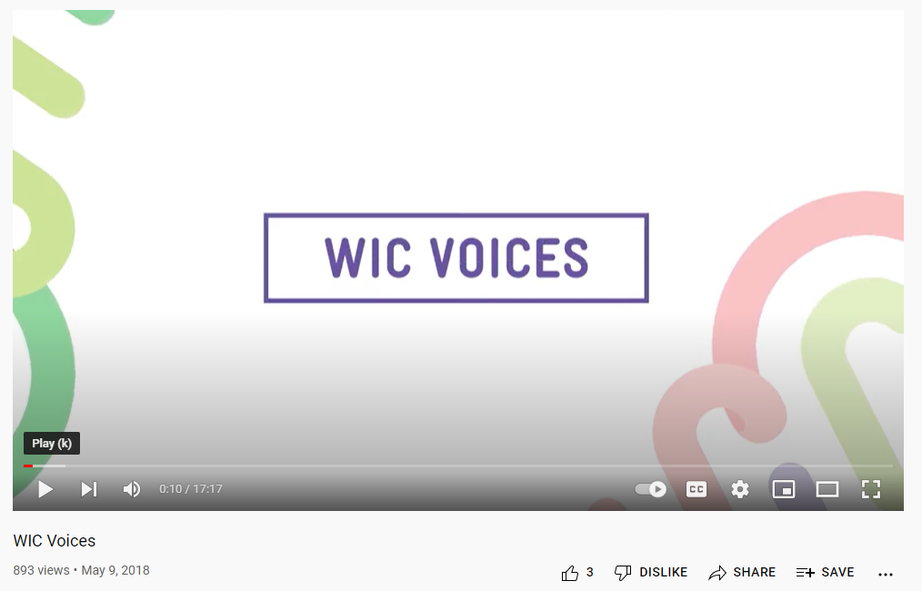
WIC Voices Video
Notes:
Let’s watch part of a video from the National WIC Associations and hear from some WIC participants!
Image links to YouTube video: https://www.youtube.com/watch?v=YdNWnqZVDsU

Slide 35

Contact Us!
State WIC Webpage
  https://www.ncdhhs.gov/ncwic
Local Agency Contact Information
Notes:
Insert local agency contact information and/or website
Consider providing business cards
Image Credit: NWA 2018 social media images

Slide 36

Thank You!
Questions?
Notes:
Offer closing remarks and thank participants.
Image credit: Microsoft Office 365 Subscription Stock Photo

Slide 37

In accordance with federal civil rights law and U.S. Department of Agriculture (USDA) civil rights regulations and policies, this institution is prohibited from discriminating on the basis of race, color, national origin, sex (including gender identity and sexual orientation), disability, age, or reprisal or retaliation for prior civil rights activity.
Program information may be made available in languages other than English. Persons with disabilities who require alternative means of communication to obtain program information (e.g., Braille, large print, audiotape, American Sign Language), should contact the responsible state or local agency that administers the program or USDA’s TARGET Center at (202) 720-2600 (voice and TTY) or contact USDA through the Federal Relay Service at (800) 877-8339.
To file a program discrimination complaint, a Complainant should complete a Form AD-3027, USDA Program Discrimination Complaint Form which can be obtained online at: https://www.usda.gov/sites/default/files/documents/ad-3027.pdf, from any USDA office, by calling (866) 632-9992, or by writing a letter addressed to USDA. The letter must contain the complainant’s name, address, telephone number, and a written description of the alleged discriminatory action in sufficient detail to inform the Assistant Secretary for Civil Rights (ASCR) about the nature and date of an alleged civil rights violation. The completed AD-3027 form or letter must be submitted to USDA by:
mail:
U.S. Department of Agriculture
Office of the Assistant Secretary for Civil Rights
1400 Independence Avenue, SW
Washington, D.C. 20250-9410;
fax:
(833) 256-1665 or (202) 690-7442; or
email:
program.intake@usda.gov
This institution is an equal opportunity provider.
Notes:
On this slide we have the USDA non-discrimination statement.

