Slide 1
NCEM HUMAN SERVICES
Dave Leonard
Human Services Branch Manager

Slide 2
State Sheltering Guides
Shelter Types
TOPICS
Access and Funcitional Needs in Shelters
Partnerships

Slide 3
SHELTER GUIDE
Provide options and guides for Local, Tribal and State sheltering and mass care
Consists of Guide and 5 Annexes (listed below)
Local Sheltering Annex
Great local info
State Coordinated-County Hosted Shelter Annex
State Operated Shelter Annex
NC-VA Evac Annex
NC Mass Evacuation and Transportation Annex

Slide 4
SHELTER GUIDE
Staffing Matrix
Division / Agency Responsibilities
Staff job descriptions
Shelter set-up recommendations (size, ADA concerns,

Slide 5
American Red Cross Staffing Matrix

Slide 6
Local Sheltering Annex
Information that can be integrated into Local Shelter Plan
Concepts of Operations
Feeding, Medical, Health, Mental Health, Child Support, Pet Sheltering, Safety & Security

Slide 7
SHELTER TYPES
Emergency Evacuation Shelter: Immediate refuge during rapid evacuations; typically for no more than 72hrs; 20 sq. ft per person
Short Term Shelter: Sustainable for populations displaced for typically no more than 2 weeks; 40 sq ft per person
Long Term Shelter: Typically, more than 2 weeks; 60-80 sq. ft per person

Slide 8
Shelter needs / resource requests are typically handled at the local level
Where are your shelter resources stored?
Cots, blankets, ADA devices, etc.
GO-KIT
Registration forms
Pens, paper, etc.
Feeding Plan
Make plan with Local EM prior to opening shelters
Where within your County can you obtain shelter resources? Generators, showers, portable toilets, etc.
Shelter Resources via WebEOC
Resource Requests
Notify Local EM at County EOC regarding resource request
Local EM, if unable to fill the request, will send the request via WebEOC to the State Emergency Operation Center (SEOC) to be filled

Slide 9
WEBEOC RESOURCE REQUEST

Slide 10
Shelter Status: Report all Shelter status, including numbers in WebEOC on the Shelter Board. Typically done via communications from Shelter to County Emergency Operation Center (EOC)
How do you communicate with your Local EOC?
Cell, landline, email, or perhaps Amateur Radio
Make sure Communications is worked out prior to opening a Shelter
Shelter Status Reports
Official capacity numbers taken at night by American Red Cross (typically after 9PM)—Field Remote Operations Support Team (FROST) Report
Recommended that numbers are reported regularly to Local EOC for their entry into WebEOC as well as for their County Situation Reports that they provide to the SEOC

Slide 11
WEBEOC SHELTER BOARD

Slide 12
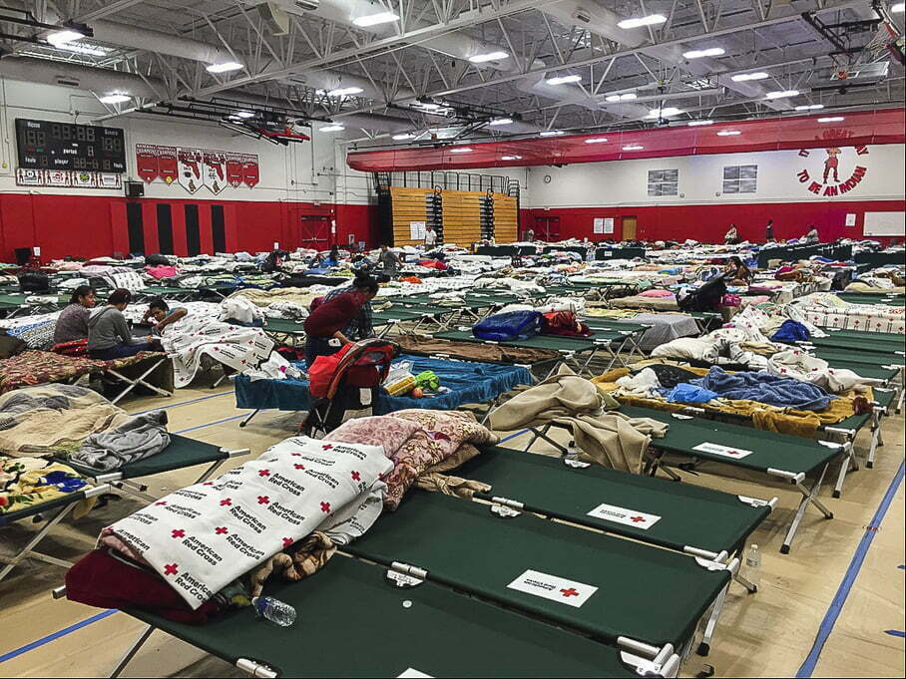
SHELTERING
Shelter Location / Accessibility
Physical Accessibility Considerations
Shelter Services
Communication
County level and with Clients

Slide 13
Access and Functional Needs CMIST Framework
IMAGE: https://aspr.hhs.gov/at-risk/Pages/at-risk_afn.aspx

Slide 14
Access and Functional Needs Includes Individuals…
Disability
Chronic condition
Temporary injury
Limited English proficiency
Older adults
Children
Late-stage pregnancy
Unhoused
Transportation difficulties
Substance Use Disorders
Mental Health condition
Limited resources
Source: dem.nv.gov/preparedness/Access___Functional_Needs/

Slide 15
Functional Assessment Support Team ------------ FAST
Trained, deployable teams that work in Disaster Service Centers during disasters. They assist with assessments and addressing the needs of people with access and functional needs.
They help shelter managers identify solutions to assist residents in maintaining their independence in the shelter.

Slide 16
STATE SHELTERING OPERATIONS
State Coordinated-County Hosted Shelter
Local (Host County) shelter operations supporting another county (Risk County)
Host County operating one of their county shelter for citizens from another County (County to County Mutual Aid / Statewide Mutual Aid
Risk County—provide assistance (staffing, resources, etc)
State Support
Same support by State as if it was a Local Shelter Operation
Reimbursable expenses

Slide 17
STATE SHELTERING OPERATIONS
State Operated Shelter
Large Scale Shelter
Often referred to as a Mega Shelter
Typically, 500-plus sheltered
State supported services
Feeding, Staffing, Wrap-around Services, Security, Medical, etc.

Slide 18
STATE SHELTERING OPERATIONS / Hurricane Helene
4 State Operated Shelters
Rowan County—J.F. Hurley Family YMCA
Caldwell County—Kelina Lane Site
Buncombe County
Western NC Agriculture Center
AB Tech

Slide 19
Training and Exercises
Training:
American Red Cross Classes
Online, in person
Reach out to Local EM for upcoming class offerings
NCEM Training
NC Training, Exercise & Response Mgt (TERMS)
Access & Functional Needs
FAST training
Exercises
Tabletop Exercises
Full-scale Exercises

Slide 20
Partnerships
Partnership
Local Emergency Management
Local DSS
Local Governmental Support
County / Municipal Management
County / Municipal Agencies and Departments
Parks and Rec, Tax Department, Administration, etc.
State DSS
Volunteer Agencies / Non-Governmental Organizations
American Red Cross, Faith-based Organizations, Salvation Army, etc.
NC Emergency Management Human Services Branch

Slide 21
QUESTIONS?
David.leonard@ncdps.gov
919-812-8684

