Slide 1

NC Department of Health and Human Services
Organizational Standards

Slide 2
Agenda
Organizational Standards Background
Due Dates / Time Frames
Flash Drive Submission Expectations
Review of Organizational Standards

Slide 3
Organizational Standards
The CSBG organizational standards provide a standard foundation of organizational capacity for all CSBG Eligible Entities (CEEs) across the United States. The Federal Office of Community Services’ Information Memorandum (IM) 138 provides direction to States and CEEs on establishing organizational standards by and includes the final wording of the standards developed by the OCS-funded organizational standards Center of Excellence (COE).
The COE-developed organizational standards are comprehensive and were developed by and for the CSBG Network through the work of the CSBG Working Group. They work together to characterize an effective and healthy organization while reflecting the vision and values of Community Action and the requirements of the CSBG Act.

Slide 4
Purpose
To ensure that CSBG Eligible Entities have the capacity to provide high-quality services to low-income families and communities.

Slide 5
State Guidance and Interpretation
The Office of Economic Opportunity (OEO) as North Carolina’s CSBG Lead Agency will assess all CSBG Eligible Entities against the Organizational Standards each year as a component of the state’s Risk Assessment process. Meeting the requirements of the organizational standards are intended to strengthen agencies capacity for delivering services to low-income families; however, meeting the standards alone does not ensure overall CSBG compliance. Compliance with the organizational standards will become a part of OEO’s remote and onsite monitoring but will in no way replace monitoring efforts relative to all applicable state, federal and contract compliance rules.

Slide 6

Organizational Standards Are Divided Into Three Groups, Comprising Nine Categories
Maximum Feasible Participation
Vision and Direction
Operations and Accountability

Slide 7

Maximum Feasible Participation
Consumer Input and Involvement
Community Engagement
Community Assessment

Slide 8

Vision & Direction
Organizational Leadership
Board Governance
Strategic Planning

Slide 9

Operations & Accountability
Human Resource Management
Financial Operations and Oversight
Data Analysis

Slide 10
Due Dates / Time Frames
Due Date-October 15, 2021
November 19, 2021- OEO will send a cleaning memo to all agencies with the completed first review no later than
January 31, 2022- Agency latest deadline to submit second submission for any standards that were determined as unmet in the cleaning memo.
February 28, 2022- Final letter documenting final scores and risk threshold to agencies.
*Dates are subject to change*

Slide 11
Standards with Activities Occurring More Frequent Than Annually
5.5 Board meets and fills vacancies in accordance with its bylaws
5.7 New board members are provided structured orientation within 6months of being seated
5.9 Board receives programmatic reports at each meeting
7.2EmployeeHandbook (personnel policies) made available to staff; Staff also notified of changes
7.8 Staff participates in new employee orientation within 60 days of hire
7.9 Conductor make available ongoing staff development/training
8.2All findings from prior year’s annual audit have been assessed & addressed
8.7 Board receives financial reports at each meeting
8.8 Payroll withholding filings and payments are completed on time

Slide 12
Annual Activities
4.2 Community Action Plan tied directly to Community Assessment
4.3 Community Action Plan documents use of Full ROMA Cycle; documents having used services of a ROMA certified trainer to assist in implementation
4.4 Written succession plan for the CEO/ED, approved by the Board
6.5 Board receives an update on meeting goals of Strategic Plan
7.4 Board conducts a performance appraisal of CEO/ED
7.5 Board reviews and approves CEO/ED compensation
7.7 Board approves agency whistle blower policy
8.1 Audit is completed in accordance with OMB A‐133
8.3 Audit or presents the audit to the Board

Slide 13
More Annual Activities
8.4 Board formally receives and accepts the audit
8.6 IRS Form 990 is completed and presented to the Board for review
8.9 Board approves an organization‐wide Budget
8.12 Agency documents how it allocates shared costs
8.13 Agency has a written policy for record retention and destruction
9.1 Agency has a system in place to track and report services.
9.2 Agency has a system in place to track and report Family, Agency, and/or Community Outcomes.
9.3 Agency has analyzed its outcomes within past 12months.
9.4 Agency submits annual CSBGIS data report reflecting organization‐wide outcomes.

Slide 14
Standards with Activities Occurring Every Two Years
4.3 Community Action Plan(if required bi‐annually) documents use of Full ROMA Cycle, and documents having used services of a ROMA certified trainer to assist in implementation
4.5 Organization‐wide Risk Assessment completed and reported o the Board
5.4 Board members receive copy of the bylaws
5.6 Board members sign a conflict-of-interest policy
5.8 Board members are provided with training on duties and responsibilities
8.10 Fiscal policies are reviewed by staff and updated as necessary, and Board approves changes to fiscal policies.

Slide 15
Standards with Activities Occurring Every Three Years
3.1 Conduct Community Assessment & Issue Report
3.4 Board formally Accepts completed Community Assessment

Slide 16

Flash Drive Submission Expectations

Slide 17
Example of submitted documents
Standard 8.1
The Organization’s annual audit (or audited financial statements) is completed by a Certified Public Accountant on time in accordance with Title 2 of the Code of Federal Regulations, Uniform Administration Requirements, Cost Principles, and Audit Requirement (if applicable) and/or State audit threshold requirements.
There are two types of documentation required to show that an agency is in compliance with Standard 8.1. This includes (1) documentation that confirms an agency has completed an audit, and (2) documentation that confirms the agency has filed the report in a timely manner.
Documentation for the first might include:
  A physical copy of the audit report and related information, or
  An electronic copy of the audit report and related information.
Documentation for the second might include:
An electronic “receipt” from the Federal Clearinghouse showing the date the audit report was submitted within the nine-month deadline, or
A letter or other correspondence from a state agency acknowledging receipt of the audit and related information within the nine- month deadline (or earlier if required by the state)

Slide 18
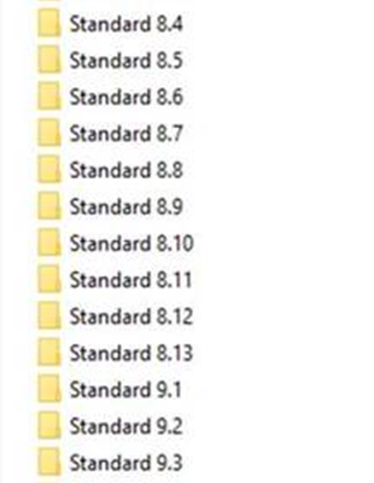
Do’s & Don’ts
Do have your Org. Standard Self-Assessment Tool saved to the flash drive
X Do not scan together (in a folder) documents referencing multiple standards
Please highlight the area in the document meeting the standard for clarity

Slide 19
REMINDERS
Due Date – Friday, October 15
When mailing your flash drives, please send an email informing your analyst that it has been mailed
USPS
We suggest sending it via Priority 1–2-day mail. This will provide you with a tracking number.
[Mailing Address: 2420 Mail Service Center, Raleigh, NC 27699-2420]
UPS/FEDEX
You must inform OEO of the expected delivery date/time so that we can inform the front desk of a package arriving. If we are not made aware of its arrival, it will be sent to the mailing process center and may take up to a week to reach our office.
[Mailing Address: 820 S. Boylan Ave. – McBryde Bldg., Raleigh, NC 27699-2420]
PERSONAL DROP OFF
You must inform OEO 1-2 days prior that you will be dropping flash drive off so we can inform the front desk.

