Slide 1

Billing Orientation for New CDSA Providers
______ CDSA
Main Office: _____
Satellite Offices: ____, ____, ____, etc.
Counties Served: ___, ___, etc.
If you contract with multiple CDSAs, please consult with each location about their specific billing processes.

Slide 2

Glossary of Terms
The following terms will be used and more information provided throughout this presentation:
ITP: Infant-Toddler Program
IFSP: Individualized Family Service Plan
ITP Services: Services which are listed on the child’s IFSP and are subject to the Medicaid Managed Care carve out (requiring the TL modifier on claims submitted to Medicaid)
EISC: Early Intervention Service Coordinator
CNDS ID (Common Name Data Service ID): Unique identifier for all children found in the NCTracks system and referenced on several CDSA forms
CBRS: Community Based Rehabilitative Services (Specialized Instruction). Any providers wishing to provide this service must be ITFC certified before joining the network and seeing children.
SFS: Sliding Fee Scale (family pay portion)
CC&E: Case Consultation and Education

Slide 3

Local CDSA Referral Process
CDSAs can add information on their local referral process for their contracted providers.
Children are referred to the CDSA/ITP through various sources (parents, caregivers, physicians, other providers, etc.) Referrals can also come from CDSA network providers. CDSA providers are obligated to make appropriate referrals to the CDSA.
The CDSA will establish eligibility in the ITP by completing an eligibility evaluation or through established condition.
An IFSP is developed for children deemed eligible and with parent consent.
Discipline-specific testing occurs and, if deemed necessary, therapy services are recommended for the child. This is the point when an EISC will work with the family to locate a provider in our network to provide the specific service(s) needed.

Slide 4

CNDS ID
CNDS ID is a unique identifier for all individuals found in the NCTracks system. This unique ID contains nine numbers followed by an alpha character (912345678A). This identifier does not signal participation specifically for Medicaid, which is a common misconception.
This ID is used to search for eligibility for multiple programs in NCTracks.
NCTracks will display the specific programs for which each child is eligible (Medicaid, Public Health/ITP, etc.).
CNDS ID is used an identifier on CDSA paperwork.
Occasionally, Medicaid eligibility will change, and a child will be issued a new CNDS ID.

Slide 5
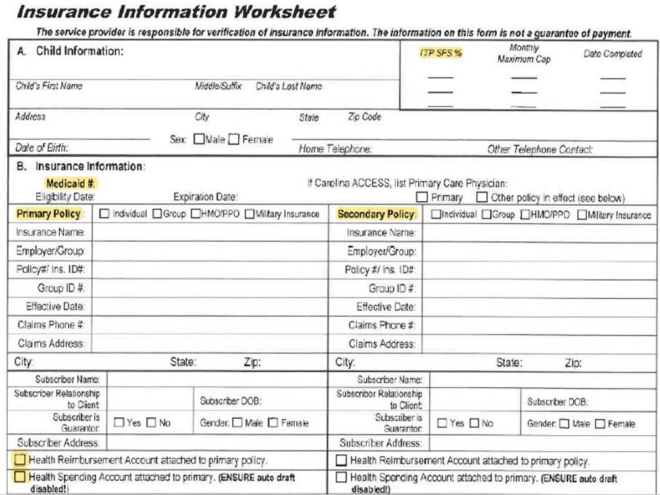
Insurance Information Worksheet
The Insurance Information Worksheet should accompany all referrals received.
In the upper right corner, the current SFS is displayed, along with the Date Completed. The SFS on this form is the official SFS by the business office. (See Appendix A for examples on applying SFS.)
In Section B, Medicaid eligibility and third-party insurance is displayed.
Health Reimbursement Accounts and Health Spending Accounts may also be noted. For families with these accounts tied directly to their insurance policy, please be sure the family has control over any spending for these accounts. Families on SFS could potentially overpay for services when HRA or HSA funds are utilized automatically by insurance.

Slide 6
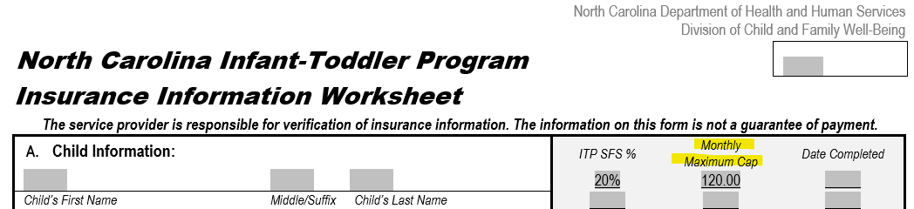

Maximum Monthly Cap for informational purposes only
1 of 2
The family’s monthly cap amount can be found in the box in the upper right corner of the Insurance Information Worksheet, beside the Sliding Fee Scale. This represents the maximum out of pocket costs a family can pay for ITP services each month.

Slide 7
Maximum Monthly Cap for informational purposes only
2 of 2
A family’s cost share for services on the IFSP should not exceed 5% of the family’s monthly gross income.
The family’s monthly cap has no impact on provider billing.
Monitoring of the maximum monthly cap is the responsibility of the family.
Enrolled providers should continue to bill for all billable services and collect payment as usual, regardless of the monthly cap amount.
Providers should provide the family with receipts for all payments made.
The CDSA will reimburse the family for payment per monthly cap guidelines.
If a family has questions about their monthly cap, please direct them to their EISC or Business Services Coordinator.

Slide 8
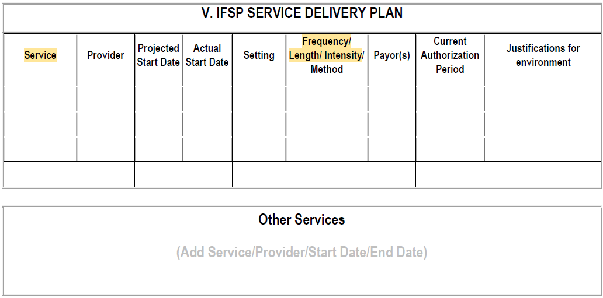
Service Delivery Plan
The Service Delivery Plan is the page in the IFSP that lists all services a family has consented to receive.
Only those services listed as an Early Intervention Service may be billed through the NC ITP.
Frequency/Intensity and cost arrangements are specified.
When multiple codes are being billed, families and EISCs should be made aware of the cost implications (for example, billing feeding/swallowing and speech therapy at the same visit).

Slide 9
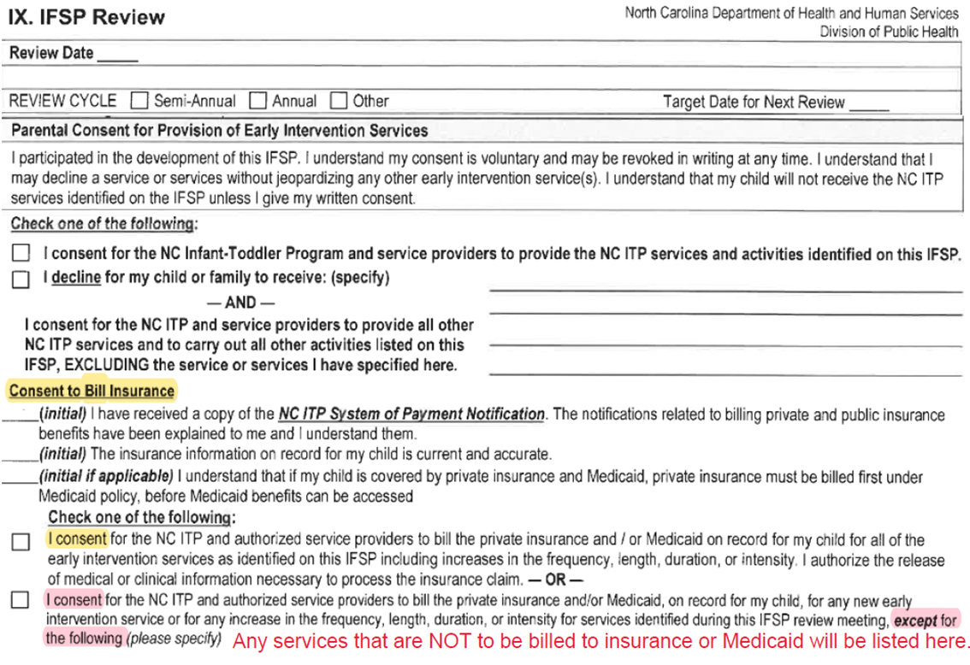
IFSP Agreement / Review Page
The IFSP Agreement/Review pages are signed by the parent consenting to services listed on the IFSP, as well as the cost associated.
From a billing standpoint, we focus on the section, Consent to Bill Insurance
  Parent initials as appropriate regarding the first three items (as indicated, it is a Medicaid requirement that insurance be billed prior to any third-party insurance).
  Check one of the following:
    First checkbox indicates permission to bill services listed on the IFSP to Medicaid and Insurance;
    Second checkbox indicates there are services that should NOT be billed to Medicaid or insurance, and those services are listed here.
  This form will be signed any time the IFSP is reviewed and when/if any changes occur to the IFSP.

Slide 10
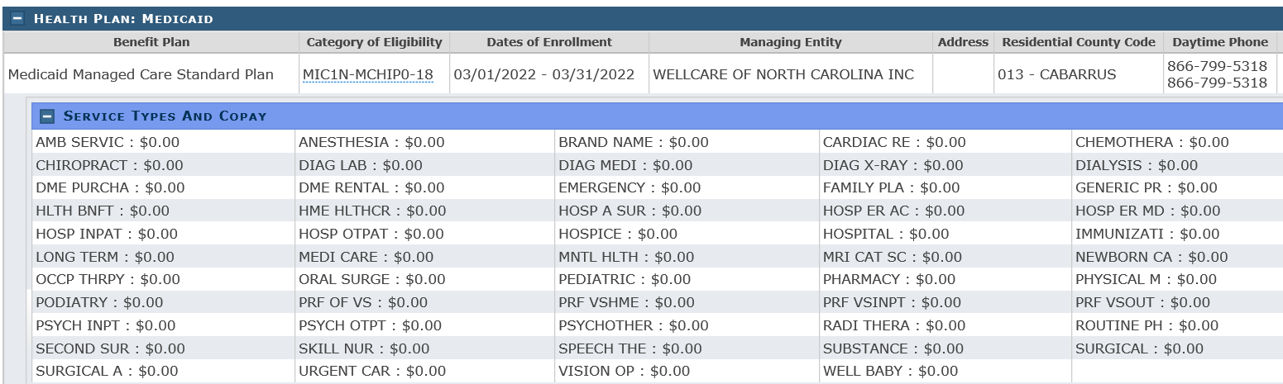
Checking Eligibility in NC Tracks
(Medicaid vs. Public Health/ITP Enrollment)
1 of 2
Upon receipt of financial paperwork, it is recommended providers verify eligibility in NCTracks.
Medicaid Enrollment – Example
* If you do not see Health Plan: Medicaid, the child does not have Medicaid eligibility.
Monthly Medicaid checks are also beneficial (and recommended) to see if there have been any changes to a child’s eligibility status.

Slide 11
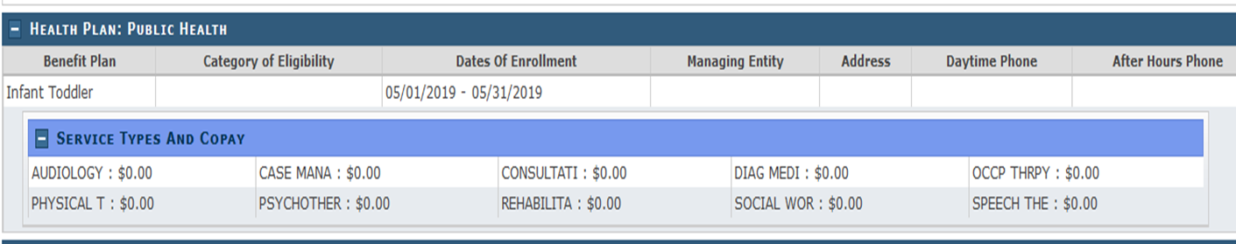
Checking Eligibility in NC Tracks
(Medicaid vs. Public Health/ITP Enrollment)
2 of 2
Public Health/ITP Enrollment – Example
* If you do not see Health Plan: Medicaid, the child does not have Medicaid eligibility.
If a child only has Public Health/Infant Toddler enrollment,
then they do not have NC Medicaid.
It is possible for a child to show Medicaid eligibility AND Public Health/Infant Toddler eligibility.

Slide 12
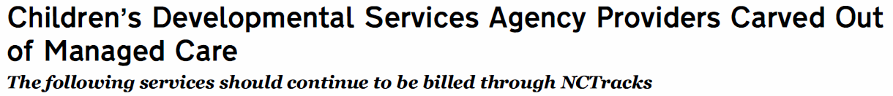
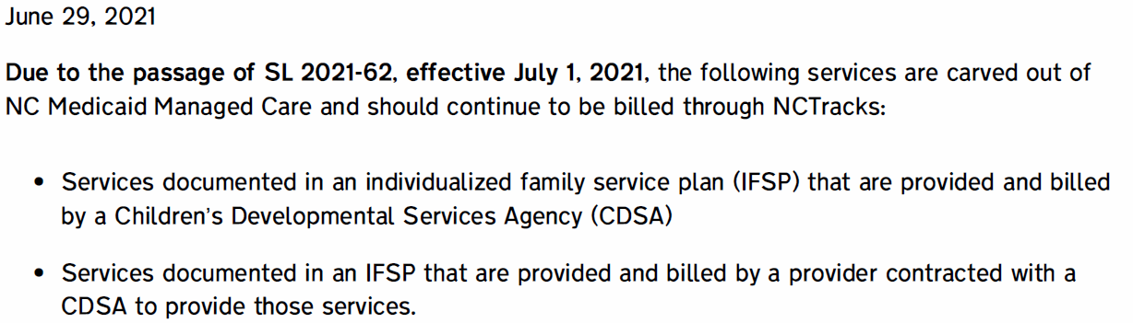
Medicaid Bulletin 6/29/2021
IFSP Services Carved out of Managed Care
CDSAs Carved Out of Managed Care (Link)
For audit purposes, providers should be sure they have a copy of the IFSP to support billing Medicaid Direct with the TL modifier.
Without the modifier, providers will receive a Medicaid denial, instructing them to bill through the child’s MCP.
Services billed to the ITP payor do not require the TL modifier.

Slide 13

Insurance/Medicaid Billing Information
1 of 2
Providers are required to accept all public and private insurance (failure to do so may be cause for termination of the Provider Agreement).
Private insurance must be billed before the ITP, with family consent to bill. The only exception is for CBRS billing.
Medicaid requires private insurance be billed prior to billing Medicaid, with family consent to bill. The only exception is for CBRS billing.
When the child has private insurance, the ITP claim submitted in NCTracks must reflect the insurance allowed amount to ensure that the ITP does not reimburse amounts greater than the determined reimbursement rate.

Slide 14
Insurance/Medicaid Billing Information
2 of 2
CC&E is not billed to Medicaid and insurance. Bill to ITP Funds only through the NCTracks portal. An ITP PA must be in place to receive payment.
All Medicaid claims for ITP services must be billed using the TL modifier. This indicates that it is an ITP service on an IFSP and does not need to be billed to the Medicaid PHP. (If the TL modifier is omitted, you will receive a denial stating that you need to bill the child’s PHP).
Providers are responsible for appropriate Medicaid enrollment, having general knowledge of Medicaid and insurance billing processes, and ensuring claims are submitted accurately for payment. Providers are responsible for obtaining Medicaid and third-party insurance prior authorizations for ITP services.
NCTracks Training (Link)

Slide 15

Prior Authorizations (PAs)
1 of 3
There are 3 types of Prior Authorizations (PAs):
Medicaid PAs – Required for any children eligible for Medicaid, receiving Outpatient Specialized Therapy services (not required for CBRS). Providers complete these PAs.
Insurance PAs – Any authorizations required by the child’s third-party insurance policy for services. Providers complete these PAs.
ITP PAs – EISCs are responsible for submitting all ITP PAs to the CDSA Business Office, who will get them keyed into NCTracks. ITP PAs must be in place prior to receiving payment from ITP through the NCTracks portal, but are not required to be in place before the start of services. Authorizations for ITP are required in the following scenarios:
  All CCE, regardless of family’s third-party payor or SFS.
  Services for children without Medicaid and have a reduced payment responsibility based on SFS (0% - 80%). Families with 100% SFS do not need ITP authorization for services.

Slide 16
Prior Authorizations (PAs)
2 of 3
Providers are responsible for:
  Any necessary prior approvals (PAs) from the child’s primary payor (Medicaid or insurance). If a provider fails to obtain proper PA, resulting in a denial from the primary payor, ITP funds will not be available as an alternative payment. Exception: CBRS does not require insurance or Medicaid PA.
  Obtaining renewal PAs as appropriate, and in a timely manner, from third party payors for continuation of therapy services. ITP does not pay due to failure to appropriately renew PAs.
  Obtaining any retroactive PAs for children who become eligible for Medicaid retroactively, as well as voiding any previous claims paid by ITP and the family for that retroactive period.
  When requesting Medicaid PAs, Outpatient Specialized Therapy providers must use ChoicePA to obtain Medicaid PAs for services listed on the IFSP, regardless of the Managed Care Plan the child is enrolled in. This is due to the ITP carve out of Managed Care. Providers should select the NPI number of the CDSA where the child is enrolled when requesting prior authorization through ChoicePA. A copy of the child’s IFSP may be requested by Choice PA prior to approving the Medicaid PA.

Slide 17
Prior Authorizations (PAs)
3 of 3
Start of Services:
  Providers are responsible for obtaining Insurance/Medicaid PAs prior to any visit date for specialized therapies. If the 30-day timeline is approaching and initial prior authorization is delayed, ask the EISC if CC&E can be arranged to meet for the very first visit. (For more information, refer to Case Consultation & Education later in this presentation.)
  Services requiring an ITP PA may begin without the PA in place; ITP PAs can be backdated to the first visit date (up to one year) and should not hold up start of services.

Slide 18

Calculation of Reimbursement
Family Cost/Sliding Fee Scale Percentage
1 of 2
When Medicaid cannot be verified for a child, the CDSA Business Office collects income information from the family and establishes a family’s Sliding Fee Scale (SFS) percentage (as displayed on the Insurance Information Worksheet).
The ITP Rate is the same as the current NC Medicaid rate.
Families enrolled in ITP may not be billed more than the current ITP Rate. If a family is on the SFS, they can only be billed the applicable percentage of the ITP Rate.
When the child has Primary Insurance, the insurance allowed amount should be compared to the ITP rate. The lower rate becomes the base rate to apply the family’s SFS. The family should be billed their percentage of the remaining total after the insurance payment is deducted from the base rate.
NC ITP Fees, Billing and Reimbursement Policy (Link)

Slide 19
Calculation of Reimbursement
Family Cost/Sliding Fee Scale Percentage
2 of 2
Providers are required to file claims to insurance in a timely manner to allow timely invoicing to families for their family pay portal (SFS). Families should be invoiced at least monthly for their family pay portion (SFS).
The provider is responsible for collecting the families’ percentage of the sliding fee scale.
Notify your EISC as soon as you are aware of possible issues receiving payment from the family.
In cases where the family is not paying their portion of the sliding fee scale, you must continue to see the family for 90 days while the CDSA tries to resolve the issue.
Examples of billing scenarios are in Appendix A of this presentation

Slide 20

Billing for the ITP Portion
1 of 2
ITP benefits are only available for services which are not covered by another third-party payor and after the family’s SFS is applied. ITP is the payor of last resort, and ITP does not cover services denied by another payor for failure to obtain appropriate prior authorization.
When the child has private insurance, and permission to bill has been given (via the IFSP), you must bill that first and then file the ITP Funds claim as a secondary claim (the same way you would a Medicaid Secondary Claim). Claims missing the other payor Claims Level Adjustment information will deny. (Exception: CBRS providers are not required to bill primary insurance.)
ITP claims must be billed through NCTracks (the same way you would bill a Medicaid claim, except the TL modifier will not be needed).

Slide 21
Billing for the ITP Portion
2 of 2
ITP Prior Authorizations (PAs) are required prior to receiving payment from ITP through the NCTracks portal. EISCs are responsible for submitting for ITP PAs.
There are only three exceptions to the requirement of billing insurance prior to submitting ITP claims in NCTracks:
  Filing private insurance is not required for CBRS
  Family declines their insurance to be billed (must be listed on the IFSP)
  CC&E claims
ITP claims have the same timely filing limits as Medicaid: one year from date of service.
NCTracks Training (Link)

Slide 22

Changes to Private Insurance, Medicaid Eligibility, and SFS
EISCs will immediately notify providers of any changes to private insurance, Medicaid eligibility, and Sliding Fee Scale by providing the appropriate updated billing documents.
The provider is also responsible for notifying the CDSA of any insurance or Medicaid eligibility changes that they become aware of, so that EISCs can make sure billing information is up to date and funding is in place for all providers providing services to the child.
Providers should check in with families at each visit to inquire if there have been changes in the child’s insurance and/or Medicaid eligibility and share any changes with the CDSA/EISC.
When Medicaid is made effective retroactively, providers are responsible for immediately applying for retroactive Medicaid PA and recouping any previously paid ITP claims and/or payments made by families.
NOTE: After a family applies for Medicaid, it may take 45-60 days to process. Medicaid will often be made effective back to the first day of the month of application, which is why retroactive prior authorization is necessary.

Slide 23

Lapse in Medicaid Coverage
Providers should inform the EISC as soon as they are aware of the child’s Medicaid being inactive.
Providers should continue to serve the child per the IFSP. If a child’s Medicaid has not been reinstated in 60 days, providers should ask the EISC to enter a Prior Authorization (PA) request for ITP funds.
After 60 days, the EI Service Coordinator will complete the Prior Authorization for ITP Funds. PAs will be completed in 30-day increments to cover the lapsed time period. If/when Medicaid has been reinstated, you will be advised by the EISC on procedures.
    In cases where Medicaid has been restored and made retroactive, you will have to return any payments made by the ITP, request retroactive authorization from Medicaid, and file a claim under the child’s active Medicaid coverage.
    In cases where on-going Medicaid is denied, a SFS will be established for the family and ITP PAs will be provided from the time Medicaid ended.

Slide 24

Humana Military (Tricare)
Humana Military processes claims for Tricare (Eastern NC Region).
    Providers must be a Tricare authorized provider either in-network or out-of-network to receive reimbursement.
    Tricare Prime families need to obtain authorization from their Primary Care Manager (PCM) to be seen by in-network or out-of-network providers. Humana will automatically pick a facility that is in-network.
    The family can still choose to be seen by an out-of-network provider, but claims will be processed after their Point of Service deductible has been met.
    If a Tricare family member has not met their deductible, they are responsible for the cost of a therapy based on their Sliding Fee Scale Percentage (not to exceed NC ITP rate)
  It would be beneficial for the family to get the referral authorized from their Primary Care Manager (PCM) so the claims can be paid at the maximum allowed amount.
  Families with Tricare Select have copays and co-insurances which can vary by plan.
  Tricare Health Plan Costs (Link)

Slide 25

Re-evaluations
ITP families may not be billed for evaluations or re-evaluations.
Re-evaluations through ITP Funds must be authorized by the EISC and added to the child’s IFSP prior to re-evaluation occurring.
To obtain Medicaid Prior Approval for treatment, a written report of evaluation must occur within three months of the requested beginning date of treatment (per Medicaid Clinical Coverage Policy 10-A).
  When a child obtains Medicaid eligibility retroactively, information from on-going therapy sessions can be used in place of an evaluation to document a child’s current abilities (per Choice PA).

Slide 26

Case Consultation & Education (CC&E)
1 of 2
Definition:
Case Consultation and Education is a service reimbursable to professional-level staff who are certified as Infant-Toddler-Family (ITF) Specialists or licensed practitioners, such as physical, occupational, speech and language therapists. This service applies to children from birth to three years old and their families who have been determined eligible for the North Carolina Infant-Toddler Program. It is a child-specific service and is limited to early intervention activities that are not covered by Medicaid and other health insurance plans, unless otherwise specified (see next slide for more information).
CC&E includes elements that are most valued by early intervention practitioners - supporting the provision of services in the child’s natural environment, encouraging participatory service planning for the child, and promoting collaboration with other service providers to help a child meet the goals on the IFSP. All CC&E services must be authorized by the CDSA for enrolled ITP Providers to be reimbursed. CC&E services and supporting documentation will be monitored on an ongoing basis by the CDSA to ensure compliance.

Slide 27
Case Consultation & Education (CC&E)
2 of 2
Use of CCE:
Participation in IFSP meetings, including transition planning meetings.
Consultation and collaboration with families and service providers regarding the child and family’s needs that are outside the scope of any unit cost covered services.
Initiation of a therapy service or completion of a discipline-specific assessment by an ITP Provider at the request of the CDSA, when there has been a delay in obtaining prior 3rd party authorization or a service order.
CC&E is only reimbursable through ITP funds and is billed through NCTracks. It is not paid by third party insurance or Medicaid.
Billing for CCE:
ITP PA is required for CC&E claim payment; EISCs are responsible for submitting ITP PAs.
Maximum 16 units allowed per 6-month period (unless additional units authorized by CDSA Director).
Pay rate is $20.69 per 15-minute unit; Procedure code to bill in NCTracks is “CCE”.

Slide 28

Cancellations/No Shows/Discharges
Providers must submit copies of their agency’s cancellation or no-show policy upon enrollment with the CDSA, and as changes are made.
Per Medicaid and ITP policies, families cannot be charged for no shows or cancellations.
If a provider believes that a child should be discharged from treatment, they should contact the EISC immediately to discuss the proper procedure to do so. This includes discharges due to family failure to pay their family pay (SFS) portion of services.
Providers may discharge CDSA children only after an IFSP Meeting occurred to authorize removal of the service from the IFSP.
Children with Medicaid – After the service is removed from the IFSP and the child is discharged from treatment the provider will also need to discharge the child in the Medicaid Choice PA system.

Slide 29
Troubleshooting ITP Denials
1 of 2
    Items to Verify on Your Claim:
    ITP eligibility
    ITP Prior Authorization (PA) is in place. This can be looked up in the NC Tracks Provider Portal. If an ITP authorization is missing, contact the child’s EISC.
    Valid ICD-10 diagnosis code is listed for the service you are rendering.
    Billing and Rendering provider NPIs have appropriate affiliations and are enrolled with ITP on their NCTracks application.
    CBRS providers should be enrolled as an agency with taxonomy 251S00000X, as well as have selected the “Early Intervention” endorsement (under CIS Services). A certificate from the CDSA for NC ITP Accreditation (with certificate number and expiration date) is required to complete the NCTracks application for CBRS agencies and must be current; the CDSA will verify ITFC certification prior to issuing the NC ITP Accreditation certificate.
    Other payer/EOB information for children with primary insurance is entered accurately (specifically, Claim Level Adjustment details). Details on how to enter this information on your claim in NCTracks can be found in the user guides on the NCTracks website:
    User Guides and Training/Fact Sheets (Link)

Slide 30
Troubleshooting ITP Denials
2 of 2
If you have questions about denials or payment, please contact the CDSA Business Services Coordinator.
There may be some issues that we are not able to resolve at the CDSA level. In these cases, you will need to contact the NCTracks Call Center at 800-688-6696.
  If you contact NCTracks, please make sure to document the call ID # which starts with an “I” and is followed by four or five digits (IXXXXX).
  If the issue is not resolved within 48 hours, please call back and reference the call ID # and ask for the ticket to be escalated.
  NOTE: As a reminder, when communicating via email with the CDSA, please be sure client PII is not listed in the subject line or within the body of the email. Any attachments must be password protected, and the password should not be included within the email.

Slide 31

General Reminders
Enrollment with Medicaid and NCTracks must be maintained.
Licenses and professional insurance must be kept current.
Rostered CBRS staff must maintain Infant-Toddler Family Certification.
Notify the CDSA when there are changes to their roster via Change Request Form (either staff leaving, or new staff hired).
Conduct background checks on staff, per provider agreement.
When new staff are signed on, the following paperwork should be submitted:
  Change Request Form
  Updated Provider Roster
  Confidentiality Agreement
  NC ITP Program Requirements document
  Copy of licensure
  ITFC approval letter (CBRS providers) – This is required before a new CBRS staff member can begin seeing children
  Submit Provider Summary notes monthly.

Slide 32
Additional Resources
Please contact the Business Services Coordinator (or designee) at your CDSA if you have any additional questions regarding the ITP Fees, Billing, and Reimbursement Policy or the information in this presentation.
Please see Appendix A at the end of this presentation for examples related to insurance rates and applying the Sliding Fee Scale to chargeable services.
NC ITP Policies & Procedures (Link)
NC ITP Provider Resources (Link)
CDSAs should provide a list of local contacts for providers

Slide 33

Appendix A
Private Insurance Billing:
Reimbursement Examples

Slide 34

Example 1:
Insurance Plan Pays Amount Higher Than ITP Rate
Family SFS percentage = 40%
ITP Rate Amount | Insurance Allowed | Insurance PAID Amount | Insurance Assigned Family Charge | Family Payment Due After SFS | Amount ITP Paid Provider
$100.00 | $120.00 | $110.00 | $10.00 | $0.00 | $0.00
In example #1, the insurance paid higher than the ITP rate. The family-assigned charge of $10, from the EOB, is therefore not owed by the family or the ITP because insurance plan payment exceeded the ITP Rate.
Note: The family insurance assigned co-pay was not required, and the provider may not charge the family for this co-pay.

Slide 35
Example 2:
Insurance Plan Assigns Deductible Amount Higher Than ITP Rate
Family SFS percentage = 40%
ITP Rate Amount | Insurance Allowed | Insurance PAID Amount | Insurance Assigned Family Charge | Family Payment Due After SFS | Amount ITP Paid Provider
$100.00 | $120.00 | $0.00 | $120.00 | $40.00 | $60.00
In example #2, the insurance paid nothing for a covered service and assigned $120 to the family deductible.
Although the EOB family assigned charge is $120, the ITP Rate of $100 must be used to assign the SFS percentage, as families cannot be charged higher than the ITP Rate.
The difference of $20 is not owed by the family or the ITP.

Slide 36
Example 3:
Insurance Plan In-Network Allowed Charge Lower than ITP Rate
Family SFS percentage = 40%
ITP Rate Amount | Insurance Allowed | Insurance PAID Amount | Insurance Assigned Family Charge | Family Payment Due After SFS | Amount ITP Paid Provider
$100.00 | $75.00 | $50.00 | $25.00 | $10.00 | $15.00
In example #3, the insurance was identified as the funding source, so reimbursement for the service is based on the plan assigned benefit and assigned family charges.
In this case, the plan allowed charge is lower than the ITP rate, and the provider would be reimbursed up to the $75 insurance allowable charge.

Slide 37
Example 4:
Insurance Plan In-Network Allowed Charge Higher Than ITP Rate
Family SFS percentage = 40%
ITP Rate Amount | Insurance Allowed | Insurance PAID Amount | Insurance Assigned Family Charge | Family Payment Due After SFS | Amount ITP Paid Provider
$100.00 | $110.00 | $90.00 | $20.00 | $4.00 | $6.00
In example #4, the insurance was identified as the funding source, so reimbursement for the service is based on the plan assigned benefit and assigned family charges.
In this case, the plan allowed charge is higher than the ITP rate; and the provider would only be reimbursed up to the ITP Rate of $100.00. Therefore, only $10 was applied to the SFS percentage.

Slide 38
Example 5:
Insurance Plan Out-of-Network Allowed Charge Lower than ITP Rate
Family SFS percentage = 40%
ITP Rate Amount | Insurance Allowed | Insurance PAID Amount | Insurance Assigned Family Charge | Family Payment Due After SFS | Amount ITP Paid Provider
$100.00 | $75.00 | $30.00 | $45.00 | $18.00 | $27.00
In example #5, the insurance was identified as the funding source, so reimbursement for the service is based on the plan assigned benefit and assigned family charges.
In this case, the plan allowed charge is lower than the ITP rate; and the provider would be reimbursed up to the $75 insurance allowable charge.

Slide 39
Example 6:
Insurance Plan Out-of-Network Allowed Charge Higher than ITP Rate
Family SFS percentage = 40%
ITP Rate Amount | Insurance Allowed | Insurance PAID Amount | Insurance Assigned Family Charge | Family Payment Due After SFS | Amount ITP Paid Provider
$100.00 | $120.00 | $30.00 | $90.00 | $28.00 | $42.00
In example #6, the insurance was identified as the funding source, so reimbursement for the service is based on the plan assigned benefit and assigned family charges.
In this case, the plan allowed charge is higher than the ITP rate; and the provider would only be reimbursed up to the ITP Rate of $100. Therefore, only $70 was applied to the SFS percentage.

Slide 40

Are there any
Questions?

