Slide 1

Day Sheets: Time Reporting and Reimbursement for County DSS
Social Services Institute –
August 2022

Slide 2
Why Day Sheets? It’s a Federal Requirement
Standards for Documentation of Personnel Expenses
Charges to Federal awards for salaries and wages must be based on records that accurately reflect the work performed. These records must:
    Be supported by a system of internal control which provides reasonable assurance that the charges are accurate, allowable, and properly allocated;
    Reasonably reflect the total activity for which the employee is compensated by the non-Federal entity;
    Encompass federally-assisted and all other activities compensated by the non-Federal entity on an integrated basis;
    Support the distribution of the employee's salary or wages among specific activities or cost objectives if the employee works on more than one Federal award;
  (2 CFR 200.430(i))

Slide 3

Why Day Sheets? – Continued
Federal regulations allow states to use several methods for allocating salaries and wages: random moment sampling, “rolling” time studies, case counts, and others.
North Carolina uses 100% time reporting
Gives Counties maximum flexibility in allocating time between funding sources
Reimbursement is based on workers’ pay and how they report their time.

Slide 4
Why Day Sheets? 100% Time Reporting Explained
“Where employees work on multiple activities or cost objectives, a distribution of their salaries or wages will be supported by personnel activity reports.” – OMB Circular A-87
Personnel Activity Report (PAR) – A timesheet or log maintained by the employee which contemporaneously accounts for 100% of their time. The objective of a PAR is to identify effort spent on multiple programs and activities.
In North Carolina we refer to a PAR as a Day Sheet.

Slide 5
Elements of a Day Sheet
Reflect an after the fact distribution of employees’ activity.
Account for the total activity for which the employee is compensated.
Be prepared at least monthly.
Be signed by the employee (or electronic certification).
Entries are made concurrently as activities begin and end.
  Per the SIS manual: if alternative formats (notebooks, logs, calendars, etc) are used by the worker to track activities throughout the day, the Day Sheet may be completed at the end of the day.

Slide 6
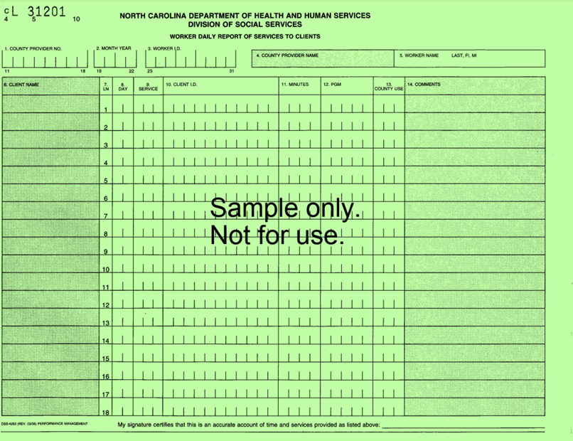
Day Sheets – Complete Them DAILY
They are called Day Sheets because they’re meant to be completed daily.
Day Sheets used to be captured via the DSS-4263, aka “green sheets.” Data entry workers in counties had to manually input all entries into SIS from the 4263’s.
All 100 counties now use electronic Day Sheet systems.

Slide 7
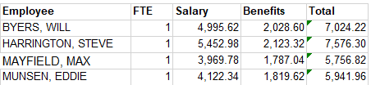
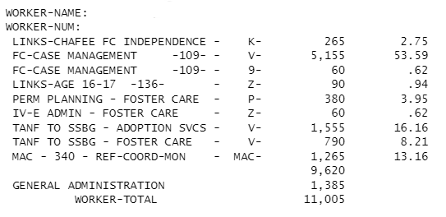
Day Sheets and DSS Reimbursement
There are two sets of data generated each month that serve as the basis for county reimbursement:
Payroll – Breakdown of salary and benefits paid for every DSS employee.
Percentage of Time report – Distribution of time per worker derived via Day Sheets.

Slide 8

Day Sheets and DSS Reimbursement - Payroll
Counties are reimbursed by the federal and state government based on the salary and benefits paid to staff.
Counties are not reimbursed on a per client, per hour, or per service rate.
This Photo by Unknown Author is licensed under CC BY

Slide 9
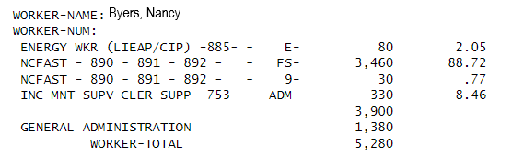
DSS Reimbursement – Percentage of Time Report
Salary and benefits are allocated to funding sources by the total percentage of time spent providing those services.
Funding streams have different reimbursement rates (Medicaid eligibility: 75% federal/25% county; FNS 50% federal/50% county).

Slide 10
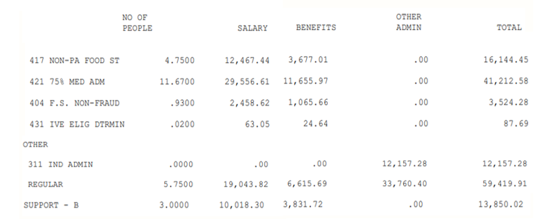
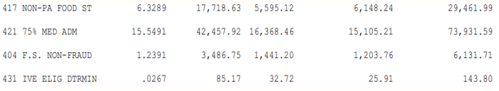
DSS Reimbursement – Cost Allocation of Admin/Support
Costs for supervisors and support staff are allocated to direct service activities based on the percentage of full-time employees (FTE’s) coded to those activities. This is called the Cost Allocation Process.

Slide 11
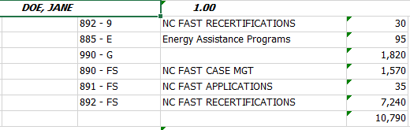
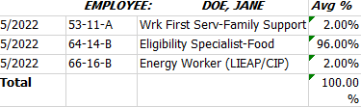
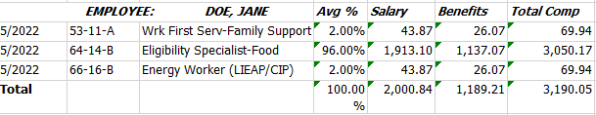
Reimbursement – Putting it All Together
During the 1571 process, the Percentage of Time report is combined with payroll data. Salary and benefits are distributed proportionally between fund sources.

Slide 12

So why are Day Sheets important again?
Since Day Sheets serve as the basis for DSS reimbursement:
Workers drive County reimbursement based on their Day Sheet coding.
Any Day Sheet error could result in a potential payback.

Slide 13
Who Keeps Day Sheets?
Who Doesn’t?
ALL staff performing direct Services (CPS/APS) functions or direct Income Maintenance functions.
Contract workers performing direct services, when they are housed in DSS and supervised by DSS employees.
Full-time supervisory and support staff.
Child Support workers. Federal policy forbids IV-D employees from working in other programs.
Interns and volunteers.
Contract workers not housed in DSS and not supervised by DSS employees.

Slide 14
Who Keeps Day Sheets – Supervisors & Support Staff
  If supervisors or support staff are providing regular direct services (for example: carrying a caseload for multiple months) they must keep a Day Sheet.
  Best practice:
  Use the 750-754 ADM codes for the remainder of their non-direct service time.
  ADM time can be recorded in a block and does not need to be broken out.
  If counties choose not to utilize ADM codes, the Day Sheet will need to be compared to the workers time card to capture the actual remainder of time worked.

Slide 15
Who Keeps Day Sheets – Contract Workers & Interns
When a clear delineation of supervision between a contract worker and DSS exists, regardless of where the worker is housed, “audit-worthy” documentation of the time charged for these workers need to be kept.
  If interns or volunteers provide direct services, those services should be recorded in the client’s case file. If paid any type of wage or salary (not including a stipend), they should be treated as any other DSS employee.
  Best Practice: To achieve “audit-worthy” documentation, have the contract worker complete a Day Sheet.

Slide 16

Worker Certification
Federal regulations require workers to sign their time reports for completeness and accuracy.
  A digital or electronic signature can serve as the worker certification. There must be a certification statement that the worker reviewed the information for completeness and accuracy.
  Counties will need to show there are internal controls in place over electronic Day Sheet accounts, so that only that worker can enter time or certify their Day Sheets.
  If a worker is absent due to an unplanned absence, a supervisor or administrator may approve the Day Sheet. The circumstance should be noted and kept with the 1571 documentation for the month.

Slide 17
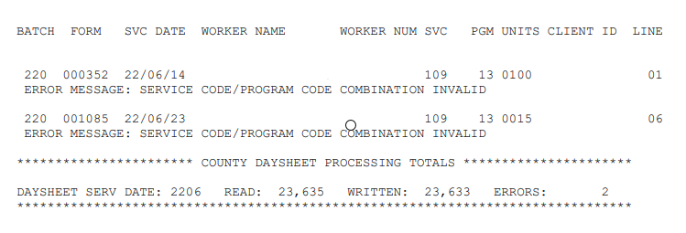
Due Dates and Uploading
Counties must upload their Day Sheet data to the state by the 5th calendar day of the month. If the 5th falls on a weekend or holiday, the Day Sheet would be due on the nearest working day.
Day Sheets must be transmitted to the state with no errors. Successful upload can be confirmed via CTY Day Sheet BATCH ERRORS REPORT available in NCXCLOUD. Common errors: incorrect SIS client ID, incorrect program/code combinations, county not approved to use code.

Slide 18

Due Dates – Planning Ahead
Plan ahead for Day Sheets, especially when the end of one month/beginning of the next month falls on a weekend or holiday. Staff are also more likely to be on vacation during these times and will need to approve Day Sheets before they leave for the month.
For example: in July 2022, June 30th fell on a Thursday. Monday (July 4th) was a holiday. This left only two workdays (Friday 07/01 and Tuesday 07/05) to complete and submit Day Sheets.

Slide 19
General Instructions for Time Entry
Day Sheets should be a single record, so all activities should be recorded on the daily report.
It is not necessary to report days on which agency isn’t open (holidays, inclement weather) or the employee isn’t scheduled to work—unless the employee actually works (for example: on-call).
All overtime work must be captured.
Leave time should be entered as 990-G. This includes sick, vacation, and compensatory (comp) time.

Slide 20

Minimum Time and “Blocks” of Time
The minimum block of time that can be reported is 5 minutes.
Activities taking less than 5 minutes can be lumped into a “block” of time and reported using the appropriate service code.
Example: A FNS recertification worker returns from a day off and has 15 voicemails from clients. The worker spends 45 minutes listening to and answering VM’s. None of the calls take more than 5 minutes. The worker can code all that time to 892-FS with the comment, “Returning voicemails.”

Slide 21
Client ID Numbers
Some codes require the use of a SIS ID (200 number) or CNDS ID (for NCFAST P4 pilot counties). These codes will not allow an entry to be made without the ID. SIS ID’s are assigned by the County DSS. CNDS ID’s are generated by NCFAST.
The client ID field can be used even when the code does not require one. This can be useful for documentation or auditing purposes.
What to do for cases with multiple clients
When a service is provided to multiple clients at the same time (example: a set of foster siblings) all clients involved should be reported with the time divided equally between them.
For example, DSS has custody of three children and has placed them with their uncle. When a home a 90-minute home visit is made, 30 minutes each are reported to Huey, Dewey, and Louie.

Slide 22
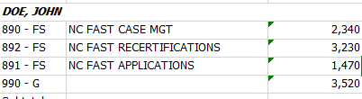

990 – G: General Administration Time
990 – General Administration: Record in a block of time at the end of the day those activities considered general administration; e.g. leave, employee travel, supervisor/worker conferences, attendance at training sessions, other non-direct service activities of less than 5 minute duration, compensatory time, etc.
Counties are not reimbursed at a lower rate when workers code to G time. G time is allocated to direct service activities, and does not factor into reimbursement. There is no need to code G-time activities as direct service when they do not meet the definition.

Slide 23
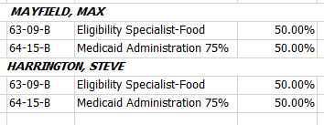
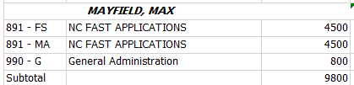

How 990 – G Affects the Percentage of Time
Let’s look at how two different workers coded Day Sheets in one month as a demonstration of how G-time affects the Percentage of Time.
One employee provided more minutes of direct services in this month. The other employee coded over 75% of his time to 990 – G.
However, the Percentage of Time for both workers would be 50% FNS, 50% Medicaid. Since G-time is allocated to direct services, the only thing that matters is the percentage of non-G time entered.

Slide 24

Understanding Non-Reimbursable Time
Using the program code “N” does reduce the amount of reimbursement a county receives.
Workers should code time to N when working with clients who are not eligible, providing services such as home studies for private adoptions, working on private grant or county funded programs, or when staffing emergency shelters.
This Photo by Unknown Author is licensed under CC BY-NC

Slide 25
“Missing” Time
?
“Missing” time is time that a worker cannot account for. Daily entry of Day Sheets should prevent time from going missing.
Missing time must be coded to 990-G.
Failure to account for 100% of time will result in shifting costs to those programs for which time is accounted—this could become a Single County Audit issue.
?
?
?
?
?

Slide 26
Day Sheet Corrections – Current Month
Errors are most easily fixed during the month of service. Corrections should be keyed by the worker—not by a Supervisor or Admin.
If Day Sheets have been submitted, but the upload deadline has not passed, the month can be “reopened.” Workers can then key corrections, recertify, and Day Sheets can be resubmitted.

Slide 27
Day Sheet Corrections – Prior Month
If errors are found in a month that has already closed, the worker should:
  Print the Day Sheet.
  Indicate the error by crossing out the erroneous entry.
  Write the correct amount of time, SIS/Program Code, and Client ID.
  Initial the correction.
  Place a copy of this correction in the client’s file and provide it to fiscal staff to keep with the 1571 documentation for the month.

Slide 28
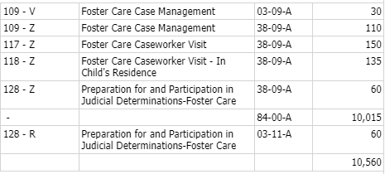
Day Sheet Corrections – Fiscal Corrections
When Day Sheet data is uploaded into NCCORELS for reimbursement, SIS codes are converted into Function / Column / Part codes. FCP codes tell the state reimbursement system how to “bill.” Many SIS codes share a FCP and are billed to the same funding source. Fiscal staff can only correct a coding error when it would result in the wrong funding source being billed.
For example: A worker billed 110 minutes to 109-Z instead of 117-Z. Since these both share a FCP, there is nothing for fiscal staff to “fix.”

Slide 29
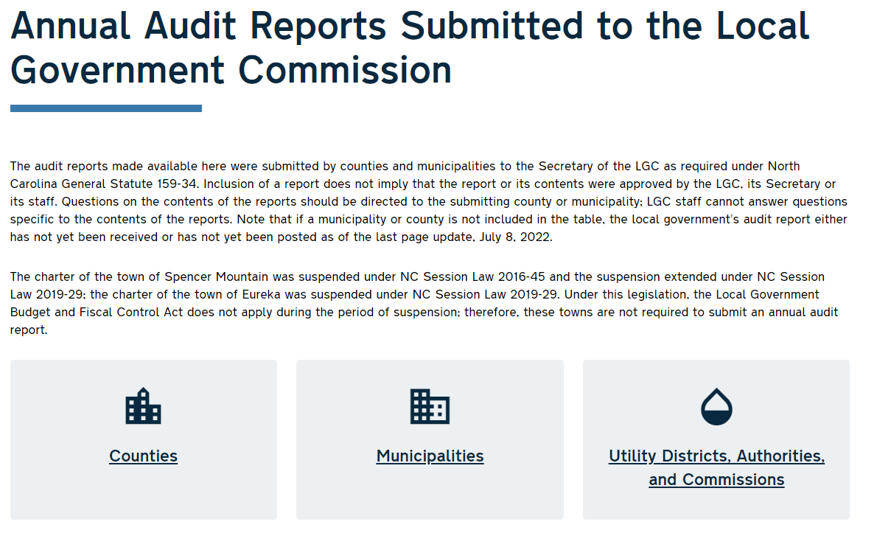
Day Sheet Documentation
Your County undergoes a Single County Audit by a each year. These are publicly available. The audit process is guided by Cross-Cutting guidance issued from the NC Treasurer.
Per this guidance, Single County Auditors must verify that “Day Sheet entries are supported by documentation in case record files.”

Slide 30
Day Sheet Documentation - Continued
What does “supported by documentation in case record files” mean?
Can you look at any direct service worker’s Day Sheet and:
Trace entries back to a specific client or case.
On a specific day supported by time stamps or date notations.
Support the time coded with case file or system documentation.

Slide 31
Day Sheet Documentation - Continued
Per the Cross-Cutting guidance:
“Workers whose activities are reportable under a single SIS code that does not require a client ID may be reported in daily blocks of time under the applicable SIS code, provided the worker performs no other direct client services and the county has a reliable method for documenting and retrieving the name or other identifiers of individuals served in relation to specific entries.”
Does your County have a method to identify which cases or clients employees worked with on a specific date?

Slide 32
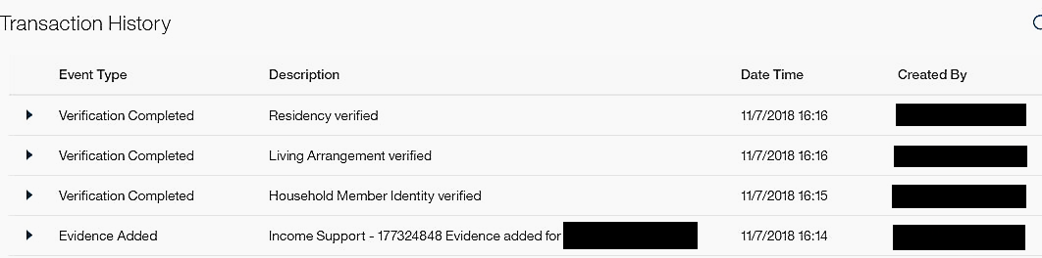
Examples of Documentation – NCFAST Time Stamps
NCFAST time stamps: Generated when taking actions in NCFAST such as editing evidence, generating ProForma documents, entering notes, etc.
NCFAST timestamps can be used to verify Day Sheet documentation from that day, but should not be used to verify how long a worker spent on any given task. The Cross Cutting guidance specifically state that “NCFAST is not to be used to track a worker’s time.”

Slide 33


Other Examples of Documentation
Case file or narrative documentation with time stamps or date notations.
If working in NCFAST on an activity that would not create a time stamp, the worker would need to document the activity they are performing.

Slide 34
Service and Program Codes - Explained
SIS Code: This is the actual activity or service you are providing to a client. Your choice of SIS Code should be based on the definition in the SIS manual.
It is not based on:
Your job description.
What section of the county budget you are paid from.
How your coworker coded something.
Program Code: This is the fund code, which will decide which Federal, State, or County source will fund the service.
Income Maintenance - the program code usually relates to the program you are determining eligibility for.
Child Welfare and Adult Services - you must often determine eligibility for the client/family/case to decide the correct code.

Slide 35
Overview of SIS/Program Codes in Income Maintenance
SIS Codes
Program Codes
891 – NCFAST Applications
892 – NCFAST Recertifications
890 – Case Management
885 – CIP and LIEAP
002 – Child Care Program Management
FS – FNS Administration
HC – Health Choice. NOTE: All time spent on Family and Children’s Medicaid should be coded to HC.
MA – Adult and Emergency Medicaid.
SA – Special Assistance
E – Energy Programs Administration
L – Child Care and Development Fund
R – TANF 100% Federal (Work First)
9 – TANF MOE (Work First)

Slide 36


Capped and Uncapped Funding Sources
There are two main types of funding sources:
Uncapped funds: No limit to the amount of reimbursement per fiscal year, although programs may be reimbursed at different rates.
Capped funds: Set amount of funding provided per fiscal year, often issued to counties quarterly. Spending over the capped amount will become all county spending.
This Photo by Unknown Author is licensed under CC BY

Slide 37
Capped and Uncapped Funding Sources - Continued
Uncapped Funding Sources
Capped Funding sources
Food and Nutrition Services
Medicaid (including MAC)
Special Assistance
Title IV-E
Title IV-D
SSBG
Work First Block Grant (TANF)
State CPS / Caseload Reduction / In-Home Expansion
LIHEAP (CIP and LIEAP)
Permanency Planning
Family Reunification
Many more!

Slide 38
Work First Block Grant Explained – TANF and MOE
TANF (Work First) is unique in that there is a required County match called Maintenance of Effort. General statue requires each county to meet their MOE goal each year. Failure to meet MOE could result in a loss of Federal funding or single county audit finding.
The MOE goals and TANF federal funding caps were set based on AFDC numbers reported in the 90’s and have not changed since.
9
Coding time to R draws down Federal reimbursement at 100% until funding expires.
R
Coding staff time to 9 for eligible activities helps meet MOE.

Slide 39
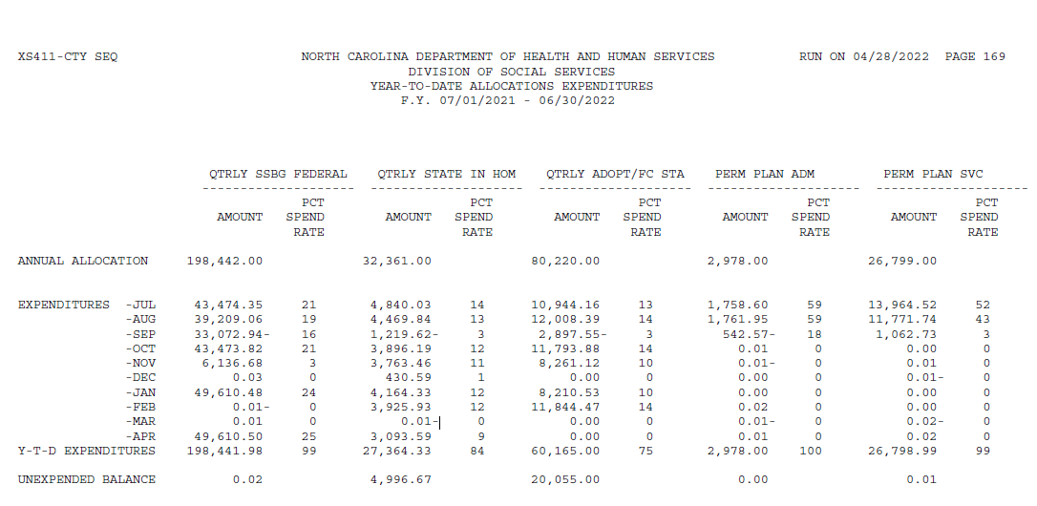
Capped Funding and the 411 Report
How do you know how much funding you have available? The 411 tracks your expenditures in capped allocations. It comes out monthly, usually around the 25th.

Slide 40
411 Report and Capped Funding - Continued
Fiscal staff should communicate which funding sources have unspent money.
Program staff should work to target specific program codes if a client is eligible.
As the year progresses, some fund sources will run out and others may become available.
Some allocations are made quarterly.
It is not wrong to code to a program with expired funding, if that is the only program the client is eligible for.

Slide 41
What happens when capped funds run out?
If your agency is well-staffed, paying competitive salaries, and targeting different funds, the agency can and will draw down most or all your capped funds.
At that point, any coding to capped programs will become all county spending. Workers must still code based one eligibility. It is possible that, at the end of the FY, the county will be allocated extra funds from counties that underspent.
Therefore it’s vital counties maximize coding to uncapped program codes such as Z (Title IV-E) and MAC (Medicaid Administrative Claiming).

Slide 42
Your Coding’s Impact on Reimbursement – Example 1
Foster Care social worker Olivia Benson has been coding the State Foster Home Fund eligible kids on her caseload to program code V (TANF to SSBG) all year. In February the County ran out of V money. No one told her, and in March when she coded her this is what happened:
Worker’s salary/benefits allocated to V: $2,200
Additional Supervisor/Support/Overhead allocated to V: $1,000
TANF to SSBG is reimbursed at a rate of 75% Federal / 25% County; however, since the County had exceeded their allocation, all $3,200 of costs went to the county.

Slide 43
Your Coding’s Impact on Reimbursement – Example 2
Foster Care social worker Olivia Benson has been coding the State Foster Home Fund eligible kids on her caseload to program code V (TANF to SSBG) all year. The Foster Care supervisor met with the Admin Officer at the end of February to review the 411 report. They saw they were out of V money, but had Permanency Planning funds. The Foster Care team reviewed eligibility for the V-coded kids, determined they were eligible for P, and switched their coding for March.
Worker’s salary/benefits allocated to P: $2,200
Additional Supervisor/Support/Overhead allocated to P: $1,000
Permanency Planning is reimbursed at a rate of 71% Federal / 29% County. The County received $2,343 in Federal reimbursement.

Slide 44
Your Coding’s Impact on Reimbursement – Example 3
A IV-E eligible child is in a kinship placement. Because the child is IV-E eligible, but not in a IV-E eligible placement, Olivia Benson codes the child to V (TANF to SSBG). The county has no V money left at this point in the year, so the administrative cost for this case is all county.
On the 26th day of the month the kinship placement is disrupted and the child is placed in a licensed foster home. The child is now in a IV-E eligible placement. Per the Foster Care funding manual, Olivia can now retroactively change the child’s coding to Z for case management services for the entire month.
Olivia goes into the County’s Day Sheet program and changes the coding for the child from 109 – V to 109 – Z for the entire month. The agency is now reimbursed at a 50% administrative rate for time coded to that case.

Slide 45
References and Links
2 CFR Part 200 – Uniform Guidance: https://www.ecfr.gov/current/title-2/subtitle-A/chapter-II/part-200?toc=1
OMG Circular A-87 Revised: https://obamawhitehouse.archives.gov/omb/circulars_a087_2004#attb
Implementation Guide for Office of Management and Budget, Circular A-87: https://www.dol.gov/sites/dolgov/files/OASAM/legacy/files/ASMB_C-10.pdf
DSS Crosscutting Requirements: https://www.nctreasurer.com/media/2525/download
Services Information System manual: https://policies.ncdhhs.gov/divisional/social-services/services-information-system-sis/policy-manuals

