Slide 1

North Carolina
Pandemic EBT (P-EBT)
5/12/2020

Slide 2
Timeline of P-EBT Implementation
1st allotment (March & April), covers 34 Days, $194 per child
2nd allotment (May & June), covers 31 days, $177 per child
Send text messages sent to Phase 1 FNS P-EBT recipients
Phase 1 P-EBT recipients on FNS get their first allotment loaded onto existing EBT card
P-EBT card creation and mailing to Phase 1 non-FNS recipients begins
Send text messages to Phase 3 FNS & non-FNS P-EBT recipients
Phase 3 P-EBT recipients on FNS get their 1st and 2nd allotments loaded onto their existing P-EBT cards
P-EBT card creation and mailing to Phase 3 non-FNS recipients begins (cards will contain 1st and 2nd allotments combined)
Estimated date for completion of notice mailings to Phase 1 non-FNS P-EBT recipients
Estimated date for completion of Phase 1 non-FNS P-EBT card creation and mailing
Estimated completion date of 2nd allotments for Phase 1 recipients
Estimated completion date of 1st and 2nd allotments for Phase 2 recipients
May 11
May 13
May 20
June 1
June 19
May 12
May 14
May 28
June 10
June 29
Begin mailing notices for Phase 1 non-FNS P-EBT recipients
Send text messages to Phase 1 non-FNS P-EBT recipients (if cell phone present in DPI file)
DPI sends Phase 2 file to DHHS
2nd allotment for Phase 1 recipients begin to be loaded onto cards (staggered over 10 days)
Send text messages to Phase 2 FNS & non-FNS P-EBT recipients
Phase 2 P-EBT recipients on FNS get their 1st and 2nd allotments loaded onto their existing EBT card
P-EBT card creation and mailing to Phase 2 non-FNS recipients begins (cards will contain 1st and 2nd allotments combined)
DPI sends Phase 3 file to DHHS
Phase 1 Recipients: Children enrolled in Free or Reduced Lunch for 2019-2020 school year prior to December 2019 (or enrolled in a CEP school prior to school closures)
Phase 2 Recipients: Children enrolled in Free or Reduced Lunch for 2019-2020 school year between December 2019 and March 31, 2020 (or enrolled in a CEP school prior to May 1st, 2020)
Phase 3 Recipients: Children enrolled in Free or Reduced Lunch for 2019-2020 school year after March 31, 2020 (or enrolled in a CEP school prior to end of school year)

Slide 3
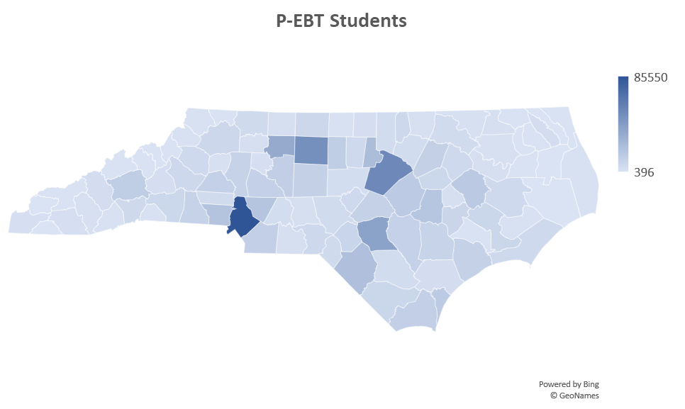
P-EBT Statistics
Total Phase 1 P-EBT Recipients:
  837,662 students
  616,137 households
Total Phase 1 P-EBT Recipients Matched to FNS Records
  290,133 students (35%)
  212,959 households
Total Phase 1 P-EBT recipients NOT matched to FNS Records
  547,529 students (65%)
  403,178 households
Total Phase 1 Issuance Dollars
  1st Issuance:
    FNS → $56,227,775
    Non-FNS → $106,111,120
  2nd Issuance:
    FNS → $51,266,501
    Non-FNS → $96,748,374
  Phases 2 & 3 are TBD
Total households with at least 1 student matched to FNS and at least 1 student not matched to FNS (i.e. will receive some benefits on existing FNS EBT card and some benefits on at least 1 new P-EBT card)
  19,552 households

Slide 4
Overview of Primary Responsibilities – County DSS/HHS Agencies
  Fielding phone calls about P-EBT and either answering questions or directing the caller to the right place
  Making efforts to find correct addresses* and resolve:
    Returned notices (Returned to the local DSS/HHS agency in cases when no forwarding address was on record with the post office)
    Undeliverable P-EBT Cards (Returned to the EBT Vendor and shown on the “Card Status Report Undelivered County” in EBT Edge (EBTDS210-4))
*The P-EBT Issuance Reports (shared via FAST Help) and EBT Edge will include the phone number of the non-FNS clients that was on record with DPI. This may be used to contact clients in order to resolve returned notices and/or undeliverable P-EBT Cards. DHHS has also shared a P-EBT Log template to assist with this process.

Slide 5
Overview of Primary Responsibilities – NC DHHS
  Coordinating with DPI for data sharing regarding Free or Reduced Lunch enrollees and CEP students
  Managing P-EBT benefit issuance and account creation in collaboration with the State’s EBT vendor (FIS)
  Generating and sharing P-EBT Issuance Reports and sharing them with authorized State and County staff
  Fielding phone calls about P-EBT and either answering questions or directing the caller to the right place
  Providing communication materials and regular updates to stakeholders
  Updating Q&A materials based on feedback from stakeholders
  Resolving card activation problems that are unable to be resolved through the general troubleshooting process

Slide 6
Overview of Primary Responsibilities – DPI, Local Schools, 211
Department of Public Instruction (DPI)
  Coordinating with local schools/school districts to collect data for newly enrolled Free or Reduced Lunch students
  Sharing data with DHHS for the purposes of matching and benefit issuance
  Providing regular communications with educational stakeholders regarding P-EBT updates and FAQ updates.
Local Schools/School Districts
  Accepting and processing new applications for Free or Reduced Lunch
  Updating data in PowerSchool (school enrollment, addresses, phone numbers, etc.)
  Sharing newly enrolled Free or Reduced Lunch student data with DPI one more time in early June
  Fielding phone calls about P-EBT and either answering questions or directing the caller to the right place
2-1-1
  Fielding phone calls about P-EBT and either answering questions or directing the caller to the right place

Slide 7
P-EBT Materials Provided by NC DHHS
Name of File(s) | Explanation
P-EBT Executive Summary | High level overview of P-EBT (including explanation, timeline, and expectations)
P-EBT Admin Letter (5-8-2020) | Admin letter summarizing P-EBT in more detail, with many important points of information
P-EBT FAQ (English/Spanish) | P-EBT Frequently asked questions with responses (as of 5-7-2020). The FAQs will be regularly updated and shared on the following website page - www.ncdhhs.gov/PEBT
P-EBT Notice (English/Spanish) | Copy of the notice being sent to those P-EBT recipients who will receive a new card(s) in the mail
P-EBT Log Template | Excel file template for counties to use when making follow-ups relating to returned notices or undeliverable P-EBT cards
P-EBT-Activation-web | Instructions for how to activate a new P-EBT card
P-EBT-How To Use-web | Instructions for how to use a new P-EBT card
P-EBT Logic Tree_v1.6 | Shows logic trees for several of the FAQs where the correct answer depends on multiple factors

Slide 8
Questions?

