Slide 1
Population Estimates &
Projections Data for
Aging Analyses and Planning
North Carolina Area Agencies on Aging
June 10, 2025
Raleigh, NC
Mike Cline, PhD
State Demographer
Integrity Innovation Teamwork Excellence

Slide 2
What Does the State Demographer Do?
Certified Municipal & County Population Estimates (Annual)
Official State & County Population Projections
Demographic analyses
Governor’s Budget (Budget and Revenue Summary 2025-27)
State Agencies
Demographic Education
Assist Census Bureau (Fed-State Cooperative)
Population & Housing Unit Estimates
Decennial, ACS, Other
https://www.osbm.nc.gov/facts-figures/population-demographics
Notes:
Certified estimates are used to distribute state revenue to local communities using formulas that incorporate population as a factor. This includes, among other things, the NCDOT Street Aid Funds (Powell Bill), sales tax distributions, arts funding, and school funding.
The US Census Bureau also produces their own population estimates that are used for distribution of federal funds and serve as the control population for various survey estimates including the American Community Survey. We assist the Census Bureau by supplying data and reviewing the estimates before they are published. We also assist some of the preparation and promotion aspects of the decennial census.

Slide 3
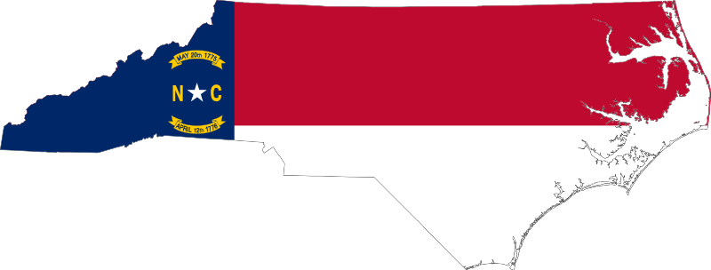
North Carolina Today
9th Largest State – 11.0 Million
3rd Largest Population Gain, 2020-2024 – 605,000
1 Additional Congressional Seat for 2030 (Projection)
See: North Carolina Now Home to Over 11 Million People | NC OSBM
Notes:
Since 2020
Added a population larger than the size of Guilford County (at 550,000 in 2023)
Added an estimated 390 people per day
Projected to become 7th largest state by early 2030s

Slide 4
Past and Future North Carolina Resident Population
Millions of People
15.4
14.2
13.0
11.7
10.5
9.6
8.1
Population Change
1.5
0.9
1.3
1.2
1.2
1.2
Source: NC OSBM Population Projections, Vintage 2024
Notes:
We had the 6th largest gain among states last decade.
The previous decade was a relatively slower going decade than the two preceding it. But towards the end of the decade, and picking up in to our current decade, we have seen a return to extensive growth of the past. If these trends continue, we expect to gain another 1.3 million people over the course of this decade.
Today, there are over 11 million North Carolinians and by the end of this decade, we expect that there will be a little less than 12 million.
In 35 years – 2060 – there will likely be over 15 million North Carolinians.

Slide 5
Migration Will Account for Almost ALL Population Growth in the Future
Source: Derived from Age-Specific Net Migration Estimates for US Counties, 1950-2010. Applied Population Laboratory, UW-Madison and NC OSBM Population Estimates, Vintage 2023 and Population Projections, 2024.
Notes:
Most of NC history – NC net “sender” of population
Beginning in 1970s, that changed with more people moving in than moving out
1980s majority of growth from net migration
For the last 3 decade, about 2/3rds of growth from Net Migration
Because of COVID and Baby Boom Aging, Net Migration has become even more important. About 95% of all growth during early 2020s and now about 85% of growth. By 2040s, allof our growth will depend on Net Migration. About 146,000 people per year.
NOTE: US Census Bureau Pop. Projections (V2023) – Main Series – Shows that US will depend solely on immigration for growth beginning in 2038, as there will be more deaths than births. By 2040s, an average 927,000 per year will be added through immigration. A projected 16% of US population will be Foreign Born by 2050.

Slide 6
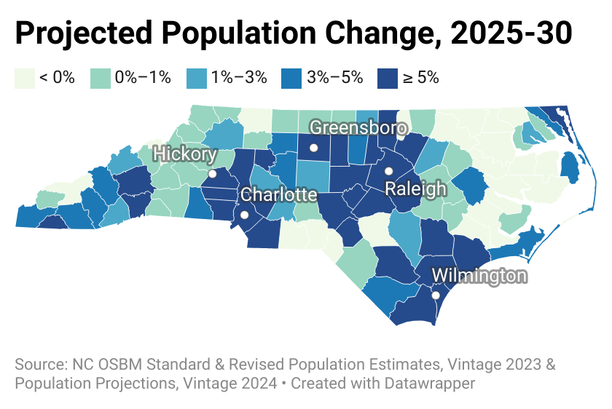
State: 6.1%
(2020-30: 12.5%)
Notes:
24 Counties w/ predicted losses, with 10 counties have loss of more than 1.5%
76 counties with predicted gains, with 51 at > 1.5%, 30 at 5% or more.
39 counties with virtually no change (small loss or gain or stay the same).
5 counties to account for 49% of growth: Wake, Mecklenburg, Union, Johnston, Guilford

Slide 7
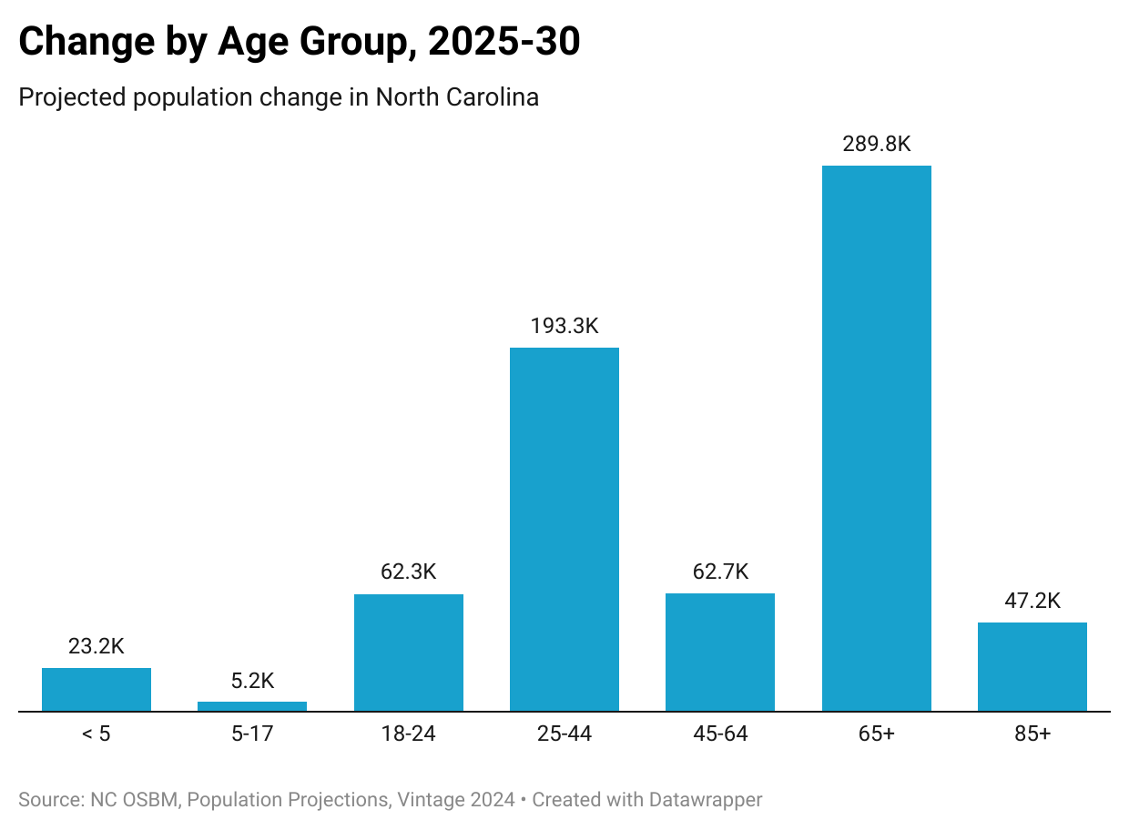
14.2%
6.7%
5.7%
2.3%
25.3%
3.8%
0.3%
Notes:
65+ and 85+ more than double the rate of growth for the total population
Adding over 130,000 65 year olds every year

Slide 8
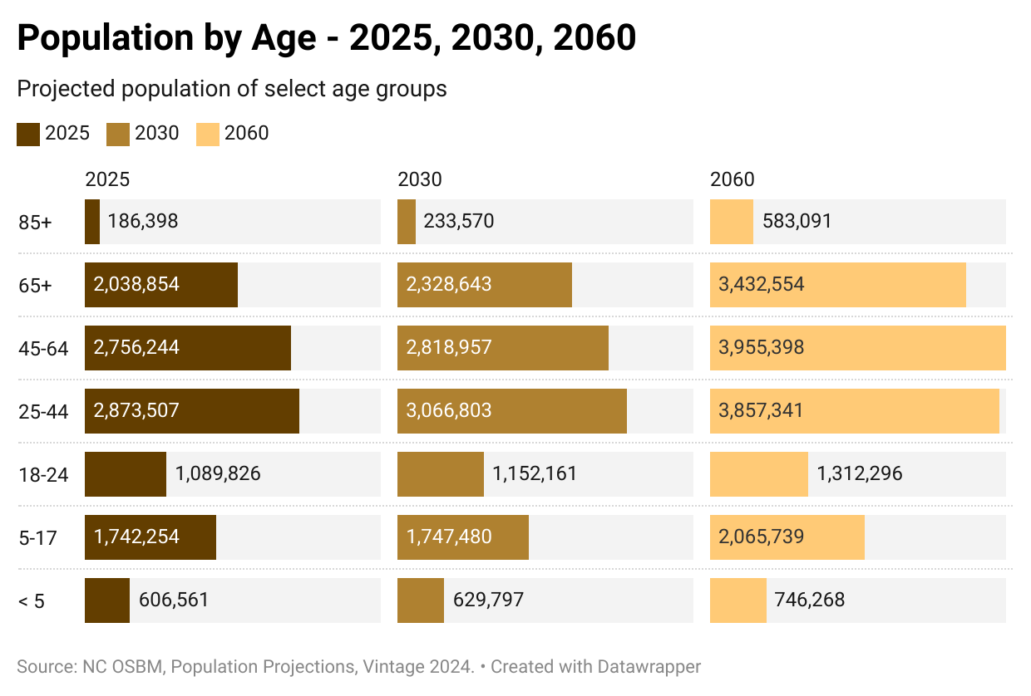

Slide 9
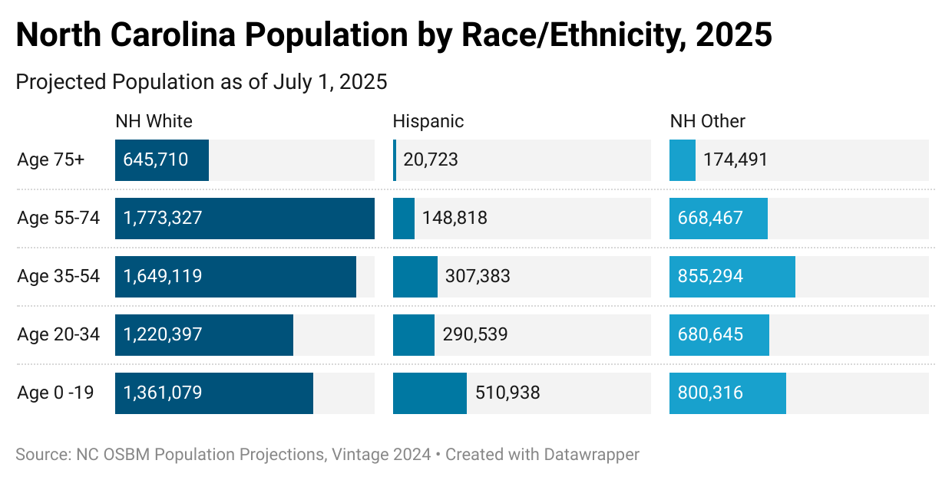
(60%)
(12%)
(29%)
Hispanic Summary
Notes:
Median age in 2021:
Hispanic: 25
NH White: 44
Black: 37
Asian: 36
American Indian: 35

Slide 10
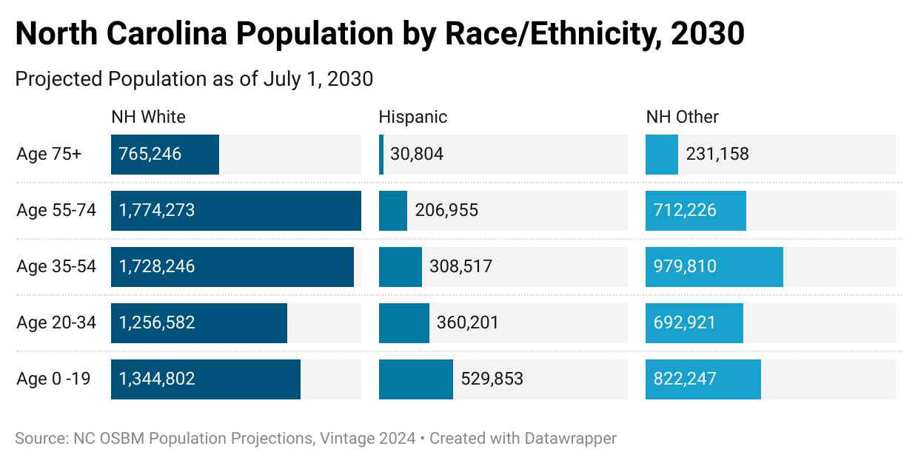
(59%)
(12%)
(29%)
Hispanic Summary
Notes:
Median age in 2021:
Hispanic: 25
NH White: 44
Black: 37
Asian: 36
American Indian: 35

Slide 11
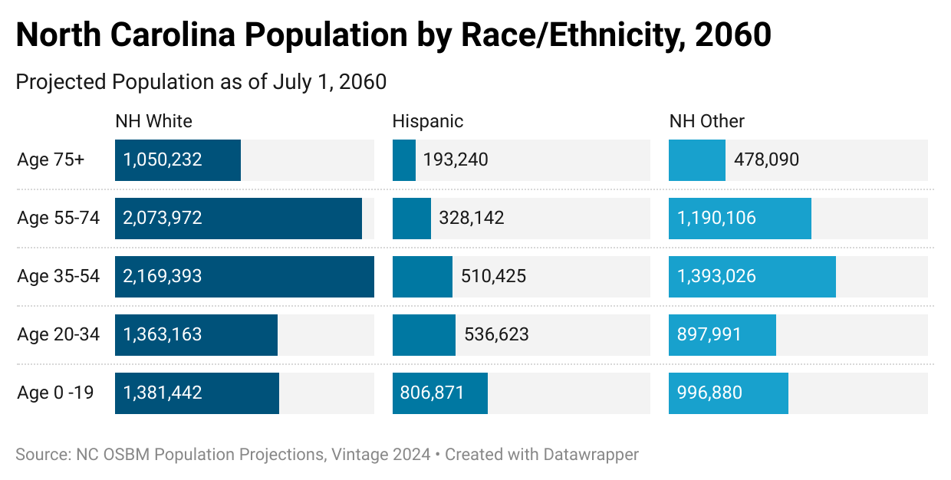
(45%)
(21%)
(34%)
Hispanic Summary
Notes:
Median age in 2021:
Hispanic: 25
NH White: 44
Black: 37
Asian: 36
American Indian: 35

Slide 12
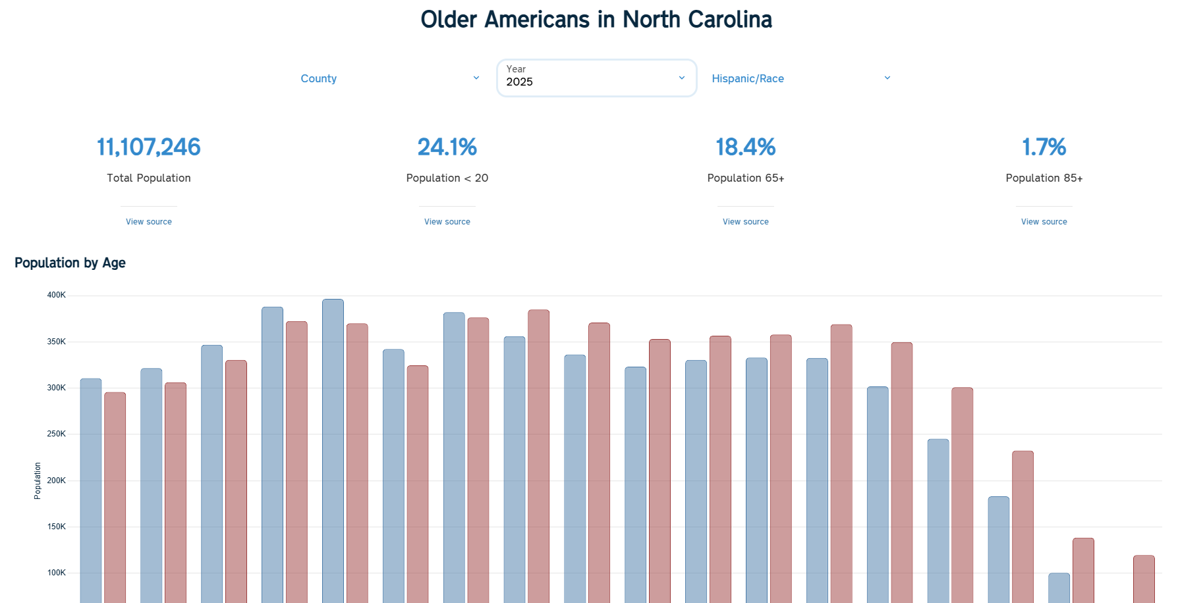
Need a Quick Summary of Current/Future Elderly Population in Your Area?
Visualization: Older North Carolinians
Quick statistics: % 65+, % 85+, % < 20
Chart of race/ethnic characteristics by 5-year age groups (0 – 85+)
Total and 65+ Population Race/Ethnic characteristics

Slide 13
Want More Detailed Information About Your Population?
3 Major Datasets
Estimated (historical populations – 2020-2023)*
& projected (future populations – 2024-2060)
Available at https://demography.osbm.nc.gov/ (in segments)
Available as complete csv/excel files at https://www.osbm.nc.gov/facts-figures/population-demographics/state-demographer/countystate-population-projections
*Forthcoming 2010-2019 estimates in 2025

Slide 14
Population Projections Available in 3 Major Datasets
1. Sex and Single Years of Age
Useful if race/ethnic characteristics not important need single age or customized age groups
Single years of age from 0 – 99 and 100+ age group
2. Sex, Race, Age Groups
Useful if interested in race and sex characteristics of aging population
Reported in 10-year age groups for most adult ages
Includes some special aging related groups (e.g. 60-64)
Age groupings through age 99 and 100+ age group
Also reported for broader age groups including 65+
Major race groups are reported by age when at least 250+ people for that race are present
NO Hispanic origin reporting
3. Hispanic Origin/Race by Sex and Age
Useful if interested in Hispanic and sex characteristics of aging population
Reported in 5-year age groups through 80-84, and 85+ age group
Broad race categories: White/Non-White
Reports Hispanic / Non-Hispanic origin

Slide 15
Sex, Race, Age Groups Dataset Aging Related Categories
Sex | Age Groups | Race (# of counties w/ race category)
Male | 55 – 59 | White (100)
Female | 60 – 64 | Black (93)
Total | 65 – 74 | American Indian/Alaska Native (73)
 | 75 – 84 | Asian & Pacific Islander (65)
 | 85 – 99 | Other* (100)
 | 100+
*Includes Black, American Indian, Asian populations when not separately reported

Slide 16
Special Note About “Other Category”
For the state and most counties
“Other” = people who identify as “some other race” and “two or more races”
For “Other” - the grpn (# of groups) variable = 1
For some counties
“Other” = “some other race” and “two or more races” AND people who identify as one of the other major race categories when less than 250 people of that group is present
The “Other” - the grpn (# of groups) variable = 1 + the number of additional groups

Slide 17
Other Example
Avery County –
Populations for Black, White, and Other are greater than 250
Populations for Asian and American Indian are less than 250
Asian and American Indian populations are combined with Other population
Grpn for Other = 3 (3 races included)
Grpn for Black = 1
Grpn for White = 1
Grpn for Total = 5
Harnett County –
Populations for all race groups are greater than 250
Grpn for American Indian = 1
Grpn for Asian = 1
Grpn for Black = 1
Grpn for White = 1
Grpn for Other = 1
Grpn for Total = 5

Slide 18
Other Important Details
Population estimates/projections published annually in the fall
Estimates/projections replace those published in previous years
Estimates/projections include vintage year and estimates/projections indicator
Estimates Vintage = Year of last estimate (e.g. Vintage 2023 estimate = July 1, 2023 estimates published in fall 2024 including revisions for 2020 through 2022).
Projections Vintage = Year projection was published (e.g. Vintage 2024 projections = 2024 – 2060 population projections published in fall 2024).

Slide 19
Other Important Details
Vintage 2023 estimates/2024 projections included major revisions to age characteristics
Adjustments done to correct age reporting issues with 2020 Census
More closely aligns with US Census Bureau estimates
DO NOT compare to pre-2020 estimates (revisions to 2010-2020 age characteristics will be included in Vintage 2024 estimates/2025 projections).

Slide 20
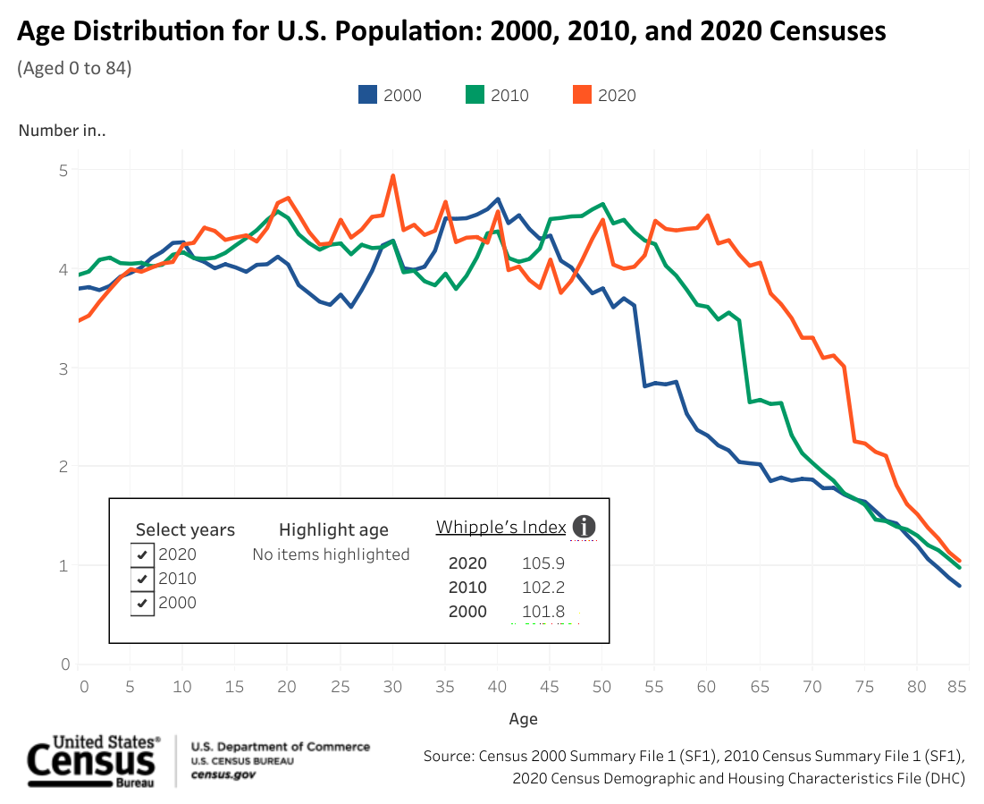

Slide 21
Stay in touch!
Email:
Michael.cline@osbm.nc.gov
Phone:
984-236-0686
Website:
www.osbm.nc.gov (See: Facts & Figures)
Demography.osbm.nc.gov
Follow us: @ NC Office of State Budget & Management

