Slide 1
Office of Rural Health
NC Department of Health and Human Services
Rural Health Centers Support Grant Request for Application Information Session
April 7, 2021
12:00PM-1:30PM

Slide 2

Welcome
Please keep your lines muted when not speaking
Submit questions in the chat box or use the raise hand feature during designated Q&A sections (click 3 dots on lower panel)
Use the call-in feature to improve sound quality
Use the active speaker view for best view
Presentation session will be recorded

Slide 3

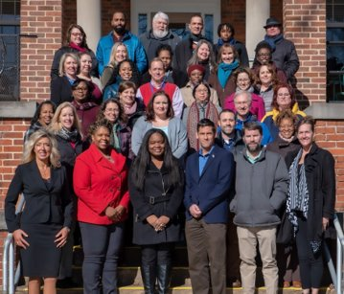
About the Office of Rural Health (ORH) and Our Mission​
First state office (1973) in the nation created to focus on the needs of rural and underserved communities​
ORH Mission Statement: The North Carolina Office of Rural Health (ORH) supports equitable access to health in rural and underserved communities.​
To achieve its mission, ORH works collaboratively to provide:​
Funding​
Training​
Technical assistance​
For high quality, innovative, accessible, cost effective services that support the maintenance and growth of the State’s safety net and rural communities.​
​
State Fiscal Year 2019 Office Facts:​
Administered over 300 contracts ​
Spent $26.3 million from state, federal, and philanthropic sources​
Returned over 88% of its budget directly to NC communities​
Provided 2,133 technical assistance activities​
While we do not provide direct care, our programs support numerous health care safety net organizations throughout North Carolina.

Slide 4



Rural Health Centers Program: Medical Access Plan and Project Grant RFA
NC General Assembly
Office of Rural Health
State Designated Rural Health Centers
Primary and Preventative Care
Purpose
The purpose of the state designation is to support health care access in primary care sites that do not fit the CMS_RHC or FQHC designation to provide services to low income, uninsured and underserved rural populations.

Slide 5

State Designated Rural Health Center (SDRHCs)
ORH definition:
SDRHC is a health care safety net organization that is a 501(c)3 non-profit, community-owned organization with an active board that has as its primary mission to provide primary health care services to those residing in its community.
SDRHCs must be located within communities that are both rural and underserved and must currently be delivering primary health care services or can serve patients within six months in its proposed service area.

Slide 6
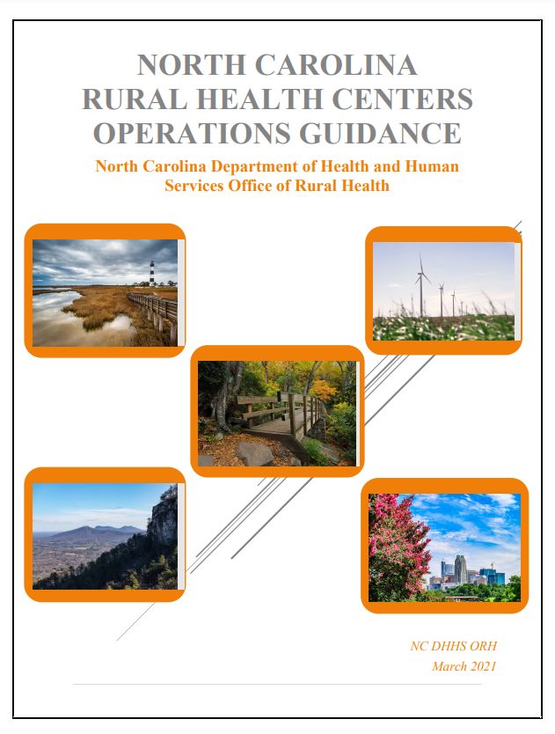
Eligibility
The purpose of the SDRHC program is to increase access to primary care for rural uninsured and underinsured residents. To determine eligibility to become an SDRHC, the applicant organization must first assess if the proposed location can meet important criteria.
The following factors are considered:
Rural determination
Health Professional Shortage Area determination
Availability of primary care services in neighboring communities
County Distress Ranking – Tier 1 or 2
501c3 Organization

Slide 7
Applicant Frameworks
Continuing Rural Health Centers
New Rural Health Centers
A current State Designated Rural Health Center (SDRHC) that has received funds from the NC ORH and seeks to continue serving its current service area and target population.
An organization that is not currently funded through the NC ORH State Designated Rural Health Center grant and seeks to serve an underserved area and uninsured target population with one or more permanent service delivery site(s).
An organization not selected to be a SDRHC but will have an opportunity to receive capacity funding need towards building a management system and/or programs. The funds can help an organization improve their community coordination, collaboration, and strengthen the organization’s SDRHC application in the future.
Capacity Organizations

Slide 8
Funding for Continuing & New SDRHCs
Medical Access Plan (MAP)
Funds available for primary health care coverage
Visits are reimbursable at a rate of $100 per encounter based on medically necessary face-to-face encounters
Behavioral Health
Funds available for behavioral and mental health counseling services
Visits are reimbursable at a rate of $75 per encounter based on face-to-face behavioral health provider encounters
Operating/Infrastructure Funds
Funds available to assist in accomplishing one of the following goals:
Organization must demonstrate ability to create systems and processes that promote sustainability
On-site x-rays
In-house labs
Surgical procedures
Services provided by practice providers
Prophylaxis
Telemedicine visits
Eligible providers:
LCSWs
Advanced Practice RNs
Psychologists
Psychiatrists
Advanced Medical Home
Sustainable technological infrastructure
Activities that increase or improve efficiencies, effectiveness, transformation, sustainability, quality, or access to care
Support innovative strategies

Slide 9
Capacity Funding
Eligible organizations may seek funding for capacity building when the assessment or application indicates further development is warranted. Organizations may apply for capacity funds directly or may be selected for capacity funds if not selected as a SDRHC
Capacity funds can help an organization improve their community coordination, collaboration, and will ultimately strengthen the organization’s future SDRHC application.
  Types of Capacity – staffing, organizational, communication, and collaboration, structural (procedures), and material (equipment)
  Levels of Capacity – information, skills, structures, and processes
  Stages of Capacity-building – exploration, emerging implementation, full implementation, and sustainability

Slide 10
Applicant Requirements
Applicant awardees will be awarded for 1-year period and must participate in a site visit or desk review within 1 to 3 months of the awarded start date.
New grantees are required to complete the Readiness Assessment Tool with the Rural Health Operational team member.
Continuing Applicants are required to complete an attestation statement.
Applicants are required to provide the following supporting documentation:
  3 Letters of support from community partners or stakeholders
  Copy of Board Member list and Bylaws
  Copy of the most recent county or regional community health needs assessment (CHNA)
  Attach a PDF format referencing the summary of your location and data resources using the Rural Health Information Hub "Am I Rural" tool.
  Organizational Chart
  Budget Template with two-year projection (Note: this will be a separate attachment)

Slide 11
Applicant Requirements cont'd.
New requirement: All grantees must participate in a new practice assessment – workplan with NC Area Health Education Center coordinated and funded by NC ORH.
Your application must document an understanding of the need for primary health care services in the service area and propose a comprehensive plan that demonstrates alignment to the NC ORH mission and vision.
The plan within the application must ensure the availability and accessibility of primary health care services to all individuals in the service area and target population with collaborative and coordinated delivery systems for the provision of health care to the underserved.
Provide baseline and target metrics for clinical performance measures.
SDRHC agrees to comply with the standards of the NC Division of Controllers Office, NC Office of Management and Budget standards, and ORH Operations Program.

Slide 12
One grant application per organization will be reviewed. Under session law, grantees must provide direct primary and preventive care and serve as a medical home.
Application Deadline
April 23, 2021
Anticipated Notice of Awards
May 2021
Maximum Award
Availability of funds/Applications
Instructions and Budget Template
Request Unique Application Link
Contract Period
July 1, 2021 -
June 30, 2022
https://ncruralhealth.az1.qualtrics.com/jfe/form/SV_5ngAqyHY7Y7Sd2B
https://www.ncdhhs.gov/about/grant-opportunities/rural-health-grant-opportunities/rural-health-centers-program-medical-0
Primary care is defined as that care provided by physicians specifically trained for and skilled in comprehensive first contact and continuing care for persons with any undiagnosed sign, symptom, or health concern. There are providers of health care other than physicians who render some primary care services. Such providers may include nurse practitioners, physician assistants and some other health care providers. *American Association of Family Practice: http:www.aafp.org

Slide 13
Two-Step Application Process
Request Unique Application Link
Submit your organization name and contact information
https://www.ncdhhs.gov/about/grant-opportunities/rural-health-grant-opportunities/community-health-grant-fy-2022-rfa
Application Deadline
Submit application electronically using the link unique to your email address and organization by close of business April 23, 2021.

Slide 14

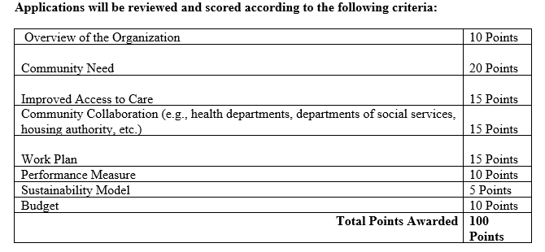
Scoring Criteria
Failure to fully describe all sections will impact the funded amount. Applications will be reviewed and scored according to the following criteria regardless of the funding category.

Slide 15

Overview of Organization
10 Points
These are set questions regarding hours your clinic is open, patients, capacity, etc.
Includes location and where the grant will be utilized; organization history, unique services, and description of your organization’s primary care services or experience in primary care; patient insurance status in your organization; roles and responsibilities of staff members; data collection of social risk factors. ​

Slide 16

Community Need
20 Points
Why are the grant funds needed?
Include the population’s healthcare needs, service area needs, information on the incidence of poverty in the targeted community, and other pertinent demographic data that support the necessity for grant funding and how these funds will directly meet the needs of the community.
Will this grant align with the Community Needs Assessment? Provide citations/reference sources for all community demographics and health-status data.

Slide 17

Improved Access to Care
15 Points
Will your organization make a difference in the community?
How will your organization intentionally fill the gap and educate the target population; provide or support the continuity of care with community partners; if applicable telehealth/telemedicine plans or current services in use. ​

Slide 18

Community Collaboration
15 Points
Is your organization partnering with others in the community?
Describe your role or participation in services that align with the North Carolina Department of Health and Human Services Strategic plan 2019-2021. ​
Describe how your organization has built or anticipate proposed collaborative partnerships with other organizations in your community. Include traditional and non-traditional organizations. ​

Slide 19

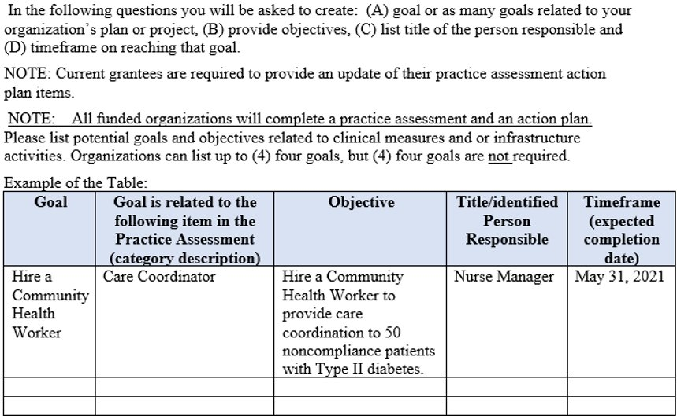
Work Plan
15 Points
Bringing it all together...

Slide 20

Performance Measures
10 Points
Medical Access Plan Targets and Performance Measure Narrative
Describe how many MAP patients and total patients your organization seek to serve.
Use the county or regional community health needs assessment data for the uninsured/underinsured population identified for your area.
Applicants should include how you plan to collect quarterly survey data and make improvements over time.
Notes:
Dorothea Performance Measures Narrative: Describe how and what your organization will identify as appropriate benchmarks or use for tracking your workplan goals and reporting data on examples such as practices’ clinical processes, outcomes, patient satisfaction, cost saving, and quality improvement. Examples: Healthy North Carolina 2030; U.S Department of Health and Human Services Healthy People 2030 ​

Slide 21

Performance Measures
Note:
Our performance measures are based off the measures in the Uniform Data System, a standardized reporting system that federally qualified health centers use to submit data.
- BMI
- High Blood Pressure
- Diabetes – HbA1c
- Tobacco Use
Diabetes: Hemoglobin A1c
Diabetes: Hemoglobin A1c
Notes:
Dorothea – even though this is not scored this is a required component. Quarterly reporting on clinical performance measures are completed. It would be helpful to include in your workplan how you plan to move the needle on one or more of the clinical measures. Remember your AHEC and ORH partners are here to assist you.

Slide 22


Sustainability Model
5 Points
What is your next step?
Describe how your organization is planning for sustainability should funds not be available? Please include financial, programmatic, and leadership aspects that provide a specific blueprint for raising the money to continue operating your programs, serving your patients and community beyond the current funding.
Describe the ways your organization plans to use these funds to expand capacity with an accountable care organization or a clinically integrated network (CIN), or any other integrated care models/solutions. (Stating “we would not be able to provide care” is not sufficient)
Notes:
NC Medicaid Provider Services Team has partnered with NC AHEC to host virtual Health Plan Meet and Greet Sessions. NC Medicaid consultants and health plan representatives are available to address concerns about Medicaid Managed Care. Ncahec.net

Slide 23

Budget
10 Points
Complete the excel template & budget narrative
“Number of encounters x $100 per encounter = $ [MAP]”
REMINDER - Per the Free Clinics Federal Tort Claims Act (FTCA) Program Policy Guide, grant funding that applies to reimbursement, payment, or compensation for the delivery of health services to patients falls within the statutory prohibition, while grant funding that is not intended for or applied to this purpose does not. Free clinics who are FTCA recipients that choose a “per encounter’ reimbursement methodology may void their FTCA liability protection.

Slide 24
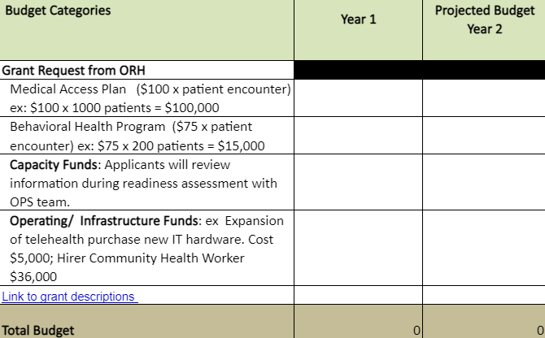
Budget
10 Points
Applicants requesting capacity or operating & infrastructure funds must also complete the expenses line items
Note: only year 1 funds will be awarded this cycle

Slide 25

Questions?
This Photo by Unknown Author is licensed under CC BY-SA

Slide 26

Dorothea Brock, Program Manager
Dorothea.Brock@dhhs.nc.gov
Rural Health Operations Specialist - Regions 4 & 6
TBA
Monifa Charles, Rural Health Operations Specialist - Regions 3 & 5
Monifa.Charles@dhhs.nc.gov
Caroline Collier, Rural Health Operations Specialist - Regions 1 & 2
Caroline.Collier@dhhs.nc.gov
https://www.ncdhhs.gov/divisions/orh

