Slide 1

NC Department of Health and Human Services
Refugee Information System RIS Upload Training
Kimberly Saunders
Refugee Program Consultant
Fall 2021

Slide 2
RIS: Uploading
Upload ANY of the following documents available to the Client Information Screen
  Immigration Documents
  SSI Documents
  DSS 6247
  DSS 8108
  DSS 8110

Slide 3



RIS: Uploading
How to Upload:
  1. Click Browse and select document to upload
  2. Click Upload Document Icon
    Square with circle at bottom right

Slide 4
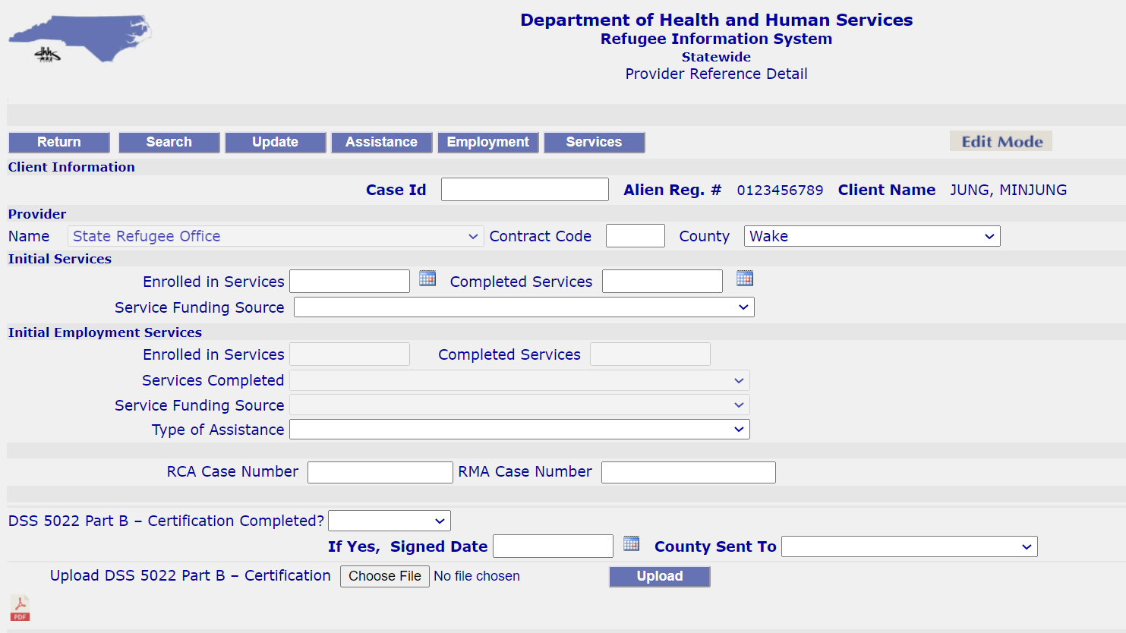
RIS: Uploading
Uploading a 5022
  Upload function is at bottom of Provider Reference Detail Page

Slide 5
RIS: Uploading
How to upload DSS-5022
  Choose File and then click upload

Slide 6
RIS: Uploading
  Uploading Tips
  If the wrong document is uploaded, you can upload another document to replace (override) it
  If you have a newer version of a document, you can override what is currently there with the new version.

Slide 7
RIS: Uploading
Contact me with any Questions/Problems:
Kimberly Saunders
Refugee Program Consultant
NC State Refugee Office
Kimberly.Saunders@dhhs.nc.gov

