Slide 1
NC Department of Health and Human Services
Rural Health Clinics
New Site Process and Resources
Notes:
Can you guess how many RHC there are nationwide? Over 4,500.

Slide 2
Objectives
PART 1
PART 2
Background Rural Health
Clinic
Types of Rural Health
Clinics
Requirements
Staffing your rural health
clinic
Community Partnership
Marketing
Resources Primary Care Workforce
Financial Feasibility
Filing RHC Application
Guidance RHC Survey Steps
Billing Coding
Sample Electronic Health
System
Funding Opportunities
Rural Health Clinics Models

Slide 3
Part 1

Slide 4
Background
1977- Congress Passed Rural Health Clinic Services Act.
Mission: Rural Health Clinics (RHCs) program is intended to increase access to primary care services for patients in rural communities. Promote a collaborative model of health care delivery using physicians, nurse practitioners and physician assistants. Congress added- nurse midwives, mental health practitioners psychologist and clinical social workers.
RHCs can be public, nonprofit, or for-profit healthcare facilities.
To receive certification, (Federally- certified Rural Health Clinic) must be located in rural and underserved areas.

Slide 5
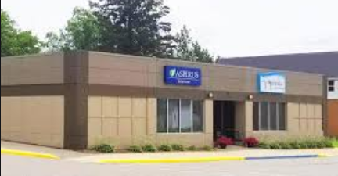
Different Types of Rural Health Clinics
RHC can be Provider-based or Independent RHCs
Provider-based RHCs owned and operated by hospital, nursing home, or home health agency
Independent RHCs- freestanding owned by a provider or a provider entity.
Notes:
What is the difference between a provider-based RHC and an independent RHC?
Provider-based RHCs are owned and operated as an essential part of a hospital, nursing home, or home health agency participating in the Medicare program. RHCs operate under the licensure, governance, and professional supervision of that organization. Most provider-based RHCs are hospital-owned.
Independent RHCs are free-standing clinics owned by a provider or a provider entity. They may be owned and/or operated by a larger healthcare system, but do not qualify for, or have not sought, provider-based status. More than half of independent RHCs are owned by clinicians.
Mobile facility that moves from one community to another community.

Slide 6
Rural Health Clinics (RHC) Must be located:
Rural Area- Census Bureau designations as “non-urbanized”
Shortage Area-
A Federally-designated Medically Underserved Area (MUA)
Health Professional Shortage Area (HPSA) : https://bhw.hrsa.gov/
Area designated by the State’s Governor as underserved.

Slide 7
Am I Rural?
https://www.ruralhealthinfo.org/am-i-rural
Notes:
Run reports, pdf format, provide additional information and resources (Tools for Success)

Slide 8
What is you lose your shortage area?
Can I remain a Rural Health Clinic? Yes
Centers for Medicare & Medicaid Services (CMS) notifies provider – previously certified and cannot be decertified by CMS.
Relocation of Rural Health Clinic
Submit an application to update medically underserved designation within 120 days.
Can continue as a RHC for 120 days
HRSA reviews application and status.
Notes:
If a location loses its non-urbanized area and/or shortage designation, is it possible to remain a Rural Health Clinic?
Yes. An RHC previously certified as being in a non-urbanized and/or designated shortage area that loses either or both of these designations cannot be decertified by CMS. See RHC Rules and Guidelines Condition of Coverage: Location of Clinic for additional information.
Additional rules apply to RHCs that choose to relocate. Any RHC that no longer meets one or both of the location requirements and chooses to relocate to another non-qualifying area will be terminated from the program. An RHC may maintain RHC status if the new location meets current location requirements. See Rural Health Clinic (RHC) Location Determination Guidance Updated for detailed information.

Slide 9
Rural Health Clinics Requirements
Staffing
One or more physicians; and
One or more physician assistant (PA’s), nurse practitioner (NPs), or certified nurse midwife (CNMs); and
The PA, NP or CNM must be on-site and available to see patients 50 percent of the time the clinic is open for patients.
A physician (MD or DO) must supervise each NP, PA, or CNM consistent with state and federal law.
Contract staff

Slide 10
Staffing cont’d.
There is no specific FTE percentage or employed/contracted agreement required for physicians in an RHC.
The physicians do not have to be employed by the RHC; they can provide services under contract.
The arrangement must comply with state scope of practice laws, and the physician must be on-site for sufficient periods depending on the needs of the facility and its patients.
Records review may be conducted via an electronic health record (EHR).

Slide 11
Staffing Physician Responsibilities
Medical direction, consultation and medical supervision of health care staff
Helps develop, execute, and periodically review written policies
Reviews patient records, provides medical orders, and provides services to patients
Provides medical direction at least once very 2 weeks, and is available for consultation, assistance with medical emergencies, or patient referral.

Slide 12
Staffing Mid-Level Practitioners
Helps develop, execute, and review written policies.
Assists with physician’s periodic review of patients’ records.
Providers patient care services (not performed by a physician).
Provides services in accordance with the clinic’s policies.
Arranges for, or refers patients to, needed services that cannot be provided at the clinic; and
Assures that adequate patient health records are maintained and transferred as required when patients are referred.

Slide 13
Staffing –Temporary Staffing Waiver
If the RHC has been unable to hire mid-level practitioner to be onsite 50% of RHC hours, despite reasonable efforts in the previous 90-day period.
Waiver is good for 1 year, then CMS will terminate RHC from Medicare program.
Can re-apply for waiver, but no earlier than 6 months after the expiration of the previous waiver.
How to file for a waiver?
Submit information to the CMS NC Office requesting a
waiver.

Slide 14
Provision of Services
RHC must be capable of delivering out-patient primary care services, although clinics are not limited to primary care services.
Must maintain written patient care policies that:
Are developed by a physician, physician assistant or nurse practitioner, and one health practitioner who is not a member of the clinic staff.
Describe the services provided directly by the clinic’s staff or through arrangement.
Provide guidelines for medical management of health problems.
Provide for annual review of the policies.
Notes:
Sample procedure and policies in manual Appendix D.

Slide 15
Direct Services
Clinic staff must provide diagnostic and therapeutic services
Must be able to provide the following six laboratory tests:
Chemical examinations of urine
Hemoglobin or Hematocrit
Blood sugar
Examination of stool specimens for occult blood
Pregnancy test
Primary culturing for transmittal to a certified laboratory.

Slide 16
Emergency Services
Rural Health Clinics must be able to provide “first response” services to common life-threatening injuries and acute illnesses.
The Clinic must have access to those drugs used commonly in life-saving procedures.

Slide 17
Agreements and Arrangements
RHC has agreements or arrangements to provide:
Inpatient hospital care
Physician services (regardless where furnished); and
Specialized physician services
Specialized diagnostic/lab
Interpreter for foreign languages
Interpreter for hearing impaired/ devices to assist communication with blind patients
Diagnostic and laboratory services not available at the RHC
If the agreements are not in writing there is evidence that patients referred by the clinic or center are not being accepted and treated.
Ambulance Services
Community partnership and regional partnership

Slide 18
Patient Health Records
Clinic must maintain an accurate and up-to-date record keeping system that ensures patient confidentiality.
A description of the Clinic’s system must be included in the policy and procedures manual
Clinic staff must be involved in the development of this record keeping system.
Records must include the following information:
Identification data
Physicians orders
Physical exam findings
Consultative findings
Social data
Diagnostic and lab reports
Consent forms
Medical history
Health Status assessment
Signatures of the physician or other health care professionals
Notes:
Appendix D has a sample

Slide 19
Protection of Record Information Policies
Maintaining the confidentiality of patient information.
Must have written policies and procedures that govern the use, removal and release of information.
The policy and procedures manual must also document the mechanism through which a patient can provide consent for the release of his or her medical records.
RHCs like all other Medicare providers, must also be compliant with the HIPAA privacy standards.

Slide 20
Quality Assessment and Performance Improvement (QAPI) Program
Must develop, implement, evaluate and maintain an effective, ongoing, data-driven QAPI program
Must be appropriate for the complexity of the RHC’s business, and focus on maximizing outcomes by improving patient safety, quality of care, and patient satisfaction.
Examples
Plan, Study, Do, Act
Joint Commission process model
Lean Model
Six Sigma
Chronic Care Model
The Four Habits Model
PCMH
Notes:
Board as support

Slide 21
Role Clinical Team and Board Members
Board Development
Recruitment strategy ( candidates would be good fit)
Organization’s long term goals
Skills or resources needed to achieve those goals- strategic plan
Ensure structure – set up clear terms of engagement, term limits (2 years), minimum contribution ( Board contribution policy)
Clearly identify the skills your board members have
Orientation process ( rules, job description, responsibilities)
Peer learning roundtables
Performance evaluation
Patient Satisfaction survey
Community engagement

Slide 22
Steps to Designing the Process
Notes:
How much does is cost,
Vendors/ maintain
Social Media/ Facebook, etc.
Brand
Boost your services

Slide 23
Resources Primary Care Workforce
3RNet (Rural Recruitment and Retention Network) helps rural healthcare organizations attract healthcare providers by posting job opportunities online by state. Candidates who are interested in working in rural areas may register with 3RNet to search for job opportunities.
The National Health Service Corps (NHSC) provides scholarships and loan repayment programs for primary care providers willing to work in areas that are federally designated as a Health Professional Shortage Area (HPSA).
The J-I Visa Waiver allows international medical graduates who have pursued residency training in the U.S. to stay in the country and practice in a federally designated Health Professional Shortage Area (HPSA) or Medically Underserved Area (MUA) if recommended by an interested federal government agency or by a state under the Conrad 30 program.
Notes:
Research what a competitive salary would be for a given health occupation the region
What are options available for benefits and incentives you can include to make a compensation packages desirable to potential employees. https://www.ruralhealthinfo.org/topics/rural-health-recruitment-retention#salary
Occupation Employment statistics listing occupation profiles https://www.bls.gov/oes/current/oes_stru.htm

Slide 24
Part 2

Slide 25
Financial Feasibility Analysis
Financial impact or benefits are significant enough to outweigh the cost incurred in establishing a RHC.
Financial Feasibility Analysis can be created by estimating the volume and payments from Medicare, Medicaid, and other payers. Ex. Payor mix
Example RHC -25%-75% increased revenue in overall annual revenues. Based on minimum 50% of the total visits are Medicare and Medicaid combined.
When the percentage of Medicare & Medicaid patient volume drops below 50% as a combined number the financial impact is usually much less.
Factor improve patient flow via utilization of PAs and NPs.
Reimbursement – cost-based report methodology.
Notes:
Accountant or business consultant to review practice revenues.
Estimation of patients encounters- Face-to-face / telehealth

Slide 26
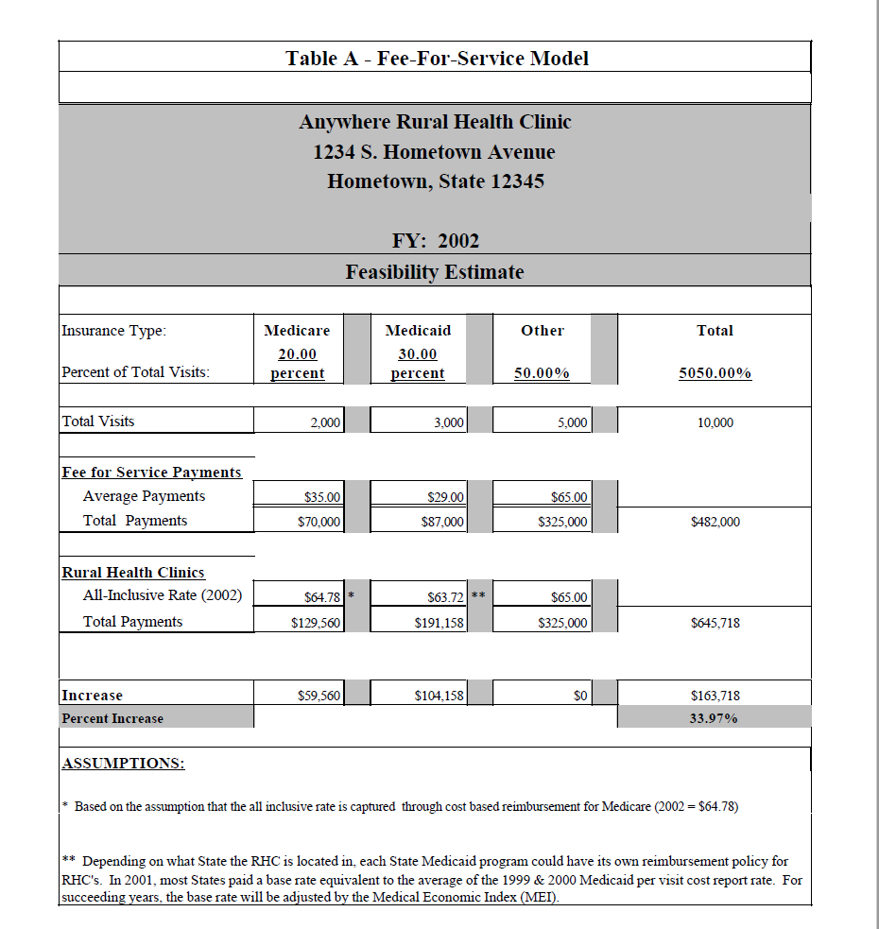

Slide 27
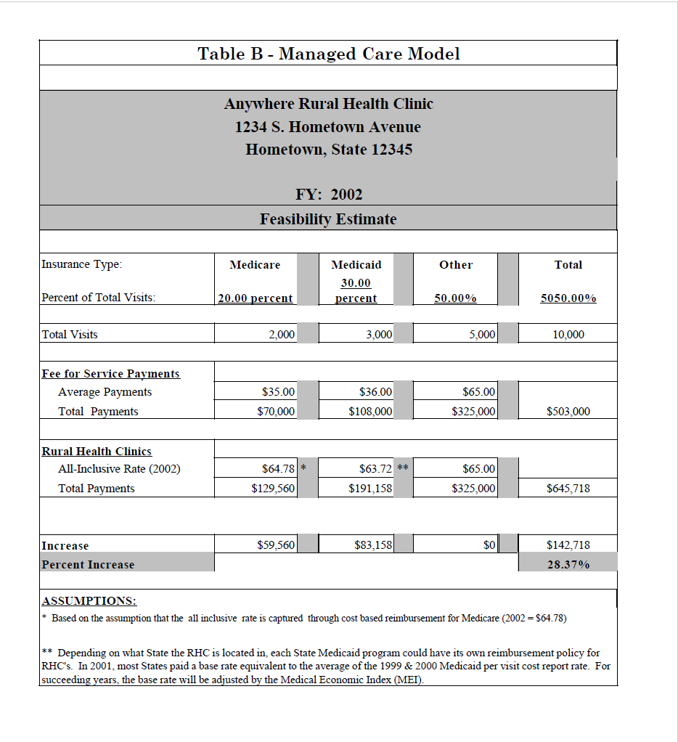

Slide 28
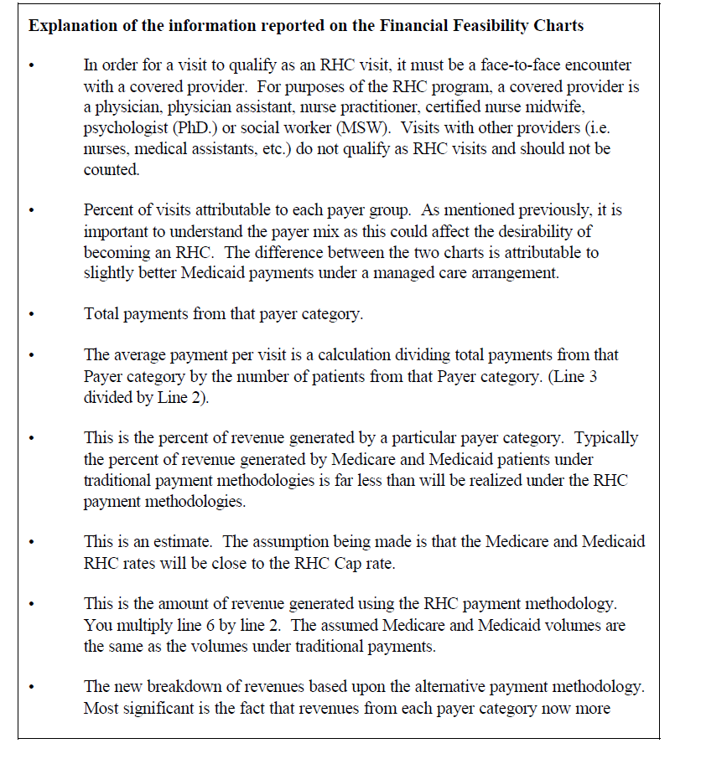

Slide 29
Filing the RHC Application
RHC Application
CMS 855 A Medicare Provider/Supplier Enrollment application
CMS forms required to ensure proper compliance:
CMS-29 Request to Establish Eligibility to Participate in the Health Insurance for the Aged and Disabled Program to Provide Rural Health Clinic Services
CMS-1561A Health Insurance Benefits Agreement
HHS-690 Assurance of Compliance ( if participating as a Medicaid RHC)
CMS-2572 Statement of Financial Solvency, and Expression of Intermediary Preference
Notes:
RHC Application packet
Any of the forms are subject to change

Slide 30
After you submit your application/form
Submit information to CMS Office NC DR
Packet is reviewed by appropriate staff
Staff then approves the CMS 855A
A letter will be sent to the provider and State agency informing them of the recommendation of approval.
The provider will be informed in their letter that the State agency will be contacting them regarding their date of readiness for the RHC Survey.
When you respond with our dates of readiness, you are indicating to the State agency, that as of that date, you believe you are, to the best of your ability, in compliance with RHC program regulations.
You must be in operation and providing services to patients when surveyed.
Schedule initial surveys within 90 days of receiving notification that 855 process is complete the provider is open and operating.
Notes:
The State agency does have the option, under certain circumstances, of giving clinics a 48-
hour notice of the scheduled survey. Some States, however, will not exercise this option
and the survey will be unannounced.
Clinics are encouraged to begin collecting the information needed for completing the cost
report. Although this report will not be filed until after the clinic is certified, you can use
this time to make preliminary preparations so as to expedite the filing once certification is
granted.

Slide 31
Preparing for the RHC Certification Inspection
RHC Policy and Procedure Manual: cover key human resource policies, administrative policies, clinical procedures and protocols, and medical guidelines per RHC Code of Federal Regulations (CFR) §491.7(a)(2).
Developing human resource policies, there are several laws, administrative
rules, acts, and regulations that must be considered: RHC Code of Federal Regulations, RHC Interpretative Guidelines, State and Federal Laws, State Public Health Code, and Professional Practice Standards.
The Human Resource policies should include:
job descriptions
benefits, compensation and pay practice
employment criteria and conditions of employment
smoking, drug use/possession and distribution
appointment of providers/credentialing
confidentiality
personnel files (organization, management, and access)
harassment, and employee privacy
Notes:
RHC site visit,
may request additional information such as: Clinic contact name and position, clinic phone
and fax numbers, travel directions to the clinic from the State agency, clinic floor plan,
hours of operation, clinic organizational chart, practitioner (physician, PA, NP or CNM)
resumes and work schedules, and copies of the Advisory Meeting Minutes. If your state
requires that you be licensed, you must obtain this license prior to being approved as a
Medicare provider.

Slide 32
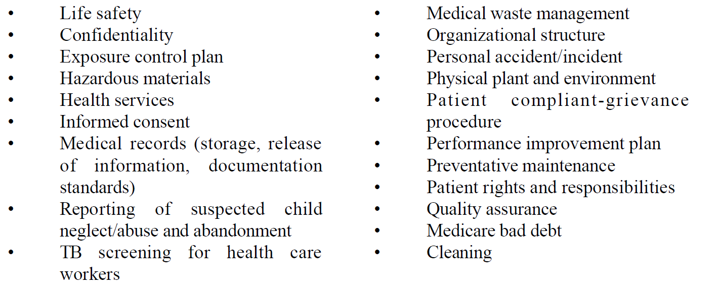
Preparing for the RHC Inspection
Administrative policies should include:
Notes:
when developing your Administrative section, the best place to start is with the Code
of Federal Regulations (CFR). An example of an Administrative policy would be
Preventive Maintenance. CFR Section 491.6(b) States, “The clinic has a preventive
maintenance program to ensure that: (1) All essential mechanical, electrical and patientcare
equipment is maintained in safe operating condition.” The RHC Interpretive Guideline
for this regulation defines the requirement further, “A program of preventive maintenance
should be followed by the clinic. This includes inspection of all clinic equipment at least

Slide 33
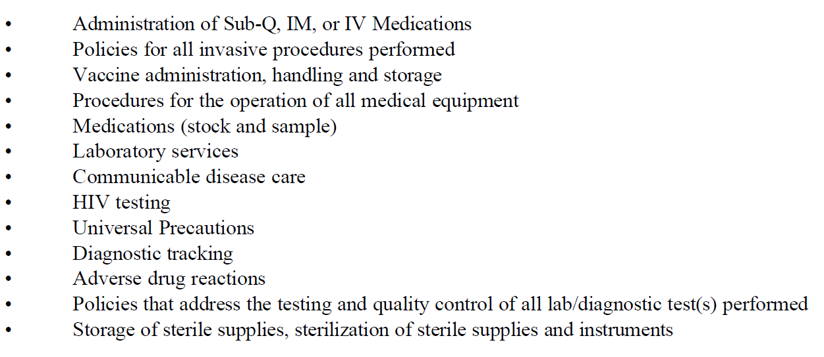
Preparing for the RHC Inspection
Clinical Policies should include:
Notes:
RHC
Regulations and Interpretive Guidelines, manufacturer recommendations, professional
practice standards, pharmacy regulations and administrative rules, American Heart
Association, Federal and State OSHA standards, CLIA regulations, CDC, State Public
Health Code, American Academy of Pediatrics, and PHS Standards for Pediatric
Immunization Practices.

Slide 34
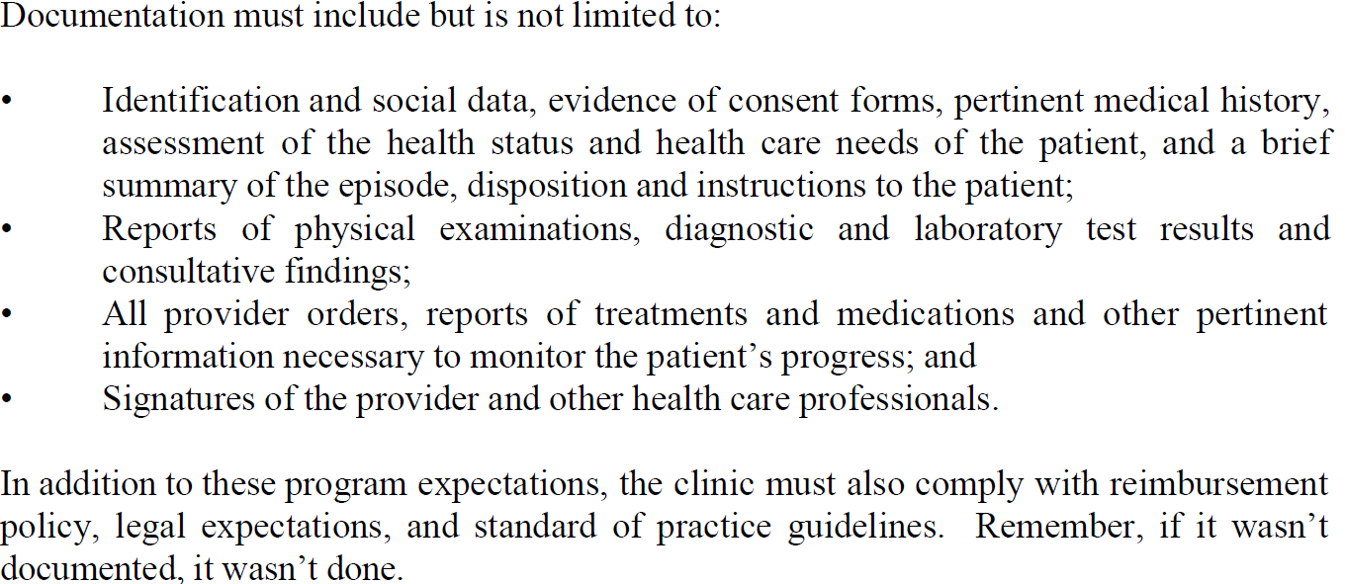
Preparing for the RHC Inspection
Medical Records
Notes:
Code of Federal Regulations.
The clinic has written policies and procedures of how it will maintain
confidentiality of patient health records and provide a safeguard against: loss, destruction,
or unauthorized use of patients’ health record. CFR Section 491.10 Patient health records
of the Code, outlines expectations for medical record confidentiality, maintenance,
organization, content, protection, release and retention.

Slide 35
Preparing for the RHC Inspection
Facility
To insure the safety of patients, personnel, and the public, the physical site should be maintained consistent with appropriate State and local building, fire, and safety codes.
Free from hazards that may affect the safety of patients, personnel, and the public.
Provide adequate space for the provision of direct services
Provide laboratory services directly to its patients
Clinical Laboratory Improvement Amendments (CLIA) certificate of waiver. ( perform simple laboratory examinations and procedures)
Preventive maintenance program to ensure that all essential mechanical, electrical, and patient-care equipment is maintained in safe operating condition.
Assuring the safety of patients in case of non-medical emergencies that include, placing exit signs in appropriate locations and taking other appropriate measures.
Notes:
Some of the regulations,
laws, rules, and standards that impact the facility are: RHC Code of Federal Regulations,
Clean Indoor Air Act, OSHA Hazardous Communication Standard, local building, zoning
and, fire ordinances, and State laws for storage and disposal of medical waste.

Slide 36
Preparing for the RHC Inspection
Program Evaluation:
An evaluation of the clinic’s total operation including the overall organization, administration, policies and procedures covering personnel, fiscal and patient care areas must be done at least annually.
This evaluation may be done by the clinic; an outside group of professional personnel that includes one or more physicians and one or more physician assistants or nurse practitioners and at least one individual who is not part of the clinic staff; or through arrangement with other appropriate professionals.
The State survey does not constitute any part of this program evaluation.

Slide 37
Successful Survey…Plan and Prepare
Certification Survey results in no deficiencies
The State agency has ten(10) calendar days to prepare the Survey Packet for the CMS Regional Office (RO) with a recommendation of approval.
The RO has 60 days to review and approve the survey packet and issue the Medicare Provider Letter to the clinic.
RHC Provider-based entity, the provider-based request- submit to RO with the survey packet. The RO will make the PB determination and will notify the appropriate Fiscal Intermediary via the Medicare Tie-In Notice.
Notes:
Having these documents ready and prepared for the surveyor

Slide 38
Unsuccessful Survey
Result in deficiencies or citations:
A Statement of Deficiencies will be sent to the clinic by the State agency within ten (10) days of the survey.
The clinic will have 10 days to develop a Plan of Correction (POC) and submit the POC back to the State agency.
An initial submission to the Medicare program cannot be certified or approved unless in compliance with the Conditions of Coverage.
Judgement of the surveyor, if the deficiencies are still non-compliance at the condition level, then cannot be approved; need a follow-up survey.
Until deficiencies are in compliance. The State will review the POC for completeness.
POC include: doable or realistic, it must have completion dates, specifically address the citation, if appropriate, document proof of compliance.

Slide 39
Guidance for Survey Steps
Tasks in the Survey Protocol
State Operations Manual Appendix G
Task 1: Off-site Survey Preparation
Task 2: Entrance Activities
Task 3: Information Gathering/Investigation
Task 4: Preliminary Decision-Making and Analysis of
Findings
Task 5: Exit Conference
Task 6: Post-Survey Activities
Notes:
Binder with all the forms information
Compliance with Medicare Conditions of Certification (Cfc)
Reference Guidance for survey steps pdf.

Slide 40
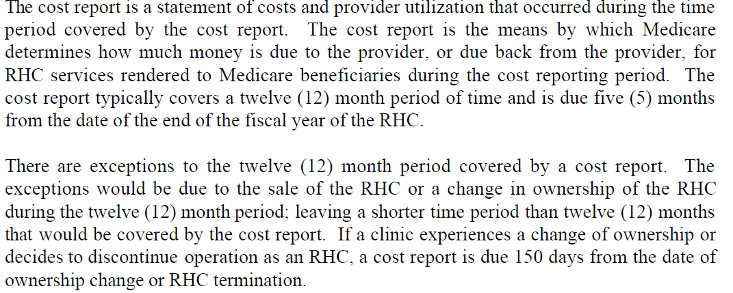
Completing the RHC Cost Report
CMS- Form 222 – Independent RHC
Schedule M Form ( hospital, nursing home, or home health) Medicare Cost Report : Submission is electronic
Notes:
12 month period covered by the cost report
Due 5 months from the date of the end of the fiscal year of RHC.
The maximum time period that can be covered by a filed cost report is thirteen (13)
months. There are no extensions to file cost reports except under special circumstances,
such as a natural disaster (i.e. flood, earthquake, fire, etc.). The Fiscal Intermediary
generally will grant this type of extension. You can find a listing of the Fiscal
Intermediaries for the independent RHC community in Appendix F.
Cost report is different for an independent RHC and Provider-based RHC.

Slide 41
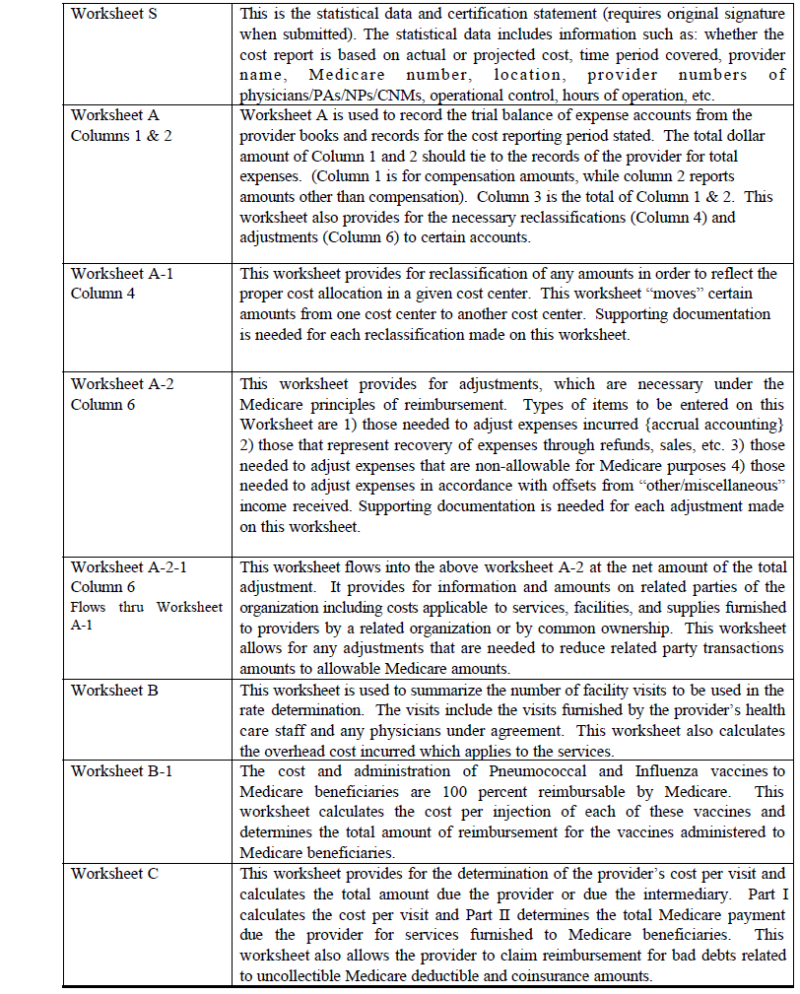
Worksheet
Description
Notes:
RHC Manual Chapter 6 Completing the RHC Cost Report

Slide 42
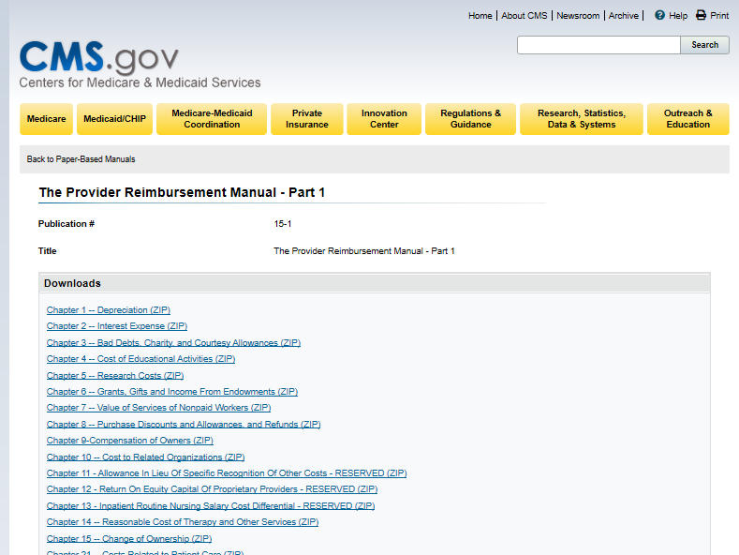
Medicare RHC Cost Report Reimbursement Regulations
https://www.cms.gov/Regulations-and-Guidance/Guidance/Manuals/Paper-Based-Manuals-Items/CMS021929
Notes:
Open the link to access the word document downable guidance with all the regulations.

Slide 43
Cost Reporting Forms
Independent RHCs
CMS-222-17
Link to PDF of Forms https://www.cms.gov/Regulations-and-Guidance/Guidance/Transmittals/2018Downloads/R1P246.pdf
Provider-based RHCs
CMS-2552-10
https://www.cms.gov/Regulations-and-Guidance/Guidance/Transmittals/Downloads/R3P240f.pdf

Slide 44
Medicare Cost Report E-Filing (MCRef)
https://www.cms.gov/Outreach-and-Education/Medicare-Learning-Network-MLN/MLNGenInfo/index

Slide 45
MCReF (FAQs)
https://www.cms.gov/Medicare/Compliance-and-Audits/Part-A-Cost-Report-Audit-and-Reimbursement/Downloads/MCReF-FAQ.pdf

Slide 46
Mandated Cost Reporting Timeframes
Description | Timeframe
Cost Report prepared by the clinic and due to Medicare | 5 months year-end
Number of days the MAC has to accept the cost report | 30 days
Number of days the MAC has to pay a tentative settlement | 60 days
Time to final settle cost report | 1 year from acceptance
https://www.cms.gov/Regulations-and-Guidance/Guidance/Manuals/downloads/fin106c08.pdf

Slide 47
Cost Reporting Additional Resources
Cost Reporting for Rural Health Clinics - What is needed to file an accurate and timely cost report. In this webinar we go over the rural health clinic cost reporting process, the information needed to file the cost report, timeframes for filing, Medicare Bad Debts, Influenza, and Pneumococcal reimbursement, P S & R reports, and Electronic Filing of the Cost Report.
https://www.youtube.com/watch?v=oFL0HpIs0LE&feature=youtu.be

Slide 48
RHC Coding and Billing
Cost-per-visit basis
Rural Health Clinics submit claims to Medicare Administrative Contractors (MACs) for services to Medicare beneficiaries.
Medicare Part B payment all inclusive rate (AIR)
RHC Payment CY 2020 is $86.31
Terms:
UPIN- Unique provider identification number- issued after application to Medicare Part B is received
Provider Identification Number- unique number that is issued by payers to each provider to identify that provider as a credentialed and approved provider.
Notes:
Introduction for better understanding

Slide 49
Telehealth During COVID-19
https://www.narhc.org/narhc/COVID-191.asp https://www.cms.gov/files/document/se20016.pdf
Notes:
Updated: 8/4/20 President signed an executive order to expand telehealth, broadband , increase rate for Medicare.
Utilization rate
Patient engagement
Resources equipment
New Guidance on Telehealth Billing for RHCs including payment for Telephone Only Visits-May 1, 2020
Link: https://www.youtube.com/watch?v=-t98HJPuPIs

Slide 50
NC Medicaid Division of Health Benefits
https://medicaid.ncdhhs.gov/providers/cost-reports
Notes:
Submitting your cost report-Medicaid CMS form 222-17

Slide 51
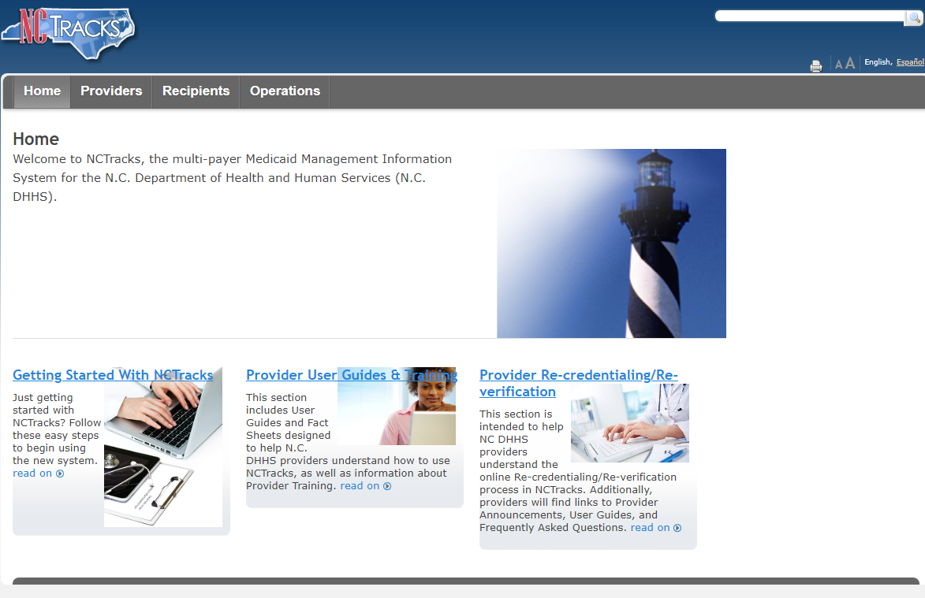
https://www.nctracks.nc.gov/content/public/

Slide 52
National Association of Rural Health Clinics
Why NARHC is important?
NARHC advocate on your behalf RHC policies, certification
guidelines, and resources.
Rural Health Research
Resources:
Conferences
Discussion Forums
Webinars
Technical Assistance
Listing of vendors and consultants
NARHC Academy – Certified Rural Health Clinic Professional Course
Membership

Slide 53
Overview Organizational Services
Regional Office
NC State Office DHSR
Ms. Lana Dennis
Centers for Medicare & Medicaid Services
Office of Program Operations & Local Engagement & Administration
Atlanta, GA
CMS Rural Health web page
CMS updates
Survey and certification policies to states
Open Door Forums
CMS seek public opinions
CMS Application
Waivers
Certification
Assign CMS number
Site Visits
Compliance check

Slide 54
Division of Health Service Regulation
Division of Health Service Regulation
Acute & Home Care Licensure & Certification Section
North Carolina Department of Health
https://info.ncdhhs.gov/dhsr/

Slide 55
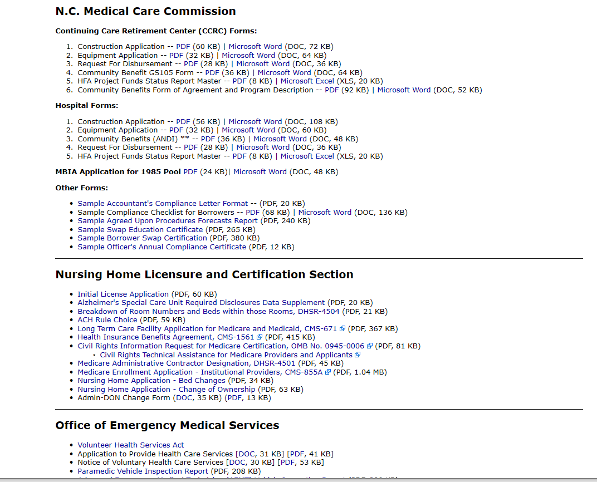
Steps for form
Homepage
Click on
Forms and Applications

Slide 56
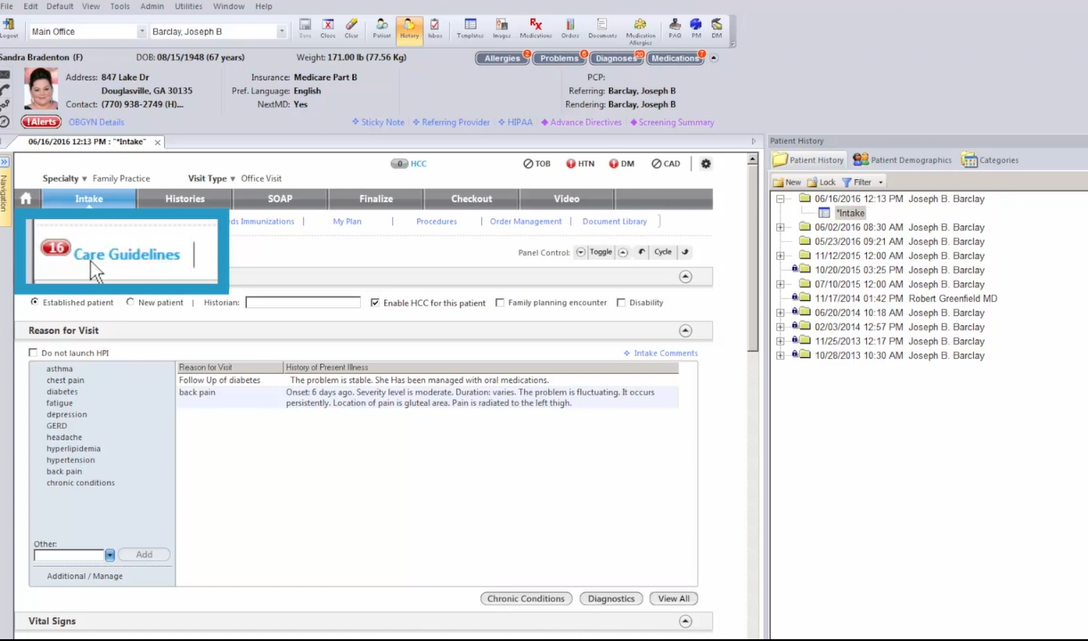
Electronic Health Record System
Notes:
SOAP ( Subjective, Objective, Assessment Plan ) Note an acronym that is most common method of documentation used by providers to input notes into patient’s medical records.

Slide 57
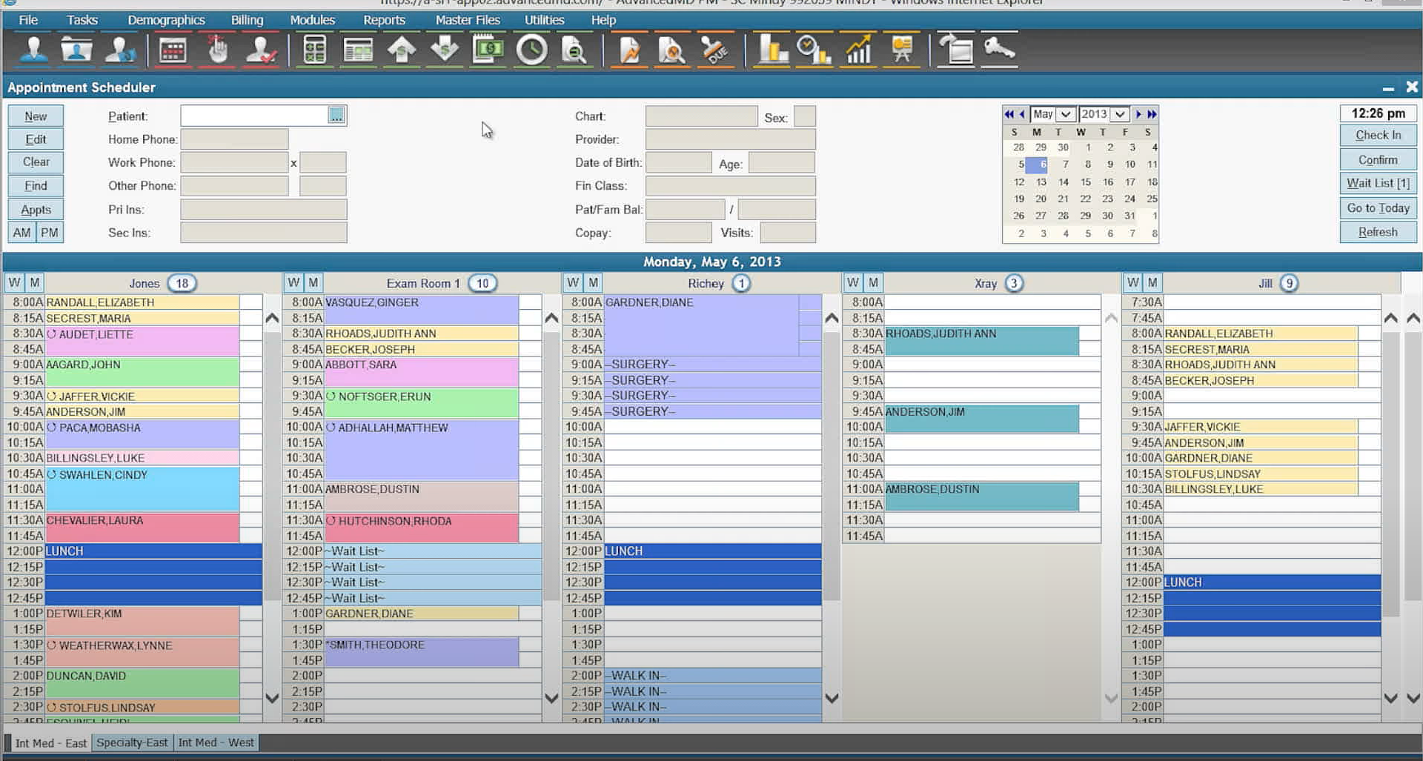
Scheduling Providers/ Patients
Notes:
Color codes helpful
Reduce no shows and save time with automated patient reminders

Slide 58
Notes:
Transfer patient data quickly and accurately with any system.

Slide 59
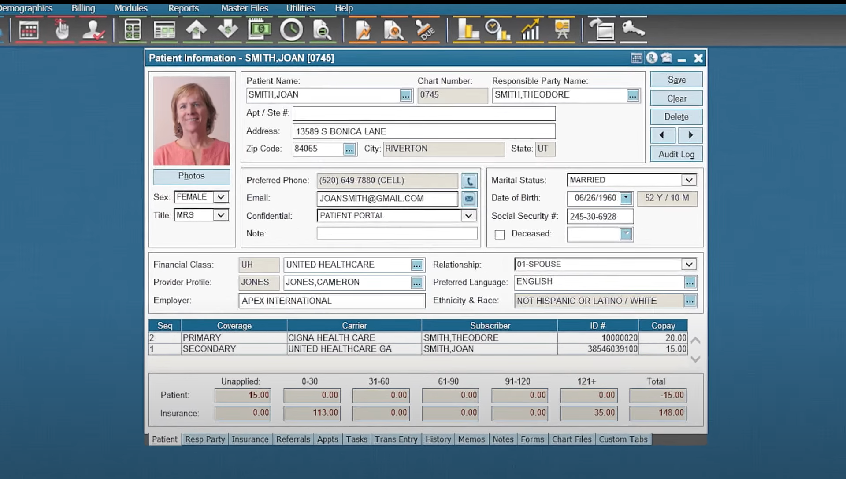
Notes:
Access patient charts in seconds.

Slide 60
Financial Reporting
Financial summary (charges, payments, adjustments)
Custom dashboards
KPIs – Key performance indicators
Current trends, top carriers, encounters
RVU- Relative value units
Relative value units (RVUs) are a measure of value used in the United States Medicare reimbursement formula for physician services. RVUs are a part of the resource-based relative value scale (RBRVS).
EOB An explanation of benefits (commonly referred to as an EOB form) is a statement sent by a health insurance company to covered individuals explaining what medical treatments and/or services were paid for on their behalf.

Slide 61
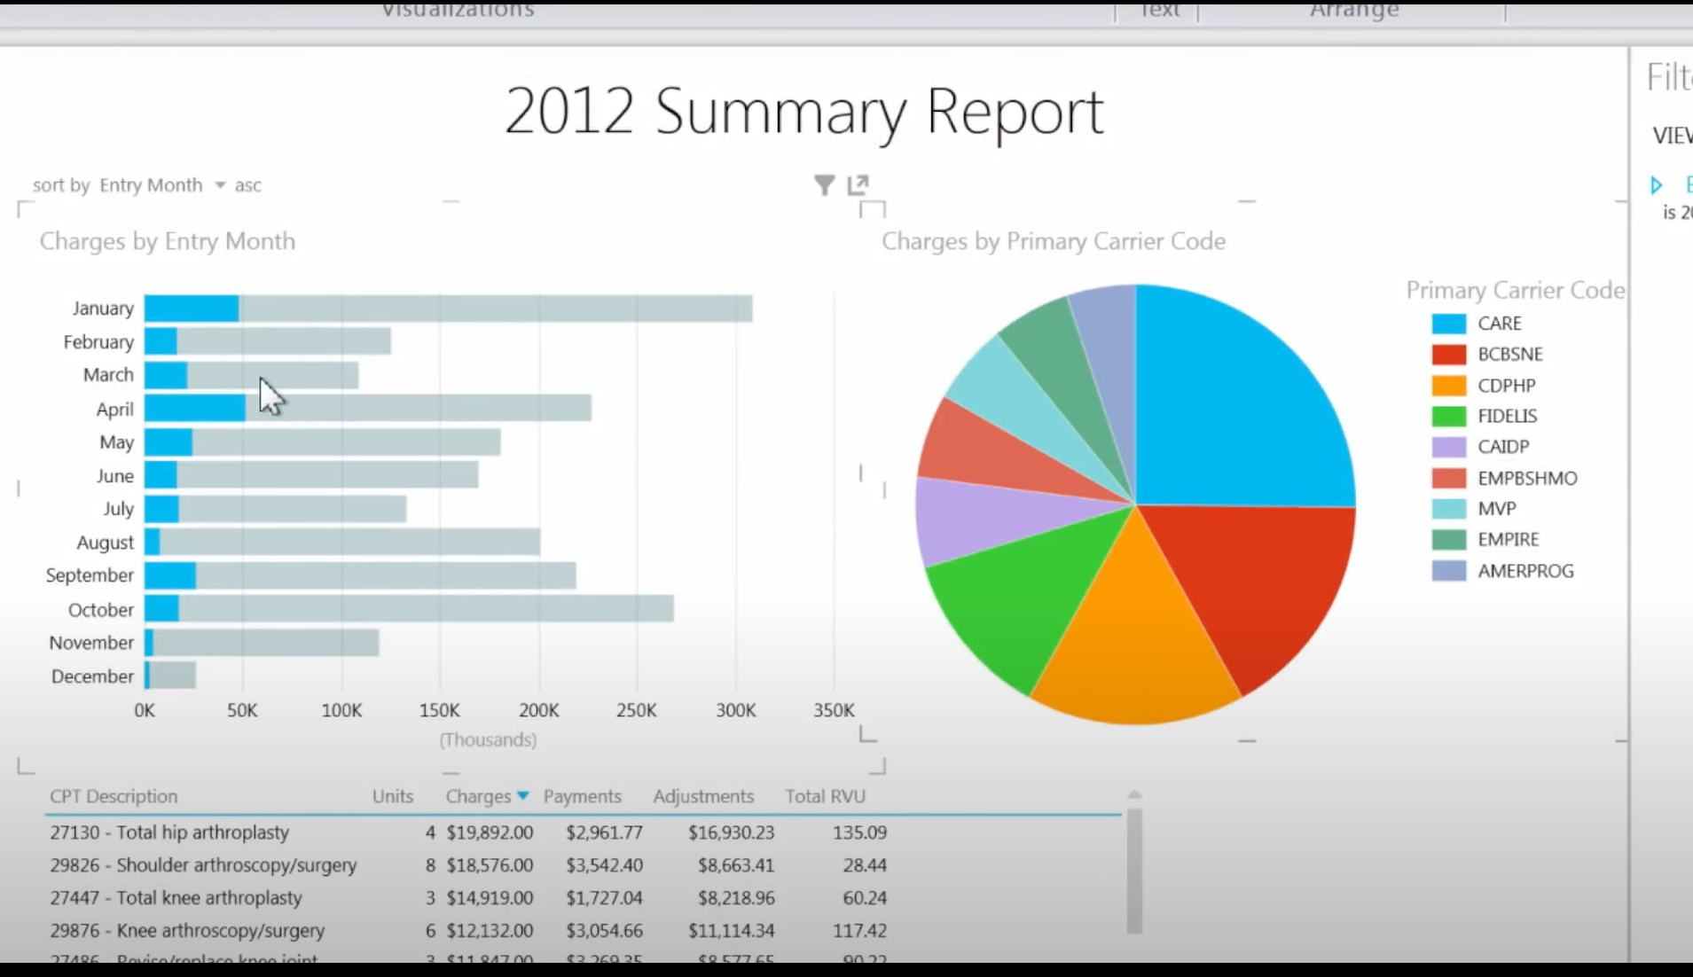

Slide 62
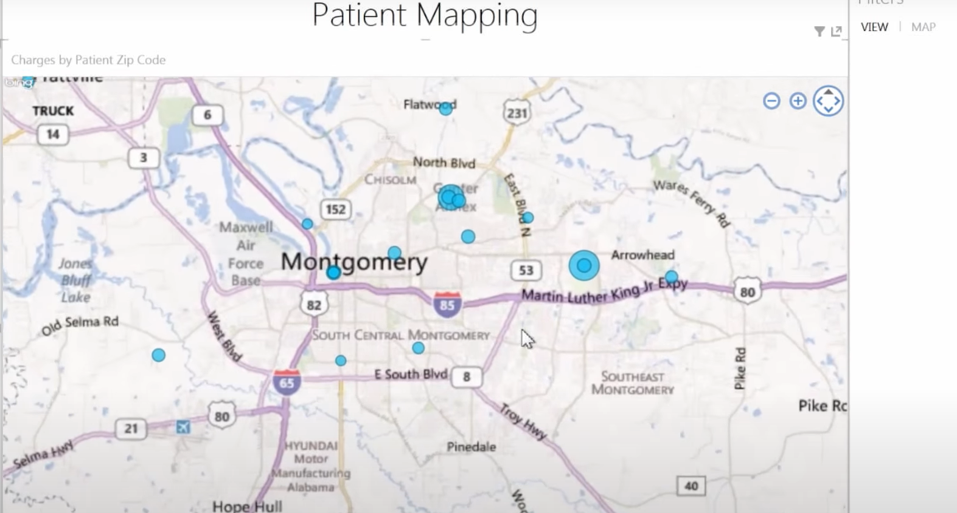

Slide 63
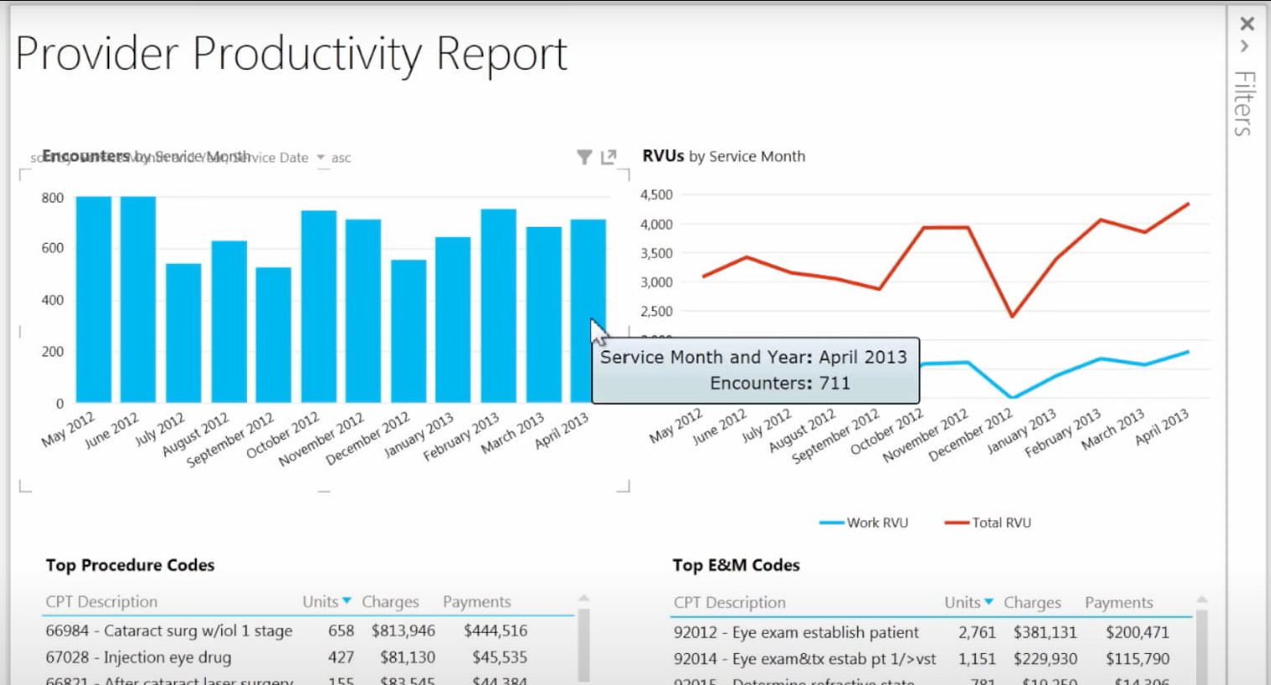

Slide 64
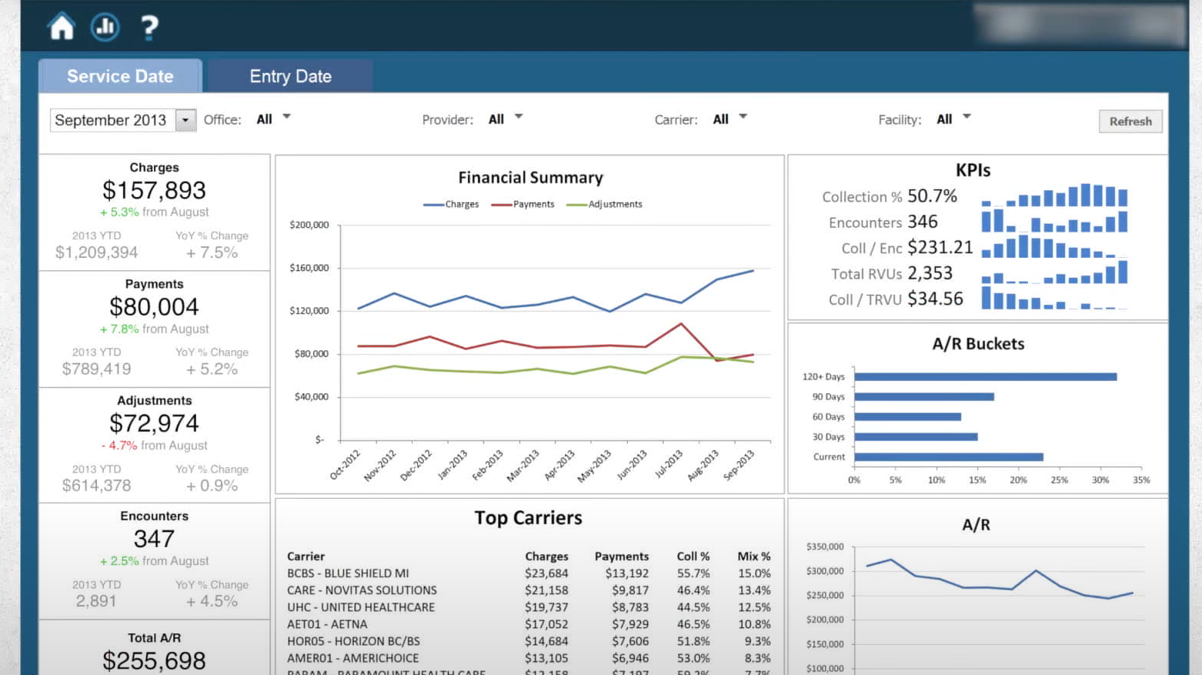

Slide 65
Funding Opportunities
https://www.ncdhhs.gov/about/grant-opportunities
Notes:
Community Health Grant

Slide 66
Funding Opportunities
Special Funding Initiatives | Federal Grants | Private / Loans | Corporations | Others
Robert Wood Johnston Foundation AARP Foundation | Grants.gov | Small Business Administration (SBA) Loans County Chamber of Commerce Personal Loans Credit Unions | Target Wal-Mart Amazon Humana Foundation Citigroup Foundation Robert Wood Johnson Foundation W.K Kellogg Foundation Nationwide State Farm Insurance Spectrum | Community Partners ( In-Kind) Fundraisers Grantwatch.com Duke Endowment NC BCBS Private donations- venture capital KBR Charitable Trust Funds NC Department of Commerce Grants & Incentives
Notes:
Small Business Administration (SBA) Loans:
This involves funding from a government administration devoted to assisting small businesses to succeed. SBA’s help small businesses get capital and ensures that a certain percentage of contracts are awarded to the small businesses.
CARES Act
Corporate responsibility
Philanthropic Organizations
Community impact
Grant Writer
https://www.nonprofitexpert.com/foundation-master-file/north-carolina-foundations-on-the-web/

Slide 67
NCCARE 360
https://nccare360.org/join/

Slide 68
Screening Tool
Social Determinants of Health.
A variety of non-medical factors influence how patients interact with the health care system and how well they are able to manage their health.
These include education level, income, employment, housing quality and stability, the strength or weakness of social relationships, access to transportation, and availability of nutritious and affordable food. Problems in any of these areas can contribute to increased chronic conditions, substance abuse disorders, and shorter life expectancy in rural areas.
Working with other community-based organizations allows health care providers to address the social determinants of health.

Slide 69
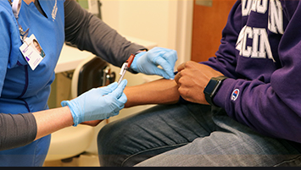
Rural Health Clinic Models
Identifying and knowing the types of patient population
Services centered around making accessible health care
List of Patient Services
Dental Care
Substance Abuse Treatment / Behavioral Health
Pharmacy
Nutritional Support
Preventative Care ( Diabetes Management, smoking cessation)
Physical & Occupational Therapy ( school physicals)
Saturday Clinic (Urgent Clinic)
Telehealth
Imaging/radiology ( Mammogram test)
Collaborative Team: Health Educator, Patient Navigator, Community Health Worker, Community Paramedicine
Notes:
Screening, SoDH ,Value-based care model

Slide 70
Example Models
Value-based Health Care Models
Value-based health care models recognize that meeting the needs of complex patient populations requires support from multiple systems of care (health, behavioral health, social services, public health, and other enabling services).
The following models provide opportunities for rural health organizations to work collaboratively with others.
Patient- Centered Medical Homes (PCMHs). This health care service delivery model has been widely implemented to transform the delivery of primary care. The model aims to deliver whole-person care that is coordinated and tracked by the patient’s primary care provider or “medical home.”
Accountable Care Organizations (ACOs). An ACO is a value-based arrangement that generally includes a network of physicians and hospitals that voluntarily share financial and clinical responsibility for a defined patient population and are held accountable to third-party payers. These clinical networks are formalized by an agreement between the payer and providers involved; the agreement stipulates how care will be provided and how financial incentives will be disbursed.

Slide 71
Programs at ORH
NC Farmworker Health Program
Rural Health Information Technology Program
Placement and HPSA Services
NC Rural Health Centers
NC Community Health Grants
Provides technical assistance to improve the use of Electronic Health Record (EHR) Systems and the use of health information exchange
Recruit providers and designates health professional shortage areas
Supports state designated rural health centers that serve the entire community
Supports the primary care safety net system with increasing access to health care for vulnerable populations
Supports medical, dental and educational services for members of the North Carolina agricultural labor force and their families
NC Rural Hospital Program
NC Medication Assistance Program
NC Statewide Telepsychiatry
Program
NC Analytics & Innovations
Funds operational improvement projects for the benefit of all critical access hospitals and eligible small rural hospitals
Provides free and low-cost medications donated by pharmaceutical manufacturers to patients who cannot afford them
Supports psychiatric evaluation of patients through videoconferencing technology in emergency departments
Support data analytics, shortage designations, and pioneering
efforts to improve health

Slide 72
Questions
Dorothea Brock
Dorothea.Brock@dhhs.nc.gov
North Carolina Department of Health and Human Service
www.ncdhhs.gov
North Carolina Office of Rural Health
https://www.ncdhhs.gov/divisions/orh

