Slide 1
State CFAC – Annual Report Update
March 13, 2024

Slide 2

Area | Deliverable | SCFAC Due Date | Progress
Veterans | Continue to participate in Governor’s Working Group | December 31, 2023 | In-Progress
Veterans | Plan of Action developed for “Ask the Question” campaign | October 1, 2023 | In-Progress
Veterans | Continued elevation of NC Serves. Continued conversation about needs of veterans/military/families and promote innovative and specialized treatment and resources that support the population. | December 31, 2023 | In-Progress
Communications | Present Accessible Communications Plan | December 31, 2023 | In-Progress
Reporting | Provide data to SCFAC on an annual basis after the start of Tailored Plan | TBD | In-Progress
Reporting | Develop and share plan for providing data to SCFAC prior to Tailored Plan launch | September 1, 2023 | In-Progress

Slide 3
SCFAC Deliverables
Area | Deliverable | SCFAC Due Date | Progress
IDD | Advocate for additional Innovations slots | Ongoing | In-Progress
IDD | Develop and share comprehensive plan to address issues identified by Annual Report | November 29, 2023 | In-Progress
Peer Support | Contract with Manatt to conduct a comprehensive review of NC CPSS Program | July through December 2023 | In-Progress
Peer Support | Develop funding plan for FY 23 and FY 24 Peer Support initiatives that either maintains or exceeds current funding levels | September 1, 2023 | In-Progress
Peer Support | Increase funding for Peer Support Services in successive years | FY24 and FY25 | In-Progress
Peer Support | Re-open yearly application status for certification course | August 1, 2023 | Completed

Slide 4
Veterans

Slide 5
SCFAC Ask: Develop a feasibility study about taking measures to advance the "Ask the Questions" campaign
DMH/DD/SUS Response: Will develop a committee and report to the SCFAC their findings.

Slide 6
Ask the Question Update
The Committee within the next two weeks, will be presenting a recommendation to DMHDDSUS with a plan for implementing the campaign
Committee Members Include:
Suzanne Thompson – Community Engagement Team Leader DHHS
Dr. Nicole French -Clinical Director Veterans Bridge Home
Kevin Rumley LCSW – Buncombe County Veterans Treatment Court Coordinator
Crystal Miller – Mecklenburg County Veterans Services Operations Officer
Brandon Wilson Chief Operating Officer ABCCM
Jeff Smith – Veterans Consultant AVIO

Slide 7
SCFAC Ask: Continue to elevate and support the NC Serves through funding, promotion, and integration of NC Care 360
- Continue to participate in the NC Governor's Working Group for Veterans
DMH/DD/SUS Response: Promote innovate and specialized treatment and resources that support the population
- Continue to participate in Workgroup during monthly meetings

Slide 8
New and Additional Funding & Working Group
Program Type | Program Description
NC4Vets Inserts | Two 24-42page inserts to be included in the April and November issues. Highlight the work NC State Govt is doing to support veterans, share resources and show the community impact of veterans.
ABCCM | Veterans Peer Services and Outreach programs to reach homeless veterans
NC Governors Working Group for Veterans:
Deputy Director continues to serve as Vice Chair and provides DHHS updates at monthly meetings
Veterans Liaison will serve on Workgroup Committees once the position is filled
DMHDDSUS continues to look for ways to fund additional projects and services for veterans

Slide 9
Accessible Communications

Slide 10
SCFAC Ask: Implementation of communication strategy to include Spanish language translation
DMH/DD/SUS Response: Develop a plan for providing and implementing an accessible Communication Plan

Slide 11
Accessible Communications Campaign
Engagement begins January 2024 and concludes April 2025
Priority programs/topics:
  Tailored Plans
  Tailored Care Management
  1915(i) Medicaid Plan Options
  Innovations Waiver

Slide 12
Accessible Communications Campaign
  Activities:
    17 interviews with 18 sources: SCFAC/CFAC members I/DD, TBI, SMI, SUD advocates and NC DHHS program and policy subject matter experts
    Online Focus Group: 12 participants-individuals with lived experience with I/DD, TBI, SMI, SUD and/or a family member or caregiver of someone with I/DD, TBI, SMI or SUD
    Accessible Communications Research Findings Report
    Deliverables development:
      TP Essentials Presentation
      TP Flyer
  Next Steps:
    TP Essentials Presentation Feedback Session – SCFAC & CFAC's
    Distribution of Essentials Presentation and Flyer

Slide 13
Tailored Plans Essentials Presentation Feedback Session
Date: Friday, March 15th 1:00pm EST
We invite you to participate in a feedback session to gather your reactions to a presentation about Tailored Plans.
-As part of the Accessible Communications Campaign, a presentation detailing information that people need to know about Tailored Plans has been created.
-This presentation is designed to be used by stakeholders and community members to explain Tailored Plans to audiences of various abilities.
-Using simple language and visuals Tailored Plan program elements and action steps for beneficiaries and caregivers is explained.
-Presenters can decide to use all or some of the slides in the presentation and tailor the content for their audience and specific use.
Zoom Invitation: Click: https://us02web.zoom.us/j/87154953425?from=addon Meeting ID: 871 5495 3425
Thanks for considering participating!

Slide 14
Comprehensive
Reporting

Slide 15
SCFAC Ask: Provide an annual statewide gaps and needs report
DMH/DD/SUS Response: Develop and Share plan for providing data prior to Tailored Plan launch

Slide 16
Provide Annual Statewide Comprehensive Gaps and Needs Report
Network analysis will be submitted to the State post Tailored Plan Go Live. Leading up to Tailored Plan Go Live the DMH/DHB network team is meeting regularly with the plans and monitoring Core service contracting and network changes as consolidation efforts occur.
In an effort to bring information to SCFAC about service access & consumer perceptions of service access prior to the network analysis being available. The DMH Quality Team has information available on:
  NC treatment Outcomes & Program Performance Data
  Prevalence & Penetration
  DMH Service trends by LME/MCO
  LME/MCO performance measures related to service access
  Consumer surveys
  Telehealth service utilization

Slide 17
IDD

Slide 18
SCFAC Ask: Advocate for additional Innovations slots. Develop a comprehensive plan to address needs in annual report.
DMH/DD/SUS Goals: Develop and share a comprehensive plan to meet the needs of individuals on the registry of unmet needs

Slide 19
Needs of Individuals on the Waitlist
Updated Waitlist Reporting
  Standardized format
  Richer data and understanding of individual experiences
  Ability to digest, analyze, and use the data to understand the needs of individuals waiting for Innovations
Report includes data on services being provided including state-funded, B3, and 1915i.
Additional Categories include:
  Living arrangement
  Guardianship status
  Co-occurring diagnoses
  Risks for hospitalization, homelessness, medical emergencies, etc.
SOURCE: MEM016-MD Template
Notes:
Sharing this slide as a reminder as to what our waitlist reporting consists of.
We have started receiving the waitlist data. This data started coming in November, December 2023. During that time, we discovered some inconsistencies in the reports received. We started conversations with the MCOs to understand their reporting methodology and how we can support better reporting. so we are working with MCOs to correct, re-train if need be, and clean up the reporting.

Slide 20
Future of Reporting
Report | Use
1915(i) Report | Monitoring access and use of 1915(i) services Measuring the impact of 1915(i) services on individual on the waitlist in combination with waitlist data
Service Utilization Report | Monitoring access to services Monitoring impact of DSP wage increase on the workforce crisis Monitoring impact of Workforce Efforts
Notes:
Again, we will also be using our future reports that will launch with the start of the Tailored Plans. We will work with the TPs to ensure this reporting is consistent and clean.
The service utilization report helps us monitor access to services not just from whether people are billing, but also from the lens of if people are getting the services they are authorized to receive. Which is also directly linked to the DSP Workforce initiatives. An authorization does little good if there is no staff to fill the hours.
So our work right now is planning the launch and use of this reporting for data informed efforts. I am a big believer in using data to guide our efforts to support more individuals on the waitlist to accessing the services they need.

Slide 21
Access to Services Workgroup
Waitlist Report
Utilization Report*
Stakeholder Experience
1915(i) Report*
Enhance access to services
&
Improve transparency
Notes:
Finally, an update on the Access to Services Workgroup. We plan to launch the Access to Services Workgroup in late spring to be fully functional by Tailored Plan Launch. So we will be sending out information about how to get involved in the coming weeks – if all goes according to plan, it will launch in May. We want this to be a place where we use the data and work together to break down barriers and increase access to Medicaid-based services and State Funded Services.
We need representation to include people with lived experience, MCO/TP partners, and from our providers.

Slide 22
IDD & TBI

Slide 23
SCFAC Ask: Add extended State Plan Allied Health Services to the Innovation Waiver
DMH/DD/SUS Response: Complete a comprehensive analysis of individuals on Innovations and the Waitlist receiving allied health services

Slide 24
Analysis Status Update
DMHDDSUS and DHB have partnered with Quality Management to define parameters and pull data.
Defined “allied health” as
  Physical Therapy
  Occupational Therapy
  Speech Therapy
Expect to have utilization data available to share in May
  Innovations Waiver Members
  Waitlist Members and Recipients
Notes:
We chose to narrow the scope of allied health. This is a broad category and can include everything from PT to phlebotomists. So we chose to narrow it to PT, OT, and Speech as those are three of the most common Allied Health professionals that we see in regular therapy. If there is a specific allied health that you would like us to consider outside of that, we are happy to do so – just need to know what one.
We should have utilization data related to Innovations Waiver Members and those on the waitlist.
In the spirit of full transparency, we are challenged by how to gather data around those who might need the service, but have never accessed it. We are exploring with QM to determine if we can leverage other data sources outside of claims data, but so far we have not found a way. And as we talked about the waitlist report earlier, I think we could potentially leverage that in the future.

Slide 25
Peer Support Services

Slide 26
SCFAC Ask: Increase capacity in community-based peer support services
DMH/DD/SUS Response: Contract with Manatt to conduct a comprehensive review of NC Peer Support Services

Slide 27
Current State of Peer Supports in NC
In the past decade, North Carolina has seen a significant growth in utilization of peer supports across the state; more than 4,500 people are Certified Peer Support Specialists and many more offer peer supports to individuals and families with behavioral health and I/DD needs as uncertified peers or National Family Partners.
Challenges and barriers to a system of high-quality peer supports remain, such as:
The certification process is too expensive, and peers are inconsistently prepared for the workforce
Less than half of CPSS are employed in peer supports, despite provider agencies claiming they struggle to find peers to fill open positions
Many peers do not feel valued or respected by clinical partners
Some communities have strong peer support services available while others have few peer supports
Many peers are not paid a living wage, and Medicaid reimbursement remains burdensome
The definition of peer supports is too restrictive and is often not inclusive of populations such as children/youth, people with I/DD or TBI, and families

Slide 28
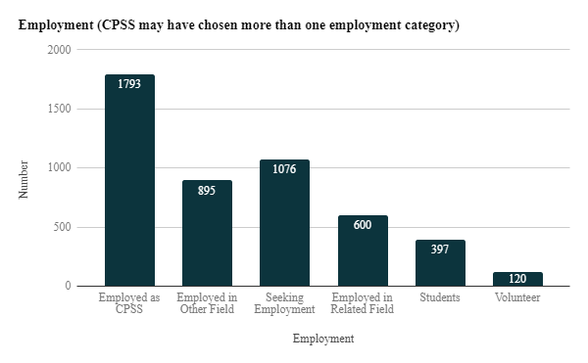
CPSS Employment Data
Only ~40% of CPSS are employed or volunteering in a peer support role
A significant portion of CPSS are seeking employment
  This may indicate CPSS are unprepared to enter the workforce after certification, there are not enough jobs to match their skills, or the pay isn’t high enough to keep them in the field
Approximately 12% of CPSS are employed in a related field, indicating there may be other behavioral health professionals taking the CPSS training

Slide 29
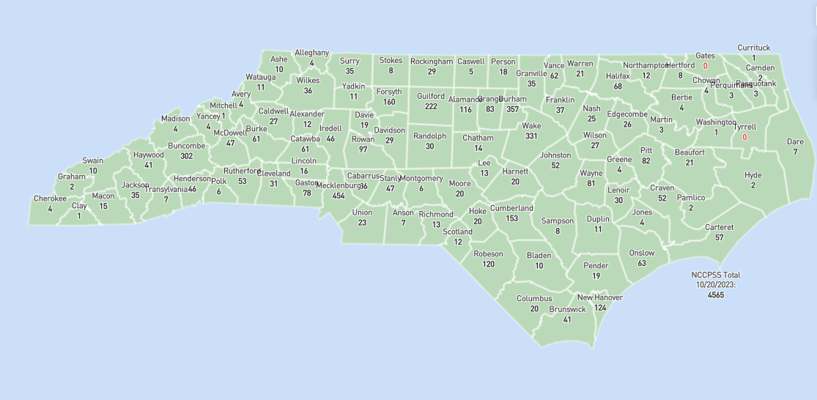
Certified Peer Support Specialists Across the State
There are over 4,500 Certified Peer Support Specialists in North Carolina, representing nearly every county

Slide 30
Future State: Goals for Expanding Peer Supports in North Carolina
DMH/DD/SUS Goals for the Future of Peer Supports:
A peer should be able to get certified for free or at a low cost
Peers should receive consistent, high-quality education and skills-building
Peers should be able to grow in their career
The role of peers should be clearly defined and held to consistent standards
Employers, supervisors, and teammates should value the expertise of the peers in their organizations
Peers should be paid a living wage, and providers should be appropriately funded for peer support services
Peer supports should be accessible in all NC communities, in a range of settings
Peers should represent the diversity of all NC communities

Slide 31
SCFAC Ask: Increase funding for Peer Support Services to expand access to services across the state
DMH/DD/SUS Response: Develop funding plan for FY24/FY25 PS Initiatives that maintains or exceeds current funding levels

Slide 32
Opportunity to Strengthen the Workforce & Expand High-Quality Peer Supports through Funding Streams
Through significant budget investments in behavioral health, DMH/DD/SUS received $18 million to support efforts to strengthen the peer support and direct support professional (DSP) workforce. This is a critical opportunity to make investments in a group of providers that have been historically overlooked.
Provision | FY24 | FY25
Behavioral Health Workforce Training | ~$8M | $10M
NC Psychiatry Access Line (NC PAL) | ~$4M | ~$4M
Behavioral Health Rate Increases | $165M | $220M
State Facility Workforce Investment | $20M | $20M
Electronic Health Records for State Facilities |  | $25M
Child Welfare and Family Well-Being | $20M | $60M
Collaborative Care | $2.5M | $2.5M
Workforce /Wellness/ Recovery

Slide 33
Building out additional funding sources
Working to find additional funding sources and evaluating current MHBG and SUBG dollars
Evaluating a potential scholarship fund for current course fees through ARPA funds
Working over the next 2 to 3 years to build a better Medicaid billing system and definition for Peer Support Services
Using current funds and a better Medicaid definition we can build better programs across the entire state.

