Slide 1
State Consumer and Family Advisory Committee Meeting Agenda
Location: 2104 Umstead Drive, Ashby Building, Conference Room 115 Raleigh, NC 27699 | Join Link: Click here to register You must register prior to the meeting to receive log-in information and dial-in options.
Contact: | Stacey Harward, Stacey.Harward@dhhs.nc.gov, 919-604-6027
8:45 –9:00 a.m. | Welcome, Roll Call, Approval of Agenda and Minutes Brandon Wilson Bob Crayton
9:00 - 9:30a.m. | Medicaid Updates/Appendix K Response Jay Ludlam Deputy Secretary, NC Medicaid Division of Health Benefits NC Department of Health and Human Services
9:30-10:00 a.m. | Medicaid Expansion Melanie Bush Deputy Medicaid Director NC Medicaid
10:00 – 11:00 | Division Update Kelly Crosbie Director of DMH/DD/SUS
11:00 – 11:30 | Public Comment Public Comment Link: https://forms.office.com/g/NLzm1gckte
11:30-11:40 | Break
11:40-– 12:00 p.m. | SCFAC Report Out -Subcommittees
12:00– 1:00 p.m. | Lunch
1:00 – 1:45 p.m. | Coalition on Aging Trish Farnham
1:45– 1:55 p.m. | Break
1:55- 2:45 | SCFAC Report Out – Subcommittees and discussion
2:45-3:00 | Takeaways from the meeting. /Action items
3:00 p.m. | Adjournment

Slide 2
Jay Ludlam Deputy Secretary NC Medicaid

Slide 3

SCFAC Updates
Renee Rader
Deputy Director, DMHDDSUS
October 2023

Slide 4
Agenda
Budget Update
NC State Plan for MH/SU/IDD/TBI

Slide 5
Budget Updates: What did
we get?
($750+m)
Behavioral Health Rate Increases
Integrated Care (Collaborative Care, NCPAL)
Workforce Investments (BH Center of Excellence, BH loan forgiveness, state psychiatric wage support)
Justice (diversion, re-entry, capacity restoration)
Child Well-Being (family peers, specialized PRTF, crisis stabilization beds)
Crisis system (crisis response teams and facilities, data tracking, non-law enforcement transportation)
Approximately three-quarters of the Governor’s $1B Behavioral Health Roadmap were funded

Slide 6
Behavioral Health Budget Provisions
Crisis​
  Crisis System (Mobile and Respite) $30M FY24, $50M FY25​
  Crisis Stabilization (Short Term Shelter) ~$3M FY24, ~$7 FY25​
  Non-Law Enforcement Transportation Pilot Program $10M FY24, $10M FY25​
  BH SCAN $10M FY24, $10M FY25​
Justice Involved $29M FY24, $70 FY25​
Behavioral Health Workforce Training Center ~$8M FY24, $10M FY25​
NC Psychiatry Access Line (NC PAL) ~$4M FY24, ~4M FY25
Behavioral Health Rate Increases $165M FY24, $220M FY25
State Facility Workforce Investment $20M FY24, $20M FY25​
Electronic Health Records for State Facilities $25M FY25
Child Welfare and Family Well-Being $20M FY24, $60M FY25​

Slide 7
IDD Budget Provisions
350 New Innovations slots
Authority to expand TBI waiver statewide
Innovations Direct Support Professional Wage Increases (Increase wage avg by $6.50 per hour)
Competitive Integrated Employment ($5,$5m)
Personal Care Service (PCS) Rate Increases

Slide 8
NC State Plan for MH/SU/IDD/TBI

Slide 9
Draft Strategic Framework
Strengthen the Workforce
Inclusive
Participant Voice
Populations of Focus
Intellectual and Developmental Disabilities
Support Choice & Inclusion
Promote Mental Wellness, Increase Recovery & Reduce Stigma
2024-2029 Priorities
Mental Health
Substance Use Disorder
Prevent Substance Misuse & Overdose
Strengthen the Crisis System
Traumatic Brain
Injury
Equitable
Expand Services for Individuals in the Justice System
Data-Driven
Trauma-Informed
The priorities will include efforts across age groups, including adults, adolescents and children.

Slide 10
Promote Mental Wellness, Increase Recovery & Reduce Stigma
Strengthen the Workforce
Goals to Promote Mental Wellness, Increase Recovery & Reduce Stigma
Increase timely access to services for evidence-based treatment for children, adolescents and adults.
Make it easier for children, adolescents and adults to access services.
Prevent suicide at all ages.
Raise public awareness of mental health and wellness and reduce stigma related to help-seeking.
Support Choice & Inclusion
Promote Mental Wellness, Increase Recovery & Reduce Stigma
2024-2029 Priorities
Prevent Substance Misuse & Overdose
Strengthen the Crisis System
Expand Services for Individuals in the Justice System

Slide 11
Support Choice & Inclusion
Strengthen the Workforce
Goals to Support Choice & Inclusion
Increase the number of people with intellectual and developmental disabilities receiving services.
Increase the number of people with traumatic brain injury receiving services.
Increase the number of people who are in and maintain independent housing.
Increase the number of people who are employed and maintain supported employment (e.g., Individual Placement and Supported Employment Program, Competitive Integrated Employment).
Support Choice & Inclusion
Promote Mental Wellness, Increase Recovery & Reduce Stigma
2024-2029 Priorities
Prevent Substance Misuse & Overdose
Strengthen the Crisis System
Expand Services for Individuals in the Justice System

Slide 12
Prevent Substance Misuse & Overdose
Strengthen the Workforce
Support Choice & Inclusion
Promote Mental Wellness, Increase Recovery & Reduce Stigma
2024-2029 Priorities
Goals to Prevent Substance Misuse & Overdose
Promote use of evidence-based primary prevention strategies to prevent initial substance exposure or use in children and adolescents.
Raise public awareness on substance misuse and accessibility of services and supports.
Increase the number of individuals in Medicaid receiving evidence-based substance use disorder services.
Reduce deaths due to overdose.
Prevent Substance Misuse & Overdose
Strengthen the Crisis System
Expand Services for Individuals in the Justice System

Slide 13
Strengthen the Crisis System
Strengthen the Workforce
Support Choice & Inclusion
Promote Mental Wellness, Increase Recovery & Reduce Stigma
Goals to Strengthen the Crisis System
Streamline 988 operations to better triage, dispatch services, and track results.
Reduce wait times for mobile crisis services.
Increase use of behavioral health crisis facilities (e.g., behavioral health urgent care centers, facility-based crisis centers) for children, adolescents and adults.
Reduce the number of crises that involve law enforcement contacts.
Collaborate with providers to decrease length of stay for emergency department boarding for children, adolescents, and adults.
2024-2029 Priorities
Prevent Substance Misuse & Overdose
Strengthen the Crisis System
Expand Services for Individuals in the Justice System

Slide 14
Strengthen the Workforce
Strengthen the Workforce
Goals to Strengthen the Workforce
Increase the number of mental health providers trained in evidence-based practices.
Build a well-trained and well-utilized peer workforce whose work leverages lived experience.
Expand the number of direct support professionals in the workforce.
Increase training / support for professionals providing services to individuals with intellectual and developmental disabilities, traumatic brain injury and dual diagnoses.
Support Choice & Inclusion
Promote Mental Wellness, Increase Recovery & Reduce Stigma
2024-2029 Priorities
Prevent Substance Misuse & Overdose
Strengthen the Crisis System
Expand Services for Individuals in the Justice System

Slide 15
Expand Services for Individuals in the Justice System
Strengthen the Workforce
Support Choice & Inclusion
Promote Mental Wellness, Increase Recovery & Reduce Stigma
Goals to Expand Services for Individuals in the Justice System
Build community-based pre-arrest diversion programs.
Build reentry programs.
Increase evidence-based programs and practices for justice-involved youth.
Increase the number of justice-involved individuals with substance use and mental health disorders engaged in treatment within 72 hours of release.
Collaborate with other agencies to increase access to Medications for Opioid Use Disorder in justice-involved settings.
2024-2029 Priorities
Prevent Substance Misuse & Overdose
Strengthen the Crisis System
Expand Services for Individuals in the Justice System

Slide 16
Public Comment
Public Comment #1
My name is Regina May and I am not only the Durham County CFAC Chair for Alliance Health but also a mother of a dual-diagnosis young adult son (IDD/SU codependency).
Since 2017 when I became a Certified Peer Recovery Coach I have worked for 2 nonprofits where I met multiple recipients between the ages of 18-24 years old who had turned to street drugs due to receiving mental health/ IDD services as young as elementary age.
Once they aged out and were no longer any guardianship care most totally refused or accepted very little help with provider services. Mostly due to trauma while receiving services. And or their body becoming so used to the prescribed meds
cont..

Slide 17
This stood out to me due to what I was experiencing with my then middle school-age son and what I had experienced during his elementary educational years.
That at one point in time led me to get a summons to what used to be known as truancy court.in Durham County because of his suspensions being coded wrong. The suspensions took place due to a lack of staff to support his IEP which was designed by the DPS staff. My son would currently be considered a success because he has no criminal background is not currently under meds, and works every day. But he never completed high school when I met others with not only diplomas but also trade certificates or college degrees.
As a parent I never was offered or suggested that I could receive family funds of compensation for caring for my son nor while I'm at the table to support others as an advocate. I currently know of a family at a local Durham shelter due to the mother trying to care for her total care son with no income other than the social security benefit she receives for him.
Thank you for your time and listening ear.

Slide 18
Public Comment #2
#HB629
Matthews Bill for Clubhouse Expansion.
Clubhouses the Fountain House Model, Club Nova in Carrboro, Threshold in Durham, Adventure House in Shelby.
Clubhouses are for the most chronic and persistent seriously mentally ill. Schizophrenia, bipolar, PTSD, OCD, manic depressive.

Slide 19






A multi-year project funded by the NC Money Follows the Person Demonstration Project/NC Medicaid to develop and test a training, credentialing, and job quality model for improving direct care jobs in NC (focusing on HCBS)​.
*Grant administered by the Center for Aging Research and Educational Services at the UNC Chapel Hill School of Social Work
Additional State, Provider and Advocacy Partners and Community Members
Notes:
Project partners had all been members of the steering group for the Essential Jobs, Essential Care initiative – as described by Trish
Funded by MFP through the Center for Aging Research and Educational Services (Cares) at the UNC-Chapel Hill School of Social Work
Main aim is to: READ
What is the benefit of promoting improvements in training and credentialing for these workers?
Interconnected reasons:
Better reflect and build the complex skills that are required for direct care roles and the provision of quality care
As well as directly informing service delivery, that can help achieve better recognition of the direct care workforce overall (a workforce that is often invisible or overlooked)
Leading to recognized, "portable" and "stackable" credentials – better career mobility, better retention in the field
Supports complementary efforts to raise wages and improve supervision and other employment conditions for direct care workers
***
Duke Sanford School of Public Policy (WECARE: Workforce Engagement with Care workers to Assist, Recognize, and Educate). The project proposes a collective approach and statewide effort to improve, recruit, and retain people within the direct care worker workforce. Key partners include: Appalachian State University, the North Carolina Chapter of the National Domestic Workers Alliance, the North Carolina Coalition on Aging, and the Public Health Institute.
Hope North Carolina (Using Collective Impact to Create Inclusive, Affordable, and Lifelong Communities). The project proposes a collective impact model focused on housing and transportation to create IDEAL (inclusive, diverse, engaging, affordable and lifelong) communities. Key partners include: Alliance Health, CASA, UNC Partnerships in Aging Program
Land of Sky Regional Council (Remain at Home – Accessibility Assessment Program) The project collaborates with community health workers around creating a certification to help make homes more livable and sustainable. The program will be implemented in four counties, two of which are rural. This awardee also will work with transportation planning. Key partners include: Institute for Preventative Care and Advocacy, Mountain Area Health Education Center, RL Mace Universal Design Institute.
Piedmont Triad Regional Development Council (Building Natural Supports Through Collective Impact). This project proposes creative approaches to improve the personal associations and relationships that individuals and communities have with each other in Forsyth and Davie counties. The organization will work with individuals, including those with lived experiences, and pillar organizations to initiate this change. Key partners include: Forsyth Department of Social Services, Partners Health Management, Solutions for Independence.

Slide 20





WECARE Project Goals
Identify direct care core competencies and curricula reflecting competencies
Optimize a training and credentialing approach for direct care workers in NC
Identify high-road HCBS employers and tools to support direct care workers
Pilot the training, credentialing, and support model from
#1 and #2
Implement an awareness and community
outreach effort
Notes:
5 goals for the WECARE project
Pilot project of testing out this model will include model or “high-road” employers, allowing us to see how feasible it is to work towards what a system with clear training and recognized credentials, high quality employment arrangements.
Pilot intervention for feasibility and acceptability.

Slide 21

"It's the pay and training."
Adrienne C., DSP and manager

Slide 22
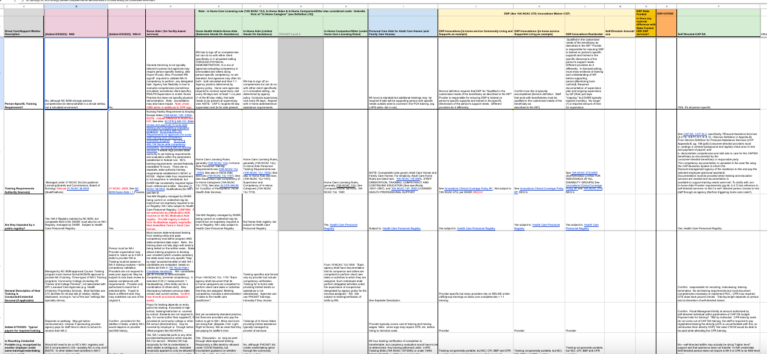
How are Direct Care Workers Trained in NC?
The WECARE Training Crosswalk Analysis
Working with partners and subject matter experts to analyze and compare training content, format and regulatory requirements for comparable but distinct direct care workforce categories through a person-centered training lens:
Nurse Aide I and II
In-home Aide (NA I)
In-Home Aide—Limited
Personal Care Assistant (Adult Care Home)
Direct Support Professionals under Innovations waiver
Support under Self-Directed Supports
Does not include all direct care worker categories in NC
Image for illustration only

Slide 23
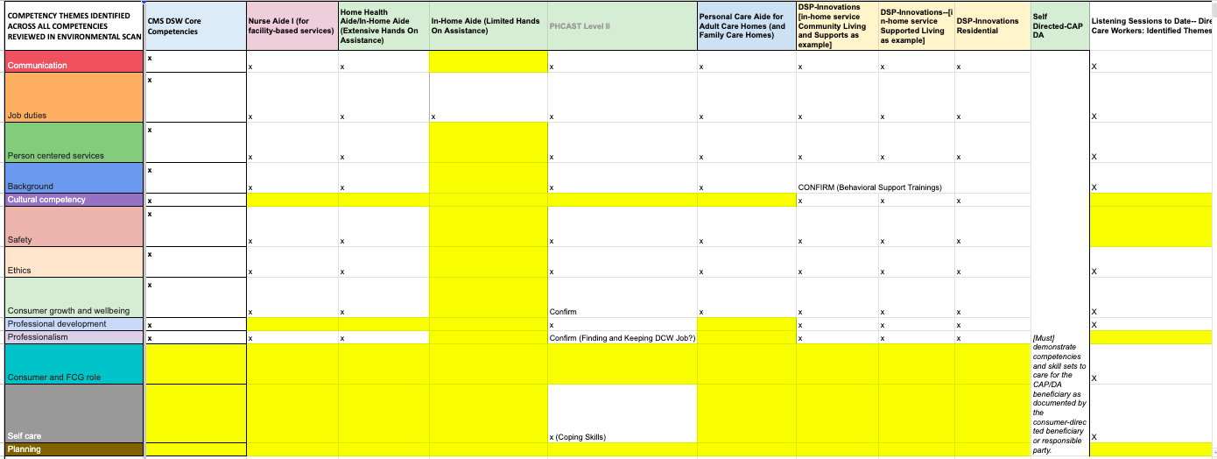
What Core Competencies are Reflected in Training?
The WECARE Core Competency Analysis
Image for illustration only
Working with partners and subject matter experts to examine training requirements through the lens of established core competency sets, including CMS' HCBS Core Competency Set.

Slide 24
A Few Things the WECARE Team Has Heard...
"We often build our 'core competencies' from our regulatory system requirements. We should start with the relationship between person using services and the direct support worker."
-provider and trainer
"I didn't feel prepared at all, I felt thrown in with the client."
-direct care/support worker
"I was looked at as a housekeeper and I wasn't expecting that as a Home Health Aide."
-direct care/support worker
"We want a personality fit over a service delivery fit."
-person using direct support services
"People sometimes start doing the work and they realize it's a lot more challenging than what they thought it was going to be—that it's not just caregiving or babysitting. I think that's why we lose a lot of people---they're not trained and they don't know what to expect. People look at the online ads for a "caring person" and they think that's the extent of the job—that you're going to just sit with the person for a while."
-direct support worker/manager
"There is a disconnect between the level of expectations and the level of compensation."
-family member

Slide 25
Preliminary Observations
Crosswalk is first comprehensive resource on training and credentialing requirements for direct care workers in North Carolina.
Findings have been immeasurably strengthened through ongoing and in-depth community partner engagement and input.
Strong training models exist in our state, thanks to previous demonstration projects and current standards/practice (e.g. 120 hours for NAI role, home care aide specialty role), but current training requirements may be outmoded or trainings most appropriate for HCBS are not systemically supported.
  Example: Home Care requirements allow for an NA I to satisfy the credentialing requirements to support individuals requiring extensive assistance under Home Care licensing rules. However, NA I training assumes a facility setting and does not address those dynamics unique and specific to Home Care.
Training and credentialing requirements for direct care/support workers are exceedingly complex, overall: numerous roles/programs, multiple authorities and oversight, several different registries.
There is very little portability of training or credentials across settings/programs.
  For example: Training a DCW/DSP may receive under Innovations waiver requirements or as an in-home aide providing limited assistance do not transfer if the DCW/DSP were to transition to another employer.
There is little relationship between DCW/DSP training and wages in HCBS settings. Securing additional, necessary training/credentials (e.g., geriatric aide), does not result in systemic wage or rate adjustments.
Staff training under self-directed options provides highly flexible, person-specific and person-centered training opportunities. But the skills learned under this model are not formally recognized by other services.

Slide 26
Preliminary Observations, cont’d.
Lack of flexibility in training requirements: relevant experience cannot count towards additional credentials.
  Example: a DCW/DSP with experience supporting a particular individual may not count that experience towards securing the subsequent credentials Home Care rules require as the person's needs increase. This creates disruption in support.
Staff supporting the same person may have different requirements depending on service.
  Example: DCW/DSP staff of a person who is eligible for both CAP DA and Innovations may have different training requirements depending on the service the person uses.
There is uneven integration of person-centered training, with levels and quality varying by provider and service.
There is uneven integration of person-specific training, with levels and quality varying by provider and service.
The in-home aide providing limited assistance service under the Home Care rules provides a critical entry point into the direct care/support workforce yet receives little systemic support related to training and competency building.
From listening sessions: "Relational" core competencies (communication, respect, etc.) were identified as high priorities.
Core competencies re: cultural competency, role determination (e.g. effectively clarifying and navigating "who does what" between workers, family members, etc.), self-care and planning appear least represented in current training landscape.

Slide 27
Year 2 (SFY 2024) Project Goals
Year 2 Project Goals | Q1 | Q2 | Q3 | Q4
Care Worker Fellow base building and outreach | x | x | x | x
In-depth interviews with recipients, care workers, agency leads |  | x | x | x
Finalize mapping of training, credentialing, and competencies | x
Assess options for a unified training/credentialing pilot | x | x
Continue outreach but with identifying best practice employers |  | x | x
Pilot development |  | x | x | x
Continued formative evaluation | x | x | x | x

Slide 28
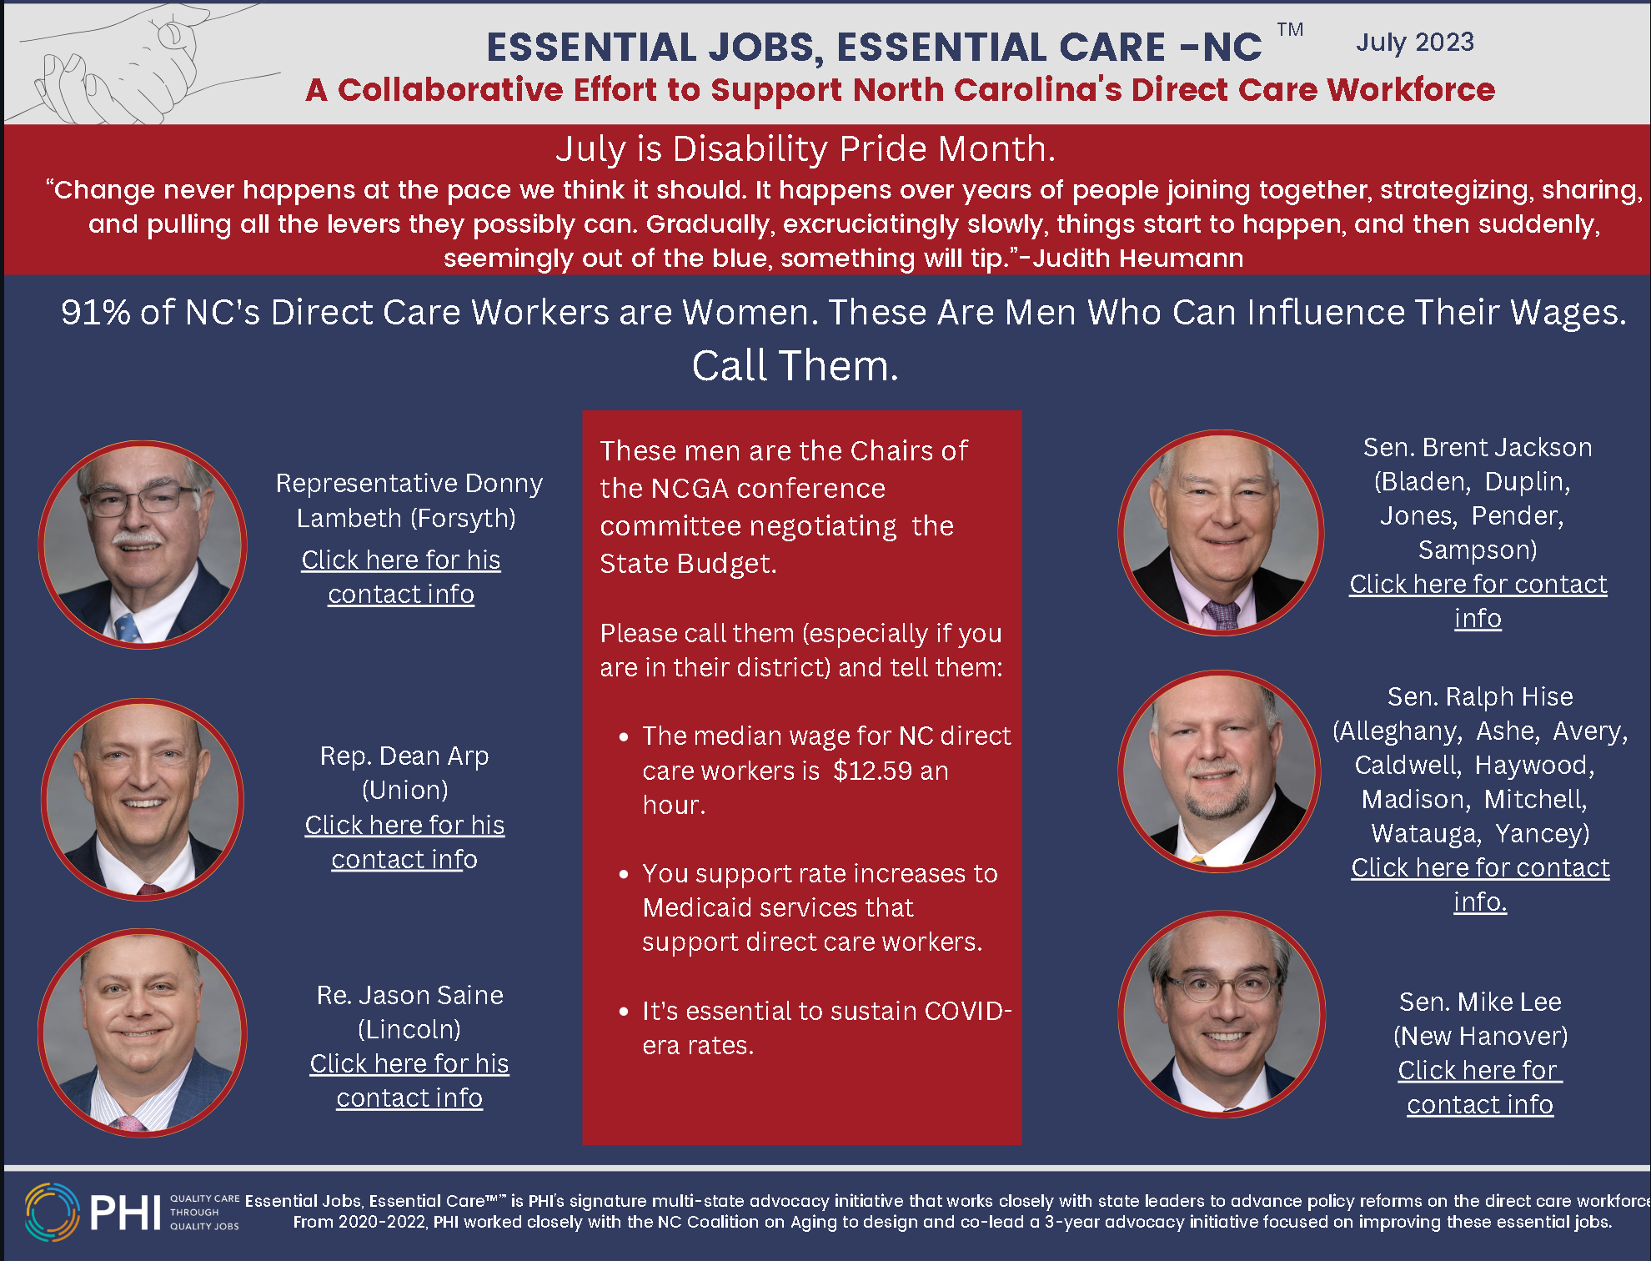
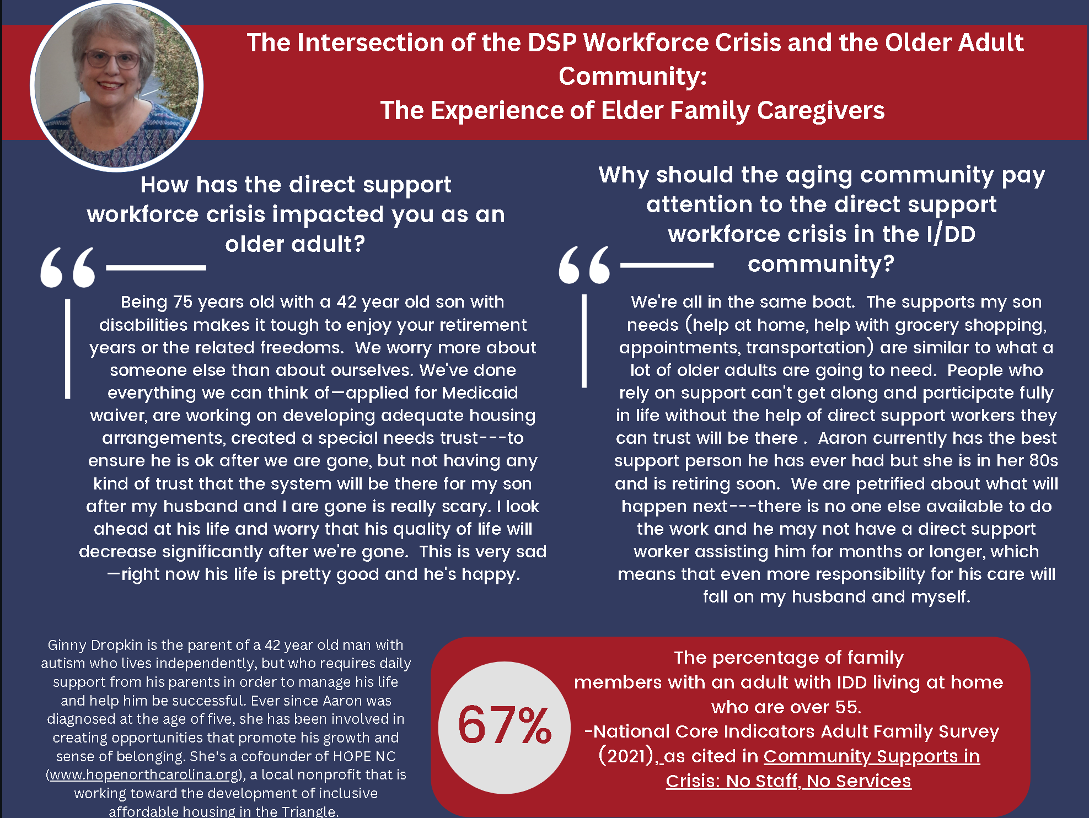
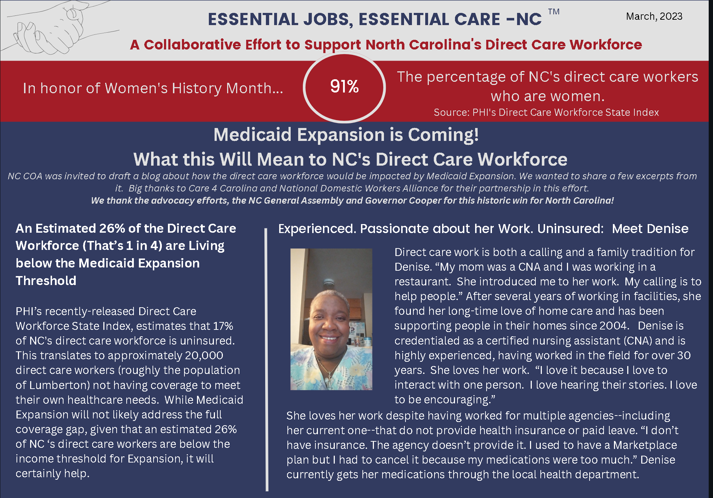
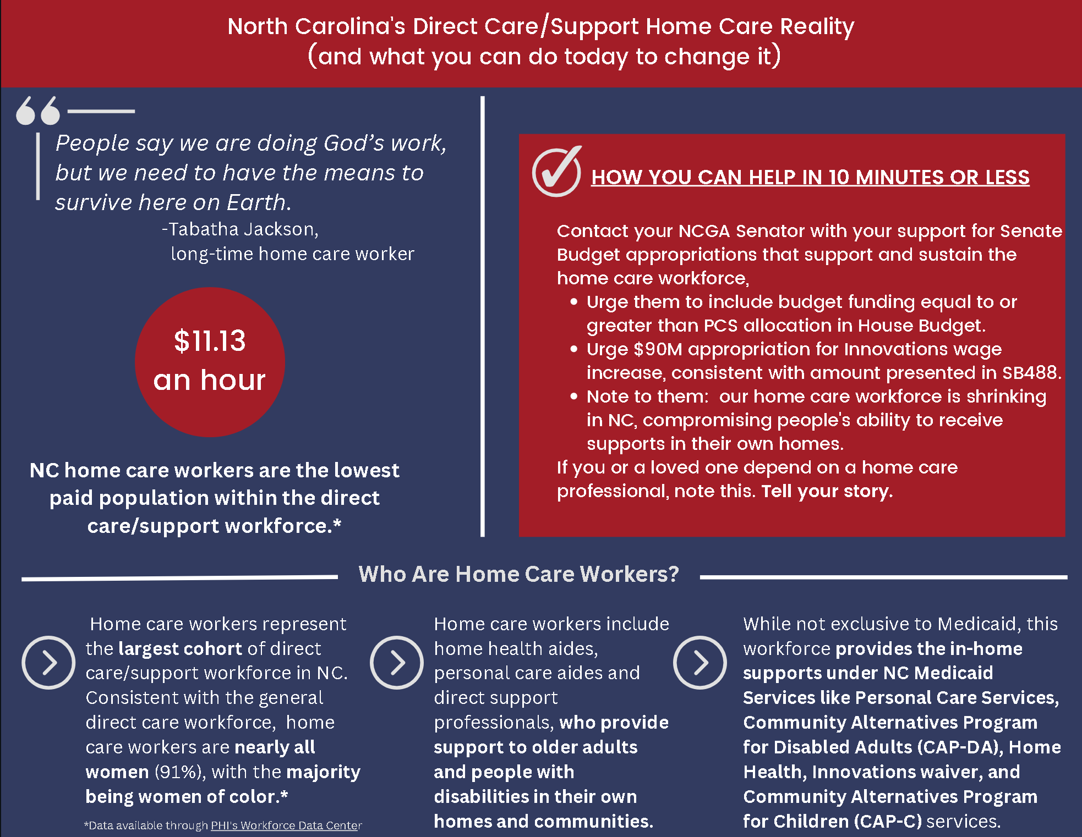
Interested in Receiving Information about NC’s Direct Care Workforce? Please email me at email address provided.

Slide 29
Trish Farnham
NC Coalition on Aging
trish@nccoalitiononaging.org
@NcAging

