Slide 1
NC Minority Health Advisory Council Meeting
Office of Health Equity (OHE)
September 18, 2024

Slide 2
Welcome and Introductions
Dr. Portia D. Pope

Slide 3
Member Roll Call

Slide 4
Meeting Objectives
Enable MHAC members to better understand how NCDHHS and OHE function to eliminate health disparities and serve the people of NC.
Leverage the expertise of MHAC members to inform and support NCDHHS priorities related to addressing health disparities and provide a call to action for member involvement, feedback, and input.
NCDHHS, Health Equity Portfolio | Minority Health Advisory Council Meeting | September 2024

Slide 5




Communication Equity Considerations
  Use the chat to ask questions. An assistant will read your question aloud to the group if there is time after each presentation section. Or, if there is not time, there is a dedicated discussion time reserved at the end.
  Use the chat to provide insight or ideas during the presentation. All feedback and comments are welcome as the speakers present.
  There is a dedicated floor discussion time later in this meeting.
  If you come off mute to speak, please state your name and affiliation for the group before sharing.
NCDHHS, Health Equity Portfolio | Minority Health Advisory Council Meeting | September 2024

Slide 6
Meeting Agenda
Welcome and Member Roll Call
NCDHHS’ Approach to Addressing Disparities
Health Equity Portfolio Updates
Legislative Office Updates
Office of Health Equity Overview of Projects
  Health Disparities Analysis Report Updates
  Minority Diabetes Prevention Program Updates
  Community & Partner Engagement Initiative Updates
Questions / Closing Remarks
NCDHHS, Health Equity Portfolio | Minority Health Advisory Council Meeting | September 2024

Slide 7
NCDHHS’ Approach to Addressing Disparities

Slide 8


NCDHHS’ Approach
NCDHHS’s Impact Through Addressing Health Disparities
The Office of Health Equity’s (OHE) Leadership and Expertise
Impact on the State of North Carolina
“Nothing about us without us.”
NCDHHS, Health Equity Portfolio | Minority Health Advisory Council Meeting | September 2024

Slide 9
Health Equity Portfolio Updates
Debra Farrington, CHEO

Slide 10
Health Equity Portfolio Updates
1
Transition Planning 2024/2025
2
Departmental Updates
3
Key Upcoming Priorities
NCDHHS, Health Equity Portfolio | Minority Health Advisory Council Meeting | September 2024

Slide 11
Legislative Updates From The Assistant Secretary
Janssen White
Assistant Secretary for Government Affairs, NC Department of Health & Human Services, Janssen.White@dhhs.nc.gov
Suzy Khachaturyan
Legislative Liaison, NC Department of Health & Human Services, suzy.Khachaturyan@dhhs.nc.gov

Slide 12
Office of Health Equity Project Overview
Health Disparities Report
Minority Diabetes Prevention Program
Community and Partner Engagement Initiative

Slide 13
Health Disparities Analysis Report

Slide 14
Purpose
The North Carolina Health Disparities Analysis Report aims to:
  Highlight the most significant health disparities recognized by the North Carolina Department of Health and Human Services (NCDHHS) as opportunities to reduce disparities over the next three to five years.
  Provide measures and a starting point to track the
  state’s progress in eliminating health gaps experienced by populations that have been historically marginalized.
  Describe the services, programs, and resources dedicated to addressing identified disparities by NCDHHS.
  Emphasize actionable strategies to reduce health disparities and seek solutions.
NCDHHS, Health Equity Portfolio | Minority Health Advisory Council Meeting | September 2024

Slide 15
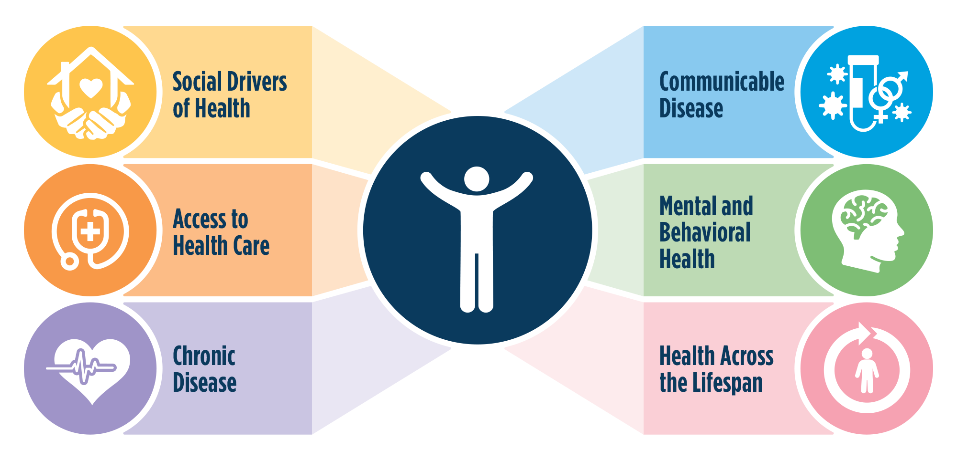
Content
THIS REPORT IDENTIFIES SIX KEY CATEGORIES
IN HEALTH DISPARITIES
NCDHHS, Health Equity Portfolio | Minority Health Advisory Council Meeting | September 2024

Slide 16






Quick Overview of Identified Disparities:
Social Drivers of Health
Access to Healthcare
Chronic Disease
Communicable Disease
Mental and Behavioral Health
Health Across the Lifespan
Higher poverty and unemployment, in Black, American Indian, & Latinx populations
Limited access to opportunities for physical activity, nutritious foods, & safe housing
Disparities in historically marginalized populations (race, ethnicity, location, income, disability status, incarceration, etc. )
Access & affordability of health care for HMPs (Black, American Indian, Latinx, Disabled)
Access & affordability of health care for HMPs (Immigrants, Farmworkers, and LGBTQ+)
Access to health care providers in rural areas
Lack of health care, unhealthy behaviors, environmental conditions, & SDOH as contributors to heath disparities in chronic disease
Higher rates of chronic disease and death in Black, American Indian, and Latinx populations
Disease disparities in cancer, stroke diabetes, COPD, kidney, liver, and heart
Higher rates of syphilis and HIV in Black, American Indian, Latinx
Higher rates of communicable disease in LGBTQ+, youth, and substance users
Acute impact of communicable disease on people with existing problems (chronic disease, disability, aging, immuno-compromised)
Adverse experiences, financial struggles, ongoing hardships, & lack of access to care contribute to mental health disparities in these populations: youth, justice-involved, housing insecure, Black, American Indian, Latinx, Asian, Rural communities, military & veterans, people with disabilities, & LGBTQ+
Maternal mortality & racial disparities
Infant mortality, preterm birth, low birth weight & racial disparities
Childcare costs & availability & meeting housing, food, & health care needs for special needs children
Access to services & support in in rural areas
Rates of injury/illness & lower income in 65+ pop.

Slide 17



Process
ENGAGEMENT-DRIVEN DEVELOPMENT OF HEALTH DISPARITIES REPORT
Community Engagement
Results
NCDHHS SME Engagement
Convened 3 Community Listening and Sharing Sessions in collaboration with the Data Office (Bilingual) (~80 participants, 53 CBOs)
Received ~20 survey responses as alternative to Listening Sessions (both Spanish and English)
Facilitated Minority Health Advisory Council (MHAC) guidance and advice
Expansion of historically marginalized population groups represented and reviewed 8 new data categories requested by community partners and NCDHHS partners
Comprehensive, intuitive design that addresses the diverse needs and interests of our partners
Incorporated feedback on community-identified data visualization, communication, and analysis needs
Educational content to increase understanding of health equity
Recommended strategies for each health topic
Utilization of Equity Data Toolkit, Root Cause Analysis, NCSHIP, HNC2030, State Action Plans, and other NCDHHS tools and resources
Hosted 3 cross-sectional Work Group meetings
Engaged 10 different Division data teams across NCDHHS (20+ data specialists)*
Conducted ~15 interviews with subject matter experts (SMEs) across NCDHHS to inform strategy sections
Consulted SMEs for epidemiology strategy development
Engaged NCDHHS workgroups such as Equity Planning, Data Governance Council
Conducted final reviews with NCDHHS leadership
*NCDHHS Data and Strategy Contributors: Data Office; Division of Aging and Adult Services; Division of Child and Family Well-Being (including NC Child Fatality Task Force, Office on Disability and Health); Division of Child Development and Early Education; Division of Health Benefits (NC Medicaid); Division of Mental Health, Developmental Disabilities, and Substance Use Services; Division of Public Health (Chronic Disease and Injury Section, Cancer Prevention and Control Branch, Communicable Disease Branch, Environmental Health Branch, Injury and Violence Prevention Branch, State Center for Health Statistics); Division of Services for the Deaf and Hard of Hearing; Division of Employment and Independence for People with Disabilities; Health Equity Portfolio
NCDHHS, Health Equity Portfolio | Minority Health Advisory Council Meeting | September 2024

Slide 18
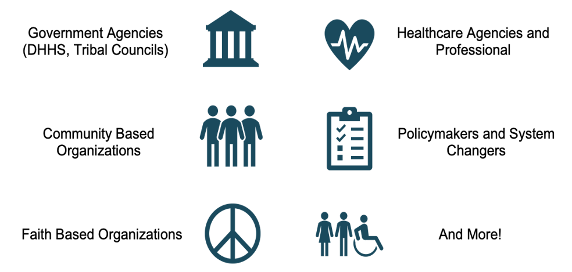
Dissemination
Socialization Deliverables- Publication on September 16th
Health Disparity Report (Spanish) - virtual PDF (physical copies in a spiral bound booklet soon to be available)
Dissemination Email (Spanish)
OHE Data Webpage updates
Press Release (Spanish)
Video Introduction to the Report by the Secretary (Spanish transcription)
Data Summary Powerpoint (Spanish)
Social Media Toolkit for Community-Based Organizations (Spanish)
NCDHHS account Social Media Graphics, Messages (Spanish)
Audience
Building Capacity- Forthcoming Deliverables
Presentations and resource sharing within community-based spaces
Additional data fact sheets, lifting up other data reports (i.e. LGBTQ+, American Indian, Medicaid)
OHE's Community-Based Data + Evaluation Technical Assistance and Consultation offerings
Minority Health Advisory Council Engagement
NCDHHS, Health Equity Portfolio | Minority Health Advisory Council Meeting | September 2024

Slide 19
Increasing Coordination for the Reduction of Health Disparities
NCDHHS has mobilized strategies for the reduction of health disparities. To name just a few:
Medicaid Expansion, with more than 500,000 people enrolled. Other Medicaid examples:
  Healthy Opportunities Pilot
  Tailored Care Management
  Children and Families Specialty Plans
$835 million dollar investment towards behavioral health
Newly released Strategic Housing Plan
Community and Partner Engagement Initiative
Medical Debt Relief Incentive Program
The Health Disparities Report is a new call to action for:
The Health Equity Portfolio to increase our leadership across the Department to better coordinate, collaborate, and elevate health equity strategies and initiatives that reduce health disparities.
Divisions and Offices to consider new, or improve on existing, programs, initiatives, and activities for reducing health disparities.
Centering communities and embracing a systems-change mindset, utilizing multisectoral collaboration.
NCDHHS, Health Equity Portfolio | Minority Health Advisory Council Meeting | September 2024

Slide 20

Call to Action
Reducing health disparities requires teamwork from individuals, communities, businesses, health care providers, policymakers, government agencies and more. NCDHHS is committed to improving the health of all North Carolinians and we invite you to join us in this effort.
NCDHHS, Health Equity Portfolio | Minority Health Advisory Council Meeting | September 2024

Slide 21

HDR Update
2024 NCDHHS Health Disparities Analysis Report (Spanish) Published!
Supplemental Materials Have Also Been Published:
Social Media Toolkit for Community-Based Partners (Spanish)
2024 NCDHHS Health Disparities Analysis Report: Data Summary PowerPoint Slides (Spanish)
Press Release (Spanish)
Updates to OHE's Data Resource Center webpage
Additional Data Materials for FY 2024-2025 Include:
Fact Sheets
Consultation, Training, Coaching, Technical Assistance tools
NCDHHS, Health Equity Portfolio | Minority Health Advisory Council Meeting | September 2024

Slide 22
Minority Diabetes Prevention Program (MDPP) Updates

Slide 23



NC MDPP Overview
NC MDPP was established in 2016 to reduce diabetes prevalence. The aim of NC MDPP is to create and implement a statewide framework that will reduce diabetes prevalence in communities of color.
12.4% of Adults have Diabetes
MDPP Key Components
NC MDPP is a multi-component initiative that includes the following components:
Community screenings and region-specific targeted marketing campaigns
12-month NC MDPP Lifestyle Class series
Community conversations
Engaging community and partner collaboratives
The annual health care cost of diabetes in North Carolina is estimated to surpass $17 billion by 2025 *
25.8 percent or 2,765,000 people in North Carolinian have prediabetes, and in 2023
1/3 of people with prediabetes in NC are from communities of color
* According to the North Carolina Diabetes Advisory Council Report
NCDHHS, Health Equity Portfolio | Minority Health Advisory Council Meeting | September 2024

Slide 24
NC MDPP FY 24 Highlights
Richmond County
Million Hearts Initiative
Alamance County
Ramseur Community Wellness Committee
Pinehurst Resort Employees
Alamance County Detention Center
Buncombe County
Appalachian Mountain Health
All-State
American Diabetes Association – CDC Grant
Partnerships
Participant Feedback
“No Diabetes for me! I'm empowered to take change of my health and I gained some new friends that supports me in my lifestyle change."
"I am so happy I participated. I’ve made changes that are sustainable and I’m excited to see how they will benefit me in the long haul."
American Public Health Association (APHA) Conference
Living Well: Living Healthy with Chronic Disease Classes and Diabetes Empowerment Education Program (DEEP)
Total Programmatic Reach: 2,245,091 people across the state
NCDHHS, Health Equity Portfolio | Minority Health Advisory Council Meeting | September 2024

Slide 25
NC MDPP FY 2025 Goals
Key Performance Indicator (KPI) | Goal
Prediabetes Screening | 1365 people screened
MDPP Enrollment | 410 people enrolled
12-month Lifestyle Class Series | 32 classes conducted
Living Well Events | 8 events
NCDHHS, Health Equity Portfolio | Minority Health Advisory Council Meeting | September 2024

Slide 26
Community and Partner Engagement (CPE) Initiative Updates

Slide 27




CPE Initiative Updates
CPE Website Metrics
Other CPE Updates
Following the NCDHHS Community and Partner Engagement Guide, HEP launched new resources in September 2024, focusing on cultural humility, competency, and key engagement principles
Cultural Competence Summary Document
Cultural Competency Baseline Self-Assessment
Cultural Competency Awareness Self-Assessment
Cultural Competence Checklist for Community Engagements
NCDHHS Community and Partner Engagement Resource for Graphics, Pictures, and Templates
Cultural Humility Practices for NCDHHS Staff
Community Engagement Event Planning Checklist
Available in English and Spanish
Overall totals for 25 weeks:
2024: February 27 – August 26
Comparison to February
of 2024
5,243 users
31.81% increase
7,726 views
32.50% increase
12.115 avg. views by user
77.12% increase
20,614 events counted
31% increase
NCDHHS, Health Equity Portfolio | Minority Health Advisory Council Meeting | September 2024

Slide 28
Any Questions?
Welcome and Member Roll Call
NCDHHS’ Approach to Addressing Disparities
Health Equity Portfolio Updates
Legislative Office Updates
Office of Health Equity Overview of Projects
  Health Disparities Analysis Report Updates
  Minority Diabetes Prevention Program Updates
  Community & Partner Engagement Initiative Updates
Questions / Closing Remarks
NCDHHS, Health Equity Portfolio | Minority Health Advisory Council Meeting | September 2024

Slide 29
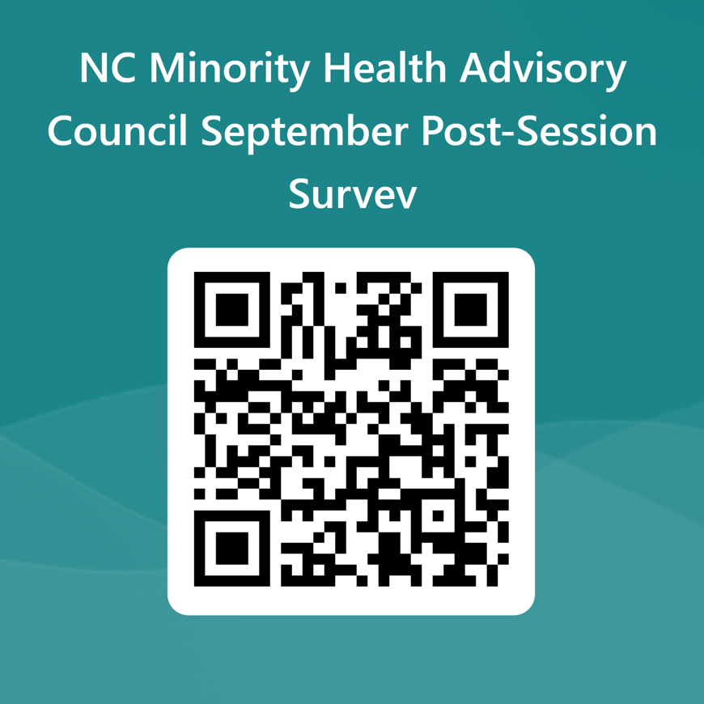
Closing Remarks
Contact Us:​
Office of Health Equity:
  HealthEquityOffice@dhhs.nc.gov​
Dr. Portia Pope, Deputy Director, OHE:
  Portia.D.Pope@dhhs.nc.gov
Resources:​
Office of Health Equity Website
Health Equity Portfolio Website
Community & Partner Engagement (CPE) Website
  CPE Resources Page
MHAC Website
NCDHHS, Health Equity Portfolio | Minority Health Advisory Council Meeting | September 2024

Slide 30
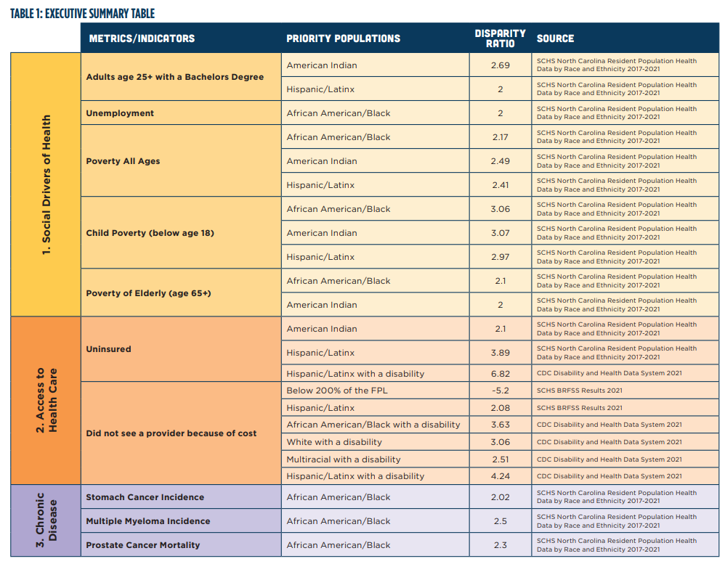
Blue arrow indicates the most severe disparity in each category

Slide 31
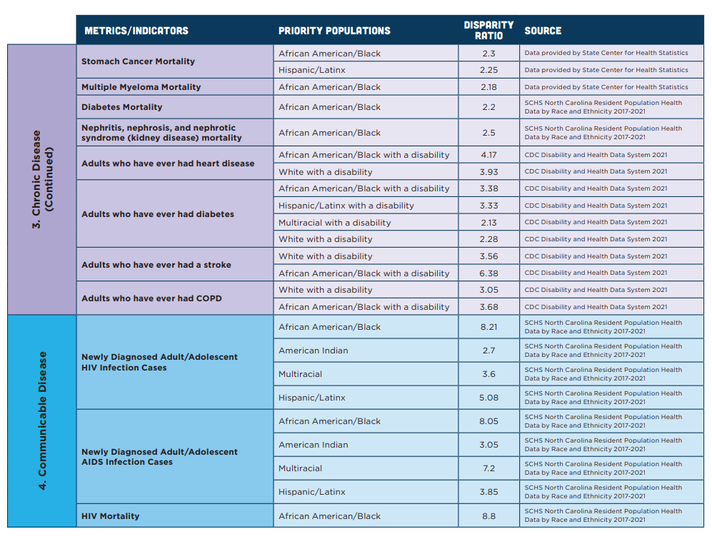
Blue arrow indicates the most severe disparity in each category

Slide 32
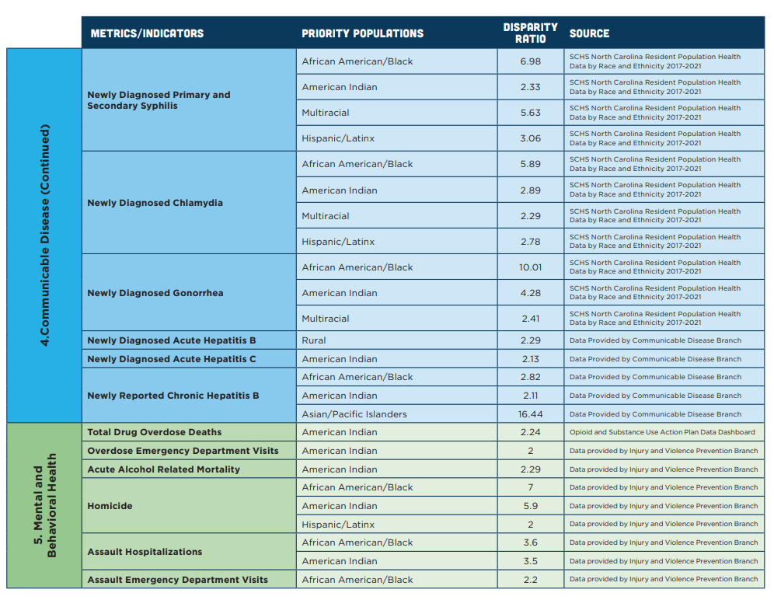
Blue arrow indicates the most severe disparity in each category

Slide 33
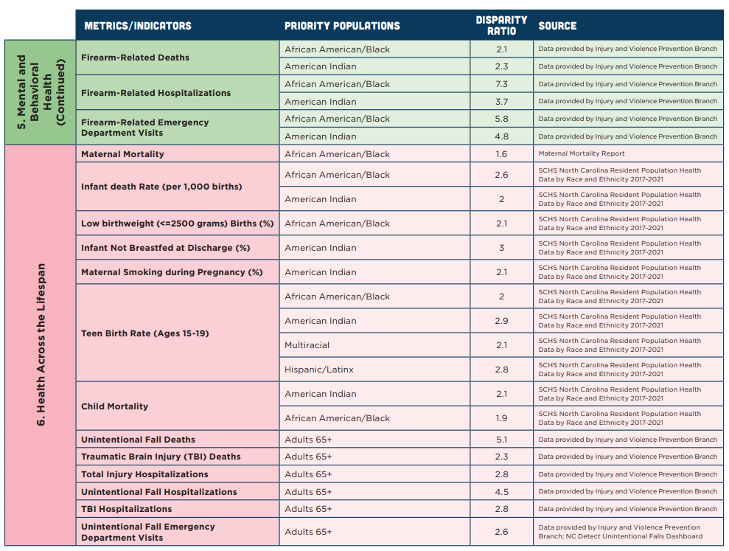
Blue arrow indicates the most severe disparity in each category

