Slide 1
North Carolina’S Opioid Action Plan
Updates and Opportunities

Slide 2
Since the launch of the Opioid Action Plan, we’ve advanced many strategies
Since January 2019, we have distributed nearly 250,000 doses of naloxone
As of 2021, there are now 40 registered Syringe Services Programs (SSPs) operating in North Carolina serving 57 counties and one federally recognized tribe.
Trained over 300 community and local government partners to create or expand syringe service programs and advance harm reduction strategies
Over 21,000 people without insurance received treatment with federal funding
Launched a medical residency training project that has provided waiver training to nearly 1200 prescribers, and worked with over 29 residency and advance practice program programs to incorporate waiver training as an ongoing part of their curriculum.
Trained over 4,000 providers on clinical issues related to the opioid epidemic, include safe prescribing of opioids and pain treatment
Notes:
https://ncconnect.sharepoint.com/:w:/r/sites/IVPBranchTeam/_layouts/15/doc.aspx?sourcedoc=%7B4f109777-ffa5-4969-ab9b-5b261cfa569b%7D&action=edit&cid=d387c192-7b0d-4fcd-bbad-05f2e240e488

Slide 3
Funded 31 local organizations to implement community-based, linkage-to-care OAP strategies.
Funded 19 programs to connect justice-involved individuals to care, including a technical assistance manager to coordinate implementation of awarded strategies.
Currently providing funding to four of the jail-based MAT programs across the state.
Launched multiple public education campaigns
Expanded and revamped the OAP Data Dashboard to add local actions in monitoring OAP progress
Improved the controlled substance reporting system to provide visualization of the data to enable providers to make informed decisions at the point of care
Enabled providers to query the CSRS from electronic health records and established connections with 29 other states

Slide 4
Since the launch of the Plan:
The number of individuals receiving dispensed opioids has decreased by 36%
Uninsured and Medicaid beneficiaries who have received opioid use disorder treatment has increased by 48%
Buprenorphine is an FDA-approved medication for the treatment of opioid use disorder.

Slide 5
But there is still much more work to do …

Slide 6
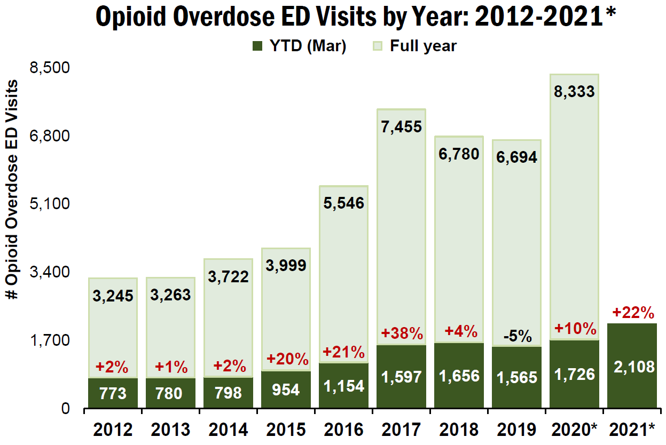
We saw a resurgence of opioid overdoses during COVID19
*Data are preliminary and subject to change
Source: NC Division of Public Health, Epidemiology Section, NC DETECT, 2012-2021
Detailed technical notes on all metrics available from NC DHHS
Notes:
In 2020, ED visits for opioid overdoses increased 24%
As of March 2021, we are still seeing a 22% increase in ED visits for opioid overdose

Slide 7
Fatal opioid overdoses increased during COVID19 as well
Expected^
Goal
*Data are preliminary and subject to change; ^Expected value based on 2013-2016 trend
Source: NC State Center for Health Statistics, Vital Statistics-Deaths, ICD10 coded data- unintentional opioid overdoses,
includes NC Resident deaths occurring out of state, 1999-2020 Q2; Detailed technical notes on all metrics available from NC DHHS

Slide 8
Overdoses involving opioids and stimulants are increasing
*Heroin and/or Other Synthetic Narcotics (mainly illicitly manufactured fentanyl and fentanyl analogues); ᵜCommonly Prescribed Opioid Medications
Source: Deaths-N.C. State Center for Health Statistics, Vital Statistics, 1999-2019; limited to N.C. residents
These counts are not mutually exclusive; If the death involved multiple substances it can be counted on multiple lines
Detailed technical notes on all metrics available from NC DHHS
Notes:
Main point: Rates highest for AI and whites; rates increasing faster for minority pops in recent years (more on next slide); whites had sharp increase earlier in epidemic (2014-2017 and now leveling out/slight decrease) while other pops are increasing steadily still

Slide 9
North Carolina’s Opioid and Substance use Action Plan
Updates and Opportunities Version 3.0
Notes:
Another option for cover slide

Slide 10
Goal: Reduce All Drug Overdoses by 20% from expected by 2024
Expected^
Goal
NC Overdose Action Plan 2017-2024
*Data are preliminary and subject to change; ^Expected value based on 2016-2020 Q2 trend
Source: NC State Center for Health Statistics, Vital Statistics-Deaths, ICD10 coded data- all intent medication/drug overdoses,
includes NC Resident deaths occurring out of state, 2010-2020 Q2; Detailed technical notes on all metrics available from NC DHHS
Notes:
Expected 2024 Q4 is now 755. Showing a 10% decrease for the goal (680). A 20% would be 604.

Slide 11
Opioid and Substance Use Action Plan
Prevent
Track Progress
Measure our Impact
Reduce inappropriate prescribing
and expand pain management
Prevent future addiction by supporting children and families
Expand access to SUD treatment and related supports
Equity and Lived Experiences
Advance harm reduction
Connect to Care
Reduce Harm
Address the needs of justice-involved populations
Address drivers of health and eliminate stigma
Monitor Emerging Trends
The Opioid and Substance Use Action Plan broadens its focus to include polysubstance use and centers equity and lived experience

Slide 12
Priorities for the Opioid and Substance Use Action Plan
Equity and Lived Experiences at the Center
Prevent:
Prevent future addiction and address trauma by supporting children and families
Reduce Harm:
Move Beyond Just Opioids to Address Polysubstance Use
Connect to Care:
Increase Treatment Access for Justice Involved People &
Expand access to housing and employment supports, and recover from the pandemic together

Slide 13
equity
Communities of color have been systematically marginalized through decades of a criminalized response to addiction. This has taken root in critical systems, including education, employment, housing, child welfare, immigration, and public benefits.
Source: https://pubmed.ncbi.nlm.nih.gov/32485658/
Notes:
https://pubmed.ncbi.nlm.nih.gov/32485658/

Slide 14
Equity: Overdose rates are increasing in Historically Marginalized Populations
*Non-Hispanic
Source: NC State Center for Health Statistics, Vital Statistics-Deaths, ICD10 coded data- all intent medication/drug overdoses, 2010-2019
Detailed technical notes on all metrics available from NC DHHS
Notes:
Main point: Rates highest for AI and whites; rates increasing faster for minority pops in recent years (more on next slide); whites had sharp increase earlier in epidemic (2014-2017 and now leveling out/slight decrease) while other pops are increasing steadily still

Slide 15
Equity: Overdose rates are increasing in Historically Marginalized Populations
*Data are preliminary and subject to change; ^Expected value based on 2016-2019 trend
Source: NC State Center for Health Statistics, Vital Statistics-Deaths, ICD10 coded data- all intent medication/drug overdoses,
includes NC Resident deaths occurring out of state, 1999-2020 Q2; Detailed technical notes on all metrics available from NC DHHS
Notes:
Main point: zooming in on the % increase in fatal OD rate from 2017-2019 (2017 when NC saw big increase in fent deaths, also used as starting point for trend analysis/new goal setting). Any opioid and any stimulant categories are subsets of any med/drug; showing differences across races and drug types

Slide 16
Equity: Priorities
Acknowledge the systems that have disproportionately harmed historically marginalized persons who use drugs, and implement programs that reorient those systems towards service and treatment
Increase access to comprehensive, culturally competent, and linguistically appropriate drug user health services for Historically Marginalized Populations (HMPs)
HMPs are defined as individuals, groups and communities that have historically and systematically been denied access to services, resources, and power relationships across economic, political, and cultural dimensions as a result of systemic, durable and persistent racism, discrimination and other forms of intersecting oppression.
Notes:
Center lived experiences of individuals who use drugs and are from HMPs
Analyze demographic and HMP data to address service disparities
Identify new, additional ways for community-based organizations to prevent overdose and overamping
Encompass different consumption modalities and multiple substance types (polysubstance use)
Implement culturally competent and linguistically-appropriate programming and prioritize funding opportunities for programs that are doing so
Create a resource hub for training and education
HMPs are often identified based on their race (Black/African American, American Indian), ethnicity (LatinX/Hispanic), social economic status, geography (rural), religion, language, sexual identity (LGBTQ+), and disability status.

Slide 17
Prevent
Prevent future addiction and address trauma by supporting children and families
Source: https://pubmed.ncbi.nlm.nih.gov/32485658/
Notes:
https://pubmed.ncbi.nlm.nih.gov/32485658/

Slide 18
Prevent
Prenatal (Mother’s experiences)
Adulthood (Addiction)
Infant (Neonatal Abstinence Syndrome)
Adolescence (Experiences with drugs)
Childhood (Adverse Childhood Experiences)
The epidemic is part of an intergenerational cycle of trauma and harm.

Slide 19
Prevent: Priorities
Increase judicious opioid prescribing and the use of non-opioid pain treatments.
Prevent youth misuse by addressing the upstream causes of substance use disorders, including trauma and adverse childhood experiences (ACEs).

Slide 20
Reduce harm
Move Beyond Just Opioids to Address Polysubstance Use
Source: https://pubmed.ncbi.nlm.nih.gov/32485658/
Notes:
https://pubmed.ncbi.nlm.nih.gov/32485658/

Slide 21
Polysubstance Use: Most overdose deaths now involve multiple substances
Source: NC State Center for Health Statistics, Vital Statistics, 1999-2019
Detailed technical available from NC DHHS
Notes:
Main point: zooming in on the % increase in fatal OD rate from 2017-2019 (2017 when NC saw big increase in fent deaths, also used as starting point for trend analysis/new goal setting). Any opioid and any stimulant categories are subsets of any med/drug; showing differences across races and drug types

Slide 22
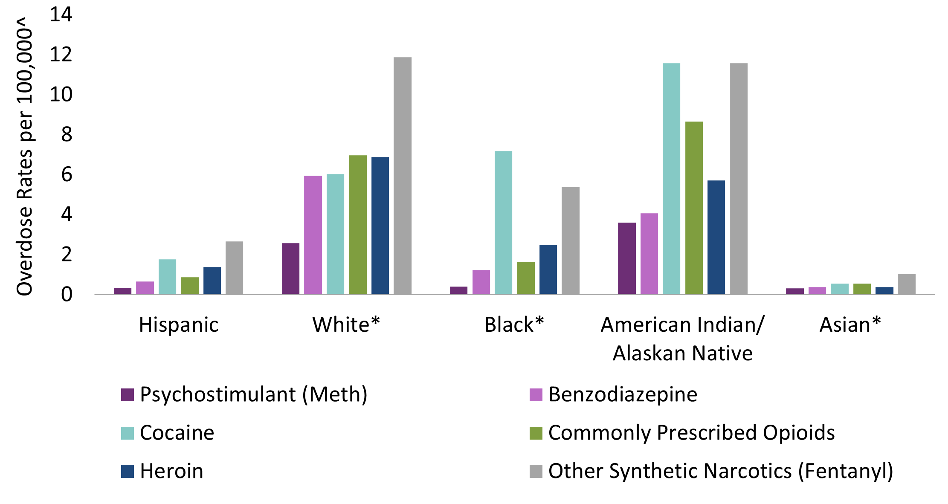
Drug overdose trends vary by race/ethnicity
*Non-Hispanic; ^2015-2019 rates, per 100,000 residents
Source: NC State Center for Health Statistics, Vital Statistics-Deaths, ICD10 coded data- all intent medication/drug overdoses
Detailed technical notes on all metrics available from NC DHHS

Slide 23
Polysubstance Use: Priorities
Expand comprehensive drug user health services to encompass multiple substances
Increase healthcare services in low barrier and non-traditional settings.
Expand drug checking to prevent overdoses

Slide 24
Connect to care
Increase Treatment Access for Justice Involved People
Expand access to treatment, housing and employment supports, and recover from the pandemic together
Source: https://pubmed.ncbi.nlm.nih.gov/32485658/
Notes:
https://pubmed.ncbi.nlm.nih.gov/32485658/

Slide 25
Connect to Care: Justice Involved
An estimated 89% of people Don’t receive the Substance Use Disorder treatment they need.
people are 40 times more likely to die of an overdose in the two weeks post incarceration than the general population.
Notes:
Not sure of the first stat's citation.
40 Xs overdose risk for post-incarceration citation - 2018 AJPH paper: https://pubmed.ncbi.nlm.nih.gov/30024795/

Slide 26
Justice-Involved
Despite lower overdose rates, African Americans are 6.5 times more likely to be incarcerated for drug-related offenses
North Carolina Institute of Medicine. Healthy North Carolina 2030: A Path Toward Health. Morrisville, NC: North Carolina Institute of Medicine; 2020
Notes:
Incarcerated people in NC have 3-4 times higher mental illness than the general population.
Application of law enforcement and sentencing has led to disproportionate incarceration rates, with African Americans making up 52% of the total incarcerated population, but only 22% of the state population.44,45 For example, although drug use is lower among African Americans and rates of trafficking are not different based on race/ethnicity, African Americans are 6.5 times more likely to be incarcerated for drug-related offenses.35 Numerous studies have shown systematic differences exist in outcomes for people of color from arrest, case processing, sentencing, and parole, all of which increase their likelihood of serving time in jail or prison.
https://nciom.org/wp-content/uploads/2020/01/HNC-REPORT-FINAL-Spread2.pdf

Slide 27
Justice-Involved: Priorities
Expand jail diversion programs to reduce incarceration for people who use drugs
Increase access to naloxone and overdose prevention education
Expand medication-assisted treatment during incarceration, upon release, and with reentry into communities.

Slide 28
Drivers of Health
Housing, employment, and access to healthcare all drive a person’s health.
People who use drugs disproportionally experience homelessness, food insecurity, lack of employment access, lack of social support, and poor access to healthcare.
Source: https://pubmed.ncbi.nlm.nih.gov/32485658/
Notes:
https://pubmed.ncbi.nlm.nih.gov/32485658/

Slide 29
211 calls for housing assistance increased 69% in 2020
Drivers of Health: Recovery from COVID-19 should be inclusive
Number of unemployed residents increased 88% in 2020
*Non-Hispanic
Source: NC State Center for Health Statistics, Vital Statistics-Deaths, ICD10 coded data- all intent medication/drug overdoses, 2010-2019
Detailed technical notes on all metrics available from NC DHHS

Slide 30
Drivers of Health: Priorities
Expand employment support services for people with substance use disorders, and increase workplace policies and employment assistance programs that support people with substance use disorders
Create a training program on Housing First principles and harm reduction for housing providers, including homeless shelters and emergency housing.
Build local adoption of fair chance hiring, including by counties, municipalities and companies to increase adoption of fair chance hiring practices.
Notes:
Make sure that people who use drugs don’t miss out on the pandemic recovery.

Slide 31
Medicaid Expansion
In 2020, 1 in 3 emergency department visits for a medication/drug overdose was self-pay
Expanding Medicaid would provide insurance to more than 500,000 North Carolinians.

Slide 32
Strategies
Notes:
Text of all strategies/activities are here - https://ncconnect.sharepoint.com/:w:/r/sites/IVPBranchTeam/_layouts/15/doc2.aspx?sourcedoc=%7B44992547-ef1a-4334-9ffa-7c74fdbcbcb4%7D&action=edit&wdLOR=c03E1B39F-54A2-49D7-BA32-FAB42CC8719B&wdPid=1fe52ddc&cid=fb30024b-3194-42f9-b83a-c32747262511

Slide 33
Advance Equity
Center lived experiences of individuals who use drugs and HMPs by hiring, contracting, and collaborating with HMPs in all phases of organizational development.
Analyze data to identify disparities in HMPs accessing services and programs.
Work with and support providers and HMPs to effectively address service disparities. Ensure they are leading implementation of these programs.
Create a resource hub for service providers to provide culturally competent and linguistically appropriate services, centering and hiring individuals with lived experiences, and health equity for substance use.

Slide 34
Advance Equity (cont'd)
Increase access to comprehensive, culturally competent, and linguistically appropriate outreach, overdose prevention, harm reduction, and connections to care for Historically Marginalized Populations (HMPs)
Expand prevention, harm reduction, and treatment services to include consumption modalities and substances most commonly used by HMPs.
Improve access to outreach, overdose prevention, harm reduction and connections to care services for HMPs by implementing culturally competent and linguistically appropriate programming and prioritizing funding opportunities for programs that are doing so.

Slide 35
Prevent: Reduce inappropriate prescribing and expand pain management
Improve and expand pain management practices
Develop and increase adoption of models of safe opioid prescribing policies in hospitals and health systems, including standardization of electronic order sets.
Improve access to multi-modal, evidence-based pain management across all medical professions.
Expand utilization of chronic pain self-management programs, such as those offered through Healthy Aging NC.
Provide training to healthcare providers to reduce stigma of treating chronic pain with cultural competency across different populations, but particularly for HMPs, including people with substance use disorder, communities of color, military veterans, and the elderly.
Use CSRS to reduce inappropriate prescribing
Register 100% of DEA registered prescribers and dispensers based in North Carolina in CSRS.
Improve compliance with checking the CSRS before prescribing a targeted controlled substance.
Report data to NC professional boards, including the NC Board of Dentistry, so they can investigate aberrant prescribing or dispensing behaviors.
Identify and educate high opioid prescribers in the state on safe opioid prescribing by utilizing academic detailing.
Reduce the supply of excessive medications by increasing knowledge and practices of safe storage and disposal of unused medications.

Slide 36
Prevent: Prevent future addiction by supporting children and families
Increase education and awareness
Identify and disseminate culturally appropriate evidence-based curricula, and skills building trainings on emotional modulation and resiliency to address mental health needs in youth.
Prevent trauma, including ACEs, and increase community resiliency to trauma with a particular focus on youth from HMPs
Increase publicly funded behavioral healthcare integration, increasing early identification, and screening and referral for determinant of health needs.
Reduce trauma such as ACEs, and increase resiliency by supporting the NC Perinatal Strategic Health Plan and the NC Early Childhood Action Plan.
Expand trauma-informed care training and practices to healthcare providers, social service providers, court systems, school systems, and community-based organizations.
Address the impact of family substance use by working with families with children in foster care or at risk of having children placed out of the home to connect parents to evidence-based substance use disorder treatment, recovery support services, peer support, and other services such as transportation and housing.
Improve prenatal, maternal and infant care for pregnant people with SUD
Train healthcare workers who work with pregnant people on substance use disorder treatment during pregnancy, eliminating stigma, and implementing plans of safe care.
Increase access to culturally appropriate birth and post-partum support for pregnant and parenting people. Increase awareness of available social services

Slide 37
Reduce Harm: Advance harm reduction
Increase access to harm reduction services, including expanding services to encompass polysubstance use and a range of consumption modalities
Expand access to evidence-based syringe services programs (SSPs). Evidence-based SSPs are community-based programs that provide health education, infectious disease testing, and either referrals to care or on-site health services through a health hub model in addition to providing direct, secondary, and mobile distribution of sterile use supplies.
Expand harm reduction services to address multiple substance types and modes of consumption for overdose and overamping prevention, harm reduction, and connections to care. Substance types include but are not limited to opioids, stimulants, benzodiazepines, and alcohol.
Expand access to tools to check the drug supply such as fentanyl test strips, infrared spectrometry, and confirmatory testing; and increase dissemination of the results of checked drugs to promote overdose prevention and harm reduction practices.
Provide education on harm reduction to health departments, healthcare systems, hospitals, prescribers, and pharmacists; and increase referrals to harm reduction services to expand access to non-judgmental care for people who use drugs.
Provide workforce development opportunities to people working in harm reduction programs such as nonprofit management, supervisor and manager coaching, healthcare training, program planning, evaluation, advising, leadership development, and related methods for job advancement with specific emphasis on individuals from HMPs.
Expand the peer support certification and/or create a complementary peer support program for harm reduction-based peer support that does not require a year of recovery to participate in the program.
Expand opportunities for the NC OAP SSP Advisory Group to further apply their lived experience expertise to provide input on ways to increase statewide access to services for people who use drugs.
Collaborate with higher education institutions to ensure they are providing education around substance use that is grounded in harm reduction principles, as well as increasing access to overdose prevention resources including naloxone.

Slide 38
Reduce Harm: Advance harm reduction (cont'd)
Make naloxone widely available
Increase the number of naloxone kits distributed to communities with high overdose rates, particularly to people who have been recently released from carceral settings and to people who use drugs and their friends and family, such as through SSPs.
Encourage partners who distribute less naloxone to develop a strategy for working with community-based organizations that distribute large quantities to be able to move naloxone inventory before expiring to prevent waste.
Increase naloxone co-prescribing and dispensing to people who are at risk of an overdose or those who may be in a situation to assist someone experiencing an overdose.
Train pharmacists to increase sale of sterile syringes, increase dispensing of naloxone, and provide overdose prevention education to patients.
Address the syndemic of overdose and infectious disease
Increase awareness of the syndemic of overdose and infectious disease (e.g., 70% of all new HCV infections are among people who inject drugs), and provide information on how to prevent infectious diseases related to substance use.
Expand HIV, hepatitis B and C, and other infectious disease prevention, testing, vaccination, and linkage to care within substance use treatment programs such as Opioid Treatment Programs and SSPs.
Expand wound care and prevention of skin and soft tissue infections in substance use treatment, SSPs, and other community-based healthcare settings.
Provide training to healthcare partners on culturally competent and non-judgmental ways to provide care to people who use drugs.

Slide 39
Reduce Harm: Address social determinants of health and eliminate stigma
Increase access to housing options for people who use substances
Provide trainings to coordinated entry programs, housing providers, including homeless shelters and emergency housing, and domestic violence shelters on housing first principles, making naloxone available, and providing supports for people with substance use disorders using harm reduction principles.
Increase low-barrier, affordable housing options for people who have been recently released from incarceration and/or people with substance use.
Explore options for collaborations with local homeless and domestic violence shelters to decrease barriers to temporary housing such as removing sobriety requirements.
Focus on housing access for particularly marginalized populations of people who use drugs, such as people who are LGBTQ+ or engage in sex work.
Expand access to transportation services for people who use substances
Partner with local stakeholders to expand public transportation to reach marginalized populations and the services they need to access.
Hire peer support staff to provide transportation to people who need rides to harm reduction, treatment, or other recovery resources.

Slide 40
Reduce Harm: Address social determinants of health and eliminate stigma (cont'd)
Promote fair chance hiring and other policies that increase access to employment opportunities for people who have a history of justice involvement or people with SUD
Expand access to employment support services for people with SUD, and support communities in providing trainings for employers to develop workplace policies and employment assistance programs that support people with SUD.
Increase access to educational opportunities for people who use substances
Educate licensure agencies about the importance of comprehensive inclusion of people with SUD or history of incarceration in the licensing criteria.
Partner with local community colleges, trade schools, and other educational institutions to ensure they are providing adequate support and outreach to people with SUD and people who were formerly incarcerated.
Strengthen peer support training programs and opportunities in local health departments and community-based organizations that include harm reduction-based peer support specialists.
Incorporate and promote the voices of people with lived experience of substance use in program planning, implementation, and evaluation
Regularly convene an advisory council of current and former substance users to guide plan components and implementation; continue to grow the Advisory Group and identify additional opportunities to inform work across DHHS.
Run a stigma reduction campaign on substance use disorders and people who use drugs that includes significant input and guidance from people with lived experience and community partners.

Slide 41
Connect to Care: Expand access to SUD treatment and related supports
Increase coverage of substance use treatment
Close the Medicaid Coverage gap.
Increase the number of people that receive SUD treatment and recovery supports, including those with co-occurring mental health disorders, by expanding behavioral health capacity to treat co-occurring mental health conditions.
Expand use of evidence-based and emerging treatment methods for the full range of SUD, including stimulant use.
Promote resources for accessing support for substance use and mental health needs such as increased utilization of the Hope4NC hotline.
Create an alternative payment model for office-based opioid treatment in Medicaid and for uninsured populations.
Increase linkages to SUD treatment and recovery supports
Develop and promote model inpatient, emergency department, and discharge policies including naloxone access for people with substance use.
Increase the number of post-overdose response teams working across the state whereby people with lived experience link overdose survivors to naloxone, harm reduction, treatment, and a wide range of social support options; ensure teams include staff from HMPs that align with community needs.
Increase the number of community-based recovery supports, including recovery housing programs that are inclusive of multiple forms of medications for opioid use disorder and other substance use treatments (e.g., stimulants).

Slide 42
Connect to Care: Expand access to SUD treatment and related supports
Expand treatment capacity and improve treatment quality in North Carolina
Set up advisory groups of people who currently or formerly use drugs across Opioid Treatment Programs (OTPs) statewide to improve treatment quality, address common barriers, share community-based best practices and drug trends, and reduce stigma.
Expand dissemination of the best practices guide for buprenorphine treatment in different healthcare settings throughout North Carolina.
Increase the number of medical schools, NP/PA training programs, and residency programs that provide addiction training, and increase opportunities to work with patients with substance use disorders during training programs.
Increase the number of waivered providers that are prescribing medications for opioid use disorder (MOUD), including through technical assistance and training opportunities.
Explore opportunities to utilize telehealth, telemedicine, and mobile services to increase rural access to treatment.
Ensure sufficient office-based opioid treatment for the uninsured, including access to medications.
Ensure that substance use treatment utilizes evidence-based principles following the ASAM model, e.g. includes access to medications to treat substance use disorder, does not require failure at abstinence before receiving MOUD, prevent people from being discharged from treatment for continued substance use.
Expand comprehensive drug user health services by increasing accessibility and availability of healthcare services in non-traditional settings, including telehealth
Increase access to peer navigation, linkages to care, and a range of support services.
Remove barriers to care by strengthening models of low-barrier, community-based healthcare for people who use drugs, such as mobile buprenorphine or HCV treatment offered on site at syringe services programs.
Expand provision of pre-exposure prophylaxis (PrEP) in low-barrier, accessible settings.
Strengthen opportunities for people who use drugs to inform work and identify priorities happening across DHHS.

Slide 43
Connect to Care: Address the needs of justice-involved populations
Increase pre-arrest, jail-based, and court/ pre-trial diversion of low-level offenders
Support counties in adopting pre-arrest and post-arrest diversion programs to divert low-level offenders to community-based programs and services; and ensure these diversion programs have overrepresentation from HMPs.
Ensure that therapeutic (mental health, recovery and veteran) courts promote evidence-based treatment including opioid agonists. Include education for judges and court personnel on evidence-based treatment options that will be determined with the participant and healthcare providers.
Regularly track and review sentencing data to ensure drug courts are effectively reducing the length of incarceration compared to traditionally sentenced defendants to prevent unintended consequences of diversion programs.
Provide naloxone, overdose prevention education, and medication-assisted treatment (MAT) during incarceration and upon release
Screen for substance use disorders and connect to overdose prevention education and treatment during incarceration or upon release.
Establish and expand jail-based and post-release provision of all evidence-based medications for opioid use disorder treatment.
Establish and expand naloxone availability and overdose prevention health education for justice involved persons.
Establish and expand comprehensive re-entry and jail discharge programs designed to connect returning citizens to appropriate behavioral health and substance use treatments, harm reduction, and supportive services upon release.
Expand the continuum of care of the justice-involved population by including MAT beyond jails to state adult corrections.

Slide 44
Connect to Care: Address the needs of justice-involved populations
Expand dedicated support and recovery options for people after release
Provide continuous and ongoing education to law enforcement, TASC offices, local reentry councils, jails, prisons, community corrections, and courts on effective strategies for overdose prevention, harm reduction, connections to care, and related supports, such as naloxone and MAT access to prevent overdose deaths.
Reduce barriers to education for those with a criminal record, including working with community colleges and other public institutions of higher education to not screen out people based on criminal records alone.
Reduce barriers to employment for those with a criminal record, including the promotion and adoption of fair chance hiring policies, and provide information on education options, career paths and licensures that are available to people with different classes of convictions.
Ensure substance use treatment services are prioritizing justice-involved individuals, keeping wait times low and providing flexible services that meet the high needs of this population group.
Develop case management care options for justice-involved people with a focus on SUD and other health needs.
Advance the North Carolina Task Force for Racial Equity in Criminal Justice recommendations to de-emphasize felony drug possession arrests for trace quantities, use citations or summons in lieu of arrest, establish a Second Look Act to reduce racially disparate sentences, and broaden the use of Advanced Supervised Release.

Slide 45
Track and Measure: Track progress, measure our impact, and monitor emerging trends
Improve data infrastructure and monitor emerging trends
Continue to improve and incorporate stakeholder feedback into publicly accessible data dashboard of key metrics and local actions for data dissemination to monitor impact of this plan.
Identify opportunities to pair stories and highlight qualitative data.
Create data warehouse of aggregate overdose data to facilitate intra-departmental data collaborations and external sharing with data partners.
Expand alert notifications to include drug contaminant trends in addition to drug overdose cluster information in communications with local partners, including SSPs, local health departments, hospital and health care providers, EMS, and others.
Maintain a standardized data collection system to track naloxone reversals by SSPs, law enforcement, EMS, and community members.
Research and evaluation
Continue to partner with research institutions and use research agenda to maintain a timely understanding of the evolving syndemic, inform future work, and evaluate existing work.
Track outcome data
Continue to track key metrics and expand to include other substances and demographic information including race/ethnicity, gender, age, and additional information to highlight disparities for focused program development with HMPs.

Slide 46
Track progress and measure our impact: OAP Dashboard Metrics
Metrics* | 2017 | 2018 | 2019
Track progress and measure our impact
Medication/drug overdose deaths (all intents) | 2,474 | 2,301 | 2,352
ED visits for medication/drug with dependency potential overdose (all intents) | 13,063 | 12,012 | 12,163
Reduce the supply of inappropriate and contaminated drugs
NC residents dispensed opioid pills | 1,953,233 | 1,722,321 | 1,609,602
Overdose deaths involving fentanyl/fentanyl analogues | 53% | 56% | 61%
Prevent future addiction by supporting children and families
Children in foster care due to parental substance use disorder | 6,827 | 6,761 | 6,724
Newborns affected by substance use with a Plan of Safe Care referral to CC4C | Unavailable | Unavailable | 4,919
Advance harm reduction
Community naloxone reversals | 4,176 | 3,372 | 2,960
Newly diagnosed acute Hepatitis C cases | 189 | 194 | 183
Address social determinants of health and eliminate stigma
211 housing-related services calls | 42,666 | 53,052 | 58,255
Unemployed individuals of working age | 201.285 | 194,226 | 163,544
Address the needs of justice-involved populations
Incarcerated individuals | 37,263 | 35,752 | 35,010
Naloxone reversals reported by Law Enforcement Agencies | 811 | 910 | 176
Expand access to SUD treatment and related supports
Buprenorphine prescriptions dispensed | 564,067 | 669,308 | Unavailable
Uninsured individuals and Medicaid beneficiaries with an opioid use disorder served by treatment programs | 32,072 | 35,261 | 38,009
*Data are continually updated as additional cases, visits, claims, and other data points are finalized in each system
Detailed technical notes on all metrics available from NC DHHS
Notes:
The Metric Summary Table provides an at-a-glance look at each of the 14 metrics being tracked as part of the NC OAP. Metrics are divided into five strategy areas:
Reduce Death/ED Outcomes
Reduce oversupply of prescription opioids
Reduce diversion/flow of illicit drugs
Increase access to naloxone
Treatment and recovery
Each metric is updated on a quarterly basis. This table gives the annual statewide data for 2016 and 2017.
The OAP Data Dashboard tracks the most recent quarter and year to date (YTD) provisional data are displayed in the Metric Summary Table.
Data are available on the dashboard for the state and at a county and regional level. NC Opioid Action Plan (OAP) Data Dashboard: https://injuryfreenc.shinyapps.io/OpioidActionPlan/

Slide 47
Track progress and measure our impact: OAP Dashboard Actions
Local Action | Statewide Status*
Track progress and measure our impact
Dedicated point person to coordinate overdose response and prevention programs | 50%
Use NC DHHS resources (i.e., data, publications, grant funds, technical assistance) to inform/support overdose programs | 71%
Reduce the supply of inappropriate and contaminated drugs
Prescription drug disposal permanent dropbox in more than one setting | 68%
Organization distributing fentanyl test strips | 16%
Prevent future addiction by supporting children and families
START (Sobriety Treatment and Recovery Teams) or another similar program for families with a parental substance use disorder | 6%
Department of Social Services has a Community Response Program | 17%
Advance harm reduction
Access to low/no-cost sterile syringes | 35%
At least one pharmacy, EMS agency, health department, or other organization dispenses or distributes naloxone | 44%
Address social determinants of health and eliminate stigma
Housing First or related program to connect people who use drugs to housing services | 11%
Fair Chance Hiring policies in place | 9%
Address the needs of justice-involved populations
Pre-arrest diversion program | 21%
MAT in the county jail/detention center | 8%
Expand access to SUD treatment and related supports
Programs where peer support specialists refer people who are at risk of overdose to social and medical services (e.g., harm reduction, treatment, recovery supports) | 48%
At least one provider offers low or no-cost MAT | 44%
Source: Qualtrics survey to all Local Health Directors – January 2020
Analysis by Injury Epidemiology and Surveillance Unit
Notes:
The Metric Summary Table provides an at-a-glance look at each of the 14 metrics being tracked as part of the NC OAP. Metrics are divided into five strategy areas:
Reduce Death/ED Outcomes
Reduce oversupply of prescription opioids
Reduce diversion/flow of illicit drugs
Increase access to naloxone
Treatment and recovery
Each metric is updated on a quarterly basis. This table gives the annual statewide data for 2016 and 2017.
The OAP Data Dashboard tracks the most recent quarter and year to date (YTD) provisional data are displayed in the Metric Summary Table.
Data are available on the dashboard for the state and at a county and regional level. NC Opioid Action Plan (OAP) Data Dashboard: https://injuryfreenc.shinyapps.io/OpioidActionPlan/

Slide 48
Getting it done
Legislatively mandated by SL-2015-241
The Opioid and Prescription Drug Abuse Advisory Committee (OPDAAC) serves as the primary convening group to advance this work.
OPDAAC members represent a wide variety of agencies and fields, including, but not limited to: local health departments, healthcare organizations, law enforcement, substance use prevention, the recovery community, mental health treatment, harm reduction, emergency medicine, regulatory boards.
All are welcome to join the OPDAAC. For more information, visit here

Slide 49
Getting it done
To respond to this epidemic, it is critical that we support local stakeholders in responding to the epidemic in their own communities.
The Menu of Local Actions identifies impactful strategies that can be implemented at the local level, and provides information and resources on each strategy.
Local stakeholders can select strategies from the menu based on the needs and resources of their community.
The menu will continue to be updated with information and resources as more become available.
You can access the menu here.

Slide 50
Justice-Involved: People who are Incarcerated Need Comprehensive Healthcare
In one year (2017-2018), the NC general population saw an overall decrease of 10% in overdose deaths, but there was >25% increase in overdose deaths among the justice-involved population.
Notes:
From Shabbar Ranapurwala – key point is there is a much bigger increase in opioid overdose deaths with synthetic narcotics compared to heroin and commonly prescribed opioid overdose death (OOD) rates.
Main data points:
-The OOD rate in the NC general population decreased by 10.1% from 2017 to 2018. However, among FIPs the OOD rates increased by 32% during the same period.
- Of the 17,422 out-of-prison deaths among 259,861 formerly incarcerated persons (FIPs) released from incarceration between 2000-2018, 2,078 (11.1%) died of OODs.
Additional data:
The 2016-2018 standardized post-release synthetic narcotics (mainly fentanyl and its analogs) OOD rate among FIPs was 619/100,000PY (95% CI: 381, 857) at 2-weeks post-release, 249/100,000 PY (95% CI: 213, 285) at 1-year post-release, and 224 (95% CI: 196, 253) at complete follow-up post-release. The comparable heroin and commonly prescribed OOD rates were half or lower than those due to synthetic narcotics.
Similarly, the 2016-2018 standardized mortality ratios (SMR) for synthetic narcotics OOD rates among FIPs were 50.3 (95% CI: 30.9, 69.6), 20.2 (95% CI: 17.3, 23.2), and 18.2 (95% CI: 15.9, 20.5) at 2-weeks, 1-year, and complete follow-up post-release, respectively. This is a large increase compared to 2000-2015 along with corresponding decreases in heroin and commonly prescribed OOD rates.

Slide 51
Justice Involved: Increase jail-based access to medications for SUD
Only 8% of jails in NC provide medication-assisted treatment (MAT)
Source: Qualtrics survey to all Local Health Directors – January 2020
Analysis by Injury Epidemiology and Surveillance Unit

Slide 52
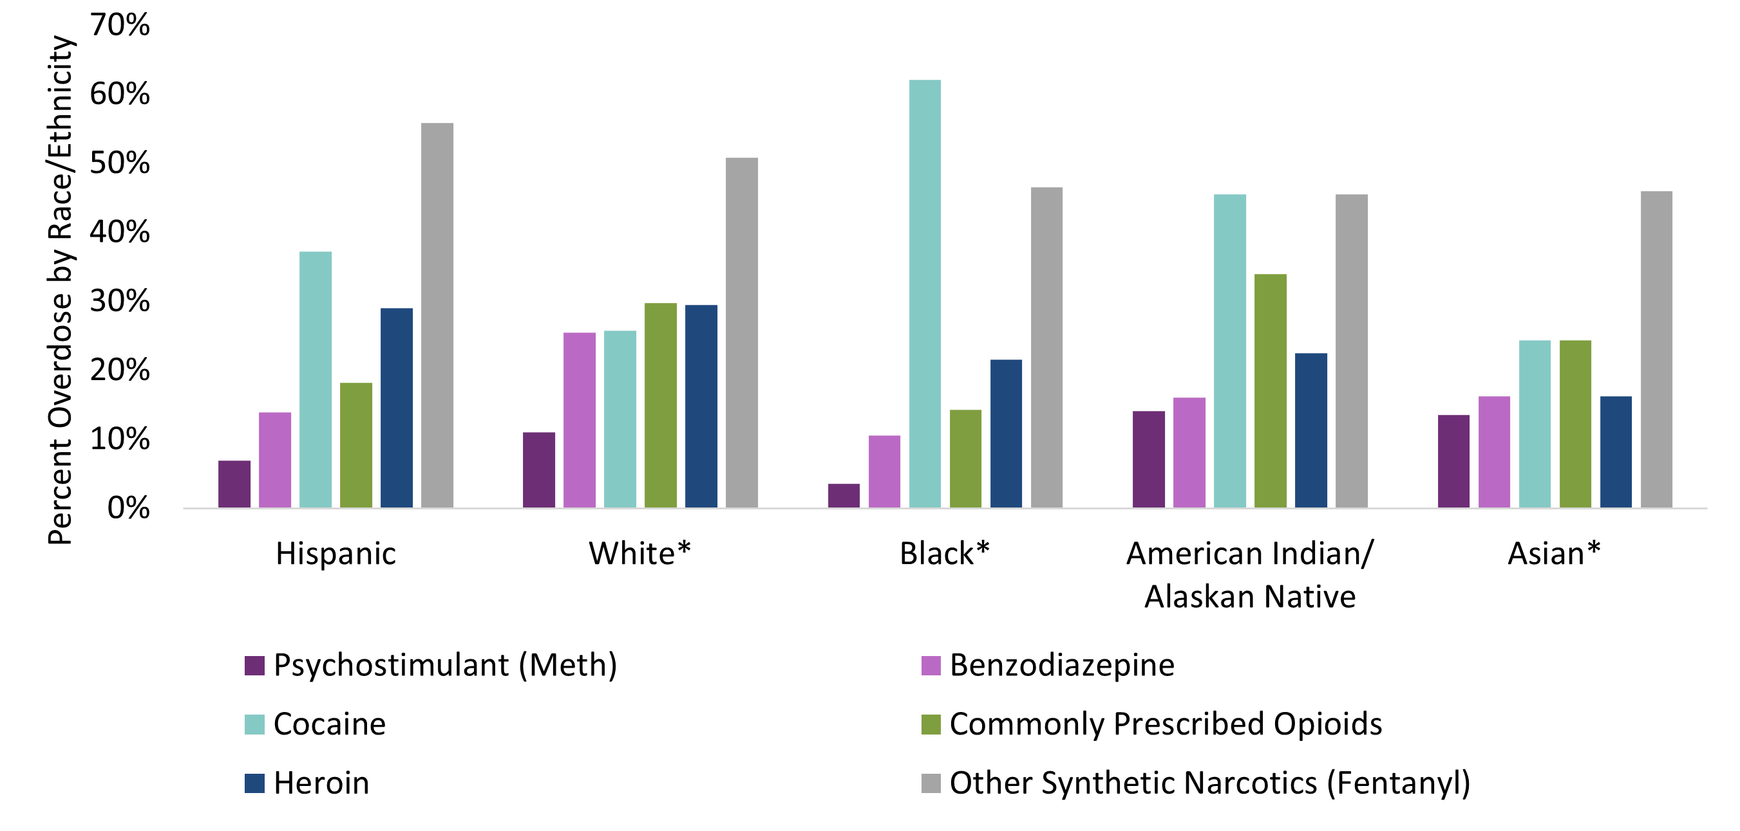
Drug overdose trends by race/ethnicity groups show similar disparities with Fentanyl
Source: NC State Center for Health Statistics, Vital Statistics-Deaths, ICD10 coded data- all intent medication/drug overdoses
Detailed technical notes on all metrics available from NC DHHS

