Slide 1
Transitions to Community Living (TCL) Sustainability Plan Webinar
Transitions to Community Living (TCL) Sustainability Plan Webinar
Debra Farrington, Deputy Secretary for Health
Deb Goda, Director for Olmstead/TCL
November 2, 2026

Slide 2
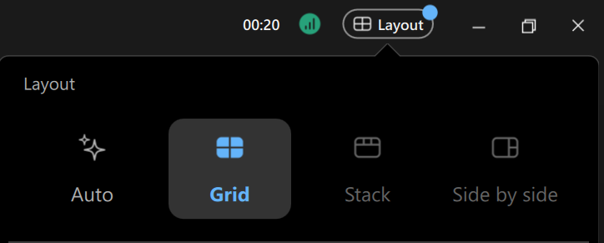
Housekeeping
Reminders about the webinar technology on WebEx:
  Please make sure you are using a computer or smart phone connected to the internet, the audio function is on and the volume is turned up.
  Please make sure your microphone is muted for the duration of the call.
  Questions can be submitted any time during the presentation using the “chat” box located on your control panel.
Adjusting Video Layout and Screen View:
  Select the “Layout" feature located in the top-right hand corner of your screen and pick your preferred layout.
Transitions to Community Living Webinar | NCDHHS | November 2026

Slide 3

Housekeeping Continued
American Sign Language (ASL) Interpreters and Closed-Captioning via Zoom.
  ASL Interpreters and Closed-Captioning options are available for today’s event.
  For closed-captioning, select the "CC" button located on the far left side of your control panel.
  To see the full script of closed captions, select the three dots next to the chat button and select ‘Captions."
  A copy of today’s slides and recording will be available on the NCDHHS YouTube Page
Transitions to Community Living Webinar | NCDHHS | November 2026

Slide 4

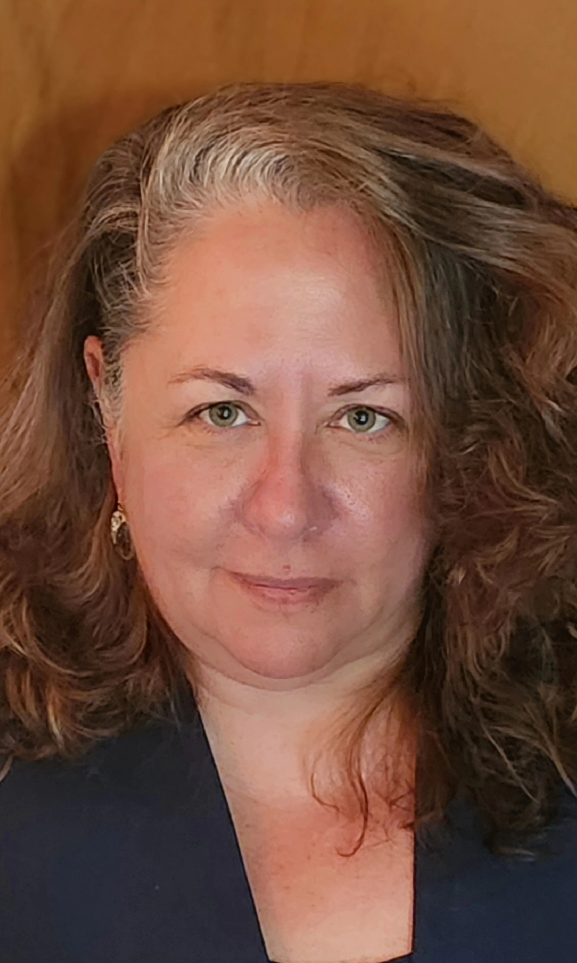
Introductions
Debra Farrington
NCDHHS Deputy Secretary for Health
Deb Goda
NCDHHS Director for Olmstead/TCL

Slide 5
Transitions to Community Living (TCL)
TCL was established in 2012 in response to a U.S. Department of Justice (USDOJ) settlement agreement for adults with serious mental illness (SMI) or severe and persistent mental illness (SPMI).
TCL Settlement Agreement created six pillars that provide the TCL framework: Community-based Supported Housing, Community-based Mental Health Services, Supported Employment (Individual Placement Supports), Discharge and Transition Process, Pre-admission Screening and Diversion, and Quality Assurance and Performance Improvement.
From November 2017-December 2024, the USDOJ and the Department jointly submitted six (6) different modifications to the settlement agreement. In the 4th and 6th modifications, with Independent Reviewer and USDOJ support, the court agreed that various provisions of the settlement agreement met substantial compliance.
In September 2026, the State of North Carolina filed a joint motion with USDOJ to end the settlement.

Slide 6
Agenda
Agenda
1
  What is Transitions to Community Living (TCL)?
Purpose: Provide an update on TCL, continued path forward, and address questions from the community
2
  TCL Compliance
3
  What This Means: TCL Commitment & The Work Continues
4
TCL Post-settlement Program Administration Overview
5
What Comes Next
6
Q&A
Transitions to Community Living Webinar | NCDHHS | November 2026

Slide 7




Transitions to Community Living (TCL) Overview
Transitions to Community Living (TCL) Overview
TCL provides eligible adults living with serious mental illnesses the opportunity to choose where they live, work and play in North Carolina. It promotes recovery through providing long-term housing, community-based services, supported employment and community integration.
TCL ELIGIBILITY
TCL EXCLUSIONSd
Diagnosis
Conditions related to Alzheimer’s or dementia
Has a serious mental illness (SMI) or severe and persistent mental illness (SPMI) diagnosis.
Has a condition related to Alzheimer’s or dementia.
Setting
Nursing Facility-Level Care
Currently living in or being considered for an adult care home or leaving a state psychiatric hospital with no safe place to go.
Individuals needing nursing facility–level care.
Other Conditions
Financial
Individuals with intellectual or developmental disabilities or traumatic brain injuries unless they also have a serious mental illness.
Has Medicaid, qualifies for Medicaid, or earns $2,000 or less a month.
Age
Not in/at risk of moving to Adult Care Home
Is at least 18 years old.
Individuals experiencing homelessness who are not eligible for adult care home admission.
Transitions to Community Living Webinar | NCDHHS | November 2026

Slide 8




TCL Impacts to Date
TCL Impacts to Date
Over 4,150 people in North Carolina are living independently with TCL supports. Evidence shows that living in a supportive community empowers adults with SPMI and SMI to shape their own lives, choose where they live, contribute to their communities through work or volunteering and form genuine friendships.
A Home in the Community
Access to Mental Health Care
Avoiding Institutionalized Settings
Support in Finding and Keeping a Job
4,150+
90.8%
93.9%
~26%
people are living in their own homes in the community today.
of people in TCL housing received recovery services support as of June 2026.
of people referred to an adult care home were diverted for SFY 2026.
of people in TCL between ages 18-64 have received supported employment as of June 2026.
7,867 people have moved into their own homes since TCL began as of June 2026
83% remained housed one year after moving in
More than 90% of people in adult care homes had face-to-face discussions about community living options.
Includes community-based services and peer support services.
Only 27 people entered an adult care home during SFY 2026
6,700+ diversions through screening and outreach as of June 2026.
2,470+ people diverted and housed in permanent supportive housing as of June 2026.
7% growth in IPS and ACT services from December 2025 to June 2026.
This signals meaningful momentum as the Department continues to improve Employment First principles in practice.
Transitions to Community Living Webinar | NCDHHS | November 2026
Notes:
Additional Speaking Notes: [PLACEHOLDER FOR UPDATED POINT IN TIME # of PEOPLE]

Slide 9
Key TCL Partners
Key TCL Partners
NCDHHS works closely with housing and health care providers, health plans, individuals with lived experience, and technical assistance partners to support TCL statewide. The Department continues to partner across divisions, including the Targeting Program with Division of Aging.
Individuals, Families & Individuals with Lived Experience
Local Management Entities/Managed Care Organizations (LME/MCOs)
Community-Based Providers
Play a vital role in TCL by informing decision-making, validating what is working, highlighting areas for improvement and helping ensure the program remains accountable to the people it supports.
Lead regional TCL delivery and serves members, including in-reach, diversion, transition planning, housing coordination, and services.
Help individuals transition to community living and access the supports needed to achieve their goals and maintain stability.
NC Housing Finance Agency (HFA)
Technical Assistance Collaborative (TAC)
General Assembly
The University of North Carolina at Chapel Hill (UNC) Institute for Best Practices
Supports access to integrated, affordable housing and administers key housing resources used by TCL.
Provides technical assistance, tools, and implementation support to strengthen TCL services.
Appropriates funds for housing supports, housing slots through NC HFA, and community-based services for people with SMI and SPMI.
Provides training, coaching, fidelity support, and practice improvement for evidence-based services.
Transitions to Community Living Webinar | NCDHHS | November 2026

Slide 10
TCL Compliance
TCL Compliance
The Court approved the United States Department of Justice and State of North Carolina joint motion (9/14/26), formally ending federal oversight of the TCL Settlement after North Carolina achieved substantial compliance.
2012
November 1, 2017 to December 11, 2024
Sept. 14, 2026
From 11/1/2017 to 12/11/2024, the court issued six (6) modifications to the settlement agreement.
The fourth and sixth modifications discharged various provisions from the settlement due to the state achieving substantial compliance.
Modifications were submitted with Independent Reviewer and USDOJ agreement.
TCL Settlement Agreement
established
Federal district court granted North Carolina and USDOJ's joint motion to terminate the settlement agreement based on substantial compliance and federal oversight ended
✓
WHAT THIS MEANS
The court recognized that North Carolina met the Settlement Agreement’s major requirements.
Federal court oversight of the Settlement Agreement has concluded.
TCL continues with on-going state oversight, accountability and continuous improvement.
TCL continues in partnership with LME/MCOs, providers, people with lived experience and their families, community stakeholders, and legislators.

Slide 11
TCL Commitment & The Work Continues
TCL Commitment & The Work Continues
While federal oversight has concluded, North Carolina’s commitment to community inclusion is not contingent on a settlement agreement. It reflects our belief that every person deserves the opportunity to live, work and thrive in their community.
TCL Commitment
Sustained Infrastructure
Looking Ahead
Help individuals transition/divert from institutional settings and maintain stable housing, services and employment supports that promote long-term success in the community.
Continue leveraging the systems, provider networks and resources established through TCL to support individuals across North Carolina.
Continue advancing recovery, choice and meaningful participation in community life. This includes continued assessment and improvement of services and supports.
We will continue to work with the community, people with lived experience and their families, LME/MCOs, General Assembly, advocacy groups, and our state and federal partners to continue and improve our TCL services.
Transitions to Community Living Webinar | NCDHHS | November 2026

Slide 12
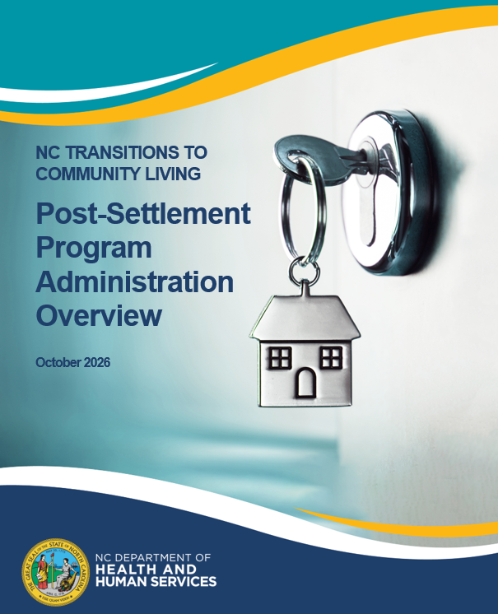
Post-settlement Program Administration Overview
NCDHHS has released the TCL Post-settlement Program Administration Overview which:
Reaffirms the North Carolina’s commitment to the principles of Olmstead;
Serves as an overview of the TCL program and highlight its core priorities and principles;
Emphasizes NCDHHS’s continuation of the established infrastructure and program administration that extends beyond the requirements of the 2012 United States Department of Justice (USDOJ) Settlement Agreement;
Outlines continued assessment and improvement of services and supports.
Transitions to Community Living Webinar | NCDHHS | November 2026

Slide 13
What Comes Next (1/2)
TCL Continues
Sustain and strengthen the TCL infrastructure built under the Settlement Agreement.
Continue to assess the service and support needs of individuals participating in TCL and pursue the funding necessary to help individuals remain successfully housed and supported in the community.
Partner with LME/MCOs for regional implementation to maintain and strengthen the robust referral and enrollment pathways for TCL services.
Continuous Improvement Remains a Priority
Continue to elevate peers and individuals with lived experience as a foundational approach for services system and delivery framework.
Continue focused technical assistance for ACT and CST providers to improve person-centered practices and promote zero exclusion practices. Ensuring no one is denied employment services because of their diagnosis, symptoms, substance use, criminal record or housing status.
Transitions to Community Living Webinar | NCDHHS | November 2026

Slide 14
What Comes Next (2/2)
TCL remains an ongoing State program dedicated to supporting adults with SMI and SPMI in living, working, and thriving in their communities.
Accountability Continues
Continue to monitor key indicators and assess progress toward TCL goals, priorities, and improvement areas.
Evaluate measures and share progress updates publicly through the TCL Annual Report and Olmstead Plan Stakeholder Advisory (OPSA) quarterly updates.
Continue quarterly LME/MCO onsite and desk reviews by external vendor.
Transitions to Community Living Webinar | NCDHHS | November 2026

Slide 15
TCL Resources
Stay Connected
Visit the:
TCL webpage for program information and updates
  LINK: https://www.ncdhhs.gov/about/department-initiatives/transitions-community-living
NC Olmstead webpage for Olmstead Plan Stakeholder Advisory meeting notes and updated Olmstead content
  LINK: https://www.ncdhhs.gov/about/administrative-offices/office-secretary/nc-olmstead
Transitions to Community Living Webinar | NCDHHS | November 2026

Slide 16



TCL Example Resources
EXAMPLE REFERENCES
NCDHHS TCL Housing Guidelines
Referral Screening Verification Process (RSVP)
TCL Transition & Diversion Manual
The main guide covering rent rules, deposits, bridge housing and more.
Determines SMI/SPMI eligibility and supports diversion from ACH admission.
The main guide covering screening, in-reach, informed choice and transition planning steps.
TCL Databases (CLIVe, TCLD)
Person-centered Plan (PCP) Guidance Document & Template
Disability Benefits (DB) 101
Helps individuals understand how employment and earnings may affect benefits and available supports.
Tracks housing supply, lease status, transition times, and engagement with the TCL individuals for timely engagement and transitions.
Statewide standards and expectations for developing person-centered plans, including crisis plans.
Transitions to Community Living Webinar | NCDHHS | November 2026

Slide 17
Q&A
What help is there for aging caregivers and work with them in planning for when they can no longer care for someone who can't live independent?
Can someone get TCL thru state funded services if they are not eligible for Medicaid? How? Or what other services might be available to them?
Do the hospitals have access to TCL resources for discharges?
How are people who end up unhoused while in this program classified: a re-house, unsuccessful, etc.

Slide 18

Thank You
While this milestone marks important progress, our shared commitment to supporting people with SMI/SPMI in living, working, and thriving in their communities continues.
Thank you for your continued partnership in advancing community integration, housing stability, recovery, and opportunity for individuals served through TCL.
Notes:
Photo by Jessica Lewis 🦋 thepaintedsquare from Pexels: https://www.pexels.com/photo/wooden-houses-on-shore-during-sunset-4982142/
Free to use
North Topsail Beach, NC, United States

