Slide 1
NC Department of Health and Human Services
Office of Rural Health
SFY 2023 Community Health Grant
Request for Application Overview
November 2021

Slide 2











Programs at ORH
NC Farmworker Health Program
Rural Health Information Technology Program
Placement and HPSA Services
NC Rural Health Centers
NC Community Health Grants
Provides technical assistance to improve the use of Electronic Health Record (EHR) Systems and the use of health information exchange
Supports state designated rural health centers that serve the entire community
Supports the primary care safety net system with increasing access to health care for vulnerable populations
Supports medical, dental and educational services for members of the North Carolina agricultural labor force and their families
Recruit providers and designates health professional shortage areas
NC Rural Hospital Program
NC Medication Assistance Program
NC Statewide Telepsychiatry
Program
NC Analytics & Innovations
Community Health Worker Program
Funds operational improvement projects for the benefit of all critical access hospitals and eligible small rural hospitals
Provides free and low-cost medications donated by pharmaceutical manufacturers to patients who cannot afford them
Supports psychiatric evaluation of patients through videoconferencing technology in emergency departments
Support data analytics, shortage designations, and pioneering
efforts to improve health
Support North Carolinians by connecting them to medical and social support resources.

Slide 3







Overview
Community Health Grant RFA
  Purpose
  Eligibility
  Reimbursement
  Deadlines
Scoring Per Section
Performance Measures

Slide 4



Community Health Grant RFA
NC General Assembly
Office of Rural Health
Community Health Grants
Primary and Preventative Care
Purpose
Strengthening the safety net through increased levels of collaboration and integration of services and organizations to more effectively meet the needs of our state’s most vulnerable population is an important purpose of this grant.

Slide 5
Who’s Eligible?
Federally Qualified Health Centers and Look-Alikes
Free and Charitable Clinics
Health Departments
Hospital Owned Primary Care Clinics
Rural Health Centers
School-Based and School-Linked Health Centers
AHEC Clinics
Other Non-Profit Community Organizations that provide primary and preventative patient care to low-income, uninsured, underinsured and medically vulnerable populations
All primary care safety net organizations that currently provide direct primary and preventive care and serve as a medical home are eligible to apply.

Slide 6
RFA, cont’d
NEW SFY23 applicants may receive a three-year award OR a one-year award, based on applicant scores.
We anticipate that approximately 30 applicants will receive three-year funding and another 12 will receive one-year funding.
This plan will stay in effect until SFY24 and will, at that time, equalize the funding available to approximately 30 grants for the competitive cycle each year going forward.

Slide 7
Primary care safety net organizations who currently care for underserved and medically indigent patients in the state are eligible to apply for this funding to pay for patient care through
Applicants must select ONE track
Encounter Based
OR
Reimbursement for eligible expenses
(line item budget)
Track A
Track B
Telehealth services and equipment are eligible expenses in both tracks.

Slide 8


CHG Funds Telehealth Use Cases for Healthcare Providers
Healthcare providers can use Community Health Grant (CHG) funds to purchase Tablets, Mobile Wi-Fi Hotspots, and Cameras to support telehealth services at their practice.
Healthcare providers can use CHG funds to support an FTE position such as a Community Health Worker or Telehealth Coordinator that helps incorporate telehealth services into existing clinical workflows.
Healthcare providers can use CHG funds to purchase or lease telehealth equipment such as scales, blood pressure cuffs, pulse oximeters, etc., that can be used for remote patient monitoring. This equipment in conjunction with patient education can assist patients with chronic disease management.

Slide 9
RFA cont’d
REMINDER - Per the Free Clinics Federal Tort Claims Act (FTCA) Program Policy Guide, grant funding that applies to reimbursement, payment, or compensation for the delivery of health services to patients falls within the statutory prohibition, while grant funding that is not intended for or applied to this purpose does not. Free clinics who are FTCA recipients that choose a “per encounter’ reimbursement methodology may void their FTCA liability protection.

Slide 10
One grant application per organization will be reviewed. Under session law, grantees must serve as a medical home and provide direct primary and preventive care services.
Application Deadline
January 14, 2022
Anticipated Notice of Awards
April 2022
Maximum Award
$150,000
July 1, 2022 -
June 30, 2023
Instructions and Budget Template
Community Health Grants SFY 2023 RFA Document
Community Health Grants SFY 2023 Budget Template
Survey Link
Request link prior to January 13, 2022
Contract Period
Request Unique Application Link
Primary care is defined as that care provided by physicians specifically trained for and skilled in comprehensive first contact and continuing care for persons with any undiagnosed sign, symptom, or health concern. There are providers of health care other than physicians who render some primary care services. Such providers may include nurse practitioners, physician assistants and some other health care providers. *American Association of Family Practice: http:www.aafp.org

Slide 11
Two-Step Application Process
Request Unique Application Link
Submit your organization name and contact information by January 13, 2022.
https://ncruralhealth.az1.qualtrics.com/jfe/form/SV_b3dUODMYHn7MRud
Application Deadline
Submit application electronically using the link unique to your email address and organization by 11:59 p.m. on January 14, 2022.

Slide 12
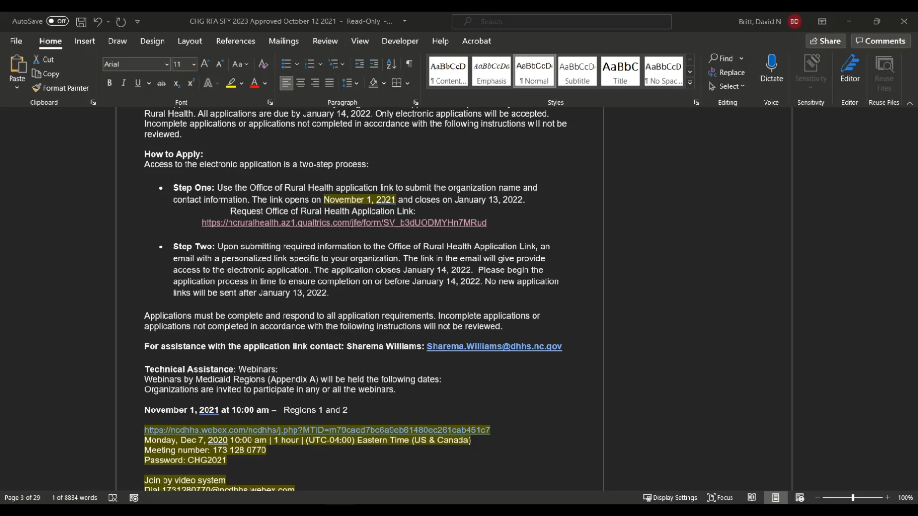
How to Request Unique Application Link

Slide 13
Application Overview
Application Areas to be Completed | Points
Overview of Organization | 5 Points
Budget Track A Track B | 15 Points
Community Need and Patient Population | 20 Points
Project Description and Improved Access to Care | 20 Points
Collaboration and Community Engagement | 20 Points
Project Evaluation and Return on Investment | 20 Points
 | Total Points 100

Slide 14
Overview of Organization
5 Points
These are set questions regarding hours your clinic is open, patient services, capacity, etc.

Slide 15
Budget – Track A
Reimbursement per encounter
15 Points
Upload document that demonstrates the organization's capacity to document patient encounter eligibility for the Primary Care Medical Access Program including:
Organization Name,
Address,
Time Period,
Number of Uninsured/Underinsured Patients, and,
Number of Unduplicated Encounters
Include accurate calculations
# of encounters x $100 per encounter =
$ [Total Amount of Grant Award]
REMINDER
Per the Free Clinics Federal Tort Claims Act (FTCA) Program Policy Guide, grant funding that applies to reimbursement, payment, or compensation for the delivery of health services to patients falls within the statutory prohibition, while grant funding that is not intended for or applied to this purpose does not.
Free clinics who are FTCA recipients that choose a “per encounter’ reimbursement methodology may void their FTCA liability protection.

Slide 16
Budget – Track B
Reimbursement for eligible expenses
15 Points
Proposed budget should align with the project
Include accurate calculations

Slide 17
Budget Template Guidance for
Track B
Track B Budget Template is located on RFA website, along with the application
Please be sure to use current version of SFY23 Track B Budget Template
Template has specific instructions, including:
Things not to include in your salary costs, such as bonuses of any kind.
Fringe cannot exceed 30% of total line item for salary allocated to the grant.
Fringe only includes employer paid benefits.
Three tabs to complete
  Personnel
  Line Item Budget
  Budget Narrative

Slide 18
Community Need and Patient Population
20 Points
Describe the population served by this grant proposal and provide citations/references of data sources
Describe how this project will align with the most recent Community Needs Assessment
Patient Insurance Status in your Organization Table = Meaningful access to care for the uninsured or medically indigent population
Describe how the organization plans to achieve the patient population goals with emphasis on care to uninsured and medically indigent patients

Slide 19
Project Description and Improved Access to Care
20 Points
Describe the purpose of the grant request and how the grant funds will be used
Include activities, timelines to implement grant activities, and anticipated outcomes
Directly align with the community need and patient population described in the Community Need and Patient Population Section
Describe the organization’s arrangements for after-hours care

Slide 20
Collaboration and Community Engagement
20 Points
Describe how the organization currently collaborates with community hospitals or other safety net organizations and provide a specific example
Describe plans to develop future partnerships to address community health needs
Describe the organization's activities and/or plans to address health equity by creating an environment that is welcoming, respectful, inclusive, and is patient-centered to improve health
In the Patients by Race and Ethnicity Table, is the number of unduplicated patients served reflective of the community? If the current patient population is not reflective of the community, does the proposal describe plans to increase services to underserved populations?

Slide 21
Project Evaluation and Return on Investment
20 Points
Include the organization's overall budget and explain why the project is a good use of State funds
Include all required Program Performance Measure (PM) data
Describe how the organization will use the mandatory PMs to improve patient health outcomes and identify potential factors that could negatively affect the PM targets and describe how these factors might be mitigated

Slide 22

Performance Measures
Note:
Our performance measures are based on measures in the Uniform Data System, a standardized reporting system that federally qualified health centers use to submit data.

Slide 23

Performance measures, cont’d.
For each measure, you will need to include the following information:
Data Source: where will you obtain the information you report for your performance measures?
Collection Process and Calculation: what method will you use to collect the information?
Collection Frequency: how often will you collect the information? (We provide the answer to this!)
Data Limitations: what may prevent you from obtaining data for your performance measures?

Slide 24
Quarterly Performance Data Reporting
Quarters 1 and 3
Patient Encounters
Patients Served
Quarters 2 and 4
Patient Encounters
Diabetes
BMI
Tobaccco Cessation
Hypertension
Patients Served
Dental
School Based Health Center
Maternal

Slide 25

Measure Description | Controlling High Blood Pressure Percentage of patients 18-85 years old who had a diagnosis of hypertension (HTN) overlapping the reporting period and whose most recent Blood Pressure (BP) was adequately controlled (less than 140/90 mm Hg) during the reporting period.
Guidance | Note that this is a “positive” measure. For this measure, the higher the number of patients with controlled hypertension the better the performance on the measure. Adequate control is defined as systolic Blood Pressure lower than 140 mm Hg AND diastolic blood pressure lower than 90 mm Hg. Include patients who have an active diagnosis of hypertension even if their medical visits during the year were unrelated to the diagnosis. Include blood pressure readings taken at any visit type at the health center as long as the result is from the most recent visit. Only blood pressure readings performed by a clinician in the provider office are acceptable for numerator compliance with this measure. Blood pressure readings from the patient's home (including readings directly from monitoring devices) are not acceptable. Patients self-reporting their blood pressure is not acceptable. The provider must be able to visually see the results on the patient's device or the Provider must use a remote monitoring device. If no blood pressure is recorded during the reporting period, the patient's blood pressure is assumed "not controlled” and isn’t counted in the numerator If there are multiple blood pressure readings on the same day, use the lowest systolic and the lowest diastolic reading as the most recent blood pressure reading.

Slide 26

Measure Description | Body Mass Index (BMI) Screening and Follow-Up Plan Percentage of patients aged 18 years and older with a visit during the reporting period with a BMI documented during the most recent visit or within the previous 12 months to that visit AND, when the BMI is outside normal parameters, a follow-up plan is documented during the visit or during the previous 12 months of that visit.
Guidance | This performance measure, as a whole, cannot be completed in a telehealth visit. The only aspect that is allowable as a telehealth visit is the documented follow-up plan with the patient. Patient's self-reporting their height and weight is not acceptable. Report this measure for all patients seen during the reporting period. An eligible professional or their staff is required to measure both height and weight. Both height and weight must be measured within 12 months of the current encounter and may be obtained from separate visits. Do not use self-reported values. BMI may be documented in the medical record at the health center or in outside medical records obtained by the health center. If more than one BMI is reported during the measurement period, use the most recent BMI to determine if the performance has been met. Document the follow-up plan based on the most recent documented BMI outside of normal parameters. Documentation in the medical record must show the actual BMI or the template normally viewed by a clinician must display BMI. Do not count as meeting the measurement standard charts or templates that display only height and weight. The fact that a HIT/EHR can calculate BMI does not replace the presence of the BMI itself.

Slide 27

Measure Description | Hemoglobin A1c Poor Control Percentage of patients 18-75 years of age with diabetes who had hemoglobin HbA1c > 9.0% during the reporting period
Guidance | Note that this is a “negative” measure. For this measure, the lower the number of adult diabetics with poorly controlled diabetes, the better the performance on the measure. Also note that unlike the Hypertension measure, this measure calls for reporting on patients with diabetes regardless of when they were first diagnosed. Only include patients with an active diagnosis of Type 1 or Type 2 diabetes Include patients in the numerator whose most recent HbA1c level is greater than 9 percent, the most recent HbA1c result is missing, or when no HbA1c tests were performed or documented during the reporting period. This measure is calculated using the numerator and denominator defined below. This service cannot be conducted via telehealth.

Slide 28

Measure Description | Tobacco Screening and Cessation Intervention Percentage of patients aged 18 years and older who were screened for tobacco use one or more times within 24 months and received tobacco cessation intervention if identified as a tobacco user This measure is calculated using the numerator and denominator defined below.
Guidance | Include in the numerator patients with a negative screening and those with a positive screening who had cessation intervention if a tobacco user. If patients use any type of tobacco (i.e., smokes or uses smokeless tobacco), the expectation is that they should receive tobacco cessation intervention (counseling and/or pharmacotherapy). If a patient has multiple tobacco use screenings during the 24-month period, use the most recent screening which has a documented status of tobacco user or non-user. If tobacco use status of a patient is unknown, the patient does not meet the screening component required to be counted in the numerator and has not met the measurement standard. "Unknown" includes patients who were not screened or patients with indefinite answers. The medical reason exception applies to the screening data element of the measure or to any of the tobacco cessation intervention data elements. If a patient has a diagnosis of limited life expectancy, that patient has a valid denominator exception for not being screened for tobacco use or for not receiving tobacco use cessation intervention (counseling and/or pharmacotherapy) if identified as a tobacco user. Electronic nicotine delivery systems (ENDS), including electronic cigarettes for tobacco cessation, are not currently classified as tobacco. They are not to be evaluated for this measure. Include in the numerator records that demonstrate that the patient had been asked about their use of all forms of tobacco within 24 months before the end of the measurement period. Include patients who receive tobacco cessation intervention, including: Received tobacco use cessation counseling services, or Received an order for (a prescription or a recommendation to purchase an over-the-counter [OTC] product) a tobacco use cessation medication, or Are on (using) a tobacco use cessation agent.

Slide 29


Performance Measures, cont’d.
School Based Health Center Applicants
Weight Assessment and Counseling for Nutrition and Physical Activity
Tobacco Use and Help with Quitting Among Adolescents
Screening for Clinical Depression and Follow-Up Plan
This Photo by Unknown Author is licensed under CC BY-NC

Slide 30


Performance Measures, cont’d.
Dental Clinic Applicants
Number of Encounters
Number of Unduplicated Patients Served

Slide 31





Performance Measures, cont’d.
Maternal Care Applicants
Access to Prenatal Care:
First Prenatal Visit in 1st Trimester
Percentage of prenatal care patients who entered prenatal care during their first trimester.

Slide 32

  Funding Agency Contact/Inquiry Information:
  Stephanie Nantz at stephanie.nantz@dhhs.nc.gov
  For assistance with the application link:
  Sharema Williams, sharema.williams@dhhs.nc.gov
  North Carolina Department of Health and Human Services Website
  North Carolina Office of Rural Health Website

Slide 33
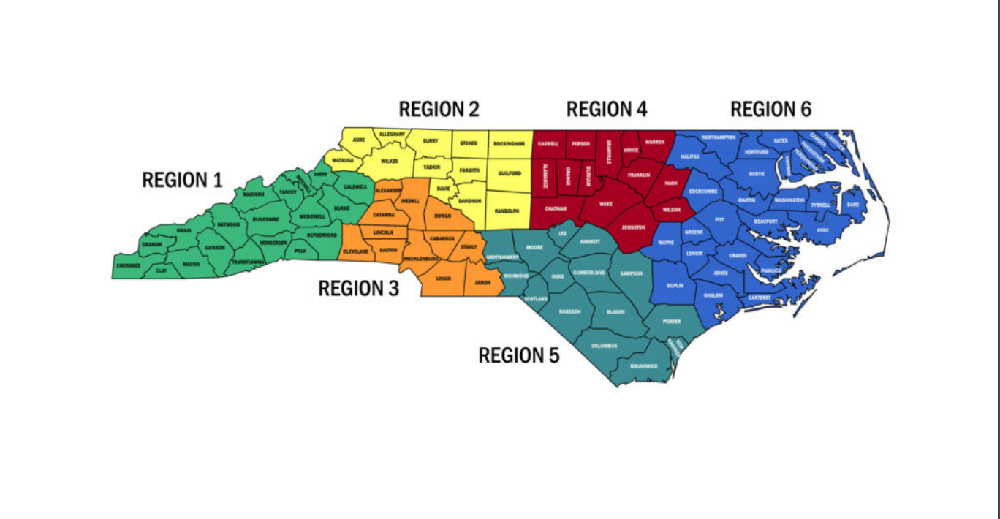
Medicaid Region Map and Contacts
Region 1: Deneen Gill deneen.gill@dhhs.nc.gov
Region 2: Jill Rushing jill.rushing@dhhs.nc.gov
Region 3: Bianca Revis bianca.revis@dhhs.nc.gov
Region 4: Nina Baccanari nina.baccanari@dhhs.nc.gov
Region 5: Sharema Williams sharema.williams@dhhs.nc.gov
Region 6: (Interim Monitors) Deneen Gill, Jill Rushing, or Nina Baccanari

Slide 34

Questions?
This Photo by Unknown Author is licensed under CC BY-SA

