Slide 1
NC Department of Health and Human Services
Telehealth: Improve Access to Care
Nick Galvez, Rural Hospital Manager
June 2019

Slide 2
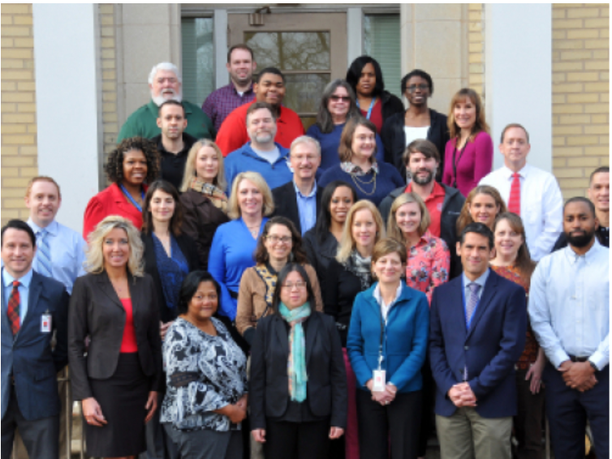
About the Office of Rural Health (ORH) and Our Mission
First state office (1973) in the nation created to focus on the needs of rural and underserved communities
Assists underserved communities by developing and funding innovative strategies for improving:
Access to health care
Quality of health care
Cost-effectiveness of health care
State Fiscal Year 2018 Office Facts:
Administered over 300 contracts
Spent $31.6 million from state, federal, and philanthropic sources
Provided over 1,300 technical assistance activities
While we do not provide direct care, our programs support numerous health care safety net organizations throughout North Carolina.
Raleigh, NC

Slide 3
Programs at ORH
NC Farmworker Health Program
Rural Health Information Technology Program
Placement and HPSA Services
NC Rural Health Centers
NC Community Health Grants
Provides technical assistance to improve the use of Electronic Health Record (EHR) Systems and the use of health information exchange
Recruit providers and designates health professional shortage areas
Supports state designated rural health centers that serve the entire community
Supports the primary care safety net system with increasing access to health care for vulnerable populations
Supports medical, dental and educational services for members of the North Carolina agricultural labor force and their families
NC Rural Hospital Program
NC Medication Assistance Program
NC Statewide Telepsychiatry
Program
NC Analytics & Innovations
Funds operational improvement projects for the benefit of all critical access hospitals and eligible small rural hospitals
Provides free and low-cost medications donated by pharmaceutical manufacturers to patients who cannot afford them
Supports psychiatric evaluation of patients through videoconferencing technology in emergency departments
Support data analytics, shortage designations, and pioneering
efforts to improve health

Slide 4
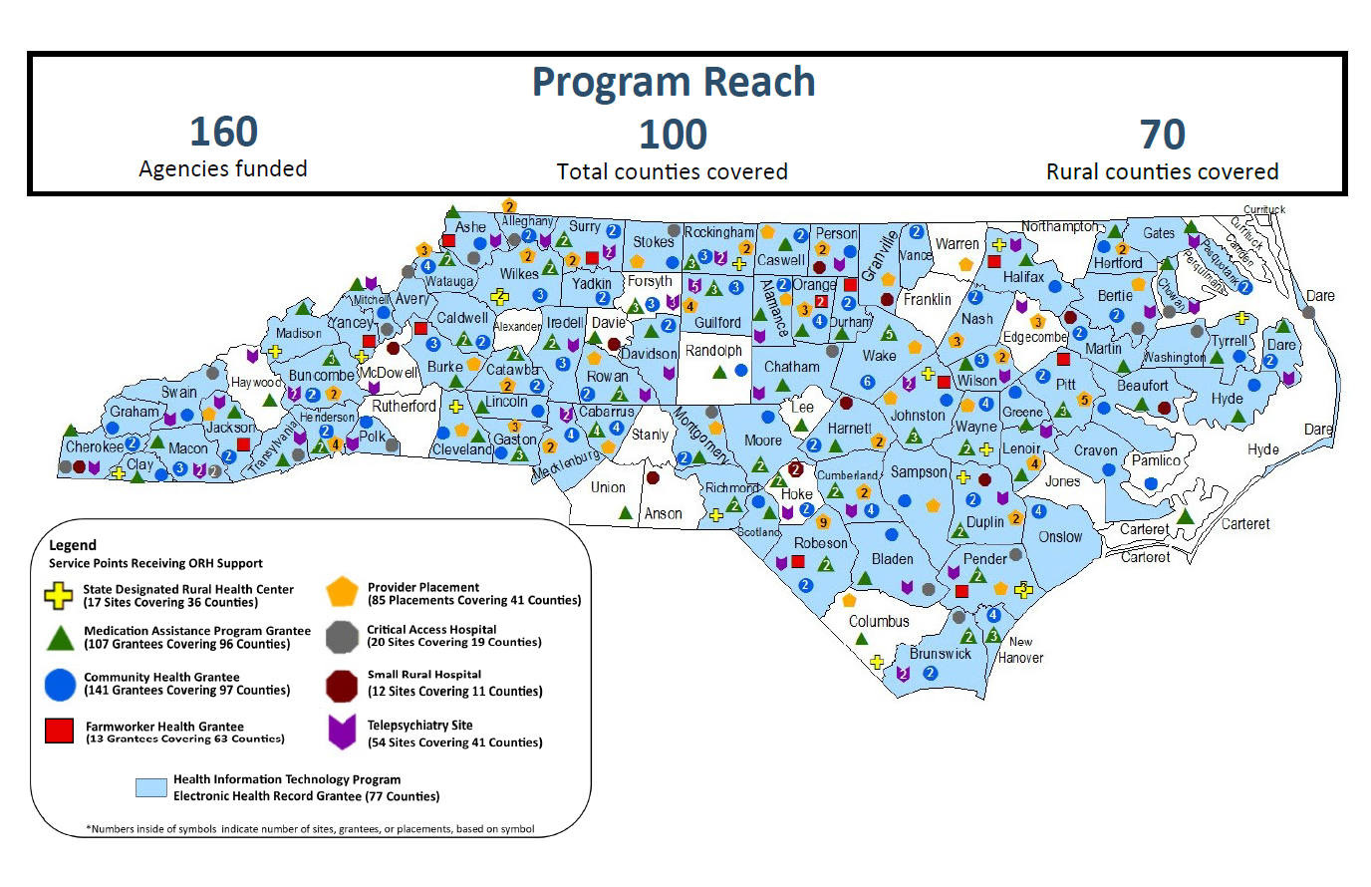

Slide 5
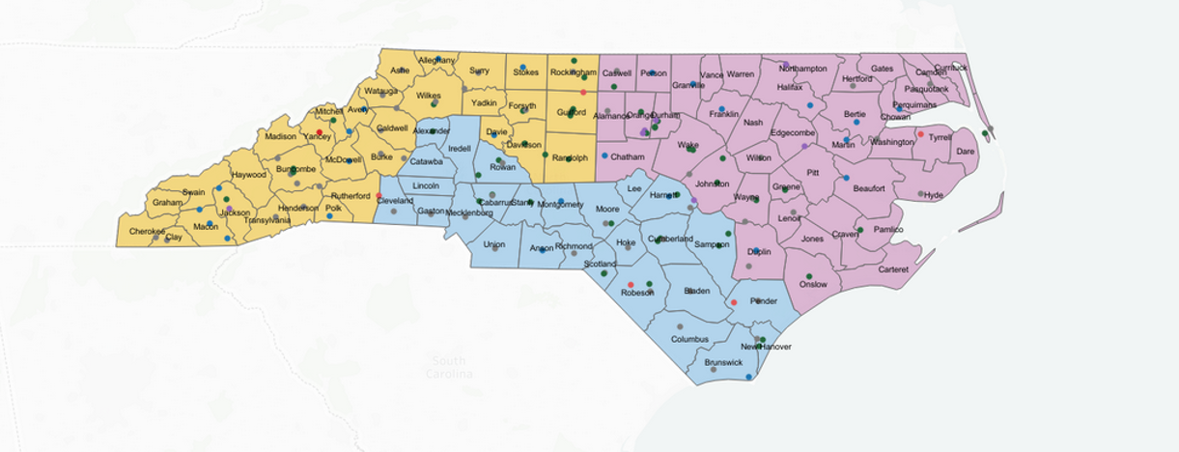
Service Areas for NC ORH

Slide 6
Objectives
-Learn the definition of telehealth
-Discuss the primary modes of telehealth
-Review Medicare/NC Medicaid guidelines for telehealth
-Show examples of telehealth in NC
-Discuss broadband as it relates to telehealth

Slide 7
Does Telehealth = Telemedicine
The Health Resources Services Administration (HRSA) defines telehealth as the use of electronic information and telecommunications technologies to support long-distance clinical health care, patient and professional health-related education, public health and health administration. Technologies include videoconferencing, the internet, store-and-forward imaging, streaming media, and terrestrial and wireless communications.
Telehealth is different from telemedicine because it refers to a broader scope of remote healthcare services than telemedicine

Slide 8
Medicare telehealth definition: real time, interactive video; (simulates face to face encounters)
Social Security Act (1997) limits telehealth to:
MUST be Rural
Originating Sites (11)
Geographic/Facility
Distant Providers (9)
Synchronous two way video

Slide 9
Originating Site (patient location)
An originating site is the location where a Medicare beneficiary/patient
The beneficiary must go to the originating site for the services located in either:
A county outside a Metropolitan Statistical Area (MSA)
A rural Health Professional Shortage Area (HPSA)
https://data.hrsa.gov/tools/medicare/telehealth
*refer to NC Office of Rural Health HPSA scores

Slide 10
Originating Sites (facilities)
Physician and practitioner offices
Hospitals
Critical Access Hospitals (CAHs)
Rural Health Clinics
Federally Qualified Health Centers
Hospital-based or CAH-based Renal Dialysis Centers (including satellites)
Skilled Nursing Facilities (SNFs)
Community Mental Health Centers (CMHCs)
NEW 2019 Sites location exceptions

Slide 11
Site Exceptions (2019 additions)
Beginning January 1, 2019, the originating site geographic conditions and added eligible originating sites for an acute stroke. (does not need to be rural)
CMS does not apply originating site geographic conditions to hospital-based and CAH-based renal dialysis centers, renal dialysis facilities, and beneficiary homes when practitioners furnish monthly home dialysis ESRD-related medical evaluations.
Beginning July 1, 2019, CMS adds an individual’s home as a permissible originating telehealth services site for treatment of a substance use disorder or a co-occurring mental health disorder.

Slide 12
Approved Site Practitioners
Distant site practitioners who can furnish and get payment for covered telehealth services (subject to State law) are:
Physicians
Nurse practitioners (NPs)
Physician assistants (PAs)
Certified nurse-midwives
Clinical nurse specialists (CNSs)
Certified RNAs
Registered dietitians or nutrition professionals

Slide 13
Telehealth Categories

Slide 14
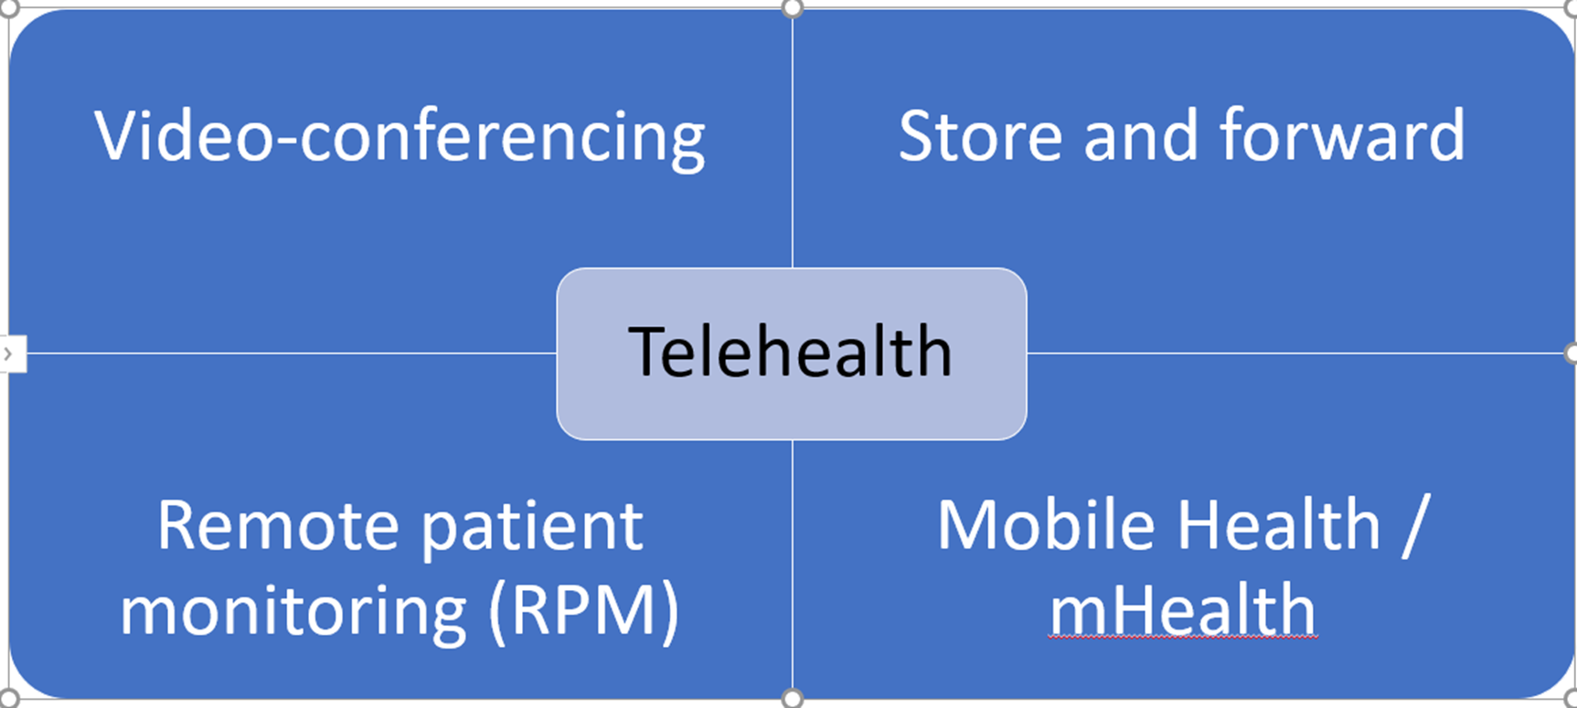
Video Conferencing

Slide 15
Video Conferencing
Many things can get in the way of getting in to see the doctor:
Transportation can be expensive and time-consuming
Inability to get time off from work
Lack of specialty providers, especially in
rural or underserved areas.
Goal: Decrease obstacles to patient access to healthcare

Slide 16
NC State Telepsychiatry Program (NC-STeP)
Program Goal: Address the mental health needs for EDs without access to psychiatric specialties
Session Law
The NC Statewide Telepsychiatry Program (NC-STeP) was developed in response to Session Law 2013-360, directing the Office of Rural Health (ORH) to oversee a statewide telepsychiatry initiative.
Funding – $2 million in recurring state appropriations since 2013
Additional one-time $1.5 million awarded by The Duke Endowment*
*1.8 million in SFY2018*

Slide 17
NC-STeP: Timeline of activities
2013: NC General Assembly creates the NC-STeP Initiative
Patients placed under involuntary commitment are taken to EDs for assessment
25 ED sites
2017: NC General Assembly requests report from NC DHHS on telehealth (recommendations and definitions)
2011: Telepsychiatry program by Albemarle Hospital Foundation shows positive results.
Closing of psych hospitals
Overcrowding of EDs due to mental health patients (weeks LOS)
Shortage of NC psychiatrists and increase mental health needs in NC (Opioid)
2019: NC General Assembly voting on multiple telehealth bills
2014-2016: NC DHHS ORH provides oversight and monitoring with advisory group meetings and performs site visits (50 sites)
2018: NC General Assembly expands NC-STeP to community-based settings
(6 sites 2019)

Slide 18
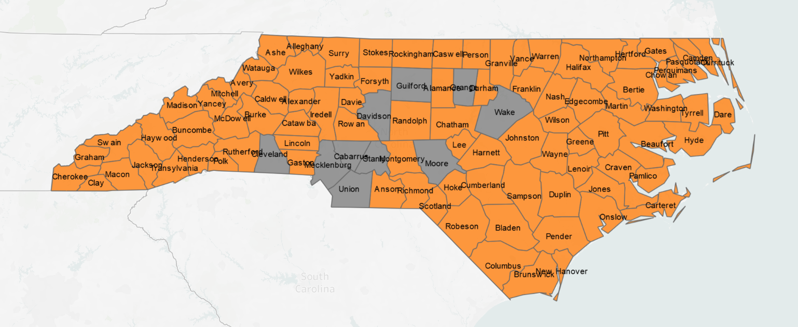
Mental Health Professional Shortage Area (HPSA)

Slide 19
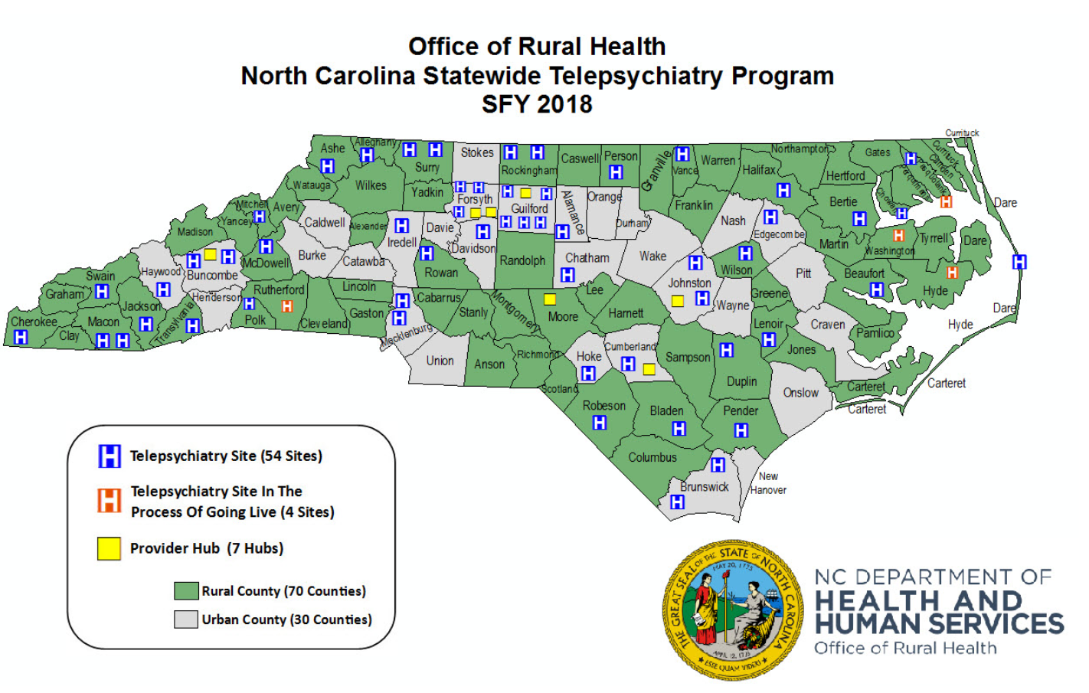

Slide 20
Program Outcomes
The difference between the mean LOS (43.5 hours) and the median LOS (24.6 hours) is due to extreme outliers.
Due to 4,668 overturned IVCs, NC-STeP estimates a cumulative cost savings of $25,207,200 to state psychiatric facilities since 2013
Performance Measure | Baseline (2013) | Target for 2017 | Actual Value as of end of 2018
Reports of Involuntary Commitments (IVCs) admitted to hospitals | 147 per month | 12,264 | 14,434
Number of IVCs Overturned | 42 per month | 3,160 | 4,668
Number of telepsychiatry assessments conducted | 450 per month | 33,950 | 35,534
Average LOS (in hours) for behavioral health patients | Between 48 and 72 | Mean: 43 | Mean: 43.5 Median: 24.6

Slide 21
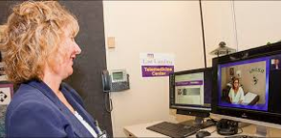
NC-STeP Expansion to Community
Community based (Health Department) sites operating under NC-STeP: Pasquotank, Albemarle, Camden, Hyde, Martin Counties. (Macon county HD June 1)
If you have program questions, please contact: Telepsych@ecu.edu

Slide 22
Store and Forward
In store-and-forward systems, rural providers transmit secure health information to external specialists in order to seek consultations outside of a real-time patient interaction.
A rural provider could send a patient's X-ray images to a specialist through secure channels and receive a diagnosis through email. Some store-and-forward systems are conducted through electronic health records.
Asynchronous

Slide 23
Clinical Information Flow
Source: ReferralMD (https://getreferralmd.com/solutions/e-consults-management/)

Slide 24
Store and Forward Outcomes
“More than 70% of routine specialist referrals can be replaced by store and forward”
Improved Quality: 72% of eConsults improved providers' treatment plans.
Decreased time: Decreased 19 days of wait time for specialty appointments.
Decreased cost of care: Reducing avoidable specialist visits, testing, procedures and ER visits by $370 (average per consult).

Slide 25
Store and Forward reduces wait time
A model for teledermatology services in community health centers.
University of Connecticut School of Medicine, Farmington, Connecticut.
OBJECTIVE: Evaluate the impact of implementing a teledermatology consultation program with dermoscopy on a statewide scale for skin cancer screening for medically underserved populations.
RESULTS: Before implementation of electronic consultations (eConsults), access to dermatology was slow with a median wait time of 77 days. Post implementation, median wait time of 28 days. Ten malignancies were identified via eConsults.
CONCLUSION: eConsults increase access to dermatologic care and reduce wait times for patients receiving medical care at community health centers.

Slide 26
Challenges
Lack of payment models. Payment models for e-consults (store and forward) vary. Those at risk need to be confident that if specialists are paid for consults, face-to-face visits will actually decrease or save time/money. North Carolina does not currently have payment model.(Medicare)
Transitions of care from remote specialists. The transitions between origination and distant sites can be challenging, especially if follow up face to face is needed.
Primary care adoption. Some referring providers will resist change and want their patients to be seen face-to-face. Identifying physician champions who understand the value of electronic consults is essential to the success of the model.

Slide 27
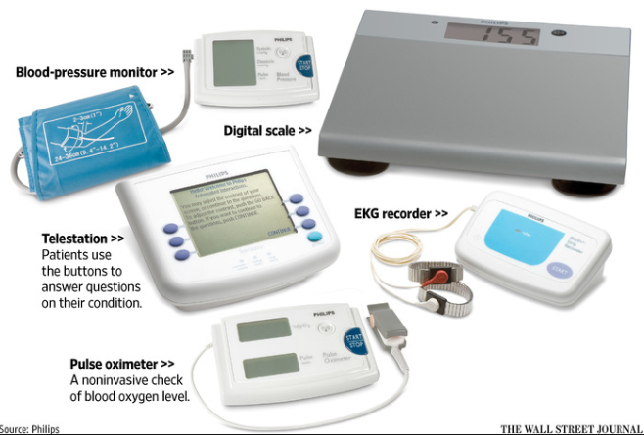
Remote Patient Monitoring (RPM)

Slide 28
Remote Patient Monitoring
Remote patient monitoring (RPM) is a subcategory of telehealth that allows patients to use mobile medical devices and technology to gather health data and send it to healthcare professionals.
Common physiological data that can be collected with RPM programs include: weight, blood pressure and heart rate.
Patient data is sent to a physician by server or software application that can be assessed and analyzed in real time or reviewed upon the next office visit.

Slide 29
Remote Patient Monitoring
Patients with chronic conditions face worse health outcomes, have higher hospital readmission rates, and generally incur higher healthcare expenses.
There are tools currently available that identify data trends, elevate critical data points, and help aggregate, summarize, and visualize health data.

Slide 30
Remote Patient Monitoring of Chronic Conditions
Chronic conditions now account for the most deaths in the nation and take up more than 85 percent of annual healthcare expenditures, according to the CDC.
A report from the Rand Corporation, found that 60 percent of the nation’s adults has at least one chronic condition, and 42 percent have more than one.

Slide 31
mHealth

Slide 32
mHealth
mHealth is an abbreviation for mobile health, a term used for the practice of medicine supported by mobile devices.
The term is most commonly used in reference to using mobile communication devices:
mobile phones
tablet computers
wearable devices such as watches
Over 325,000 mHealth apps available (most are free)

Slide 33
mHealth
Mobile health data exchange could lead to:
Store and forward
Video conference
Remote monitoring information
Medical office visits (data trends)
Emergency room referral
Family notification
(Not typically covered)
some Medicare exceptions

Slide 34
Reimbursement for Telehealth
This Photo by Unknown Author is licensed under CC BY-SA

Slide 35
NC Medicaid Policy
North Carolina Medicaid and NC Health Choice will reimburse for live video telepsychiatry and medical services subject to conditions.
North Carolina Medicaid will reimburse a facility fee to originating site providers, with some restrictions. Some telemedicine and telepsychiatry providers are eligible for reimbursement.

Slide 36
North Carolina Medicaid Requirements
Specific criteria covered by both Medicaid and NCHC Medicaid shall cover Telemedicine and Telepsychiatry services when medically necessary under all of the following conditions:
The beneficiary shall be present at the time of consultation.
The distant site of the service(s) must be of a sufficient distance from the originating site to provide service(s) to a beneficiary who does not have readily available access to such specialty services.
The consultation must take place by two-way real-time interactive audio and video telecommunications system.

Slide 37
North Carolina Medicaid Reimbursement
Specific Criteria Not Covered by both Medicaid and NCHC Medicaid and shall not cover Telemedicine and Telepsychiatry Services for all of the following:
Interactions that DO NOT constitute covered telemedicine or telepsychiatry services including: 1. Telephone conversations 2. Video cell phone interactions 3. E-mail messages 4. Facsimile transmission between a health care provider and a beneficiary.
5. “Store and forward”- Transfer of data from beneficiary visits and consultations from one site to another through the use of a camera or similar devise that records (stores) an image that is sent by telecommunication to another site for consultation.
When the beneficiary is located in a jail, detention center, or prison.
The consulting provider is not a Medicaid or NCHC enrolled provider.
The consultant does not follow established criteria for the service provided.

Slide 38
Medicare telehealth definition: real time, interactive video; (simulates face to face encounters)
Social Security Act (1997) limits telehealth to:
Patient MUST be Rural
Originating Sites (11)
Geographic/Facility
Distant Providers (9)
Synchronous two way video

Slide 39
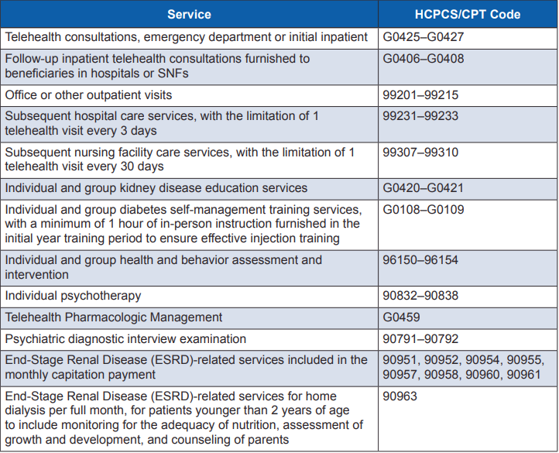
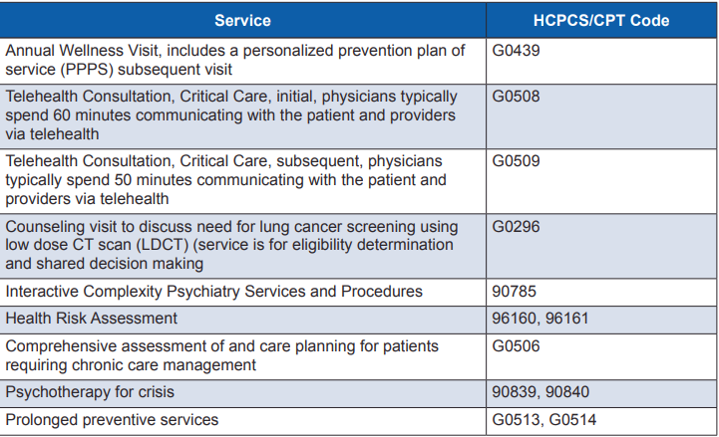
Medicare Reimbursement
TELEHEALTH SERVICES: You must use an interactive audio and video telecommunications system that permits real-time communication between you at the distant site, and the beneficiary at the originating site.
*Not all covered Medicare codes*

Slide 40
CMS Remote patient monitoring (RPM)
New CMS CPT codes added in 2019:
CPT code 99453: “Remote monitoring of physiologic parameter(s) (eg, weight, blood pressure, pulse oximetry, respiratory flow rate), initial; set-up and patient education on use of equipment.”
CPT code 99454: “Remote monitoring of physiologic parameter(s) (eg, weight, blood pressure, pulse oximetry, respiratory flow rate), initial; device(s) supply with daily recording(s) or programmed alert(s) transmission, each 30 days.”
CPT code 99457: “Remote physiologic monitoring treatment management services, 20 minutes or more of clinical staff/physician/other qualified healthcare professional time in a calendar month requiring interactive communication with the patient/caregiver during the month.”

Slide 41
Remote Patient Monitoring (RPM) revenue
Month 1
Set up $21
Devices $69
Services $54
Total $144 PPPM
Month 2+
Devices $69
Services $54
Total $123 PPPM

Slide 42
Medicare Codes
Chronic Care Management (CCM) ; $67/month or $10-20 for contracted services
“CMS connected care” for reference
30 minutes per month
Virtual Care check in (VCC) – G2010 $15/5-10 minutes
Cannot bill if relates to 7 days prior visit
Cannot bill if leads to visit within 24 hours
MD or qualified practitioner
Direct interaction with patient/billing provider
Not telehealth billed – no video interaction with provider/patient

Slide 43
Medicare Codes
Interprofessional Consultation
Originating clinician $34/30 minutes min
Phone, email, HER consults
Distant clinician ($18-73/based on 5-31+ mins)
Verbal follow up maximum $34
Written report up to $73
Remote evaluation of pre-recorded patient information (REPI) – G2012 $13
Store and Forward
MUST follow up within 24 hours (call, text, portal)
Cannot bill if relates to 7 days prior visit

Slide 44
Telehealth in North Carolina

Slide 45
Disclaimer
This presentation includes a few examples of telehealth at work in North Carolina. While the Office of Rural Health cannot endorse any one vendor, or highlight the many that are out there during this presentation, we encourage you to be aware of the valuable resources.

Slide 46
UNC Consultation Center
Carolina Consultation Center
If you are a physician in North Carolina seeking a UNC physician regarding your patient’s care
No charge for NC Providers for specialist care
Carolina Consultation Center’s toll free number at 1-800-862-6264 and be connected.

Slide 47
NC Pediatric Access Line (NC-PAL)
Duke University Psychiatry Department
Provides mental health and telehealth support to pediatric primary care sites
Year 1 pilot 8 counties (2018-2019 Feb)
Year 2 (2019-2020)
Year 3 statewide to 100 counties (2020-2021)
5-year project period
Call Duke for more information: 919-681-2909

Slide 48
Health-e-Schools (Video)
Health-e-Schools is improving access to healthcare for students in Burke, McDowell, Mitchell & Yancey counties in Western North Carolina through the use of telemedicine.
High-definition video-conferencing using specially equipped stethoscopes and cameras so that a centrally located health care provider can examine students at multiple schools without traveling.
Provides chronic disease management, medication management, sports physicals, adolescent medicine consultations, and behavioral health visits in schools.

Slide 49
Store and Forward (eConsults)
Rubicon MD
Arista MD
Community eConsult Network
ReferralMD
Services provided:
-Provide consultation platform for provider to provider communication
-Web based platform/EHR integration
-Same day responses, within 4 to 6 hours
-$250 per provider, per month, unlimited access to specialists (Rubicon, Arista)
-$40 dollars per consult, $.10 per member per month (Community eConsult Network)
*The Office of Rural Health does not endorse one platform over another*

Slide 50
RelyMD (video)
RelyMD was founded by a group of 90 innovative emergency medicine physicians in NC to deliver more convenient, efficient, and cost-effective care.
Connecting via mHealth (phone application)
Delivering 24/7 Health Care Access
RelyMD hospitals address unscheduled care needs with an easy to implement virtual medicine solution
Average wait time to see a provider is fewer than 10 minutes.

Slide 51
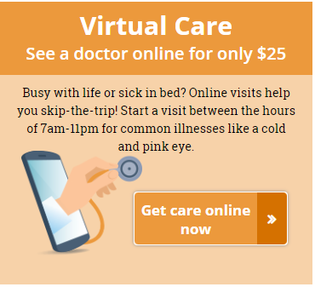
Mission/HCA Virtual Care (mHealth)
You can use Mission Virtual Clinic for the following conditions:
Cold, flu and allergies
Sinus infection or sore throat
Influenza (flu)
Influenza prevention
Female health
Urinary tract infection (UTI)
Vaginal yeast infection
Minor eye conditions
Pink eye (conjunctivitis)
Skin conditions
Canker or cold sore
Eczema and dermatitis
1 hour response time

Slide 52
Vidant (mHealth)
Vidant Health
VidantNow, allows any resident in North Carolina access to a licensed physician for urgent, but non-emergency medical issues 24/7 through their smartphone or computer.

Slide 53
Broadband for Telehealth

Slide 54
Challenges
Definition (changing)
Speed for video conferencing
Coverage for patients/providers

Slide 55
Broadband Technical Specifications
Measured in Megabits per second (Mbs): speed at which data (images or video) arrive from the internet to your device
Download speed: speed of getting data from the internet to your device
Upload speed: speed at which you can send data to a user

Slide 60
Starting Telehealth Programs
Call NC Office of Rural Health (telehealth specialists)
Start small (eConsults)
High speed broadband (ORH/DIT/BIO)
Telehealth providers with online video conferencing
Video conference with HIPPA complaint applications
Funding/Program Ideas:
HRSA telehealth resource center (Mid Atlantic Charlottesville, VA)
Secure grant funds from private, state or federal sources (USDA, HRSA, ARC, ORH)
Collaborate with hospital/ACO and other providers on telehealth
Ask county government to support telehealth

Slide 61
Nick Galvez, Rural Hospital Manager
Nick.Galvez@dhhs.nc.gov
919-527-6467
https://www.ncdhhs.gov/divisions/office-rural-health/office-rural-health-programs/north-carolina-rural-hospital-program
North Carolina Department of Health and Human Services Website
North Carolina Office of Rural Health Website

