Slide 1

NC Department of Health and Human Services
Refugee Information System Client Information Training
Kimberly Saunders
Refugee Program Consultant
Winter 2025
Notes:
Welcome to RIS Client Information Training

Slide 2
RIS Client Information Topics
  Locate the Refugee Information Screen
  Search within the Refugee Information Screen
  How to Add a New Client
    Refugee List Screen
    Refugee Detail Screen
    Uploading

Slide 3
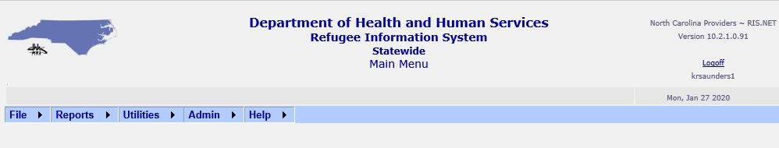
Locate Refugee Information Screen
Main Menu
  File
  Reports
  Utilities
  Admin
  Help

Slide 4
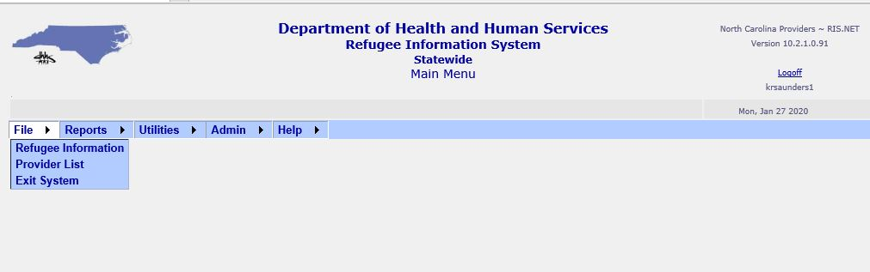
File Drop Down Menu
Refugee Information
Provider List
Exit System

Slide 5
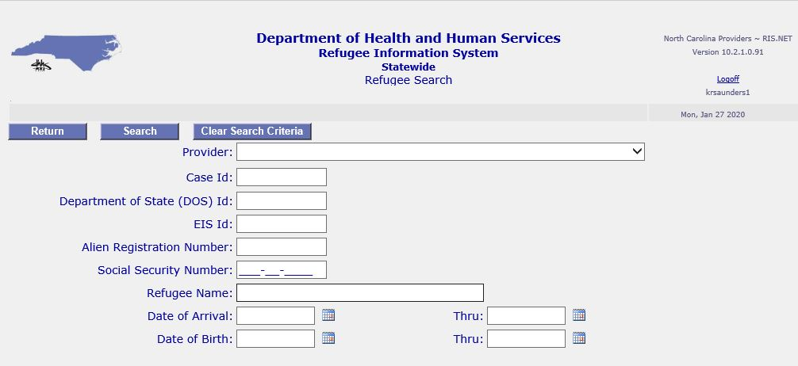
RIS: Refugee Information
Refugee Search Screen

Slide 6
RIS: Client Search Criteria
DOS ID: Department of State (DOS) ID Number
EIS ID: Employee Information System ID Number
Alien Registration Number: Alien Number
Refugee Name: Last, First
(For best results enter only one name or last name, first letter of first name)
Date of Arrival (Thru): Can enter in both fields or just first one
Date of Birth (Thru): Can enter in both fields or just first one
* If you are having difficulty finding a client in RIS, expand your search by adding a % sign to either the beginning or the end of the number or name you are entering.

Slide 7
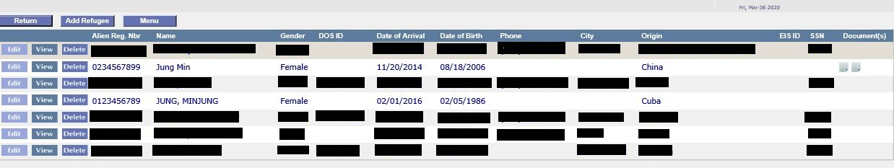
RIS: Client Search Results
Important Buttons on Refugee Search Screen
Edit: Add services, or change client information
View: View client information only
Delete: Delete Client
Add New Refugee Button
Notes:
When entering client(s) name into the search feature, remember, similar names will populate as on the slide. When adding client(s), use the Add Refugee button. You will have the option to edit, view, or delete information

Slide 8
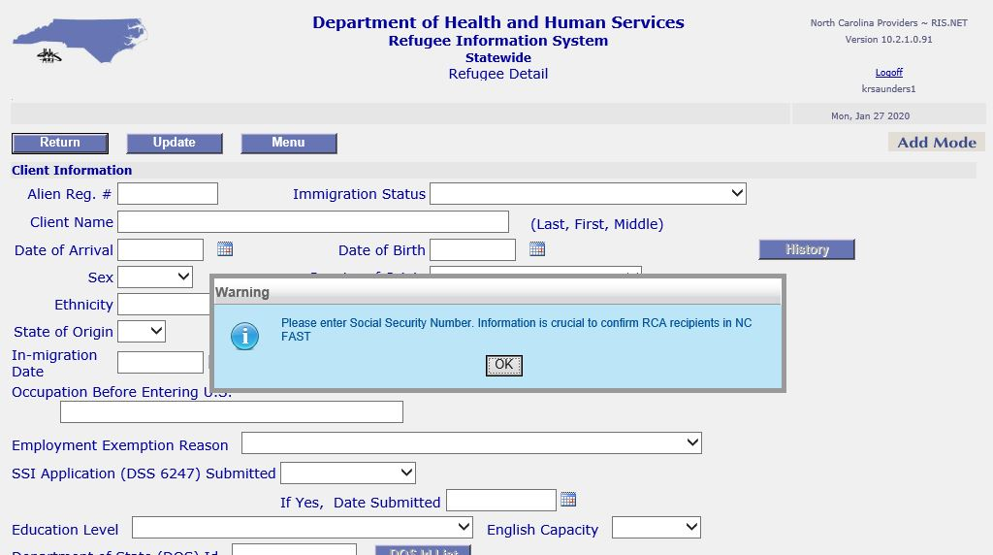
RIS: Adding New Clients
  When you click “Add Refugee” in the Search screen
    A warning box will appear asking for a SS#
    Add SS# if one has been assigned

Slide 9
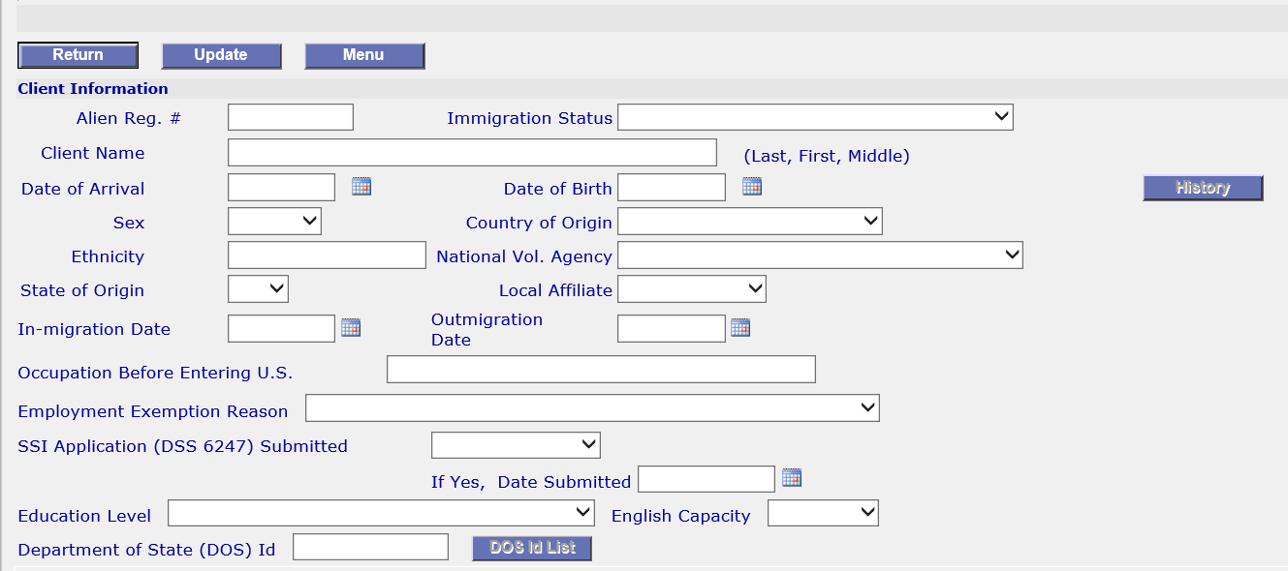
RIS: Adding New Clients
Client Information Section

Slide 10
RIS: Adding New Clients
Enter ALL Client Information in Your Possession
  It is extremely important for reporting & funding
  New client information should be entered within two weeks of arrival or ASAP
  Items in the following slides noted with a * MUST be input

Slide 11
RIS: Adding New Clients
Alien Reg #: Number should be 8-9 digits *
Immigration Status: Status on paperwork *
Client Name: SURNAME/FAMILY NAME/LAST NAME First Name Middle Name *
  Surname/Family name/Last name all CAPITAL LETTERS
  First Name (if present) Middle Name all lower case letters
  NO commas
  Examples:
    SURNAME First Name: BOROWY Rachael
    Two SURNAME/FAMILY NAME/LAST NAMES: CORTEZ SAUNDERS Kimberly Renee

Slide 12
Date of Arrival: Date client arrived in the U.S., not date the client arrived in the provider’s area *
Sex: “Male” or “Female” *
Country of Origin: Native country (country from where client fled persecution)*
  Childs’ Country of Origin should be same as parents even if they were born outside the parents’ native country.

Slide 13
RIS: Adding New Clients
Ethnicity: Clients ethnic group
National Vol Agency: The National Voluntary Agency that sponsored initial resettlement in the U.S.
History (Button): Displays history of changes/additions made to client information.
State of Origin: 1st state the client entered upon resettlement in the U.S. If this is a secondary migration you must add the state the client initially resettled in
Notes:
Continue adding all relevant information to client demographics. The History button will display information regarding who created and edited the file.

Slide 14
RIS: Adding New Clients
Local Affiliate: The local resettlement agency that provided Reception & Placement Services
In-migration Date: Date the client came into the state (must be entered for secondary migrants)
Outmigration Date: Date the client left the state (if known)
Occupation Before Entering US: Job the client had before entering the United States

Slide 15
RIS: Adding New Clients
Employment Exemption Reason: To be used if client is exempt from employment
SSI Application Submitted: Yes or No.
  If Yes, include date in the next box.
Education Level: Choose from dropdown *
English Capacity: Choose from dropdown *
Department of State (DOS) Id: Overseas Case Number assigned by the U.S. DOS *
  IF agency does not have it, use this structure: The first three letters of the client’s immigration status and the A# of the principal applicant. EX: REF123456789.
DOS Id List (Button): Lists everyone in case

Slide 16
RIS: Adding New Clients-Uploading
Immigration documents to prove eligibility for ORR programs MUST be uploaded
When appropriate also upload
  DSS 6247
  DSS 8108
  DSS 8110

Slide 17



RIS: Adding New Clients-Uploading
How to Upload:
  1. Click Browse and select document to upload
  2. Click Upload Document Icon
    Square with circle at bottom right
Notes:
Upload: Directly under the Client Information section you will see a space to upload documents. Use the instructions in this slide to upload information in your possession on the client.

Slide 18
RIS: Adding New Clients-Uploading
  Uploading Tips
  If the wrong document is uploaded, you can upload another document to replace (override) it
  If you have a newer version of a document, you can override what is currently there with the new version.

Slide 19
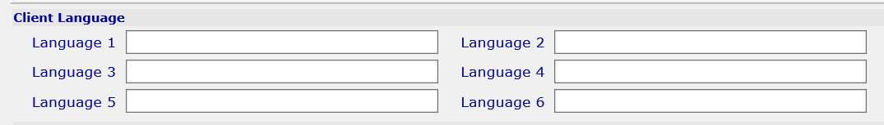
RIS: Adding New Clients-Language
Language
  Language 1: Preferred language MUST be entered
  Language 2: Second most fluently spoken language with the most interpreters available
  Language 3: To be used if a third language is spoken by the client with which you will be providing services

Slide 20
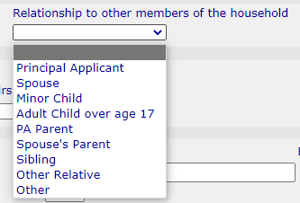
RIS: Adding New Clients-Household
The following MUST be entered
Case Size: Number of Adults & Children
Relationship to members of household: Parent, child, spouse

Slide 21
RIS: Adding New Clients-Sponsor
Sponsor: Entity that sponsored/co-sponsored the client's initial resettlement in the U.S.

Slide 22
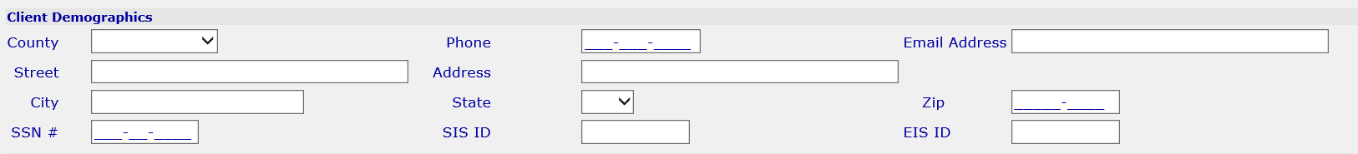
RIS: Adding New Clients-Demographics
County, City, State, and Zip Code MUST be entered
Update if a client moves within the state
Enter Landlord information if applicable

Slide 23
RIS: Adding New Clients-Health Screening
Health Screenings Should Always Be Entered
  Date: Scheduled (or rescheduled) Date of First Visit with Health Department
  Agency: Agency Conducting Screening
    Health Department
    Managed Care Provider
    Other
    Private Practice Physician

Slide 24
RIS: Administrator Changes
The following can only be changed by a Statewide Administrator of RIS
  Alien Registration #
  Client Name
  Date of Arrival
  Date of Birth

Slide 25
RIS: Next Steps
Additional Trainings are Available
RIS Overview Training
RIS New Client Entry Training
RIS Provider Entry Training
RIS Reports Training
Notes:
Thank you for your participation and cooperation during this session. This concludes the Refugee Information System (RIS) Client Training!

