Slide 1
An Update From Your Community Hospital
What you need to know about us

Slide 2
Community Presentation
Purpose and goal
Overview of the hospital
  System affiliation
  Services provided
  Providers
Community events
  Screenings
  Health Fairs
Partnerships
Challenges
Notes:
Purpose and goal – educate the community on the hospital.

Slide 3
Audience
Held onsite or at organization
  Around 1 hour
Partner with Foundation
  Promote volunteer program
Refreshments provided
Facility tour offered

Slide 4
Audience
Civic clubs
Local government
Faith based organizations
Local businesses
  Bankers
  Attorneys
  Real Estate
  Education
The ask

Slide 5
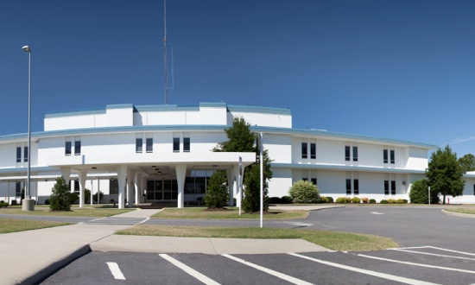
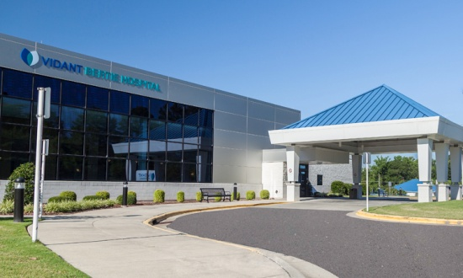
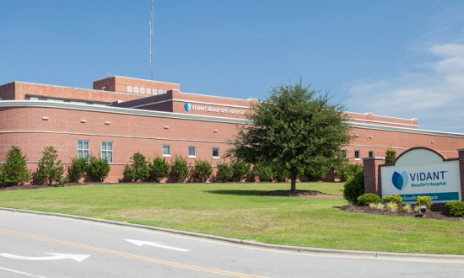
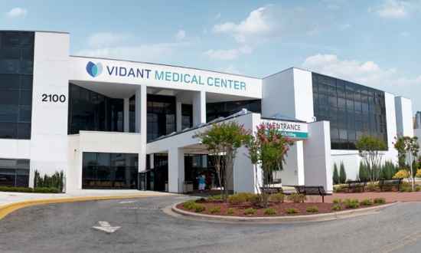
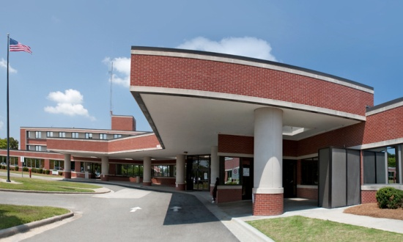
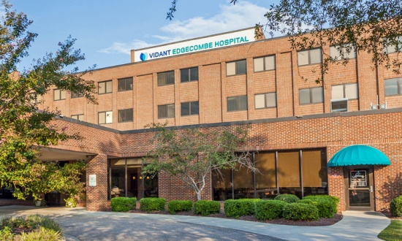
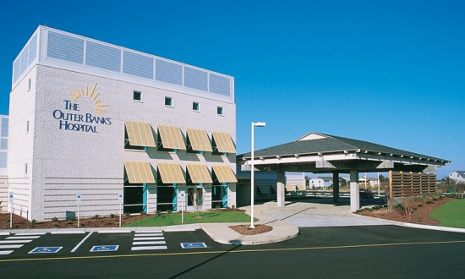
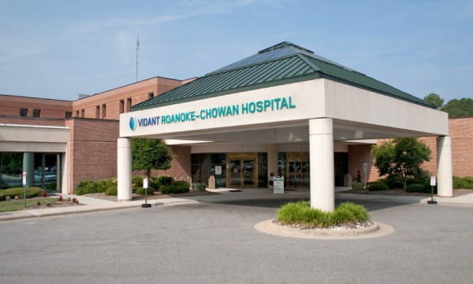
Vidant Health hospitals
A system of care at work for you
CHOWAN
BERTIE
BEAUFORT
MEDICAL CENTER
DUPLIN
EDGECOMBE
OUTER BANKS
ROANOKE-CHOWAN
Vidant Health is more than 12,000 employees, hundreds of physicians and eight hospitals serving eastern North Carolina. Halifax will join Vidant next month.
Notes:
Vidant Health is more than 12,000 employees, hundreds of physicians and eight hospitals serving eastern North Carolina.

Slide 6
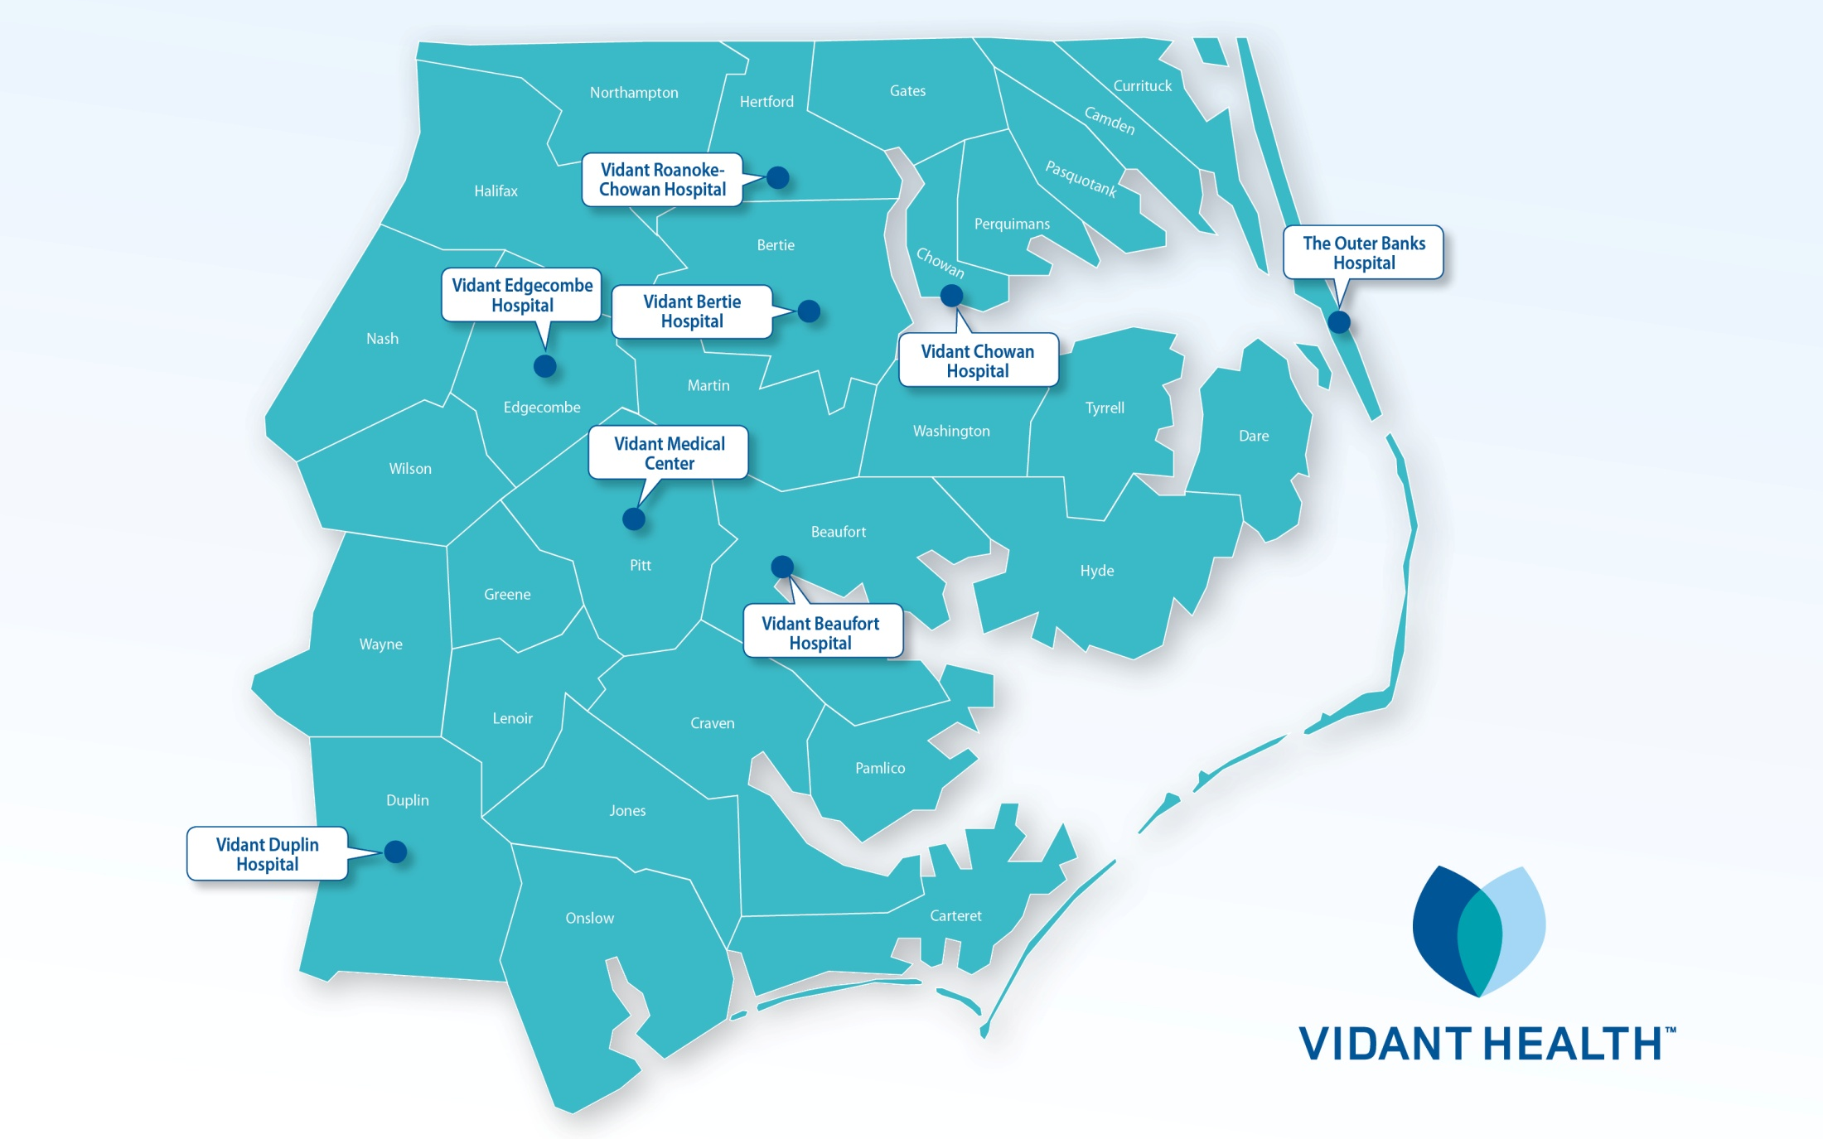
Vidant Health hospitals

Slide 7
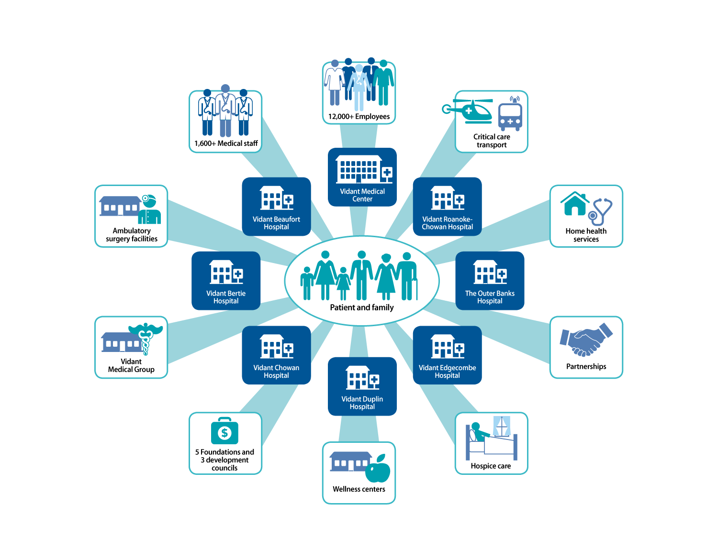
Vidant Health Services

Slide 8

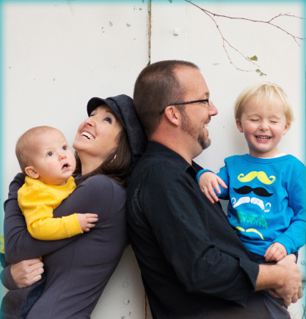
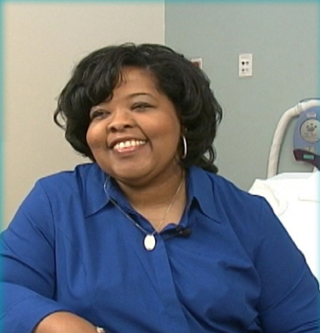
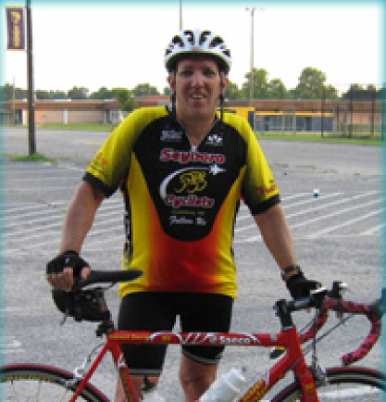



About Vidant Health
A system built to serve 1.4 million residents of eastern North Carolina, providing best-in-region access, exceptional experience and optimal outcomes.
Best-in-region access
Exceptional experience
Optimal outcomes

Slide 9
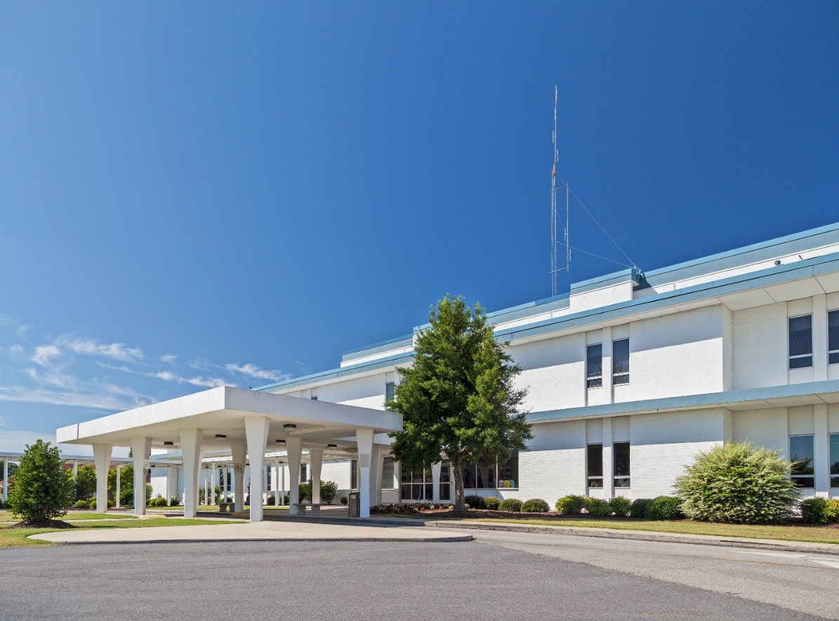

Service Area
Chowan
Perquimans
Washington
Tyrrell
Serving the community for over 70 years!

Slide 10
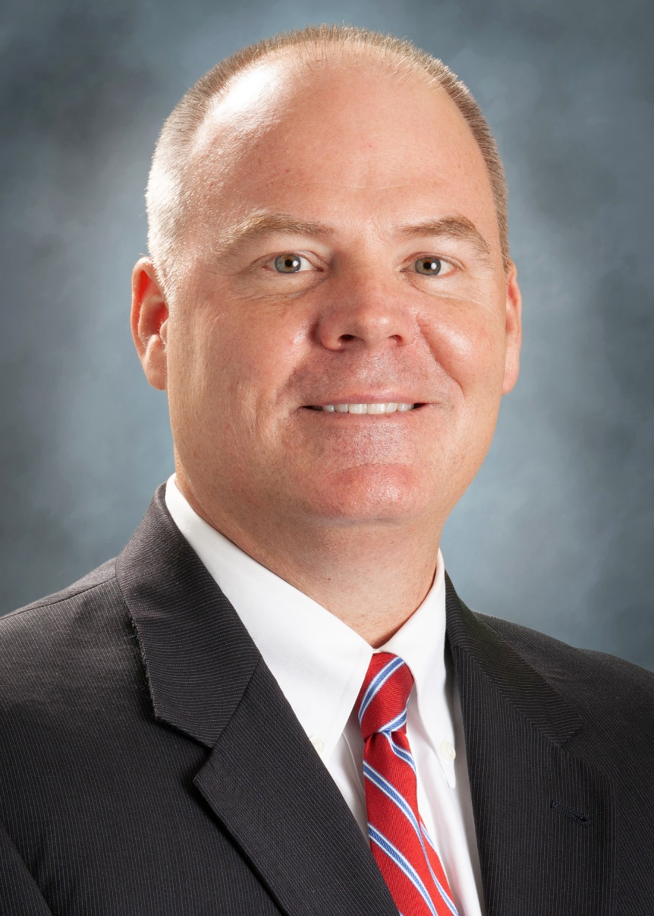
Vidant Chowan President – Brian Harvill
Masters in Business Administration from Queens University in 2000
Certified Public Accountant License in 1998
Bachelor of Science in Accounting Clemson University in 1993
Joined Vidant Chowan and Vidant Bertie Hospitals in 2011 as Vice President of Financial Services
Named Vice President of Finance and Operations of Vidant Chowan and Vidant Bertie in 2017
Appointed President of Vidant Chowan and Vidant Bertie in June 2018
Former Director of Corporate Accounting for Atrium Health (formerly Carolinas HealthCare System)
Member of the Chowan Hospital Foundation Board, the Vidant Bertie Hospital Development Council Board, American Institute of Certified Public Accountants, American College of Healthcare Executives and Past President of the Edenton Lions Club.
Serves as Chair of the NCHA District VI, Vice Chair for the Edenton Chowan Partnership Board, and Past President of the Edenton Chowan Chamber of Commerce.
Notes:
10
10
10

Slide 11

Our mission
To improve the health and well-being of eastern North Carolina

Slide 12
Our vision
To become the national model for rural health and wellness by creating a premier, trusted health care delivery and education system

Slide 13
Our values
Integrity
Compassion
Education
Accountability
Safety
Teamwork

Slide 14
Key data | Vidant Chowan Hospital
16,473
ED visits
22,880
outpatient visits
302
babies born
1,696
surgeries
1,792
admissions
FY 2018
331
employees
276
total credentialed providers
$3,239,018
total community benefit

Slide 15
Finance: Community Benefit
Estimated Community Benefit
Fiscal Year 2018 = $3,239,018
*Includes bad debts, charity, non reimbursed cost of Medicaid and Medicare and community benefit programs and services
Vidant Health has nearly 12,000 employees
Salaries and wages Fiscal Year 2018 = $963,791,000
Vidant Chowan Hospital has over 325 employees
Salaries and wages Fiscal Year 2018 = $21,348,801
Capital Funds Reinvested in Vidant Chowan Hospital
Fiscal Year 2018 = $1,709,508
Utilities Expense (Electrical, Water and Sewer) Last Year at
Vidant Chowan = $675,910

Slide 16

Economic Impact
Hospitals and health systems directly and indirectly support nearly 400,000 jobs across our state, almost 8.7% of total employment.
Every job created in a hospital or health system creates 2.44 jobs for the community.
Health systems are among the top 10 employers in at least 72 of North Carolina’s 100 counties.
Hospitals and health systems are responsible for at least 6% of wages earned in our state and contribute 4% of the state’s gross domestic product (GDP).
* North Carolina Healthcare Association

Slide 17
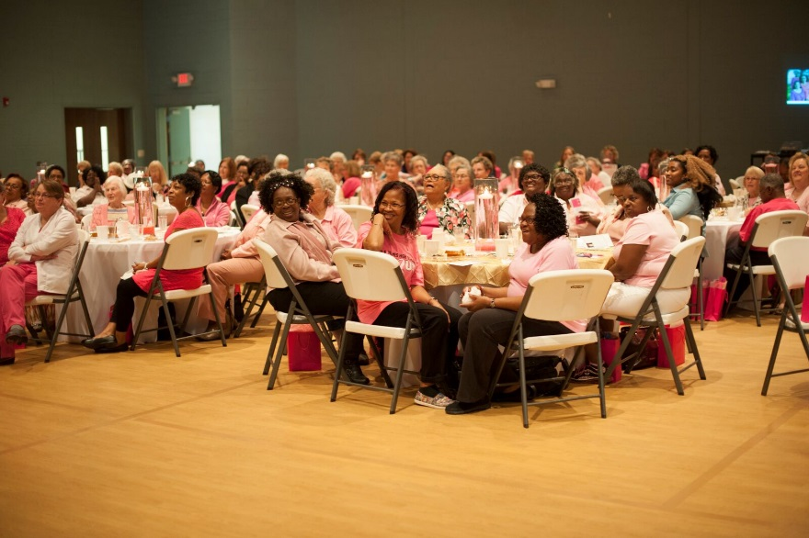
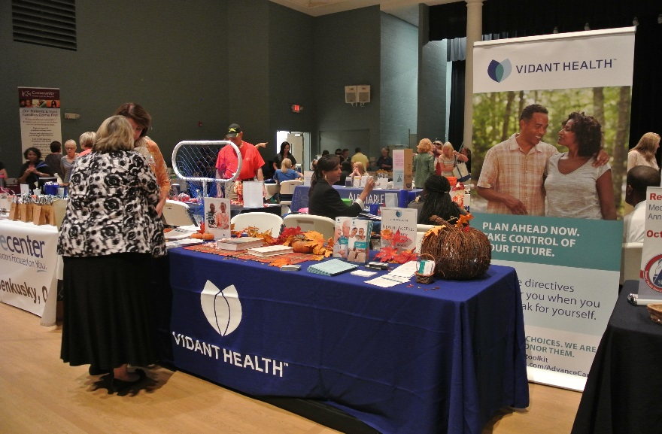
Serving our community!
Community Health Improvement Activities:
Breast Cancer Awareness Luncheon
Women’s Heart Truth Luncheon
Men’s Health Dinner
Chowan & Perquimans Health Fairs
Diabetes Education
Health Screenings
Prostate Screenings
Flu Shot Clinics
Cancer Support Group
Teddy Bear Fairs
Three Rivers Healthy Carolinians

Slide 18
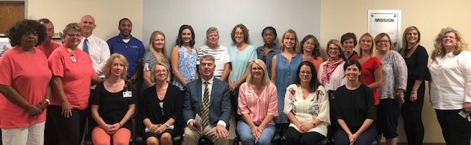
Community Benefit Grants
Chowan Hospital Foundation & Vidant Health Foundation annually partner to provide the Community Benefit Grants Program. Its goal is to enhance & improve the health status of northeastern North Carolina by encouraging residents to be more proactive in their individual healthcare.
Since 2007, over $1 million dollars have been awarded to non-profit organizations in Chowan, Perquimans, Washington & Tyrrell Counties to support programs focusing on physical activity & nutrition, access to care, & chronic disease management & prevention.
Organizations include local schools, regional health departments, local food banks, faith-based organizations, farmer’s markets, & county extension programs.
We are very appreciative to Vidant Health for providing this opportunity for all of us.
2018-2019 Community Benefit Grant recipients

Slide 19
Challenges impacting our community hospital

Slide 20

Recruitment
Providers
  Physicians
  Physician Assistants
Hard to fill positions
  Registered Nurses
  Rehabilitation
Must be creative and use unique strategies to meet patient needs
  Wound provider
  Provider/staffing model with shared hospitals

Slide 21

Environment-Threats
National and regional issues impacting us locally
  NC State Health Plan
  2 Midnight Rule
  96 Hour Rule
  Declining reimbursement
  CON Laws
  Tax Exempt Status
  Increased competition
  CAH Designation
Notes:
Donnie Lambeth, representative in NC house, referenced the importance of VH leadership talking to legislators about issues and how it impacts us.
Reference local issues – lower cost competitors
2 midnight rule – patients have to stay at least two midnights to be considered inpatient. If not, they are considered “observation” patients and we are reimbursed less
96 hour rule – has been in effect for some time but not enforced. This will likely change this year. Patients can stay no longer than 96 hours in critical access hospitals.
Declining Reimbursement – discussion on decreasing reimbursements
CON Laws – possibility of eliminating Certificate of Need
Tax Exempt Status – VH is a non-profit organization and invests its “profits” in capital projects and meeting community needs as outlined in our mission statement
Increased competition – Albemarle to Sentara, Nash to UNC, Wilson to Novant
CAH Designation – currently paid cost plus 1% for Medicare only. Discussion of eliminating CAH designation. Studies have shown that CAH provides higher quality care at a lower cost.
NC Health Plan proposed cuts – Recently, the State Treasurer has made a series of remarks regarding the State Health Plan, as he reviews options for covering the cost of health insurance for state employees. His solution would be to enforce massive cuts – to the tune of $400 million – to health systems and hospitals across North Carolina. The State Treasurer’s latest proposal—which could potentially mean a $40 million reduction in reimbursement for Vidant—would be detrimental to the health and well-being of the citizens of eastern North Carolina. It would hinder Vidant’s efforts to:
Provide services the people of this region depend on. Hardest hit would be our OB services. That means women may have to travel an hour or more to deliver a baby—or they may opt to deliver their babies at home, which brings with it enormous risk.
Offer high quality, accessible care.
Recruit and retain top talent.
It’s important to note that as a not-for-profit organization, we reinvest our profits back into the system, which ultimately benefits the communities we serve.

Slide 22
Payor Mix
 | National | VBER/VCHO (9/30/18)
Medicare | 47.3% | 58.7% | 53.3%
Medicaid | 15.5% | 12.5% | 14.8%
 | 62.8% | 71.3% | 68.1%
Notes:
Medicare is where the CAH status is derived, the cost plus 1%, etc.
Shows we are “worse” than national average when it comes to treating medicare patients – and our hospitals would be impacted greater if the designation goes away.

Slide 23
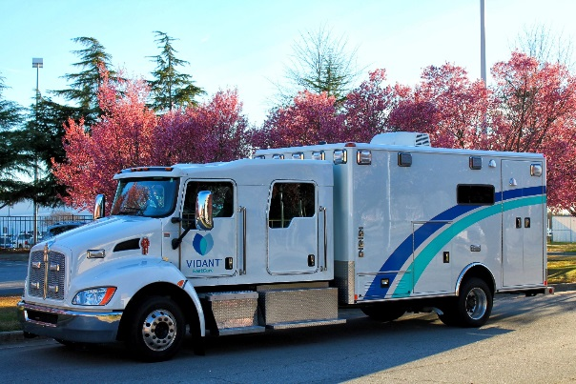
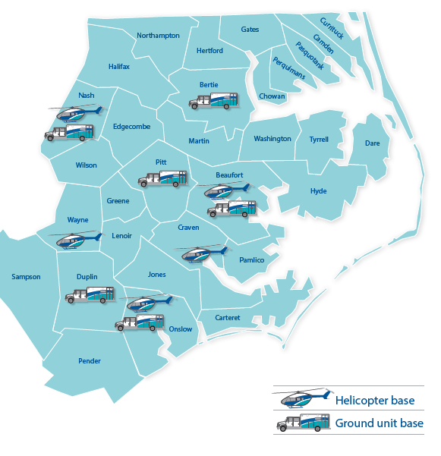
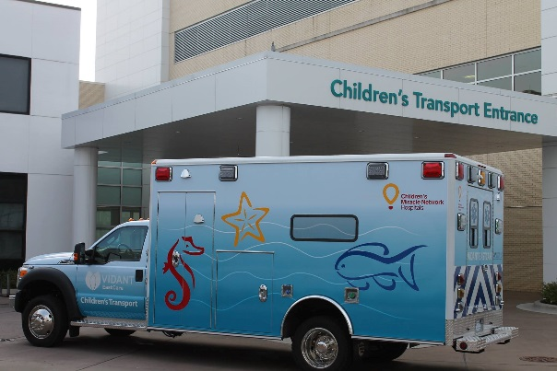
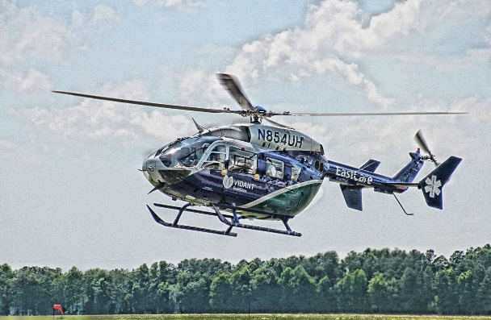
Vidant EastCare
24 Ambulances
Children’s Transport Team
6 Helicopters
Notes:
Vidant EastCare has 6 helicopters positioned at 5 bases, with a 6th helicopter as a dedicated spare. Current base locations are in Washington, Elm City, New Bern, Richlands, Mount Olive. The spare helicopter generally resides in Washington when not in use. All EastCare helicopters carry Packed Red Blood Cells AND Fresh (Never frozen) plasma for anyone who needs it. EastCare was the first flight service in NC to carry both, and helps to improve patient outcomes and decrease the length of stay at trauma centers. Based on information received from The Joint Commission, EastCare flies more stroke patients than any other flight program in the nation. Also the national average of flight time per airframe is 300 hours, EastCare averages between 1,100 and 1,200 flight hours PER helicopter. So, the EastCare team is flying about 4 times the national average.
EastCare has 6 ground bases (most are co-located with air bases) with a total of 8 trucks on shift during peak times. These trucks travel about 900,000 miles per year. Additionally, these ground crews are utilized to transport ECMO patients (Heart Lung By-pass machine). This crew will generally go to a referring hospital with a profusionsist and a cardiac surgeon to place the ECMO, then bring the patient back to Vidant.

Slide 24
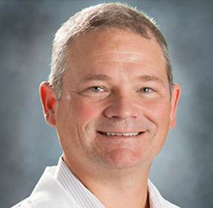
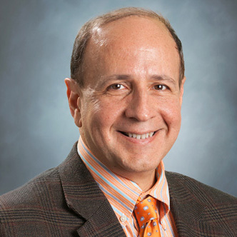
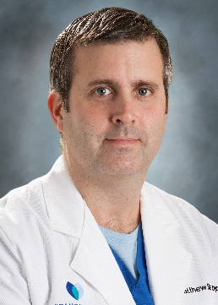
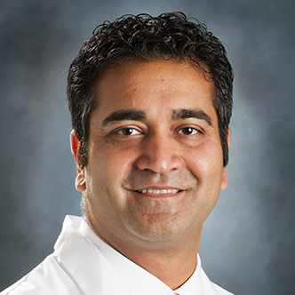
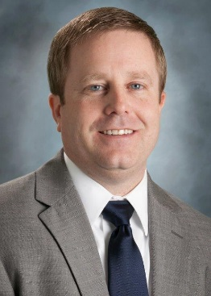
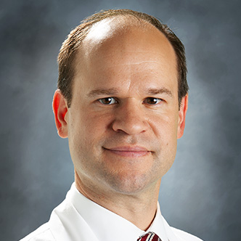
Recruitment of New Providers
Family Medicine
Bracey Robertson, MD
Neurosurgery
Keith Tucci, MD
Hospitalist
Matthew Rapp, MD
Cardiology
Sachin Logani, MD
Christopher Gregory, MD
Christopher Karkut, MD

Slide 25
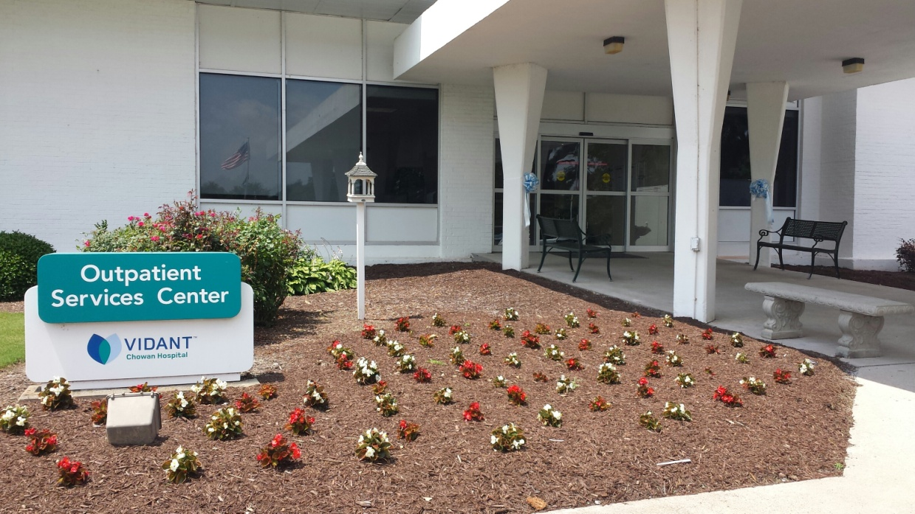
Outpatient Services Center
Specialty Clinic
    Cardiology
    Electromyography
    Gastroenterology
    Nephrology
    Neurology
    Oncology
    Orthopedics
    Pain Management
    Wound Care
Rehabilitation Services
  Occupational therapy
  Physical therapy
  Speech therapy
  Pediatric program
  Lymphedema therapy

Slide 26
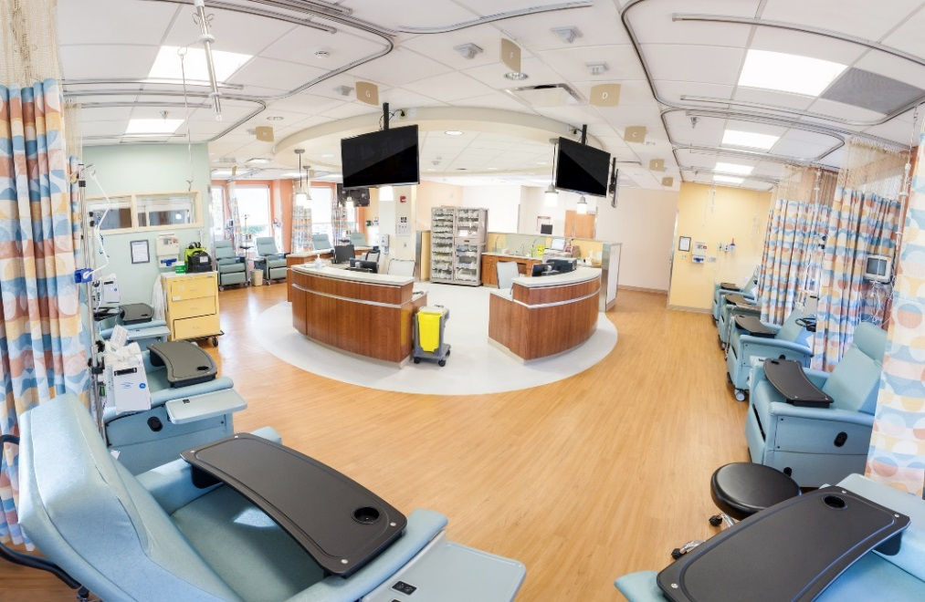

Outpatient Services Center
Pediatric Rehabilitation Gym
Expanded Chemotherapy Suite

Slide 27
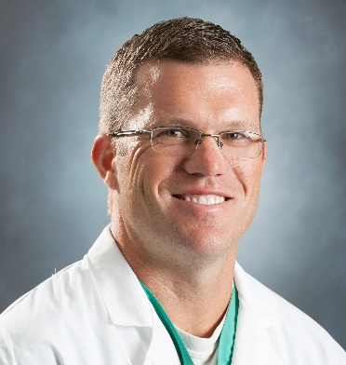
Wound Clinic
We are pleased to offer a Wound Clinic at Vidant Chowan Hospital, directed by Dr. Brandon Eppihimer, a certified wound care specialist.
  Many people experience chronic wounds caused by diabetes, infection, injury or burns that can last for months.
  Our doctors, nurses and technicians are dedicated to healing chronic wounds using the latest treatment options.
  Dr. Brandon Eppihimer

Slide 28
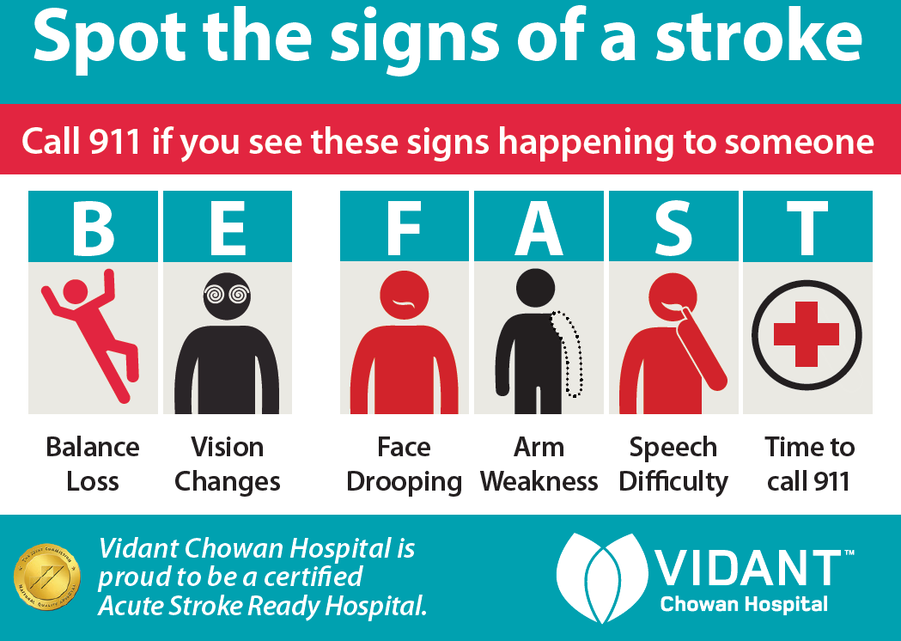
Acute Stroke Ready Certification
Vidant Bertie and Vidant Chowan Hospitals are nationally certified as Acute Stroke Ready Hospitals by The Joint Commission, The American Heart Association and The American Stroke Association. Certification was granted after a rigorous onsite review on November 16, 2018 (VCHO), and December 7, 2018 (VBER).

Slide 29
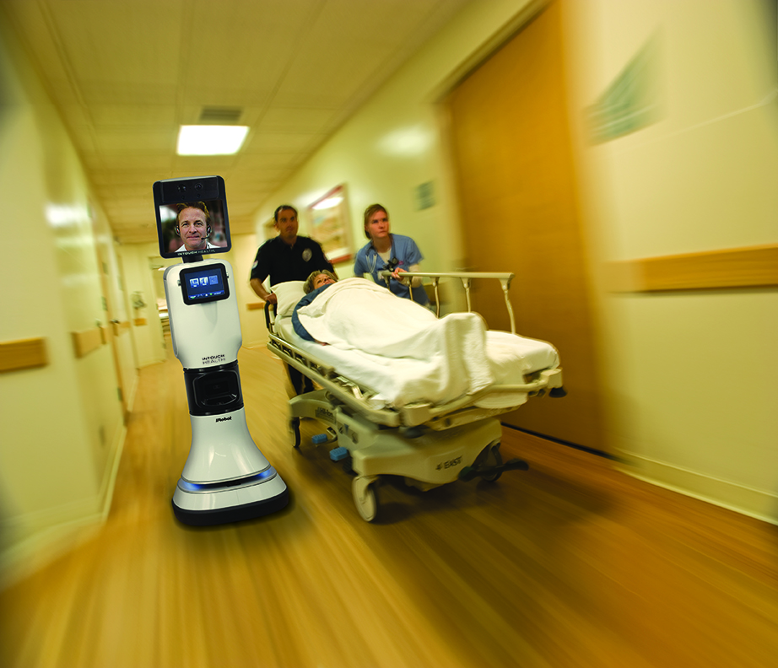
Telestroke
If you or someone you know has a stroke, faster care can mean a better outcome. That’s why Vidant Health is partnering with the Wake Forest Baptist Telestroke Network, giving our community quicker, round-the-clock evaluation and treatment of stroke symptoms.
How it works
Upon the arrival of a stroke patient to our facility, Vidant Chowan Hospital’s ER physician and the patient will communicate through this robot with a Wake Forest Baptist stroke specialist who can view the patient’s symptoms and discuss them with our ER physician and the patient. Our ER physician and the Wake Forest Baptist stroke specialist can then develop a treatment plan for the patient.
1-877-WF-4-STROKE
(1-877-934-7876)

Slide 30
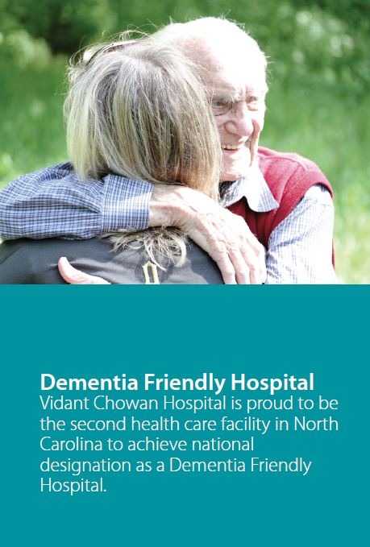
Dementia Friendly
Notes:
For our patients living with
dementia and those families
caring for them, we promise to:
• Apply principles of person-centered care to our
practices, processes and protocols
• Assure that all hospital team members and
volunteers are equipped with dementia
awareness and education through role-specific
training
• Sustain our culture of supportive options
focusing on the brain capacity that is preserved
rather than what is lost
• Partner with community groups to create a
collective impact on transforming attitudes
toward dementia
The purple angel
The purple angel symbol was originally developed
in the United Kingdom and quickly became an
internationally accepted symbol for dementia
awareness. It is now being widely used in hospitals,
businesses, restaurants and communities in the
United States as an identifier for being Dementia
Friendly.

Slide 31
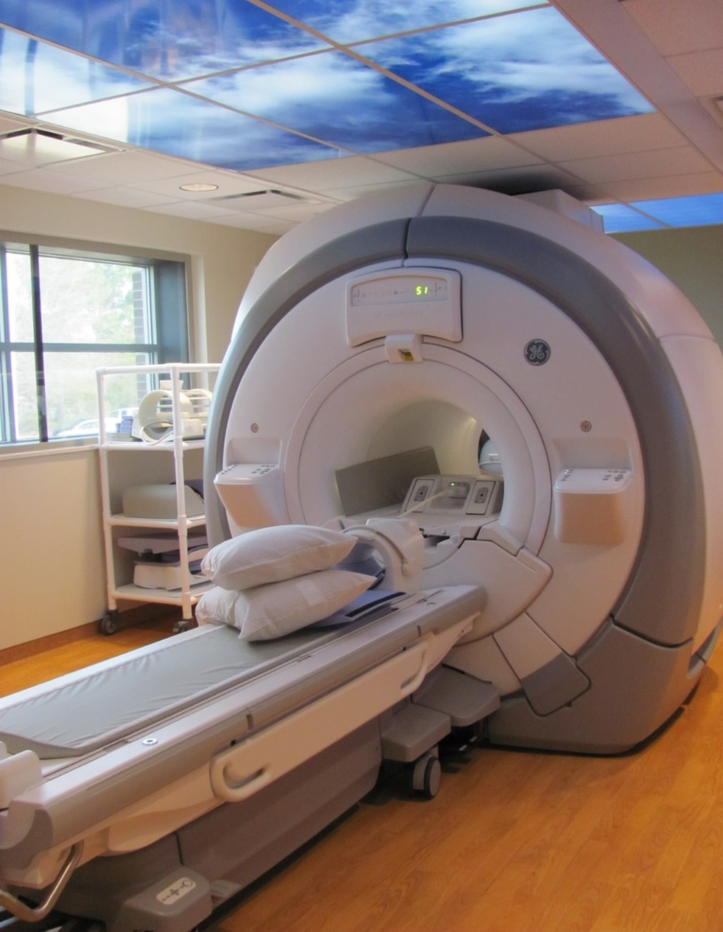
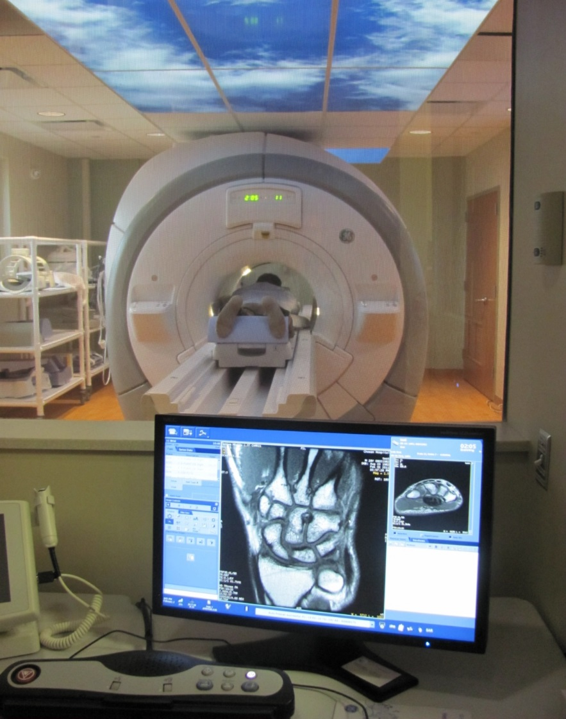
Open Bore MRI Suite

Slide 32
School System Partnerships
Partner with Edenton-Chowan Schools, Tyrrell County Schools and Bertie County Schools to provide certified athletic training services to student athletes
Partner with Vidant Medical Group to provide free sports physicals to rising 9th graders and high school students in Chowan County.

Slide 33
Questions?

Slide 34
Thank You!

