Slide 1
Why You Should Get A
Baseline Hearing Test
Dr. Kathryn Dowd, AuD
Executive Director
The Audiology Project, Inc
www.theaudiologyproject.com
North Carolina Building Our Largest Dementia (NC BOLD) Infrastructure Project
Notes:
This presentation will detail the impact of chronic disease on hearing and how the audiologist can raise awareness and focus resources on early identification of ADULT hearing loss.
The audiology profession deals with a handicap that is often not seen nor diagnosed. We know the incidence of hearing loss in the age category over 65 years is 25%, but is this due to age only? As we age, the occurrence of chronic diseases and treatment with ototoxic medications become more frequent. This presentation will detail the impact of chronic disease on hearing and how the audiologist can raise awareness and focus resources on early identification of ADULT hearing loss.

Slide 2
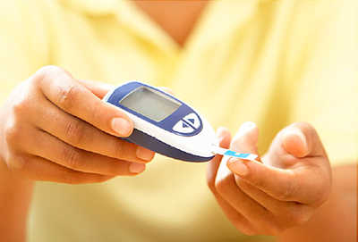
Diseases Can Cause Hearing Loss & Risk of Falls
Diabetes
Chronic renal disease
Cardiovascular disease
Hypothyroidism
Alzheimer’s disease
Paget’s disease
Infectious disease
North Carolina Building Our Largest Dementia (NC BOLD) Infrastructure Project
Notes:
Diabetes and high blood glucose can cause tiny blood vessels to break in the inner ear and disrupts sound reception. Up to 30% of persons with diabetes will have a hearing problem or auditory processing issue.
The kidney and blood supply in the inner ear share physiologic, ultrastructural and antigenetic similarities. Diabetes usually leads to kidney issues in 44% of people.
Cardiovascular disease affects the large blood vessels and can cause inadequate blood supply and trauma to the inner ear. About 80% of people with cardiovascular disease will experience a hearing loss. Strokes usually decrease hearing on the affected side of the brain.
Hypothyroidism (under active thyroid) can cause hearing loss that may be treatable or is permanent. The more severe the hypothyroidism, the worse the hearing loss.
Alzheimer’s disease can show more symptoms of not hearing, so a hearing test is necessary to determine how much of the hearing loss is from Alzheimers and how much is from not being able to hear or understand well.
Paget’s disease affects both vision and hearing and must be monitored and treated by the audiologist.
Photo credit: https://img.webmd.com/dtmcms/live/webmd/consumer_assets/site_images/article_thumbnails/quizzes/type2_diabetes_rmq/493x335_type2_diabetes_rmq.jpg?resize=400px:*&output-quality=50

Slide 3
Medications Can Cause Hearing Loss & Falls Risk
L Loop Inhibiting Diuretics
Infection Control
Cancer Chemotherapy
Pain Management
L Look up all medications on RxList.com
As Ask your pharmacist about your medications
R Report any ringing in your ears or changes in hearing
North Carolina Building Our Largest Dementia (NC BOLD) Infrastructure Project
Notes:
Loop inhibiting diuretics such as Lasix or Furosemide can affect your hearing.
Infection control medications such as gentamycin, neomycin, and other aminoglycoside antibiotic management must be monitored during the time of administration, and even for 6 months after completion of stopping these medications. Set up a hearing monitoring with an audiologist during the time you are taking these medications and for 6 months after stopping. Kidney issues may keep the medications in the system longer since they are normally cleared through the kidneys.
Pain medications such as aspirin, darvon, darvocet, advil, naproxin can cause hearing loss and ringing in the ears (tinnitus). Tinnitus is the warning sign of damage to the ears. Quinine (Requip, tonic water) can cause a mild to severe hearing loss. Using these medications during pregnancy can cause hearing loss in the infant.
High risk factors: impaired renal function, prolonged treatment course, advanced age (over 65), previous treatments with these medications, and noise exposure while taking these medications.
Photo credit: https://img.webmd.com/dtmcms/live/webmd/consumer_assets/site_images/article_thumbnails/quizzes/type2_diabetes_rmq/493x335_type2_diabetes_rmq.jpg?resize=400px:*&output-quality=50

Slide 4
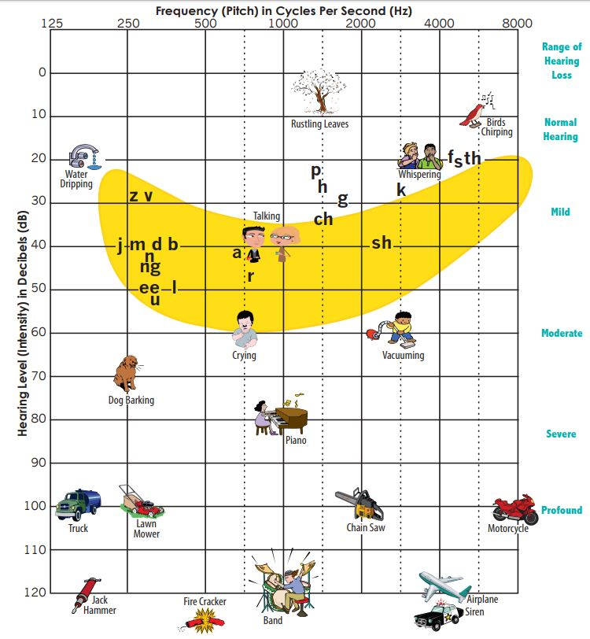
Noise, Head Trauma, Genetics
Excessive noise around the house: lawn mowers, leaf blowers, chain saws
Any falls or accidents where you hit your head or were taken to the hospital
Family History of hearing loss
North Carolina Building Our Largest Dementia (NC BOLD) Infrastructure Project
Notes:
Noise exposure can be at concerts, football and basketball games, racing, plane trips. These venues usually exceed safe loudness levels. Wear ear plugs when going to these places. Working in factories, car repair, construction can also expose you to excessive noise. You will notice ringing and a decrease in hearing if your hearing is not protected. Accidents and hospitalizations can also cause hearing loss, with medical issues such as traumatic brain injury, stroke, infections. If you have fallen recently or fear falling, ask for a Vestibular Evaluation from an audiologist.
If you have family members with hearing loss at birth or from genetic syndromes, keep a check on your hearing with periodic hearing tests.

Slide 5
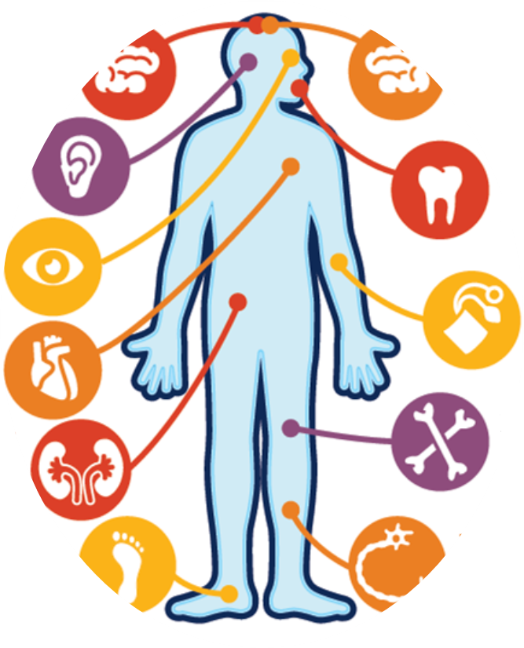
Diabetes: brain, eyes, and neuropathy issues can affect hearing
and balance
Vision loss due to diabetes is associated with major depression. ¹⁷
Diabetic retinopathy is associated with periodontal disease. ¹⁸
Comprehensive Eye Exam
Worsening diabetic retinopathy is associated with elevated diastolic blood pressure. ¹⁹
Retinal plaque signals obstructive vascular disease of the heart or carotid artery. ²⁴
L
References available by request: Michael R. Dueñas OD, FNAP, AOA Chief Public Health Officer, mduenas@aoa.org
65% of individuals with Vision Impairment could achieve normal vision with an eye exam and new glasses, reducing falls leading to fractures. ²⁰
Diabetic retinopathy is associated with early kidney disease-Albuminuria. ²³
Signs of diabetes detected in the eye are associated with peripheral neuropathies of the foot and foot ulcers. ²²
Reduced corneal sensitivity, dry eye, and ocular muscle palsies are early indicators of diabetes and associated neuropathies. ²¹
North Carolina Building Our Largest Dementia (NC BOLD) Infrastructure Project
Notes:
After controlling for diabetes, as measured by HbA1C and creatinine, the level of diabetic retinopathy was significantly associated with hearing loss severity in both ears (right ear, P = .018 and left ear, P = .007).
CONCLUSIONS:
When adjusted to include diabetes control, the severity of diabetic retinopathy showed a correlation with degree of hearing loss at most levels. Because of this association, recommendation for hearing evaluations may be considered for those with mild, moderate, or severe nonproliferative or proliferative diabetic retinopathy.
Correlational Study of Diabetic Retinopathy and Hearing Loss.
Ooley C¹, Jun W, Le K, Kim A, Rock N, Cardenal M, Kline R, Aldrich D, Hayes J.
https://www.ncbi.nlm.nih.gov/pubmed/27906862

Slide 6
Balance Complaints
I woke up and the bed was spinning (BPPV)
I had constant spinning and nausea for about 3 days (Vestibular neuronitis)
It didn’t matter if I moved or not
(Meniere’s Disease)
I felt a sudden wave come over me (Vestibular Migraine)
If I lose my balance, I just go over
(Central Dizziness)
When I get up quickly, I feel like I will faint (Orthostatic Hypertension)
North Carolina Building Our Largest Dementia (NC BOLD) Infrastructure Project
Notes:
When you have these complaints, there may be a means of treating the issues. Find a vestibular audiologist for an evaluation and the recommended treatment.

Slide 7
Hearing Complaints
I regularly ask people to speak louder
I have trouble hearing people or children with soft voices
It is difficult to follow conversations with multiple people
I turn up the volume on the TV or other listening devices to hear and I’m being told that the volume is too loud
I assume people who are talking to me are mumbling
I have difficulty hearing in noisy places, restaurants, public transportation, etc
North Carolina Building Our Largest Dementia (NC BOLD) Infrastructure Project
Notes:
If you have some or all of these signs of hearing loss, get your hearing checked soon. In fact, the CDC recommends that people with diabetes get their hearing checked when they are diagnosed and then annually.

Slide 8
Hearing Aids are a Cool Fix for Hearing Issues
Prescriptive fittings will:
Offer
offer the ability to link directly to your phones
Reduce
automatically reduce background noise in a restaurant or other group settings.
Link
Some hearing aids can link loop (hearing loop) to a T-coil (telecoil) available in some public places, such as religious venues, train stations or sports arenas.
Change
Hearing aids today can be programmable. Any changes in your hearing over time can be corrected by the audiologist with a simple change in the programming
North Carolina Building Our Largest Dementia (NC BOLD) Infrastructure Project
Notes:
The audiologist can determine from hearing testing and auditory processing evaluations what is best to correct your unique hearing issue. If a medical issue is discovered with the diagnostic test, you will be referred to an ear, nose and throat physician and then retested after treatment.
In order for hearing aids to work, you must put them on in the morning and wear them all day. It takes about 6-8 weeks initially when you are fit with your hearing aids to get used to all the sounds and all the environments where you want to hear and understand. Be sure to report any issues you are having with getting used to them. And get your hearing tested at least every year, or more often if you notice problems.

Slide 9
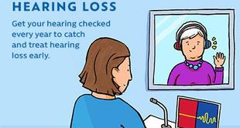
Thank you!
Questions?
The Audiology Project
www.theaudiologyproject.com
Screen your hearing
www.theaudiologyproject.com/hearscreenusa
North Carolina Building Our Largest Dementia (NC BOLD) Infrastructure Project
Notes:
Go online to find more educational material and downloadable forms
Check your hearing periodically. Only a valid screening or test will expose a problem

