Slide 1
NC Department of Health and Human Services
SOR 2 End User Training
Jaquetta Foreman
Data Coordinator
December 2021

Slide 2
FEI WITS Agenda
WITS Basics
WITS Login
Client Search\Setup
Intake
Program Enrollment
GPRA
Close Program Enrollment

Slide 3
WITS Overview
WITS – Web Infrastructure for Treatment Services
Modular platform for collection and reporting of behavioral health data

Slide 4
First Time Login

Slide 5
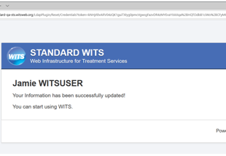
Credentials

Slide 6
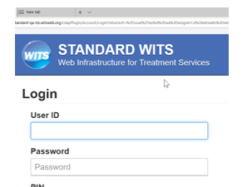
Forgot Password
Allows user to reset password after 1 or 2 failed attempts.
If password is entered a 3rd time incorrectly – your login account will lock, and you will need to contact the WITS Administrator or a Super User for your agency.

Slide 7
WITS Security Tips
Account will lock if you are signed into one computer and then use a different computer to log in. To prevent this always remember to log out at the end of the day and anytime your computer is unattended.
Establishing answer to security question will allow you to reset your own password if you have entered password/pin incorrectly 2 times.
Password and Pin must be changed every 60 days.
Maximum of three (3) incorrect login attempts.
Account will be disabled after 60 days if you do not log in.

Slide 8
SOR Workflow

Slide 9
Home Page

Slide 10
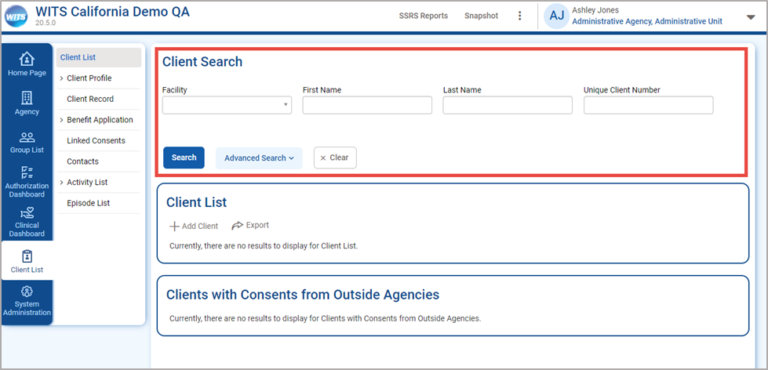
WITS Client Search
The placement of buttons now on the left side
The “Go” Button has been replace with “Search”
Search field are no longer compacted on screen
Field names are located above the field
An “Advanced Search” button is available, which displays all available search fields on the client list

Slide 11
Client Search Tips
Client Name or Number
Use a client’s nickname or alternate names in the First Name or Last Name fields.
Use an asterisk (*) to perform a wildcard search.
Client Birthday or Age
Between – colon (:).
After a date – Greater than (>).
Before a date – Less than (<).

Slide 12
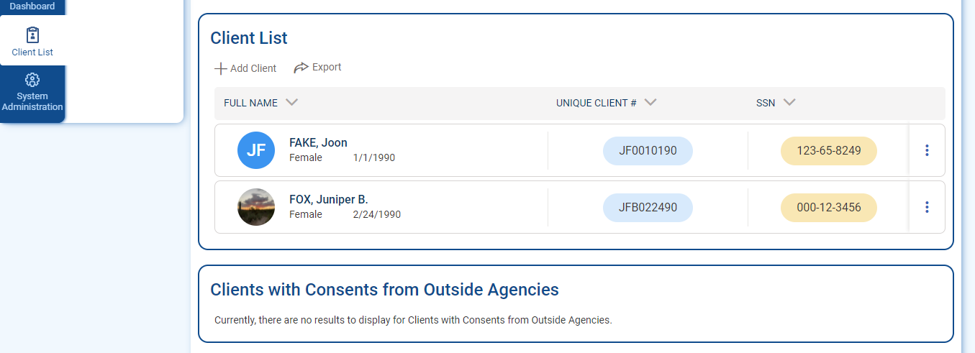
Client List
For the client list, the first column is combining First, Last, DOB and Gender is same cell with the client’s name. ID fields have accent colored background. It displays the initials of the client.
Table sorting represented by arrows
“Add” (+) icon added to section header buttons
On List screens, the Actions column is now located on the right side
Actions icon is now a vertical ellipsis, not the pencil icon
On action rollover, action links are vertically stacked

Slide 13
Entering GPRA
Once in the FEI System tool, you will see a dashboard.
Select ‘Client List’ (left side) and then click ‘Add client’ (left side).
Enter data for the required data fields (yellowed boxes).
Click ‘Save and Finish’ when done.

Slide 14
Add A Client
After completing the client profile, fill out additional information if needed:
Alternate names
Additional Information
Contact Info
Other Numbers
History

Slide 15
Episode List
Select ‘Episode list’ (left side) and then click ‘Start new episode’ (left side).
Enter data for the required data fields (yellowed boxes). ‘Reason or visit’ field can be marked ‘NA’.
Click ‘Finish’ when done.

Slide 16
Activity List

Slide 17
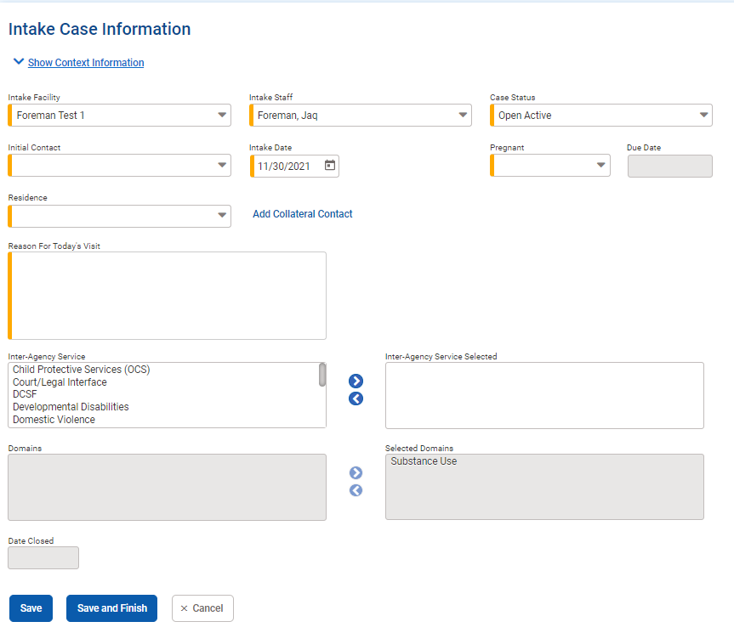
Intake Case Information
Select ‘Program enrollment’ under ‘Client list (left side) and then click ‘Add enrollment’ (left side).
Enter data for the required data fields (yellow boxes). SOR2 should be program name.
Click ‘Finish’ when done.

Slide 18
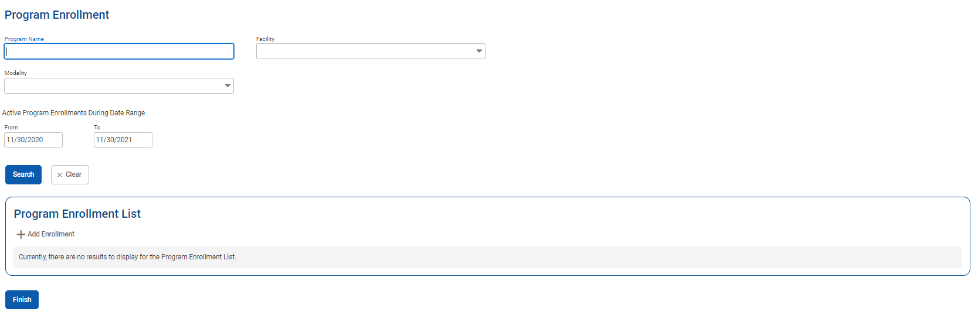
Client Program Enrollment
Select ‘Program Enrollment’ under ‘Client list ‘(left side) and then click ‘ Add enrollment’ (left side).
Enter data for the required data fields (yellow boxes). SOR2 should be the program name.
Click ‘Finish’ when done.

Slide 19
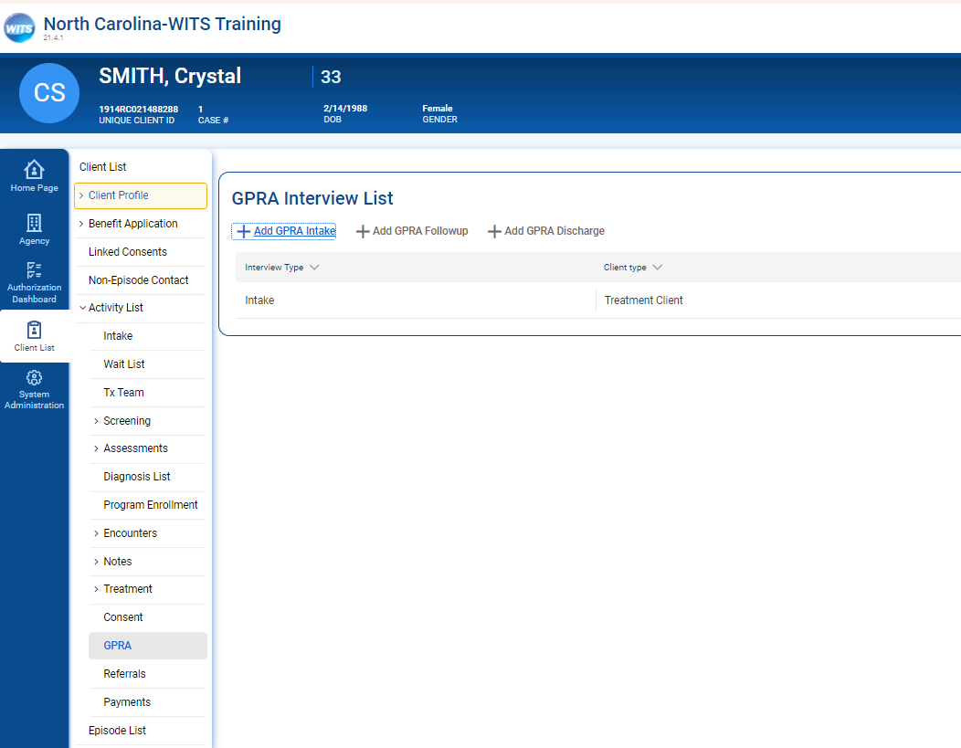
GPRA
‘GPRA’ will now be available on the dashboard
Select ‘GPRA’ (left side) and then click ‘Add GPRA intake’(left side).
Enter GPRA data – use the blue circle with arrows to navigate through the GPRA

Slide 20
Follow-up Dates Example

Slide 21
GPRA Follow up and/or GPRA Discharge

Slide 22
Update Program Enrollment and Intake to Dis-Enroll

Slide 23
Q&A

Slide 24
GPRA Resources
For questions regarding GPRA please contact:
Jaquetta Foreman
SOR Data Coordinator
Jaquetta.foreman@dhhs.nc.gov
For GPRA related requests:
sor.gpras@dhhs.nc.gov
Notes:
Please feel free to contact me for any questions or concerns that you may have. It would be better to send your request to the SOR email shown here. If I am not able to answer your questions I have coworkers who can chime in. I hope you have found this information to be of value to you. Thank you for all your hard work. It is appreciated. Enjoy your Day.

